Slide 1
OpenIE
杜威
51215901009
51215901009@stu.ecnu.edu.cn
Notes:
作者单位
根据explanation来进行关系分类

Slide 2
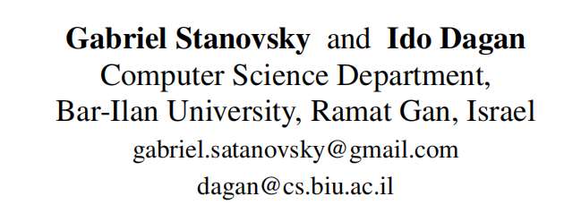
[EMNLP16] Creating a Large Benchmark for Open Information Extraction
Notes:
作者单位
根据explanation来进行关系分类

Slide 3
Introduction
(1) Most works provide a precision oriented metric,whereas recall is often not measured,
(2) the numbers are not comparable across systems, as they use different guidelines and datasets
(3) the experiments are hard to replicate.

Slide 4
OpenIE Dataset
Converted from crowdsourcing
OIE2016(QA-SRL)
AW-OIE(QAMR)
LSOIE(QA-SRL 2.0)
Model-derived
OpenIE 4
MinIE
ClausIE
Directly crowdsourced
CaRB(test)

Slide 5
Open IE Guidelines
Assertedness
Extracted propositions should be asserted by the original sentence
Sam succeeded in convincing John
(Sam; succeeded in convincing; John)
(Sam; convinced; John)
(Sam; succeeded; John)

Slide 6
Open IE Guidelines
Minimal propositions
Bell distributes electronic and building products
(Bell, distributes, electronic products)
(Bell, distributes, building products)

Slide 7
Open IE Guidelines
Completeness and open lexicon
In practice, most current Open IE systems limit their scope to extracting verbal predicates, but consider all possible verbs without being bound to a pre-specified lexicon.
Nested

Slide 8
QA-SRL
Text:“Giles Pearman, Microsoft’s director of marketing, left his job
Target predicate: left
QA pairs:
(1) Who left something? {Giles Pearman; Microsoft’s director of marketing}
(2) what did someone leave? {his job.}

Slide 9
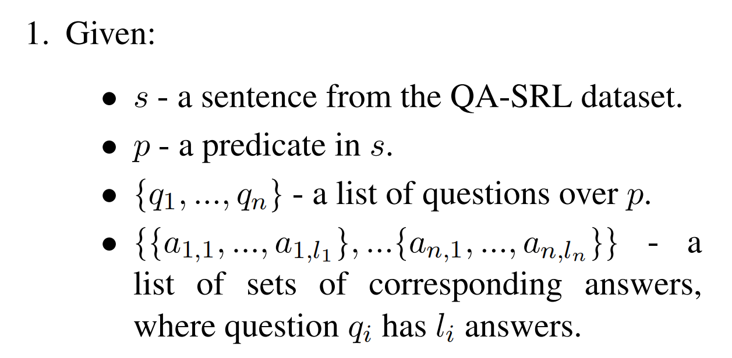
Generating Open-IE Extractions

Slide 10
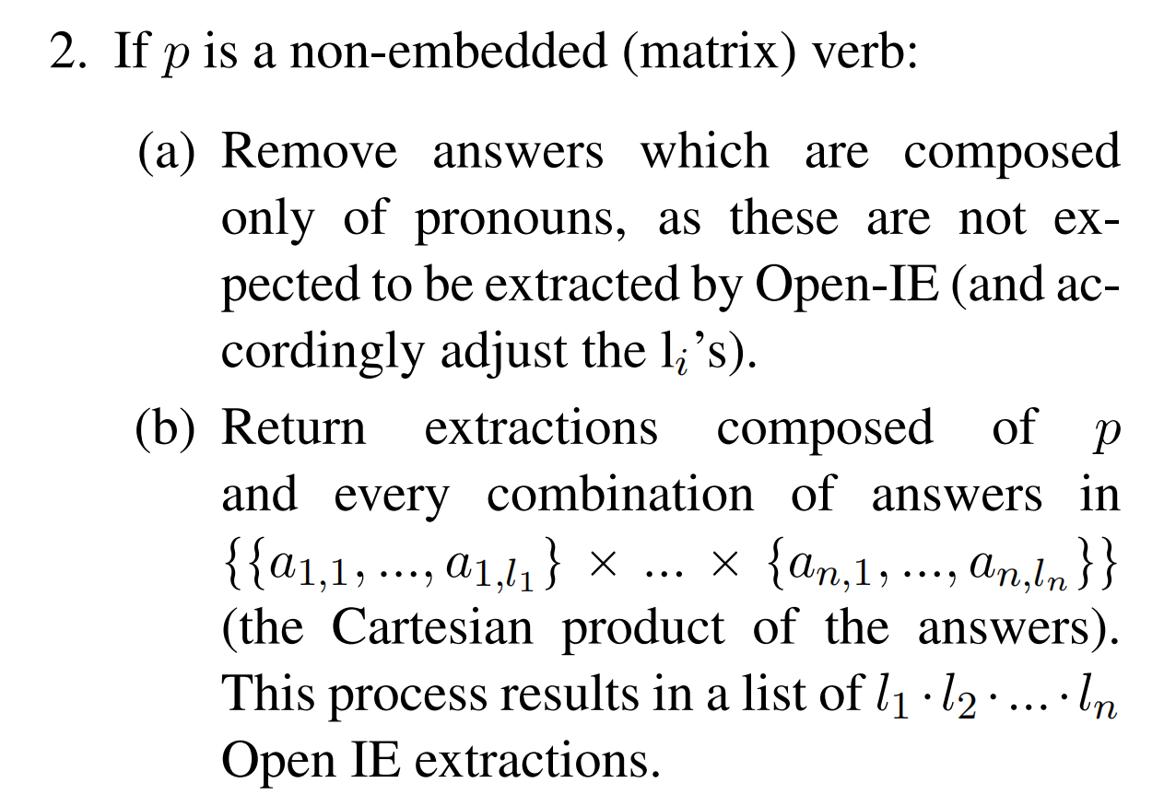
Generating Open-IE Extractions

Slide 11
Generating Open-IE Extractions
Sentence: Barack Obama, the U.S. president, was determined to win the majority vote in Washington and Arizona
Target predicate: determined
Questions:
{who was determined?, what was someone determined to do?}
Answers:
{
{“Barack Obama”, “the U.S president”},
{“win the majority vote in Washington”, “win the majority vote in Arizona”}
}

Slide 12
Generating Open-IE Extractions
Open IE extractions:
(Barack Obama; was determined; to win the majority vote in Washington),
(the U.S. president; was determined; to win the majority vote in Washington),
(Barack Obama; was determined; to win the majority vote in Arizona),
(the U.S. president; was determined; to win the majority vote in Arizona)
do not produce extractions for embedded predicates (e.g., win)

Slide 13
Generating Open-IE Extractions
Open IE extractions:
(Barack Obama; was determined; to win the majority vote in Washington),
(the U.S. president; was determined; to win the majority vote in Washington),
(Barack Obama; was determined; to win the majority vote in Arizona),
(the U.S. president; was determined; to win the majority vote in Arizona)
do not produce extractions for embedded predicates (e.g., win)

Slide 14
pronoun removal
John went home, he was tired. (who was tired?John;he) (John; was tired)
When the only answer to a question is a pronoun this question will be ignored in the extraction process
QA-SRL corpus does not address cross-sentence co-references. This issue may be addressed in future work

Slide 15
Corpus validation
We assess the validity of our dataset by performing expert annotation6 of Open IE extractions, following the principles discussed in Section 3.1, for 100 random sentences.
95.8 F1

Slide 16
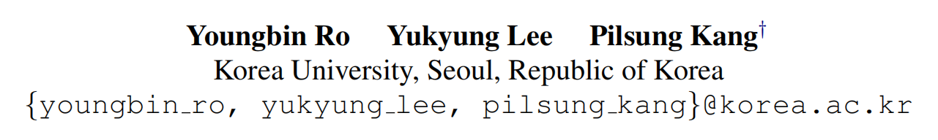
[EMNLP20] Multi2OIE: Multilingual Open Information Extraction Based on
Multi-Head Attention with BERT
Notes:
作者单位
根据explanation来进行关系分类

Slide 17
Introduction
can consider rich semantic and contextual relationships between a predicate andother individual tokens in the same text during sequence labeling by adopting a multi-head attention structure
Multi2OIE can operate on multilingual text without non-English training datasets
more computationally efficient than sequence generation systems
multi²=multi head + multilingual？

Slide 18
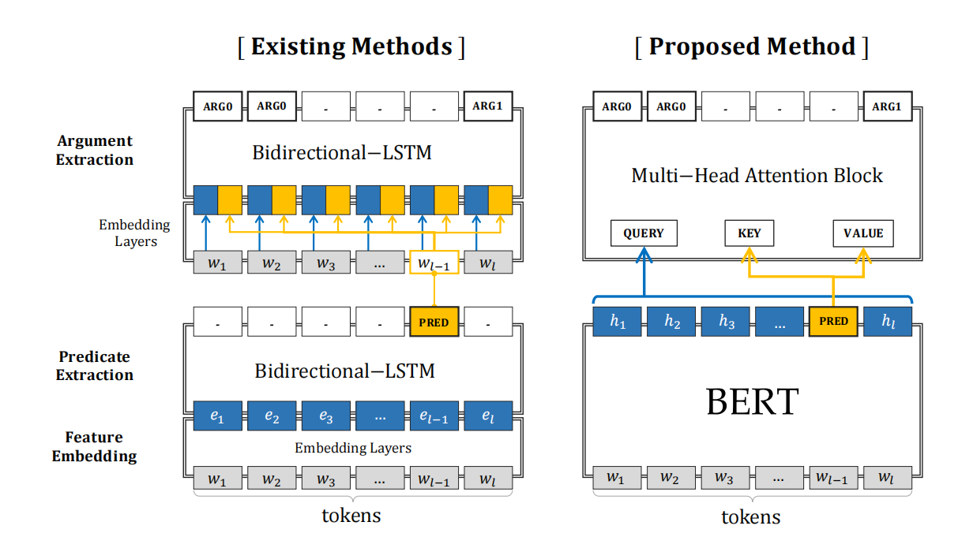
Architecture

Slide 19
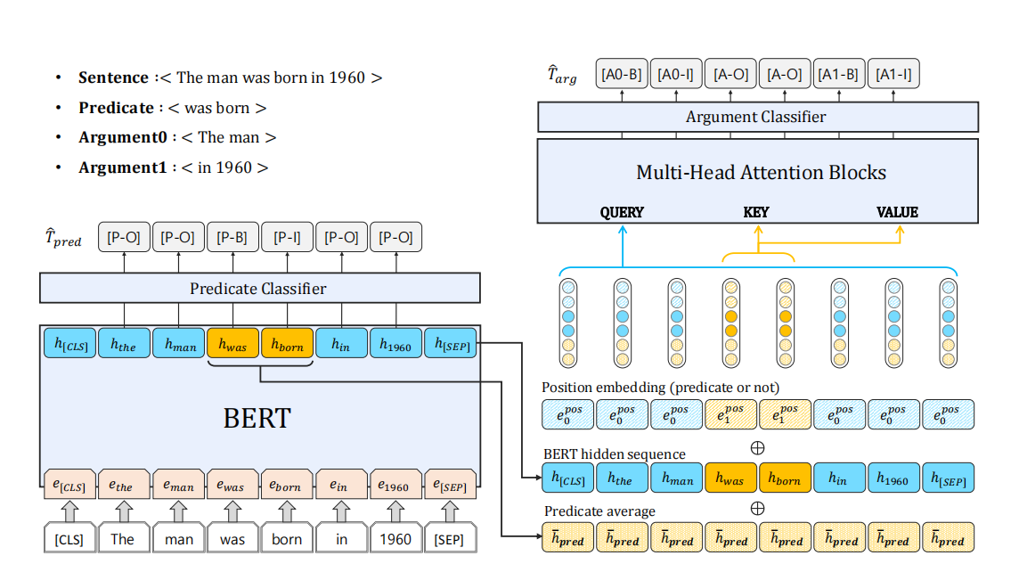
Architecture

Slide 20
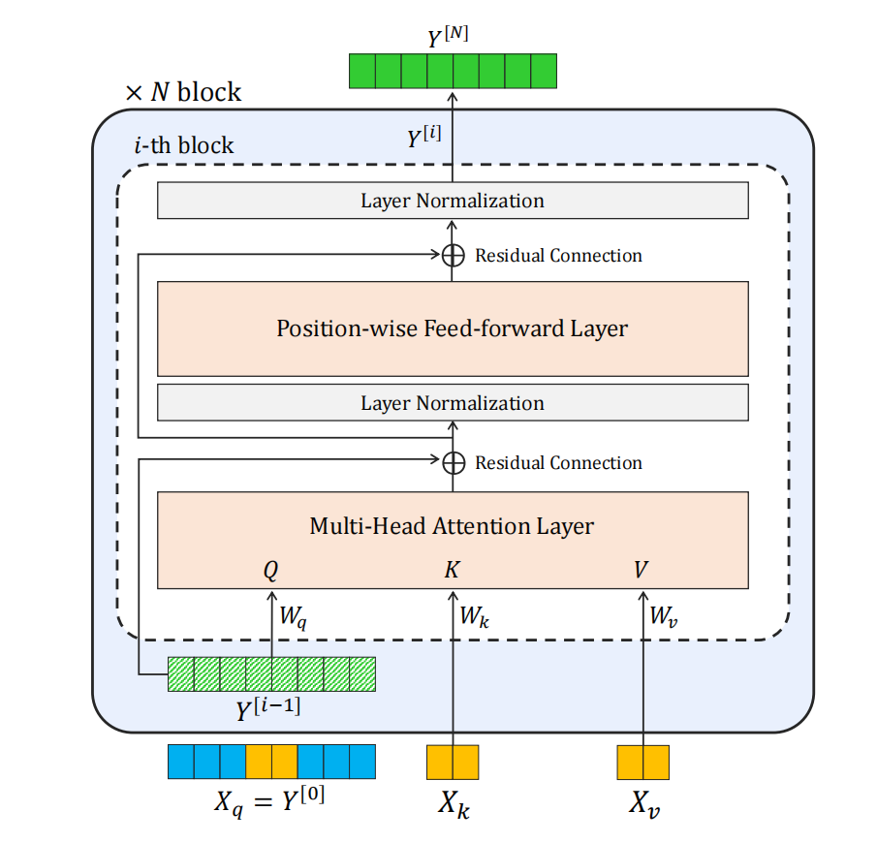
Architecture

Slide 21




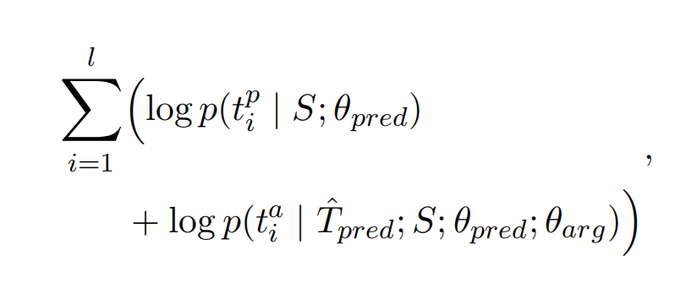
Task Formulation

Slide 22
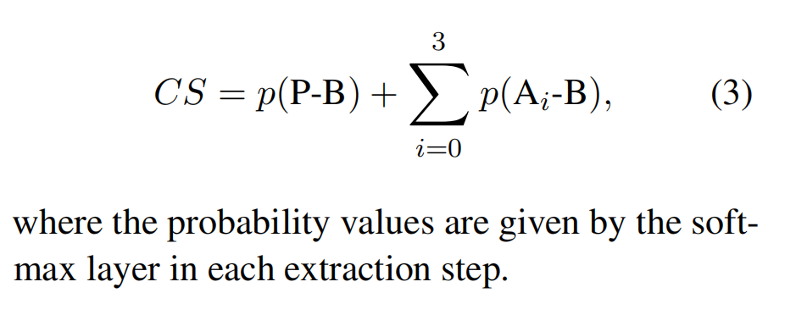
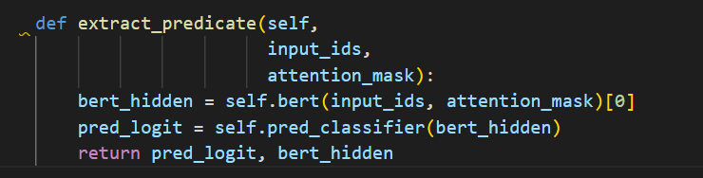
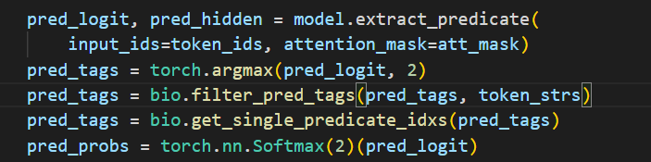
Confidence Score

Slide 23
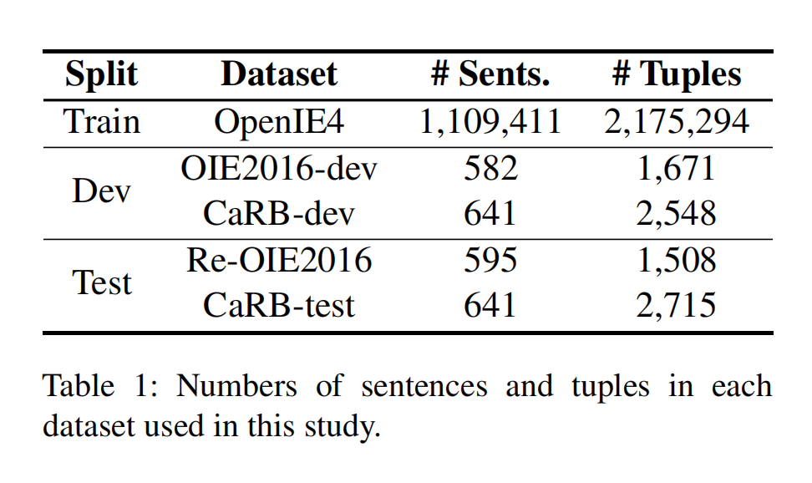
Datasets

Slide 24
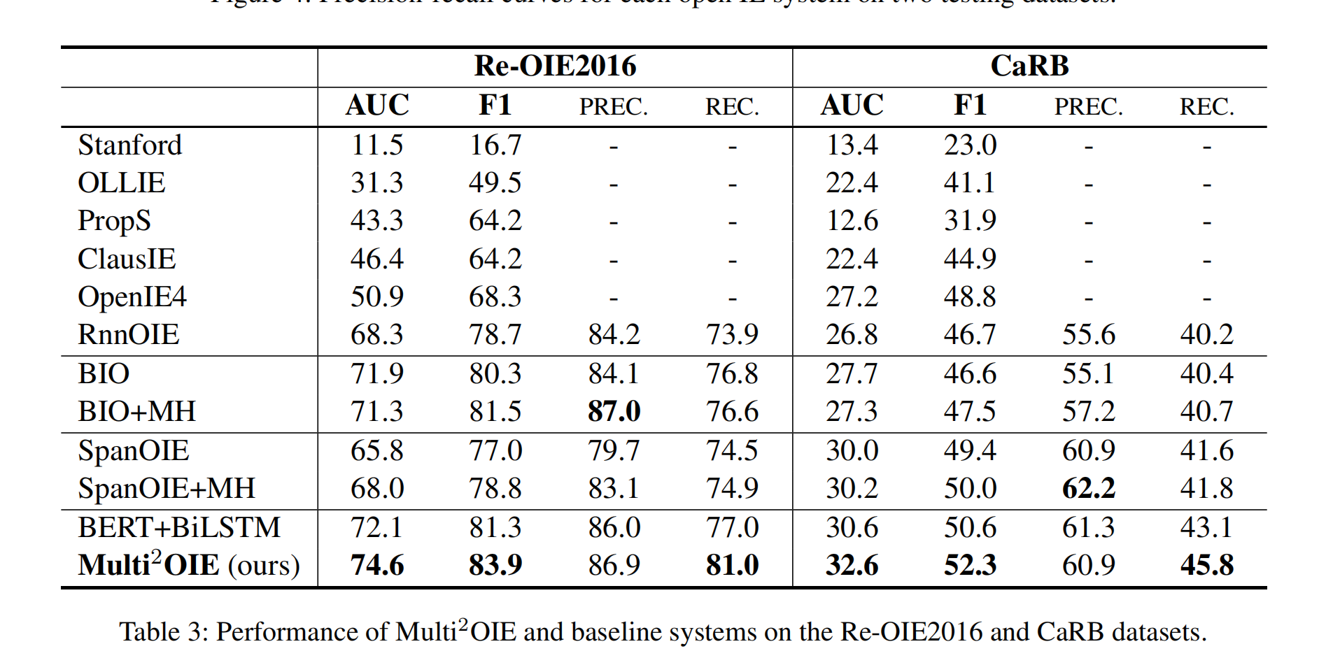
Result

Slide 25
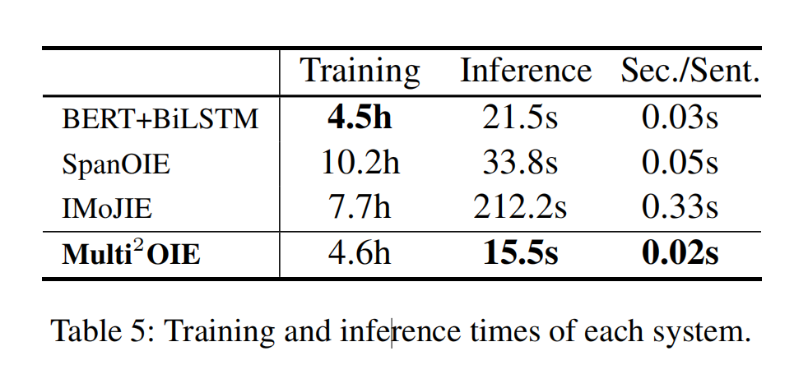
Result

Slide 26
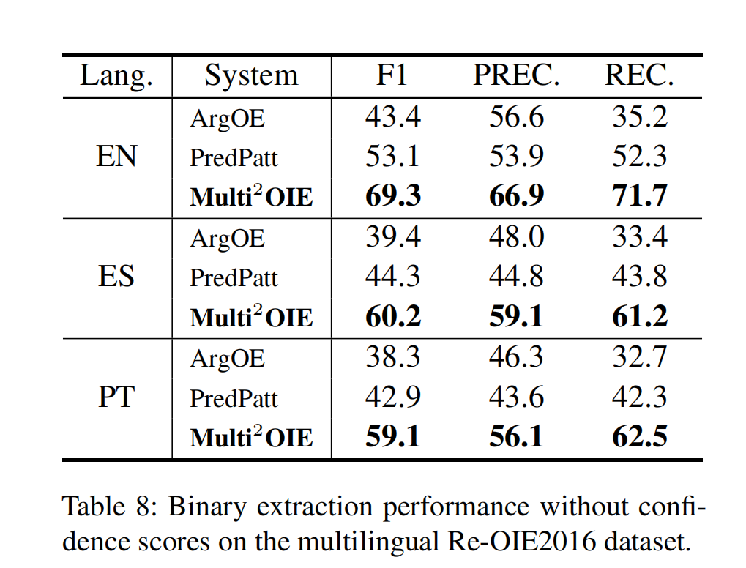
Multilingual Performance

