Slide 1
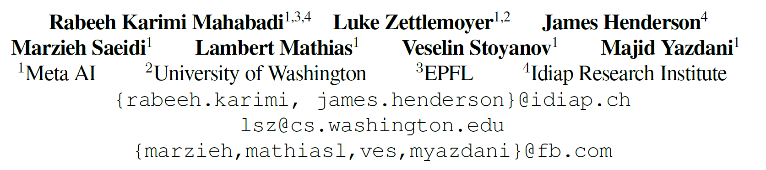
PERFECT: Prompt-free and Efficient Few-shot Learning with Language Models
1

Slide 2
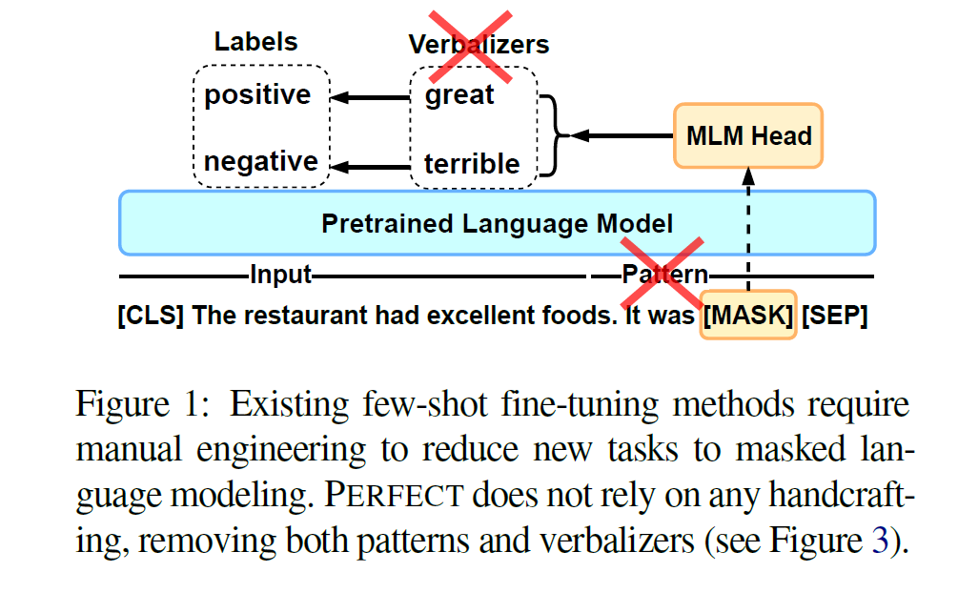
Hard prompt
Careful engineering of prompts
Verbalizers
2
Notes:
小样本文本分类，然后从其他任务迁移到目标任务上
不同的源任务不仅在输入域方面不同，而且它们的任务结构(即标签语义和输出标签的数量)也不同

Slide 3
Contribution
Avoids engineering patterns and verbalizers
Outperforms state-of-the-art prompt-based methods
3
Notes:
两种方法：支持集S，query集Q
f(Si;Qi)g从D中采样并在目标任务上测试(S;Q)

Slide 4
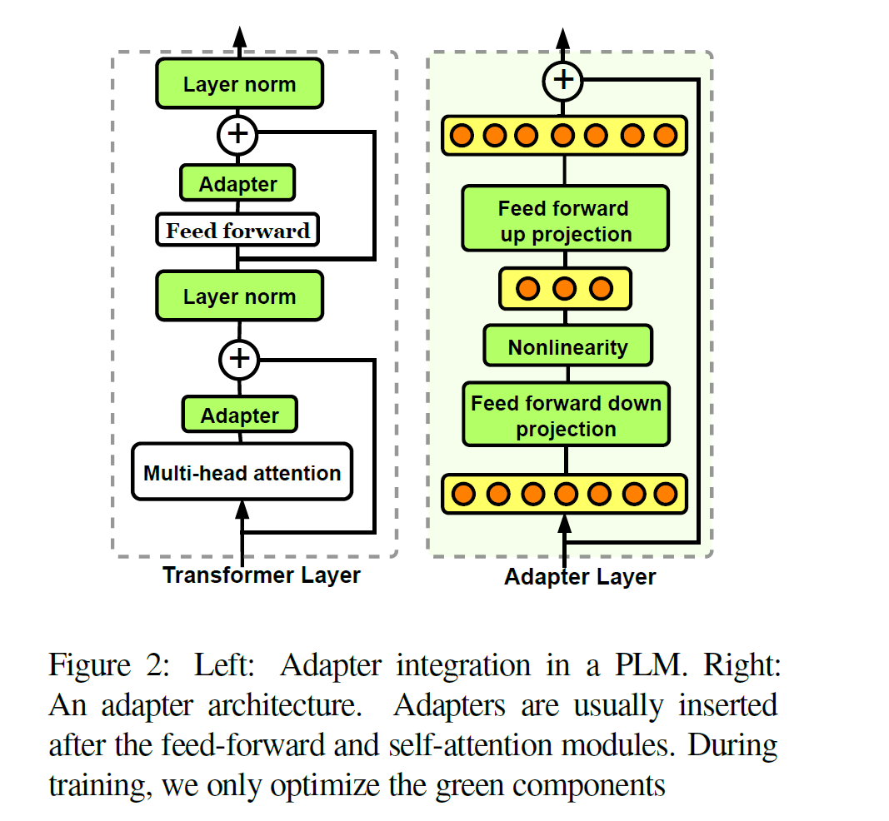
Adapter
Fine-tune all parameters of PLMs in low-resource datasets can lead to a sub-optimal solution
Adapter
4
Notes:
两种方法：支持集S，query集Q
f(Si;Qi)g从D中采样并在目标任务上测试(S;Q)

Slide 5
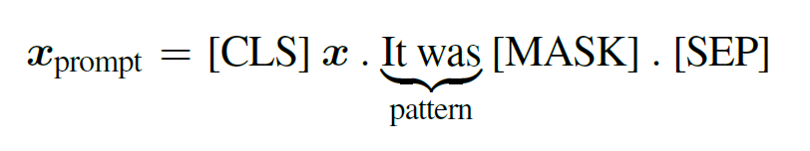

Prompt-based Fine-tuning
Finetune: Discrepancy between the pre-training and fine-tuning
Prompt-based tuning:
Verbalizers:
Predicts the verbalizer tokens in an autoregressive fashion，slow
Heavily relies on engineering handcrafted patterns and verbalizers
Sensitive to the wording of patterns
5
Notes:
两种方法：支持集S，query集Q
f(Si;Qi)g从D中采样并在目标任务上测试(S;Q)

Slide 6
Problems for efficient training
Large memory (finetune PLM)
Small learning rate , slows down tuning verbalizers
Modeling verbalizers impacts the input representation during tuning
Verbalizers have variable token lengths
6
Notes:
两种方法：支持集S，query集Q
f(Si;Qi)g从D中采样并在目标任务上测试(S;Q)

Slide 8
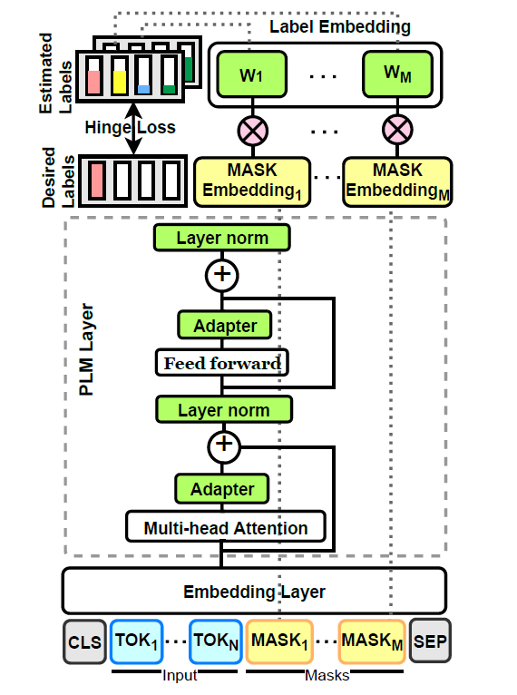
Problems for efficient training
Pattern-Free Task Description
Sample-efficient fine-tuning
Reduce the storage and memory footprints
increase stability and performance
Multi-Token Label Embeddings
8
Notes:
两种方法：支持集S，query集Q
f(Si;Qi)g从D中采样并在目标任务上测试(S;Q)

Slide 9
Problems for efficient training
Pattern-Free Task Description
Multi-Token Label Embeddings
fixed number of tokens M for each label
9
Notes:
两种方法：支持集S，query集Q
f(Si;Qi)g从D中采样并在目标任务上测试(S;Q)

Slide 10
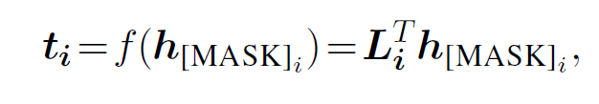
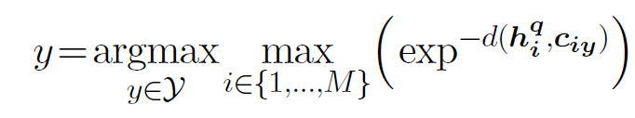
Problems for efficient training
Train
第i个mask token：
Margin loss
Inference
比较每个位置和当前位置原型的距离，选择最小的作为目标类别
10
Notes:
两种方法：支持集S，query集Q
f(Si;Qi)g从D中采样并在目标任务上测试(S;Q)

Slide 11
Baseline
PET：carefully crafted verbalizers and patterns
FINETUNE：standard fine-tuning
PERFECT-rand: randomly initialize the label embedding L
PERFECT-init: initialize with the token embeddings of manually designed verbalizers
Prompt+mte: soft prompt-tuning+multi-token label embeddings
bitfit+mte: tune biases(no adapter)+ multi-token label embeddings
Logan IV et al. (2021): remove patterns and tune the biases in the PET.
11
Notes:
两种方法：支持集S，query集Q
f(Si;Qi)g从D中采样并在目标任务上测试(S;Q)

Slide 12
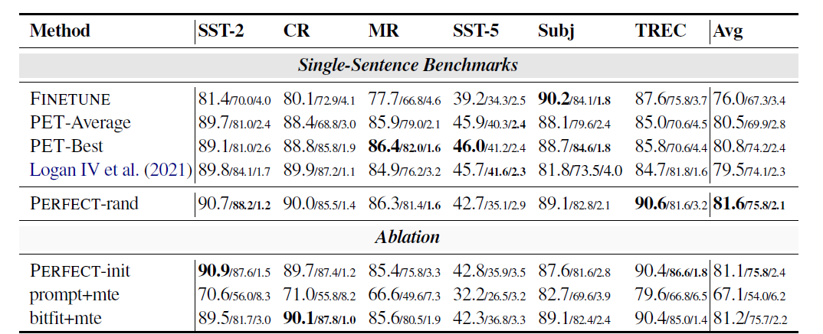
Experiment
12
Notes:
随机初始化要比手动构造pattern初始化要好，尤其是接近0，最好
prompt+mte对学习率比较敏感，low flexibility因此，该方法只允许与模型的其余参数进行有限的交互，要获得良好的性能需要非常大的模型

Slide 13
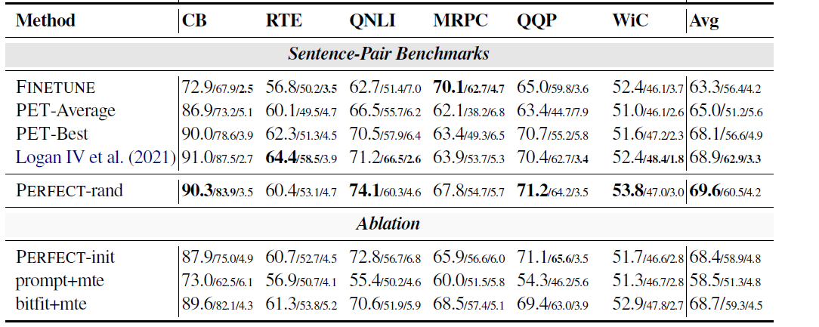
Experiment
13
Notes:
两种方法：支持集S，query集Q
f(Si;Qi)g从D中采样并在目标任务上测试(S;Q)

Slide 14
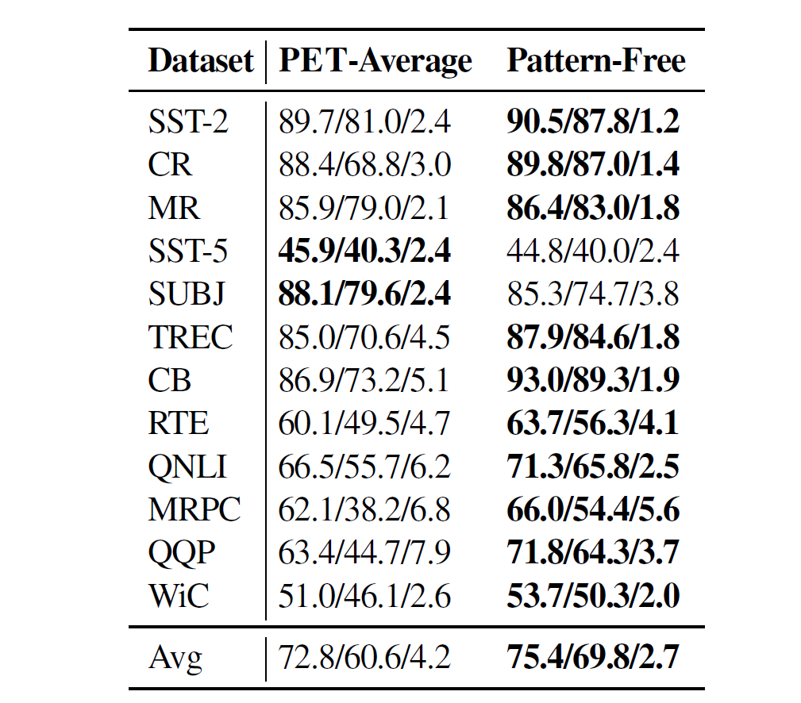
Analyse
Can task-specific adapters replace manually engineered patterns?
14
Notes:
两个原因：避免过拟合以及训练搞笑
另一个原因就是方便计算梯度，用的是adapter的梯度。

Slide 15
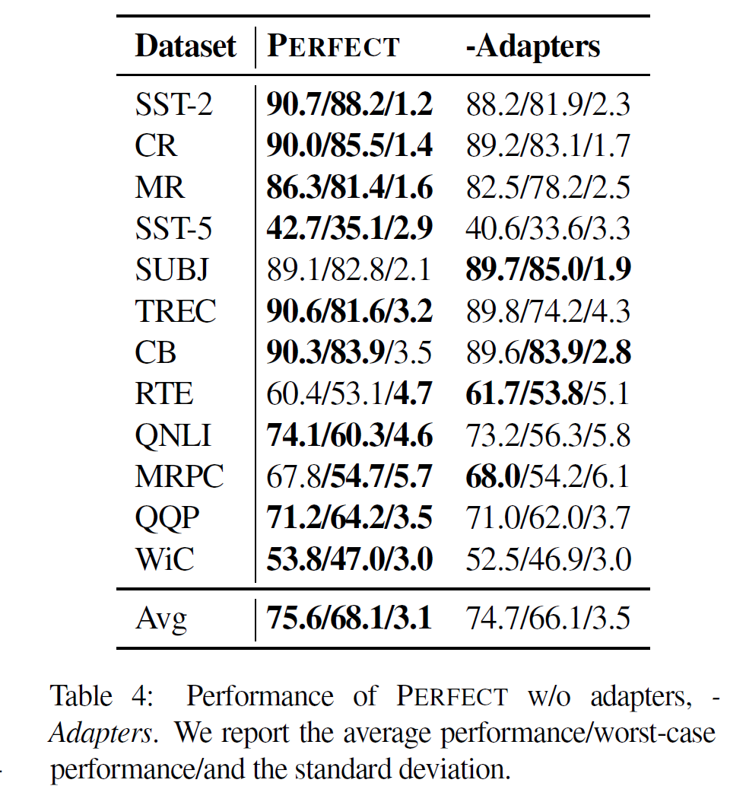
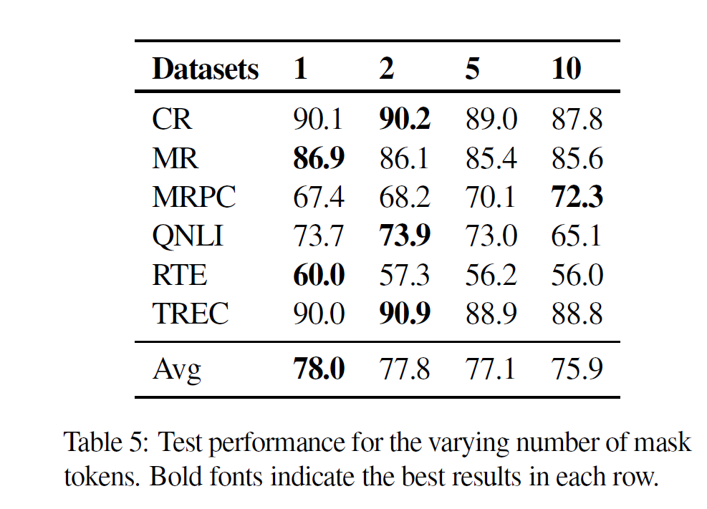
Analyse
15
Notes:
两个原因：避免过拟合以及训练搞笑
另一个原因就是方便计算梯度，用的是adapter的梯度。

Slide 16
Conclusion
Learning the patterns in a continuous space
only works with very large scale PLMs
lags behind full fine-tuning
Optimizing patterns in a discrete space：computationally costly
Automatically finding verbalizers in a discrete way
computationally expensive
not perform as well as manually
Removing manually designed patterns
Lags behind the expert-designed ones
16
Notes:
两种方法：支持集S，query集Q
f(Si;Qi)g从D中采样并在目标任务上测试(S;Q)

Slide 17
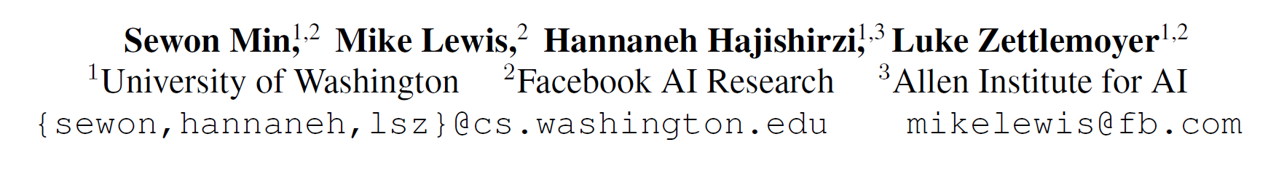
Noisy Channel Language Model Prompting
for Few-Shot Text Classification
17

Slide 18
Prompt
Unstable with high variance across different verbalizers and seeds
Channel prompt tuning
Training data is imbalanced
Generalization to unseen labels is required.
18

Slide 19
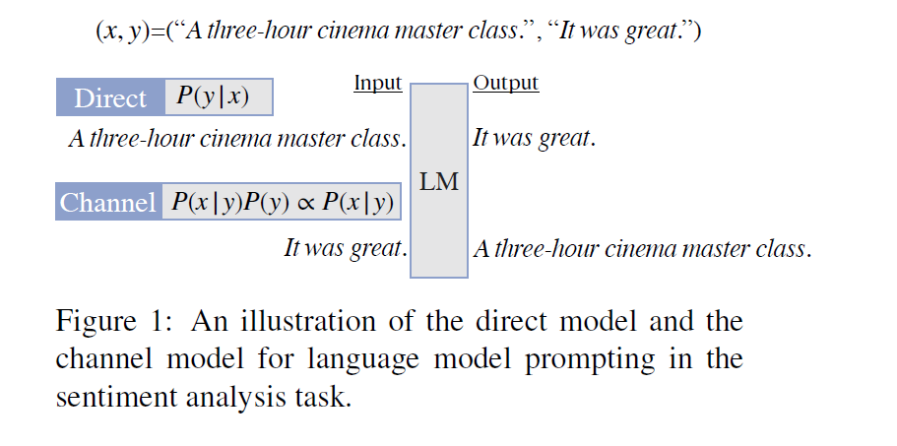
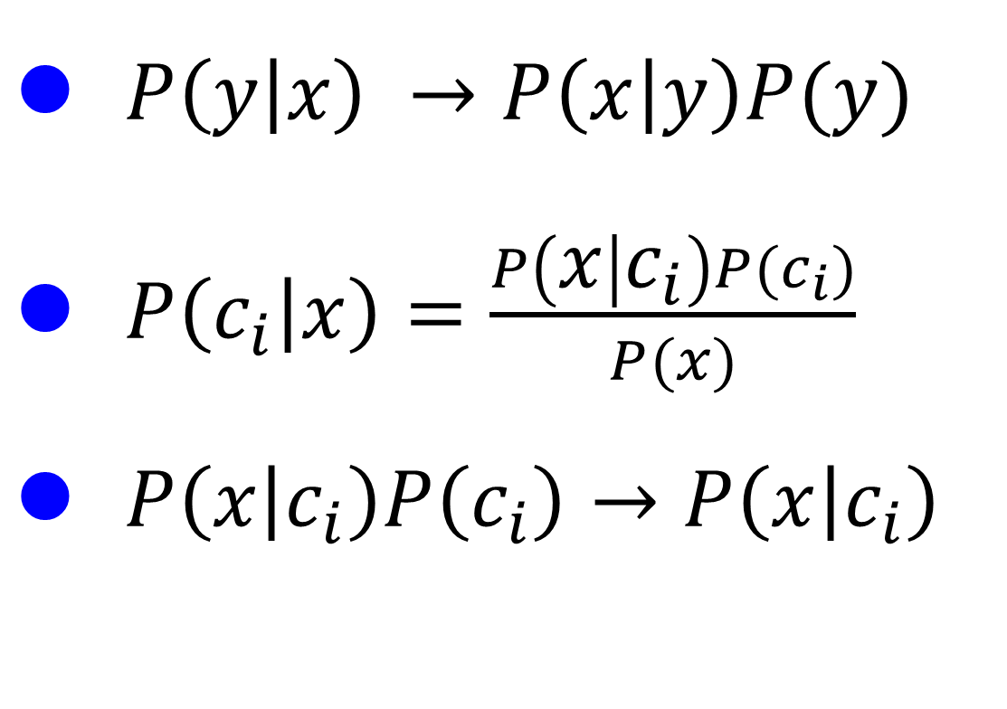
Channel Model
$P\left(y | x\right) →P\left(x | y\right)P(y)$
$P\left(c_{i} | x\right)=\frac{P\left(x | c_{i}\right)P(c_{i})}{P(x)}$
$P\left(x | c_{i}\right)P\left(c_{i}\right)→P\left(x | c_{i}\right)$
19

Slide 20
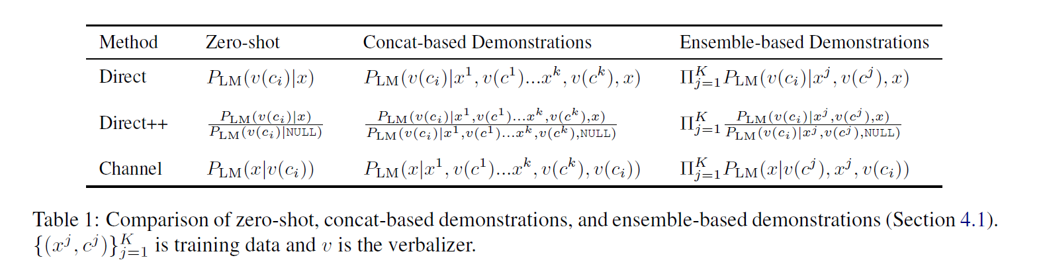
Demonstration methods
20

Slide 21
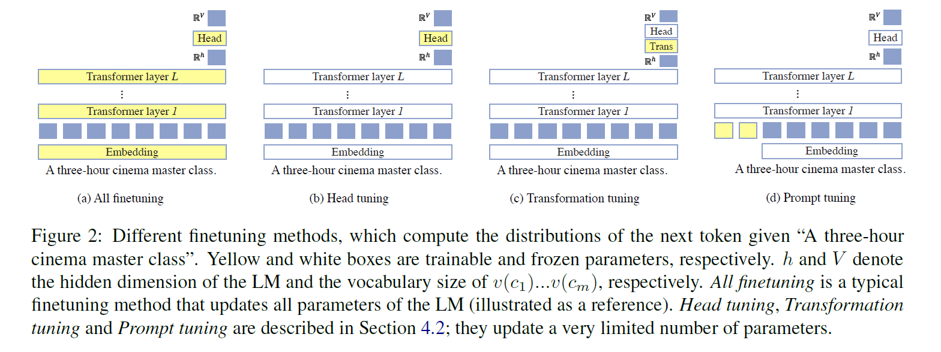
Tuning methods
21

Slide 22
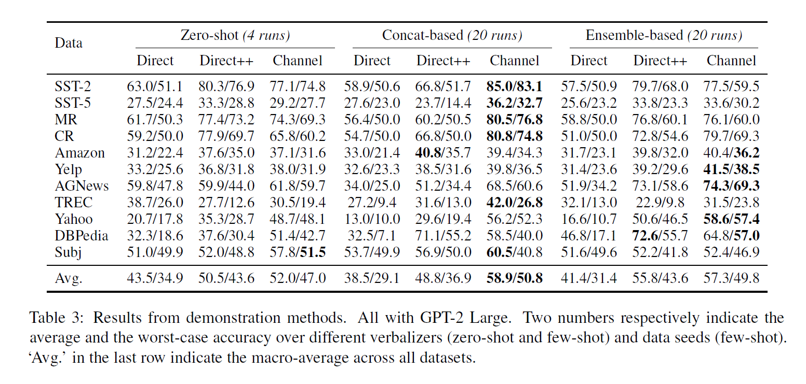
Demonstration Methods
22
Notes:
4 different verbalizers，5 different random seeds
输入比较长的时候ensemble>concat

Slide 23
Demonstration Methods
23
Notes:
4 different verbalizers，5 different random seeds
输入比较长的时候ensemble>concat

Slide 24
Demonstration Methods
24
Notes:
Few shot>zero shot

Slide 25
Demonstration Methods
25
Notes:
Few shot>zero shot

Slide 26
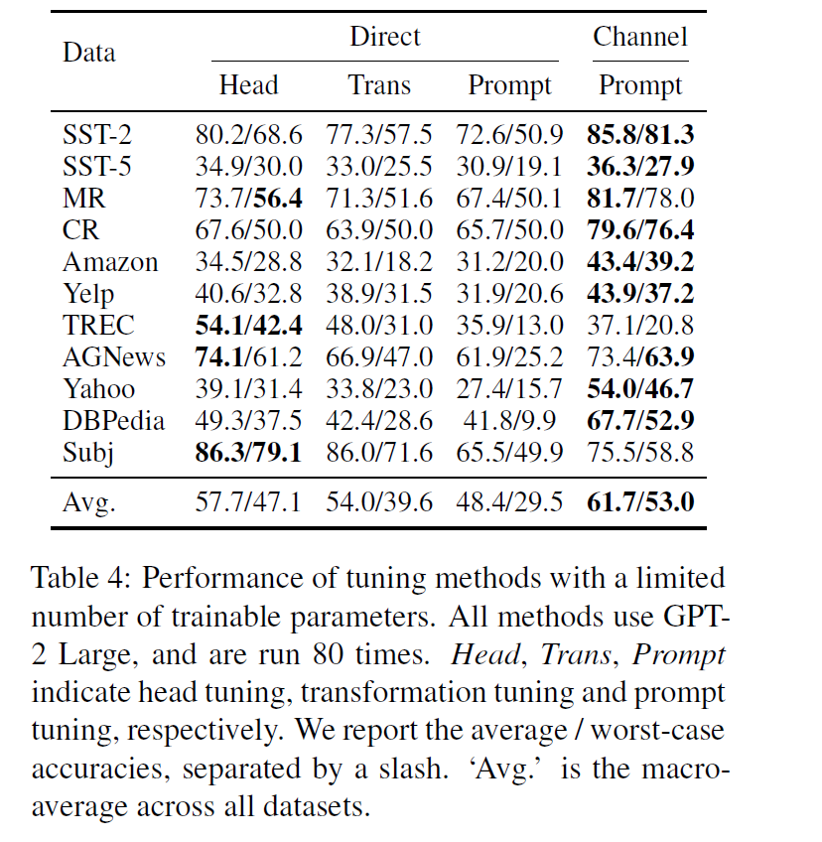
Tuning Methods
26
Notes:
4 different verbalizers，5 different random seeds
输入比较长的时候ensemble>concat

Slide 27
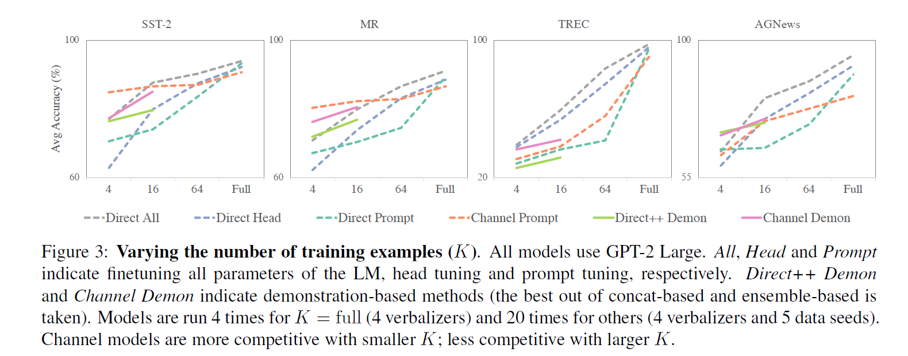
Experiment
27
Notes:
4 different verbalizers，5 different random seeds
输入比较长的时候ensemble>concat

Slide 28
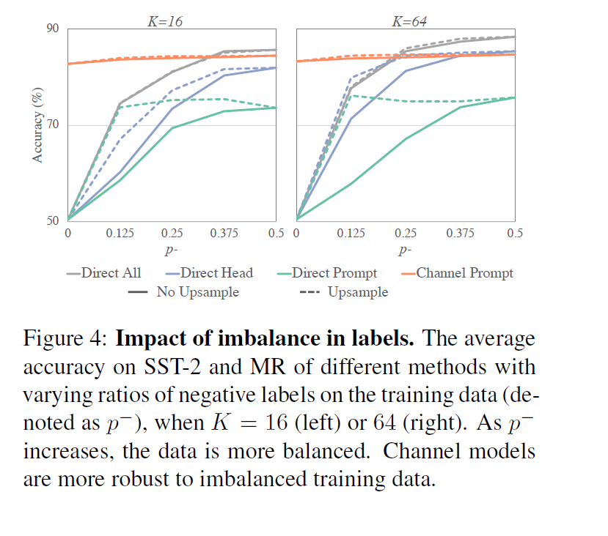
Impact of imbalance in labels
28
Notes:
4 different verbalizers，5 different random seeds
输入比较长的时候ensemble>concat

Slide 29
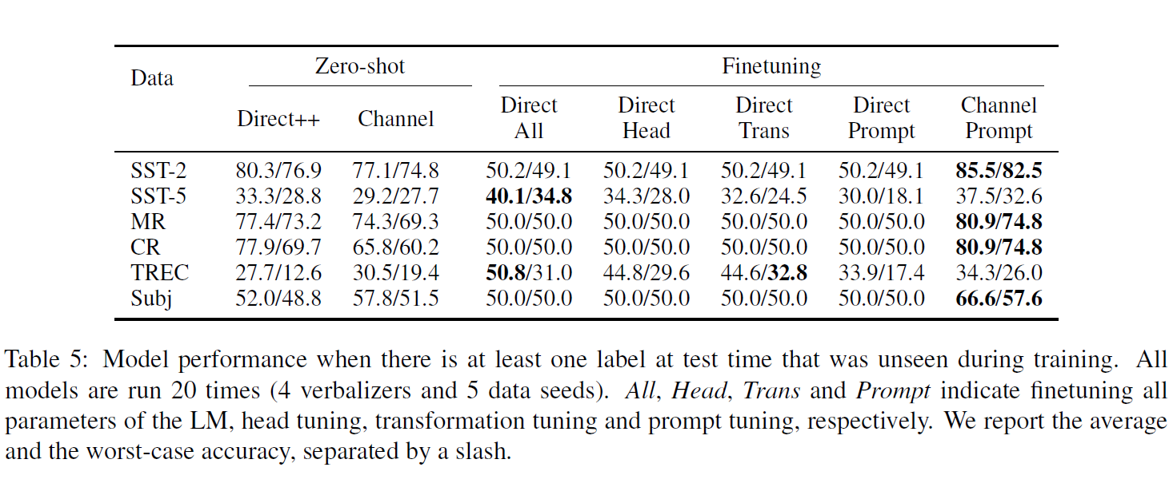
Generalization to unseen labels
29
Notes:
4 different verbalizers，5 different random seeds
输入比较长的时候ensemble>concat

Slide 30
channel prompt tuning
K is small: Channel prompt tuning
Data is imbalanced or |C| is large
Generalization to unseen labels is required
Task is closer to language modeling
30
Notes:
1. 筛选有目的的句子

Slide 31
channel prompt tuning
Stable
Provide more signals
non classification tasks
31
Notes:
1. 筛选有目的的句子

Slide 32
PILED: An Identify-and-Localize Framework for Few-Shot Event Detection
32

Slide 33
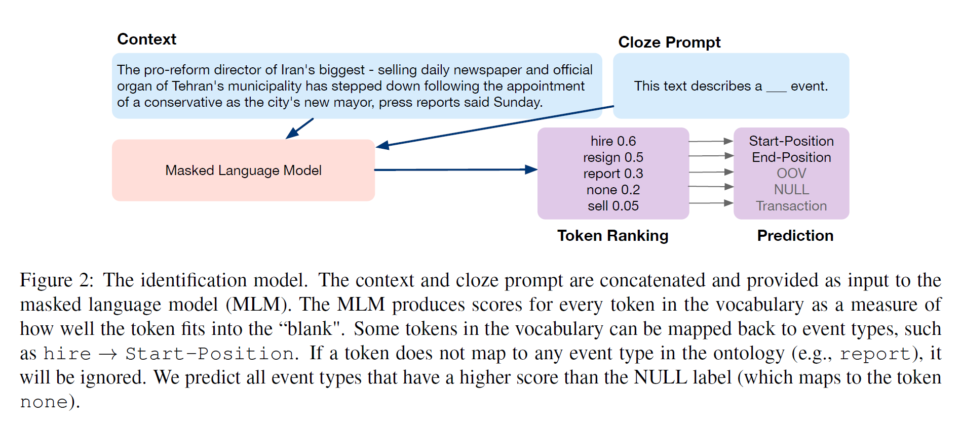
Approach
Introduce a new identify-then-localize approach to event detection
33

Slide 34
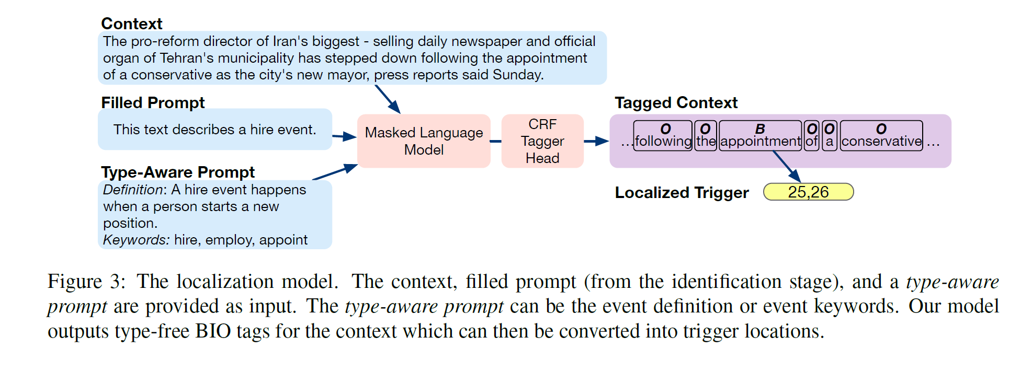
Trigger Localization
34

Slide 35
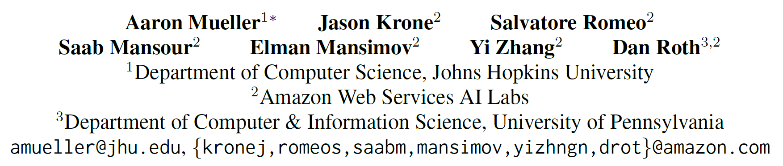
Label Semantic Aware Pre-training for Few-shot Text Classification
35

Slide 36
Contribution
Incorporate label semantics into generative models during pre-training
unlabeled noisy data → utterance-intent pairs
36

Slide 37
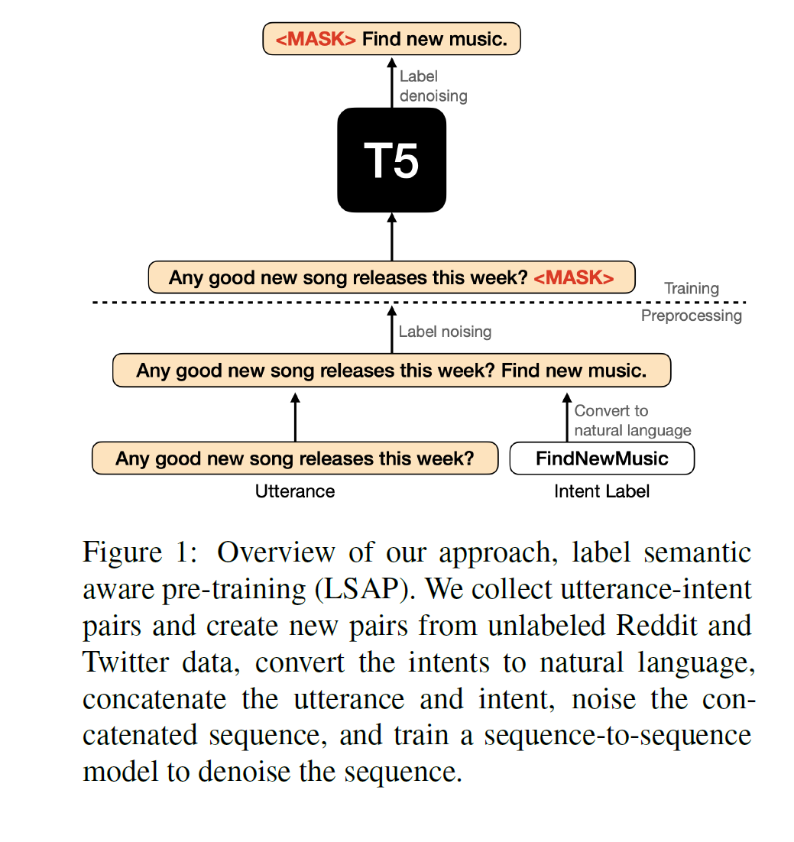
Contribution
Filter unlabeled data using a dialogue act classifier
RoBERTa based binary classifier
Intent generator → pseudo-label
T5-based generative intent labeler
Pretraine(label+ pseudo-label)
37
Notes:
1. 筛选有目的的句子

Slide 38
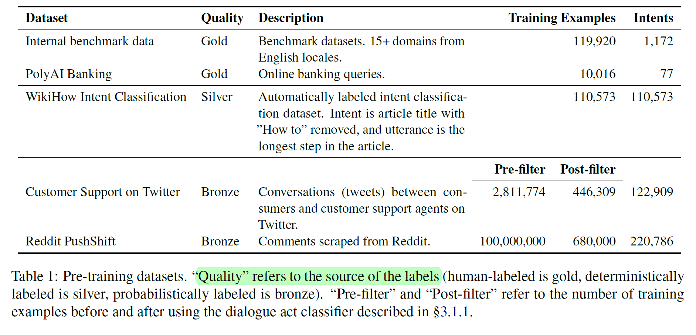
Contribution
38

Slide 39
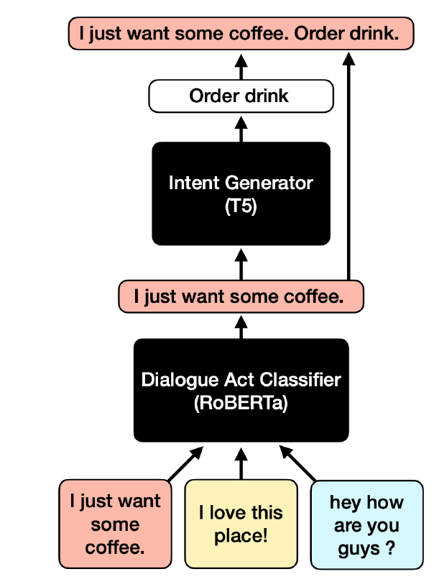
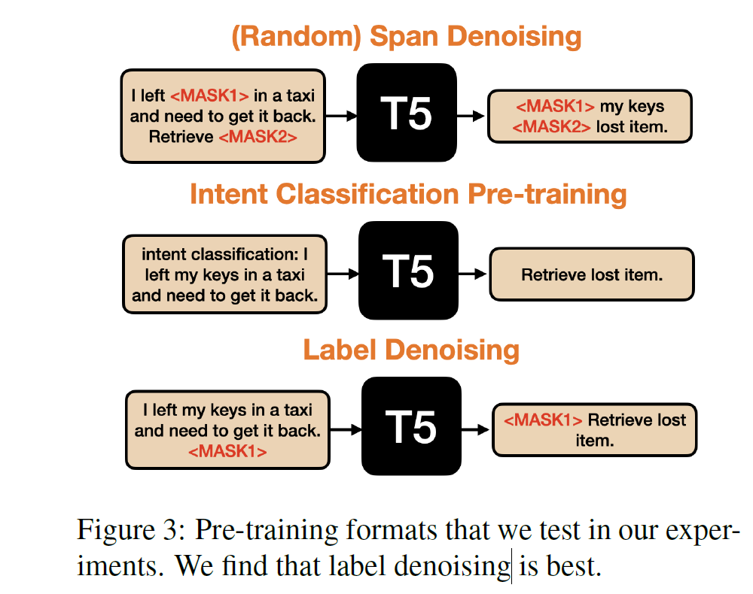
Contribution
39

