Slide 1
Chain of Thought
AntNLP 2023 spring Seminar
Liu Yanting
Notes:
The NLP landscape has recently been revolutionized by language models 。Scaling up the size of language models has been shown to confer a range of benefits, such as improved performance and sample efficiency (Kaplan et al., 2020; Brown et al., 2020, inter alia). However, scaling up model size alone has not proved sufficient for achieving high performance

Slide 2
Background
Scaling up the size of language models can confer a range of benefits, such as improved performance and sample efficiency
However not sufficient for achieving high performance on challenging tasks such as arithmetic, commonsense, and symbolic reasoning
How the reasoning ability of large language models can be unlocked?

Slide 3
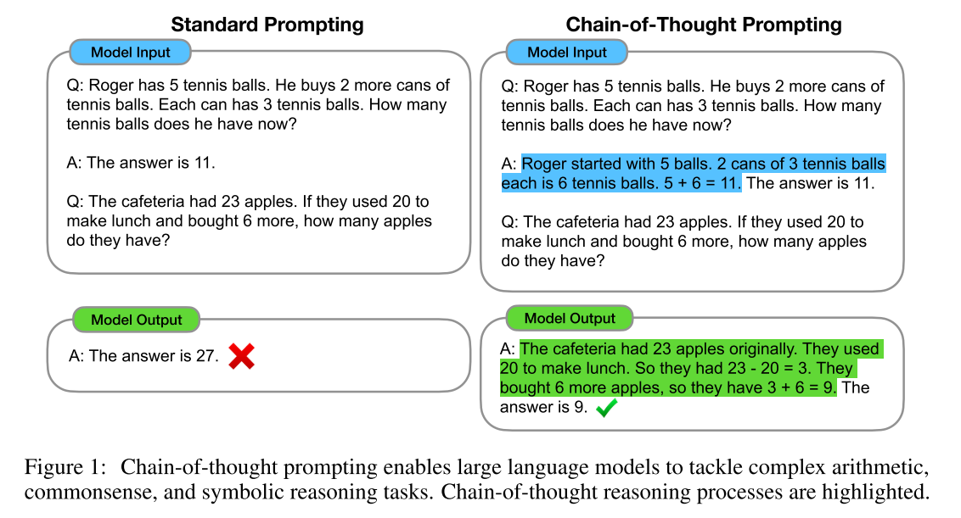
Notes:
Consider one’s own thought process when solving a complicated reasoning task such as a multi-step math word problem. It is typical to decompose the problem into intermediate steps and solve each before giving the final answer:

Slide 4
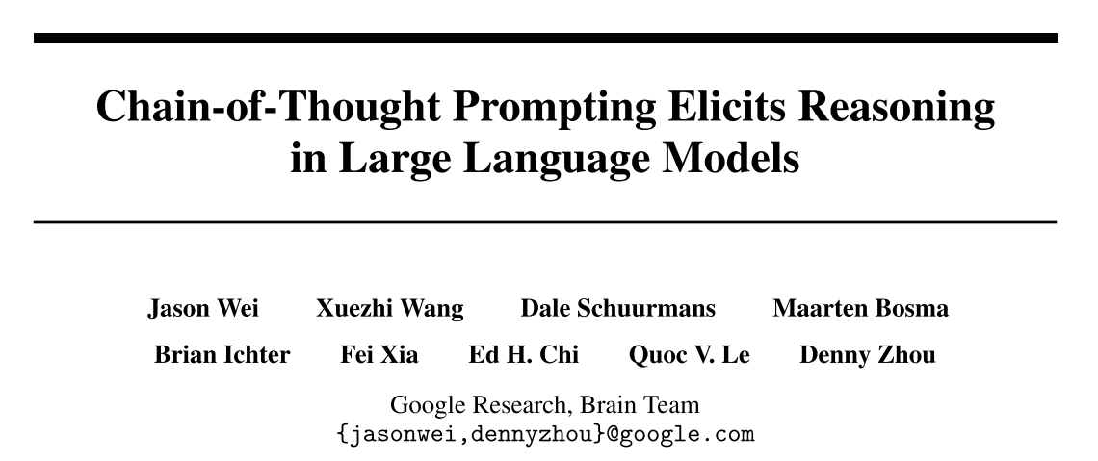
NeurIPS 2022

Slide 5
Motivation
techniques for arithmetic reasoning can benefit from generating natural language rationales that lead to the final answer
costly to create a large set of high quality rationales
large language models offer the exciting prospect of in-context few-shot learning via prompting
poorly on tasks that require reasoning abilities
not improve substantially with increasing language model scale
Notes:
Prior work has given models the ability to generate natural language intermediate steps by training from scratch (Ling et al., 2017) or finetuning a pretrained model poorly on tasks that require reasoning abilities often does not improve substantially with increasing language model scale

Slide 6
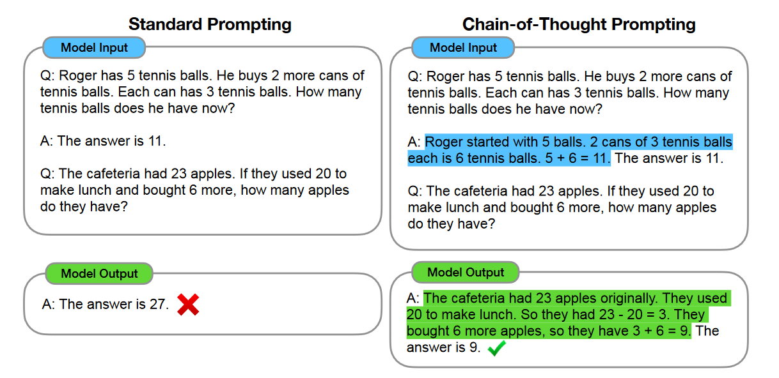
Chain of Thought
$$<input, chain of thought, output>$$

Slide 7
Chain of Thought
allows models to decompose multi-step problems into intermediate steps
provides an interpretable window into the behavior of the model
be readily elicited in sufficiently large off-the-shelf language models
Notes:
First, chain of thought, in principle, allows models to decompose multi-step problems into intermediate steps, which means that additional computation can be allocated to problems that require more reasoning steps.

Slide 8
Arithmetic Reasoning
Experimental Setup
Benchmarks:
GSM8K, SVAMP, ASDiv, AQuA, MAWPS
Language models:
GPT-3: 350M, 1.3B, 6.7B, and 175B parameters
LaMDA: 422M, 2B, 8B, 68B, and 137B parameters.
PaLM: 8B, 62B, and 540B parameters
UL2: 20B
Codex: 175B
Notes:
used this single set of eight chain of thought exemplars for all benchmarks except AQuA which is multiple choice instead of free response. For AQuA, we used four exemplars and solutions from the training set

Slide 9
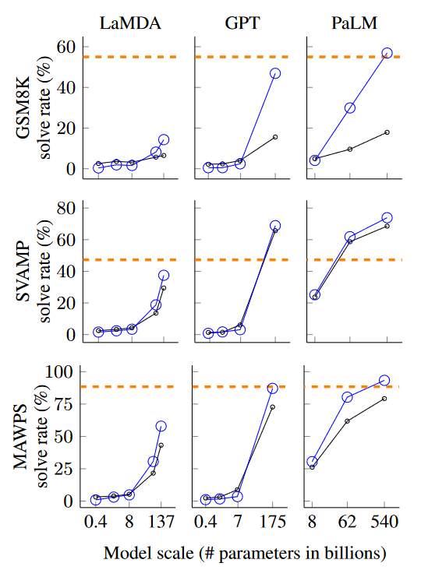
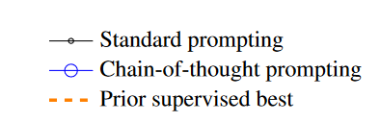
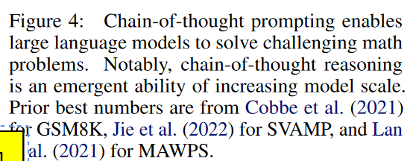
Arithmetic Reasoning
chain-of-thought prompting is an emergent ability of model scale
chain-of-thought prompting has larger performance gains for more-complicated problems
chain-of-thought prompting via GPT-3 175B and PaLM 540B compares favorably to prior state of the art
Notes:
chain-of-thought prompting does not positively impact performance for small models, and only yields performance gains when used with models of ∼100B parameters. We qualitatively found that models of smaller scale produced fluent but illogical chains of thought, leading to lower performance than standard prompting.

Slide 10

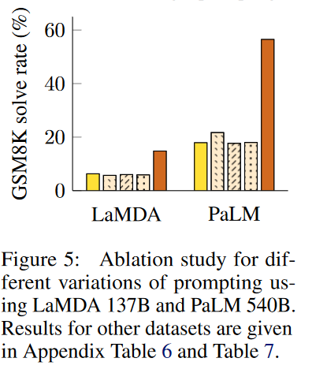


Ablation Study
prompted to output only a mathematical equation before giving the answer
prompted to output a only sequence of dots (. . .)
Notes:
The observed benefits of using chain-of-thought prompting raises the natural question of whether the same performance improvements can be conferred via other types of prompting
Another potential benefit of chain-of-thought prompting could simply be that such prompts allow the model to better access relevant knowledge acquired during pretraining. Therefore, we test an alternative configuration where the chain of thought prompt is only given after the answer, isolating whether the model actually depends on the produced chain of thought to give the final answer. This variant performs about the same as the baseline, which suggests that the sequential reasoning embodied in the chain of thought is useful for reasons beyond just activating knowledge.

Slide 11
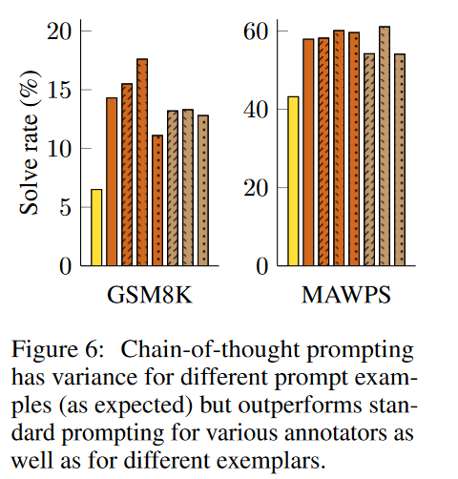
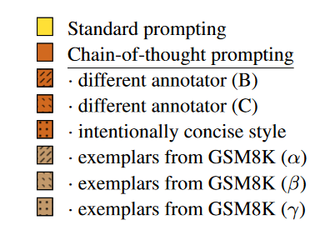
Robustness of Chain of Thought
LaMDA 137B
chain-of-thought prompting for arithmetic reasoning is robust to annotators, independently-written chains of thought, different exemplars, various language models, different exemplar orders and varying numbers of exemplars.
Notes:
Sensitivity to exemplars is a key consideration of prompting approaches—for instance, varying the permutation of few-shot exemplars can cause the accuracy of GPT-3
evaluate robustness to chains of thought written by different annotators.

Slide 12
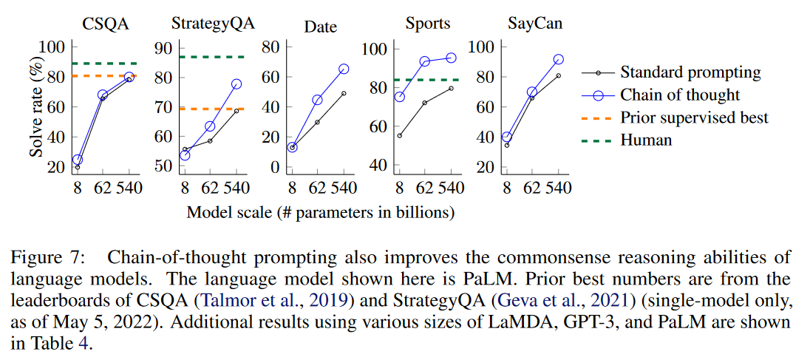
Commonsense Reasoning
PaLM 540B
scaling up model size improved the performance
chain-of-thought prompting can also improve performance on tasks requiring a range of commonsense reasoning abilities

Slide 13
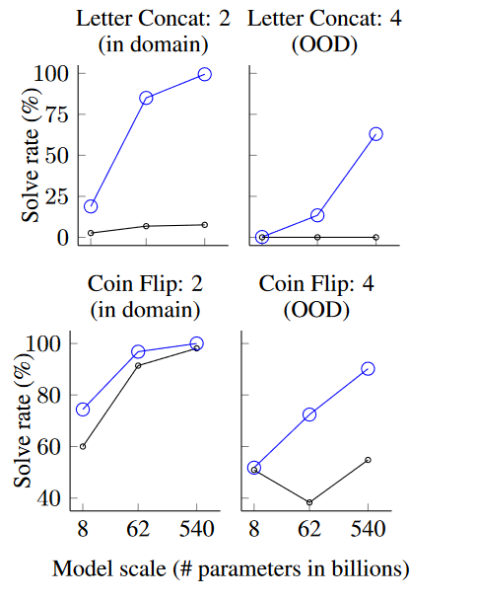
Symbolic Reasoning
PaLM
in-domain test set : the same number of steps as the training/few-shot exemplars
out-of-domain (OOD) test set: more steps than those in the exemplars
Chain-of-thought prompting enables language models to perform symbolic reasoning tasks that are challenging in the standard prompting setting and facilitates length generalization to inference-time inputs longer than those seen in the few-shot exemplars.

Slide 14
Conclusions
Chain-of-thought prompting improves performance by a large margin on reasoning tasks and is robust to different annotators, exemplars, and language models
For many reasoning tasks where standard prompting has a flat scaling curve, chain-of-thought prompting leads to dramatically increasing scaling curves.
Although chain of thought emulates the thought processes of human reasoners, this does not answer whether the neural network is actually “reasoning,”

Slide 15
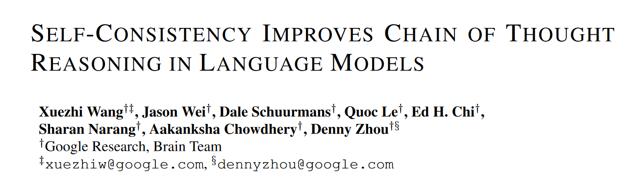

Slide 16
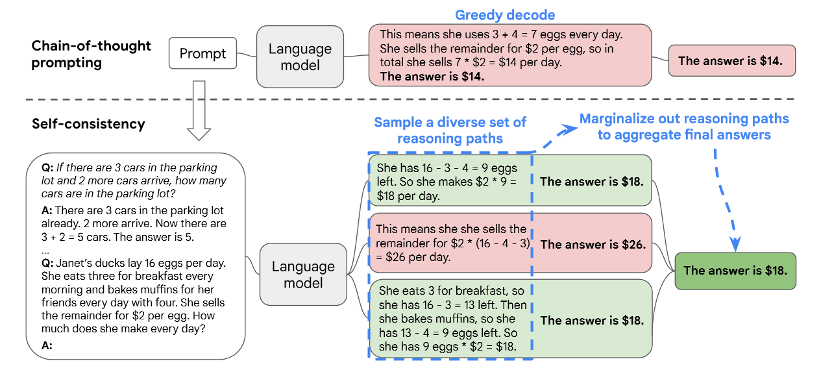
complex reasoning tasks typically admit multiple reasoning paths that reach a correct answer
Such an approach is analogous to the human experience that if multiple different ways of thinking lead to the same answer, one has greater confidence that the final answer is correct.

Slide 17
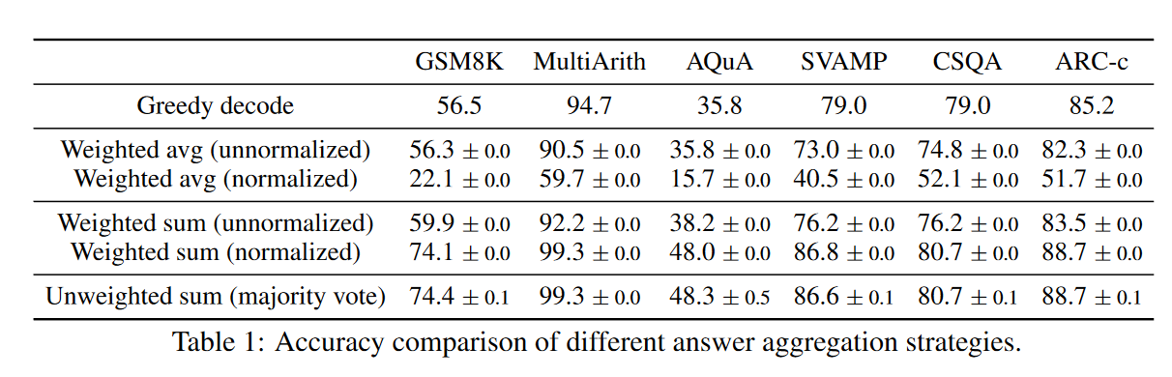
Notes:
taking a “weighted average”, i.e., each a gets a score of its weighted sum divided by ∑m i=1 1(ai = a), which results in a much worse performance.
taking a majority vote directly over a gives a very similar accuracy as calculating the exact normalized weighted sum. where the former has a strictly lower computational cost. In our experiments, for simplicity we use majority vote to report all results.

Slide 18
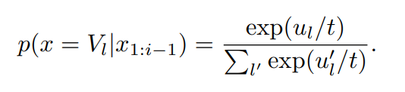
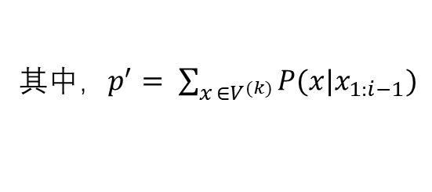
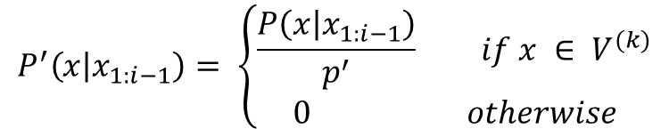
Sampling scheme
temperature sampling
top-k
$$P^{′}\left(x | x_{1:i−1}\right)= \left\{\begin{aligned}\frac{P\left(x | x_{1:i−1}\right)}{p^{′}} if x ∈ V^{(k)} \\ 0 otherwise\end{aligned}\right.$$
其中$，p^{′}= \sum_{x ∈V^{(k)}}{P(x|x_{1:i−1})}$
UL2-20B & LaMDA-137B
PaLM-540B
GPT-3
temperature sampling
0.5
0.7
0.7
top-k
40
40
w/o

Slide 19
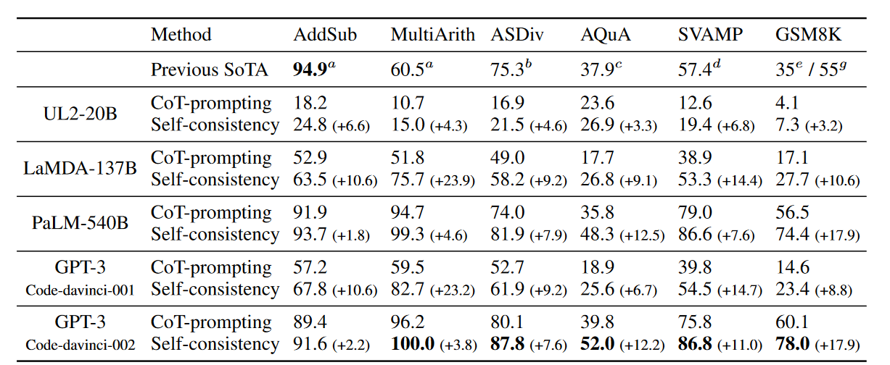
MAIN RESULTS
improves the arithmetic reasoning performance over all four language models significantly
the gains become more significant when the language model’s scale increases

Slide 20
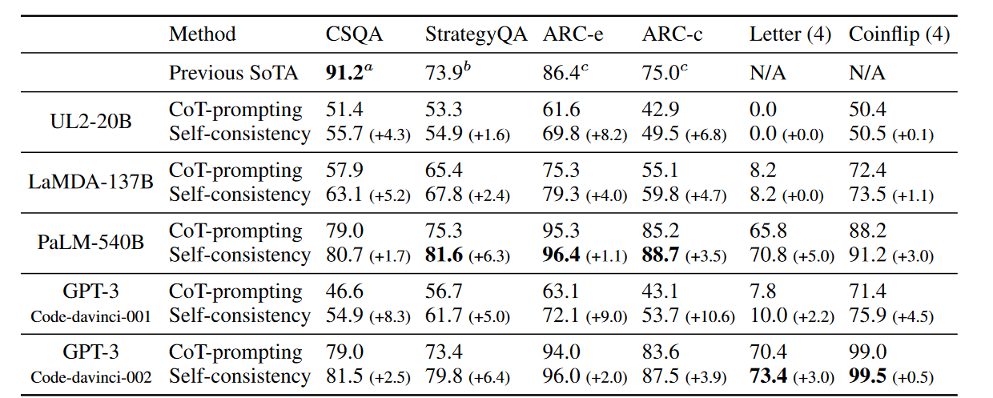
MAIN RESULTS
self-consistency yields large gains across all four language models

Slide 21
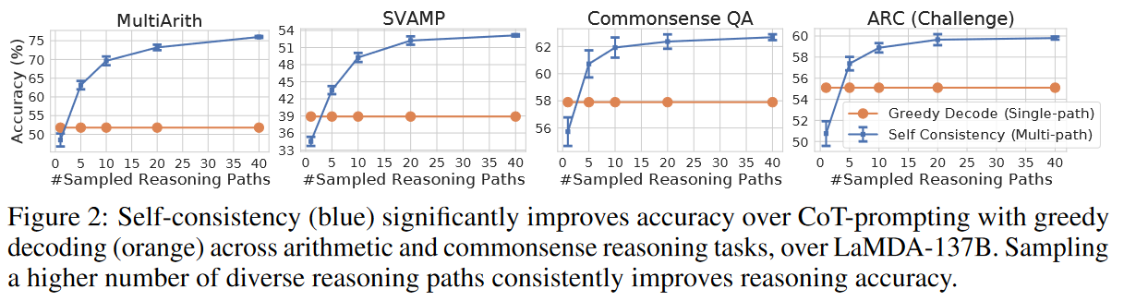
MAIN RESULTS
the effect of the number of sampled reasoning paths
sampling a higher number of reasoning paths leads to a consistently better performance

Slide 22
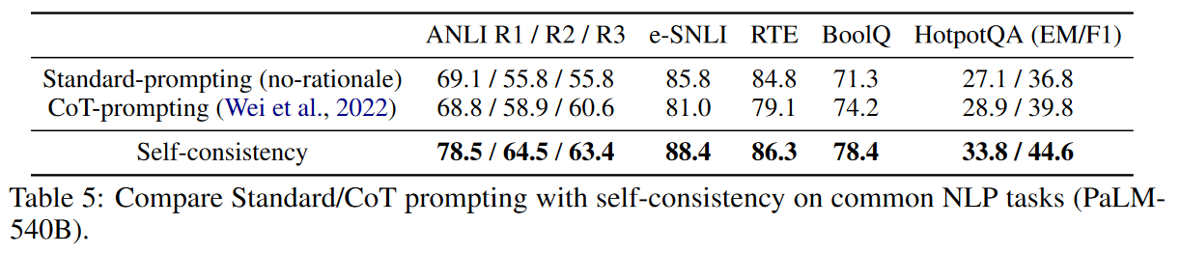
SELF-CONSISTENCY HELPS WHEN CHAIN-OF-THOUGHT HURTS PERFORMANCE
adding chain-of-thought does hurt performance compared to standard prompting
self-consistency is able to robustly boost the performance and outperform standard prompting

Slide 23
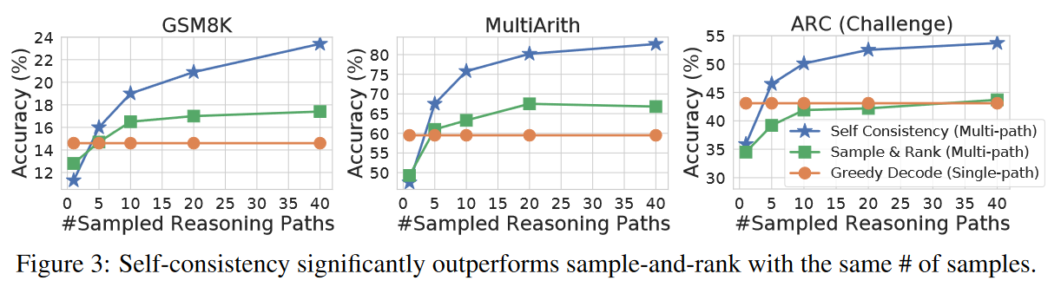
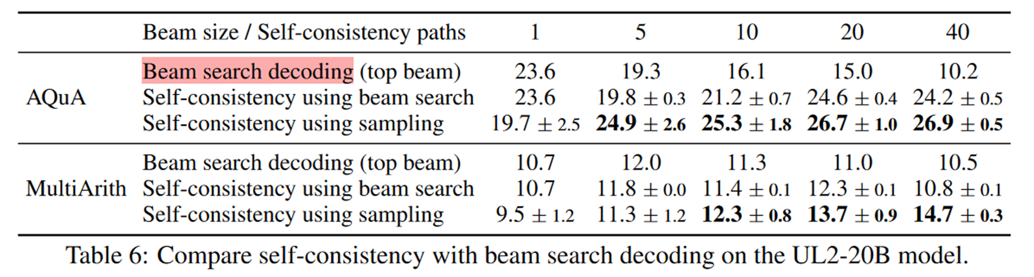
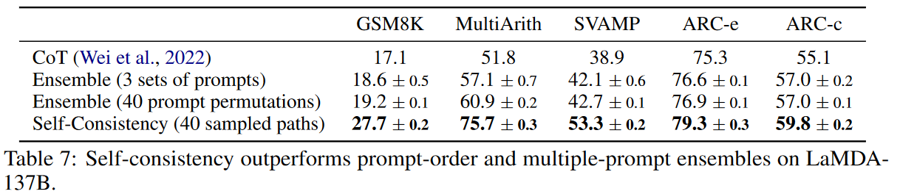
COMPARE TO OTHER EXISTING APPROACHES
Comparison to Sample-and-Rank
GPT-3
Comparison to Beam Search
UL2-20B
Comparison to Ensemble-based Approaches
Notes:
model-ensemble approach, where multiple models are trained and their outputs are aggregated

Slide 24
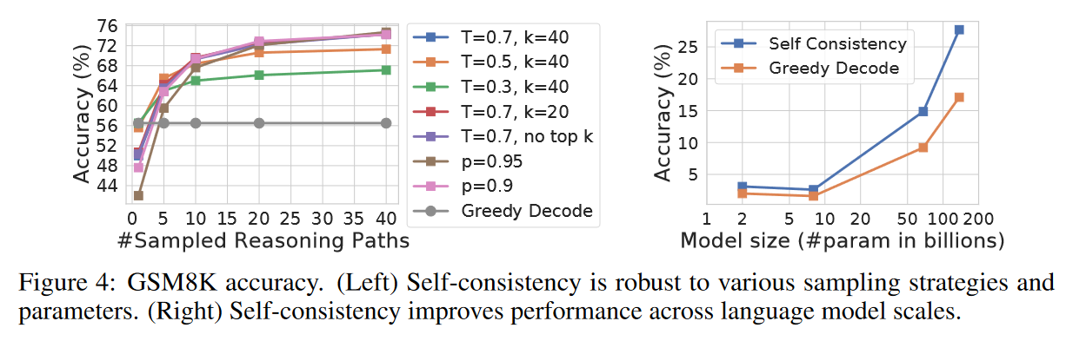
Self-consistency is robust to sampling strategies and parameters
The gain is relatively lower for smaller models due to certain abilities only emerge when the model reaches a sufficient scale

Slide 25
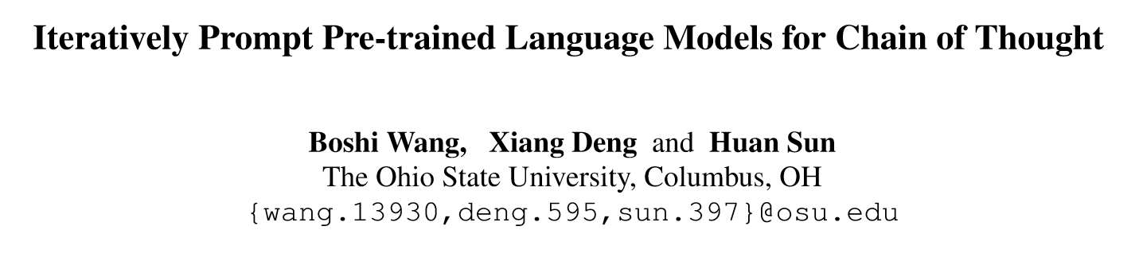
EMNLP 2022

Slide 26
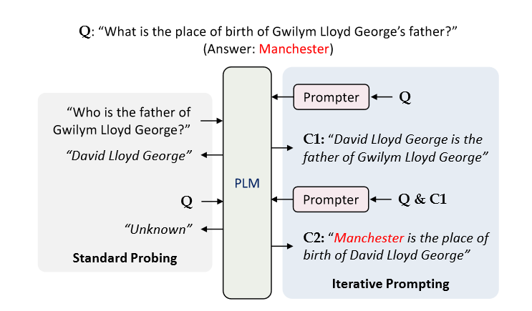
How to shepherd a PLM to recall a series of stored knowledge
At different inference steps, the prompts need to focus on different components of the complex query.
The prompts should appropriately integrate knowledge gathered in previous steps into the current step
A natural thought is to directly apply existing prompting methods in an iterative fashion.
Augment the PLM with an iterative Context-Aware Prompter

Slide 27
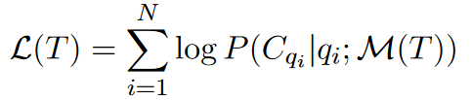
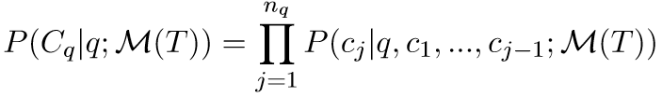
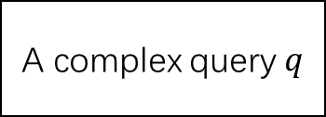


Problem Setup
A complex query $q$
Training objective is to learn how to find T which could maximize the log-likelihood
$$D=\{q_{i}, C_{q_{i}}\}_{i=1}^{N}$$
PLM M
Inspired by the sequential nature of multi-step inference tasks
$$C_{q} = [c_{1}, …, c_{n_{q}} ]$$
Notes:
Given a complex query q, a PLM M to recall a sequence of simple knowledge statements Cq = [c1, ..., cnq ] which is sufficient for deciding the response to q.

Slide 28
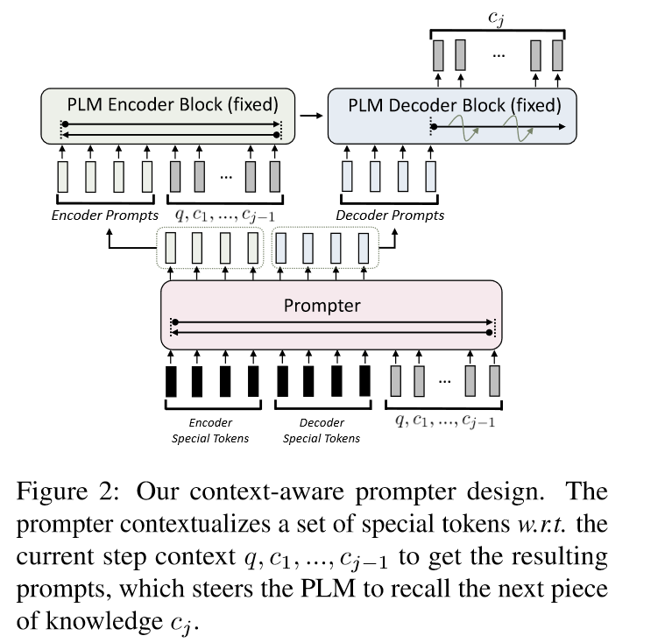

Context-Aware Prompter
dynamically synthesizes T w.r.t. the current step input context
adopt an Transformer-based PLM as Prompter(Roberta-base)
prompts are prepended to both the PLM’s encoder inputs and decoder inputs
model the prompts to be continuous virtual tokens instead of discrete tokens.

Slide 29
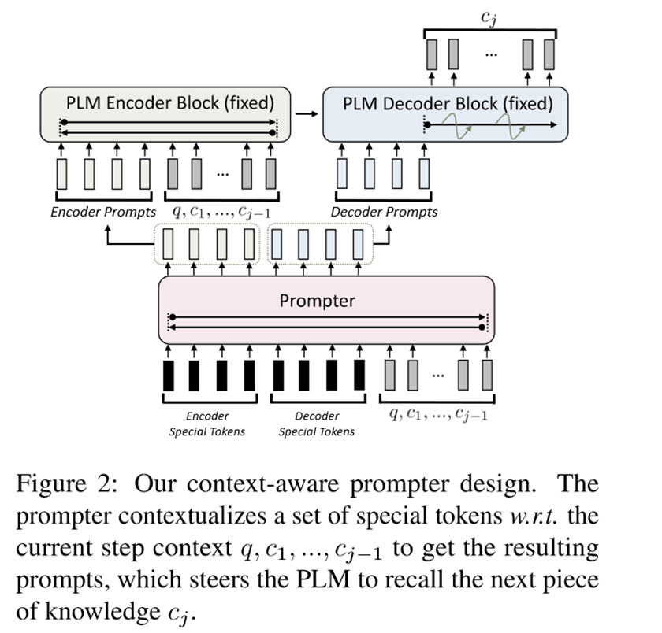
Context-Aware Prompter
use teacher-forcing for model training
execute for some predefined number of steps
2Wiki and R4C：4.
LoT：2.
jointly training the prompter with a “stopper”

Slide 30
Datasets & Preprocessing
2WikiMultiHopQA：include detailed annotations of evidence paths for each question
(subject entity, relation, object entity)
R4C：containing annotated evidence paths.
collect the evidence paths in the form of simple subject-verb-object natural language sentences
LoT
Notes:
conduct experiments on three datasets involving multi-step reasoning which include annotations for knowledge statements relevant to the queries

Slide 31
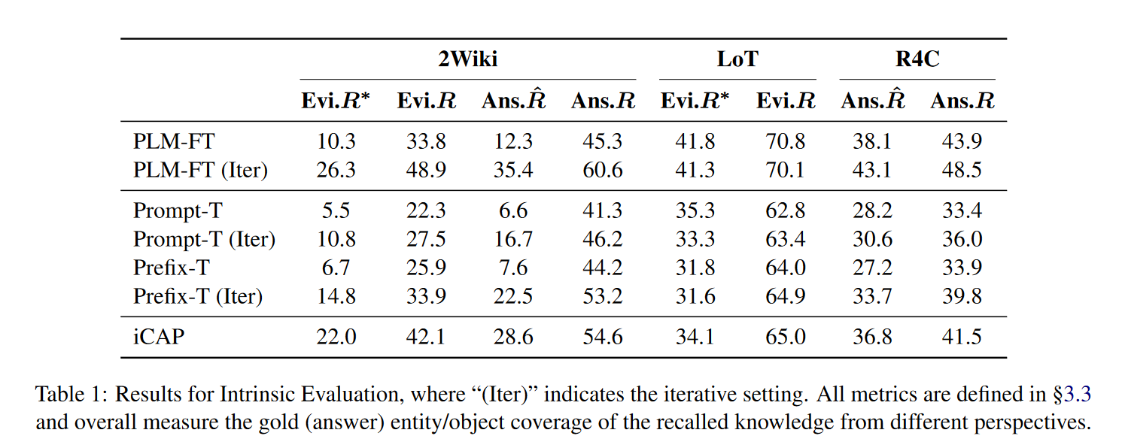
Results
compared methods benefit from the iterative setting over the noniterative setting.
Notes:
Evi.R:evaluate the evidence coverage of recalled contexts by computing the average ratio of gold evidence appearing in the recalled context
(Evi.R∗)the ratio of samples where all gold evidence are recalled
Ans.R:the ratio where the recalled knowledge contains the answer entity
Ans.R^ : compute the ratio among only those samples where the answer entity does not appear in the query

Slide 32
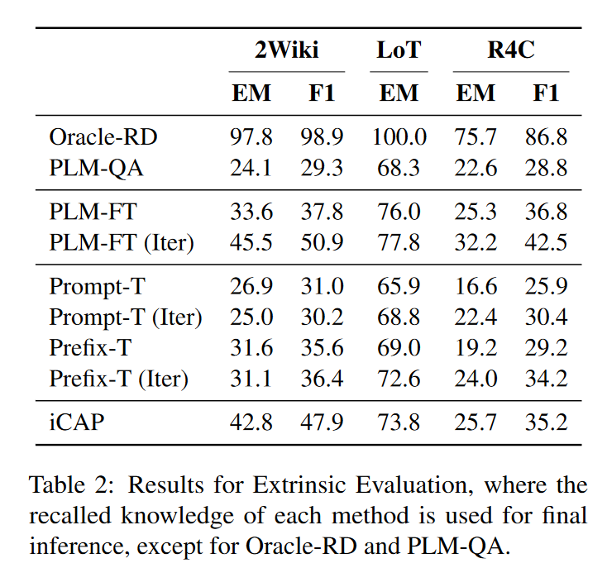
Results
measuring how much the recalled knowledge help find the response to the query
a large room for improvements with better methods for knowledge elicitation from PLMs.
Helpfulness of Knowledge Recall for Multi-step Inference
Notes:
measuring how much the recalled knowledge help find the response to the query

Slide 33
Thanks

