Slide 1
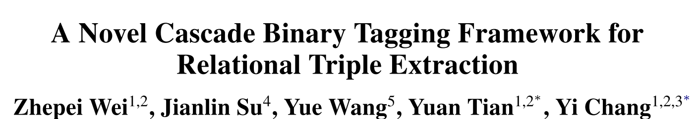
张甜甜（51194506050）
2020年5月7日
Accepted by ACL 2020.
https://arxiv.org/pdf/1909.03227.pdf

Slide 2
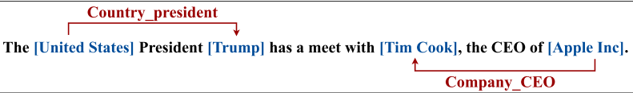
Introduction-Relational Triple Extraction
(subject, relation, object)
pipeline approach :
recognize all entities => relation classification for each entity pair
error propagation problem；neglect the relevance between them
joint models：
only through parameter sharing but not joint decoding
joint decoding - unified tagging scheme

Slide 3
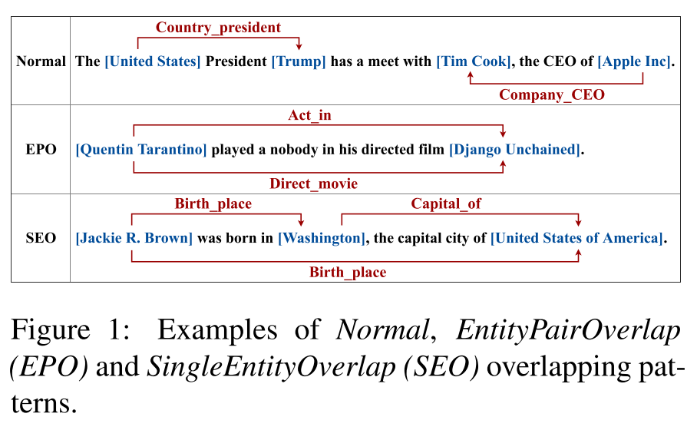
Introduction-Overlapping Triple Problem
conventional sequence tagging schemes ×
relation classification ×

Slide 4
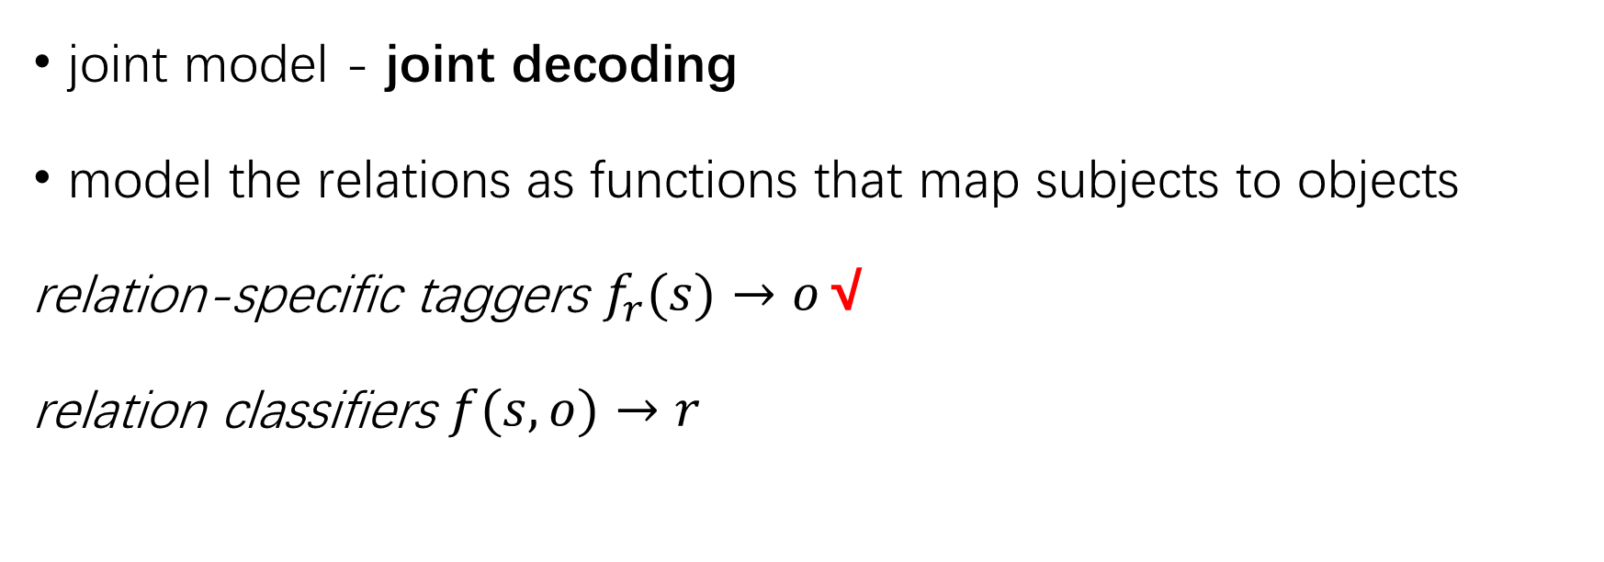
The CASREL Framework
joint model - joint decoding
model the relations as functions that map subjects to objects
relation-specific taggers $f_{r}(s)→o$√
relation classifiers $f(s,o)→r$
Notes:
treat relations as discrete labels to be assigned to entity pairs
learn relation classifiers f(s, o) → r

Slide 5
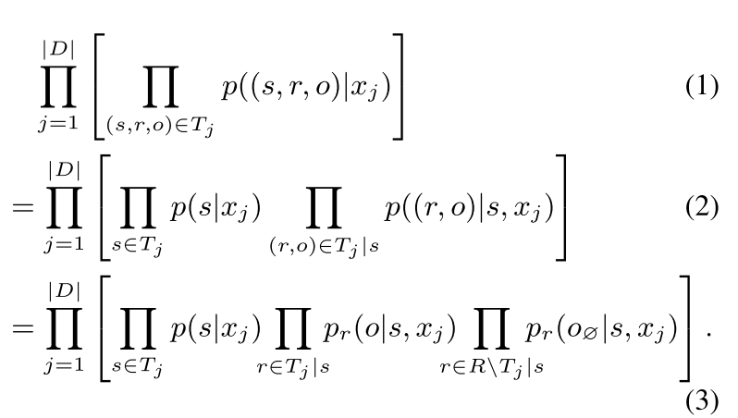
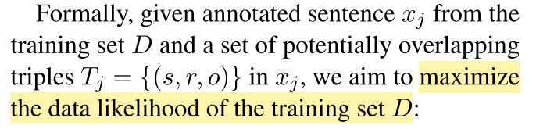
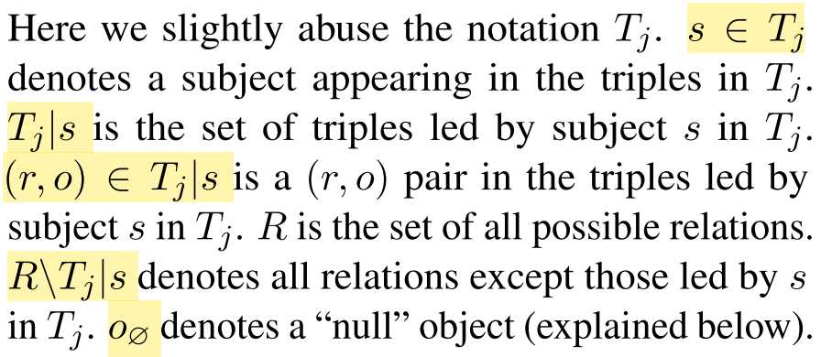
The CASREL Framework
Training objective at triple level
Notes:
treat relations as discrete labels to be assigned to entity pairs
learn relation classifiers f(s, o) → r

Slide 6
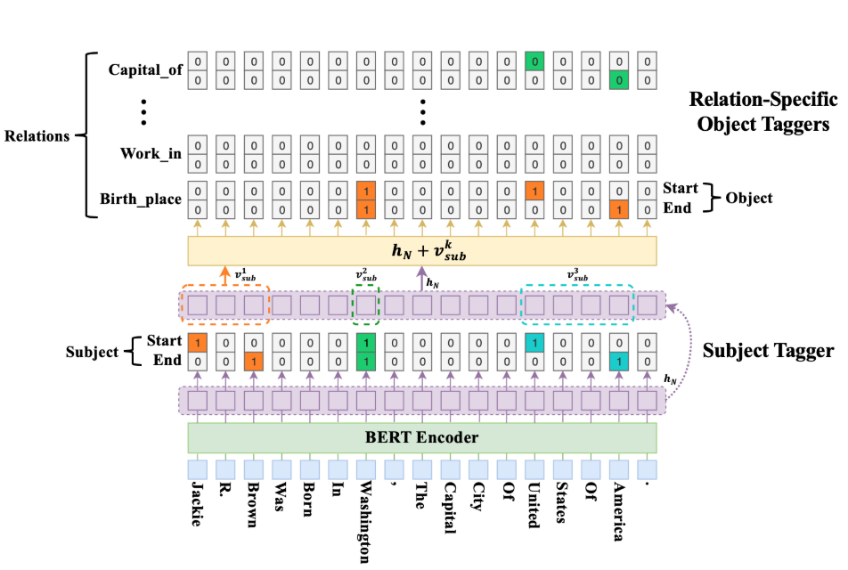
Notes:
treat relations as discrete labels to be assigned to entity pairs
learn relation classifiers f(s, o) → r

Slide 7
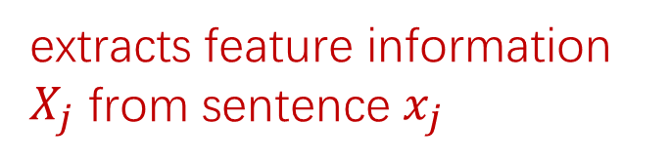
BERT Encoder
extracts feature information $X_{j}$ from sentence $x_{j}$

Slide 8
Cascade Decoder
for each candidate subject, check all possible relations
if a relation can associate objects in the sentence with that subject.
detect all subjects

Slide 9

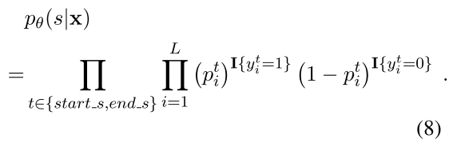
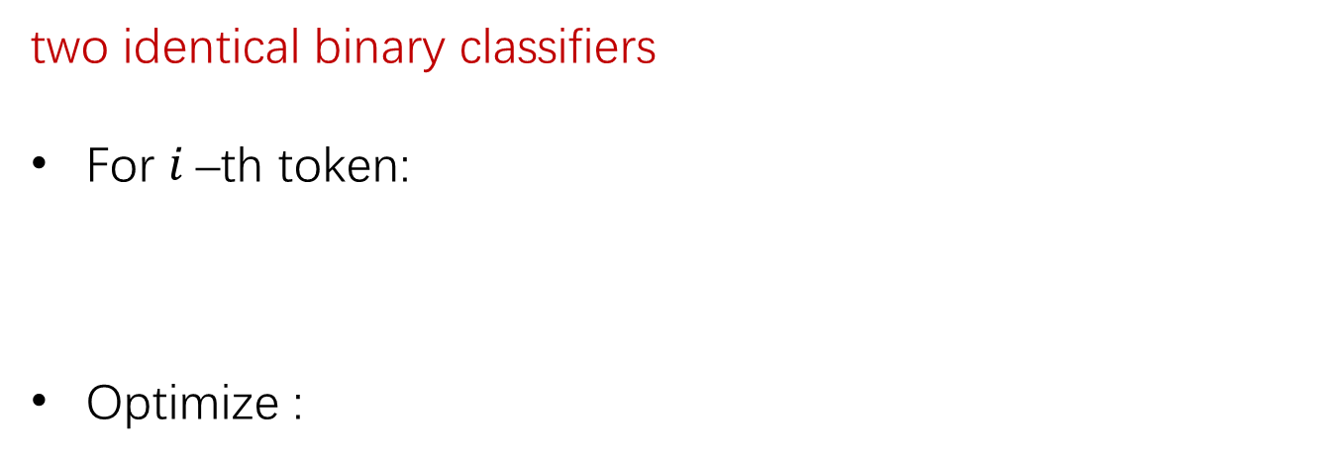
Cascade Decoder
two identical binary classifiers
For $i$–th token:
Optimize :
nearest start-end pair match principle

Slide 10
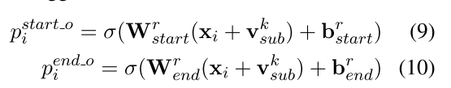
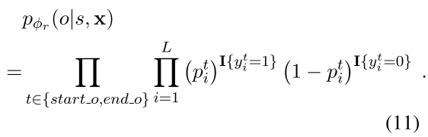

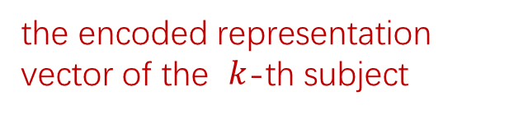
Cascade Decoder
the encoded representation vector of the $k$-th subject
For $i$–th token:
Optimize :
Include a “null” object o∅
Notes:
simultaneously identifies the objects as well the involved relations with respect to the subjects obtained at lower level

Slide 11
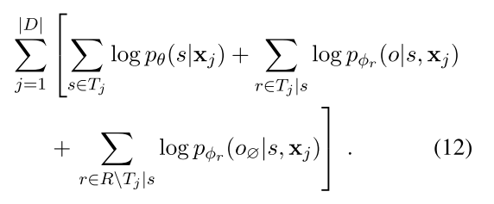
Data Log-likelihood Objective
maximizing J(Θ) =

Slide 12
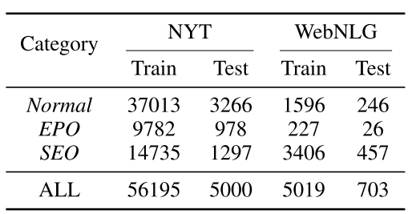
Experiments
Datasets
Metrics : only if the relation and the heads of both subject and object are all correct.
micro Precision , Recall , F1-score
24 relation types
246 relation types

Slide 13
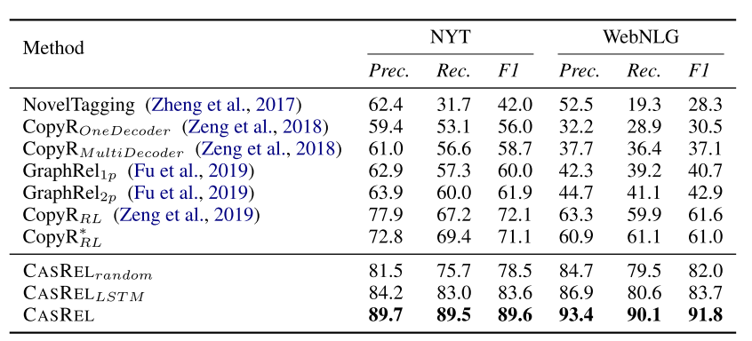
Results
Notes:
conventional sequence tagging schemes that assume each token bears only one tag (Zheng et al., 2017).
Zeng et al. (2018) is among the first to consider the overlapping triple problem in relational triple extraction. proposed a sequence-to-sequence (Seq2Seq) model with copy mechanism to extract triples
Fu et al. (2019) also studied the overlapping triple problem by modeling text as relational graphs with a graph convolutional networks (GCNs) based model.
Based on the Seq2Seq model, they further investigate the impact of extraction order (Zeng et al., 2019) and gain considerable improvement with reinforcement learning.
CASRELrandom is the framework where all parameters of BERT are randomly initialized;
CASRELLSTM is the framework instantiated on a LSTM-based structure as in (Zheng et al., 2017) with pre-trained Glove embedding (Penning- ton et al., 2014);
CASREL is the full-fledged frame- work using pre-trained BERT weights.

Slide 14
Results
Notes:
conventional sequence tagging schemes that assume each token bears only one tag (Zheng et al., 2017).
Zeng et al. (2018) is among the first to consider the overlapping triple problem in relational triple extraction. proposed a sequence-to-sequence (Seq2Seq) model with copy mechanism to extract triples
Fu et al. (2019) also studied the overlapping triple problem by modeling text as relational graphs with a graph convolutional networks (GCNs) based model.
Based on the Seq2Seq model, they further investigate the impact of extraction order (Zeng et al., 2019) and gain considerable improvement with reinforcement learning.
CASRELrandom is the framework where all parameters of BERT are randomly initialized;
CASRELLSTM is the framework instantiated on a LSTM-based structure as in (Zheng et al., 2017) with pre-trained Glove embedding (Penning- ton et al., 2014);
CASREL is the full-fledged frame- work using pre-trained BERT weights.

Slide 15
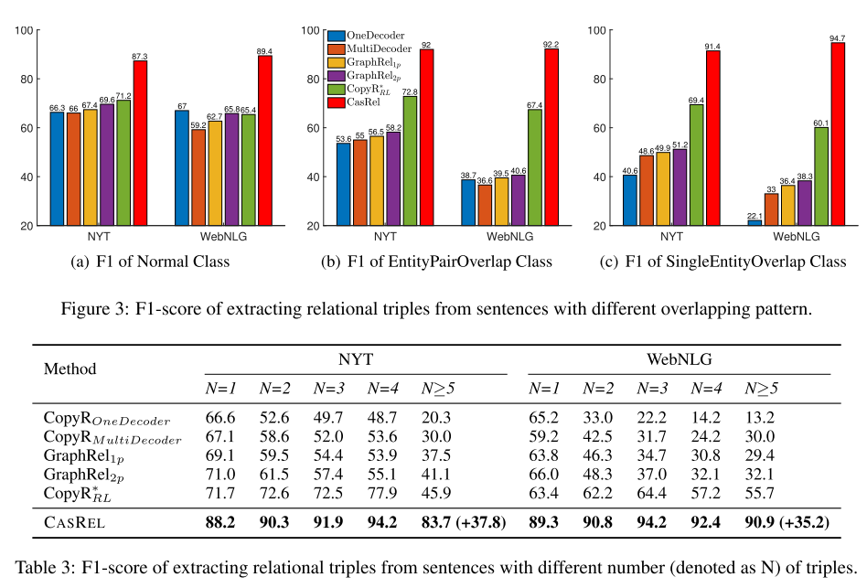
Results

Slide 16
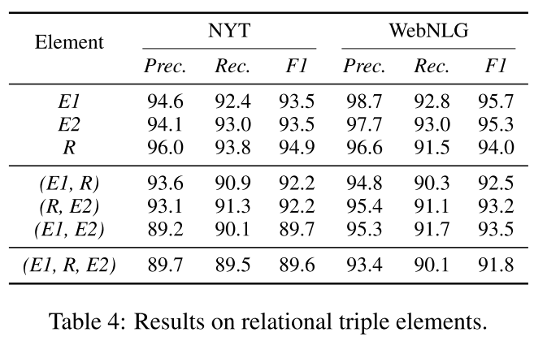
Error Analysis
Notes:
1\some extracted entities fail to form a valid relational triple.
2\misidentifying the relations will bring more performance degradation than misidentifying the entities.

Slide 17
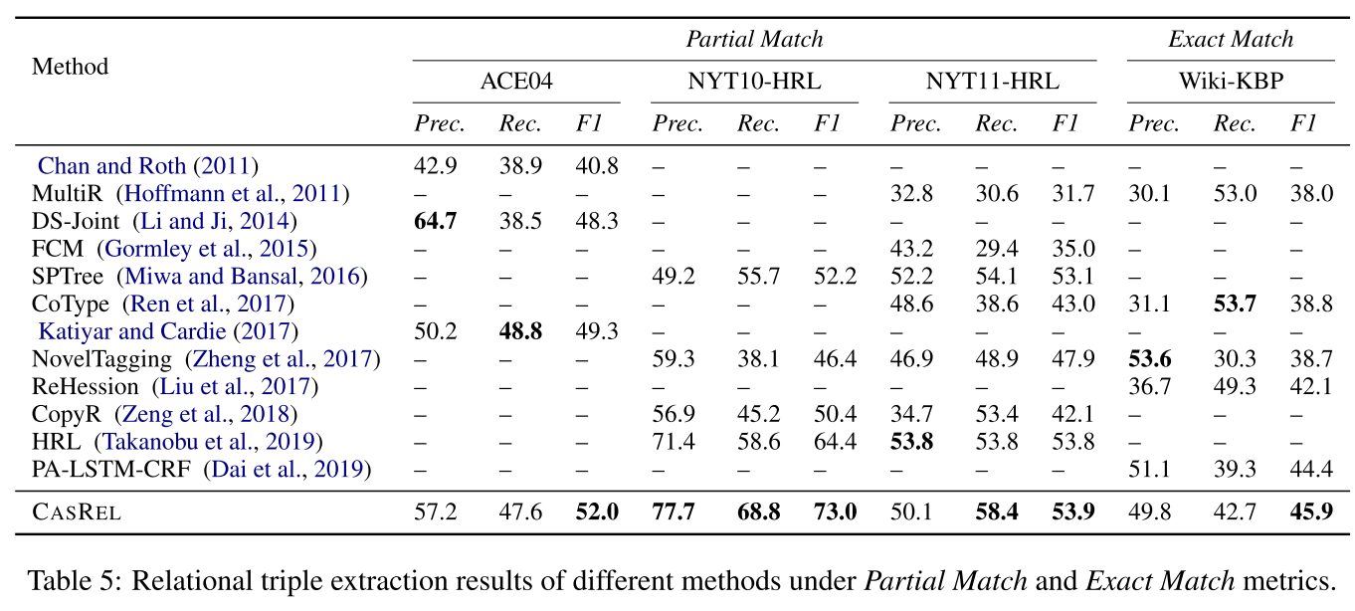
Supplemental Experiments

Slide 18
Conclusion
a novel cascade binary tagging framework (CASREL), without suffering from the overlapping problem
model the relations as functions that map subjects to objects

