Slide 1
Big Data & Analytics:
features of the online environment for better learning
Team 2: Bao Nguyen, Antoine Vo, Kyle Domen, Ivana Chen, Henri Wood, Sai Avadhanam
CS160 | Section 80

Slide 2
Overview
The amount of data we have access to today is like an ocean.
Text messages, internet searches, social media posts…
It’s impossible to process it all by hand, so how would we learn to compute everything to find patterns, features, relationships?

Slide 3
Introducing:
bigdata.io
Feature List
Core requirements
Learning modules | C1: Categorized content of technical subject
Specialization filtering | C2: Tutorials or latest reviews of the subject
Visual data interactive modules | C4: Achieve online learning objectives
Gamification and progress rewards | C3: Meeting both beginner/professional needs
Social media integration | C4: Achieve online learning objectives
Integrated payments for each course | C3/4: Meeting both beginner/professional needs and Personalized Learning

Slide 4
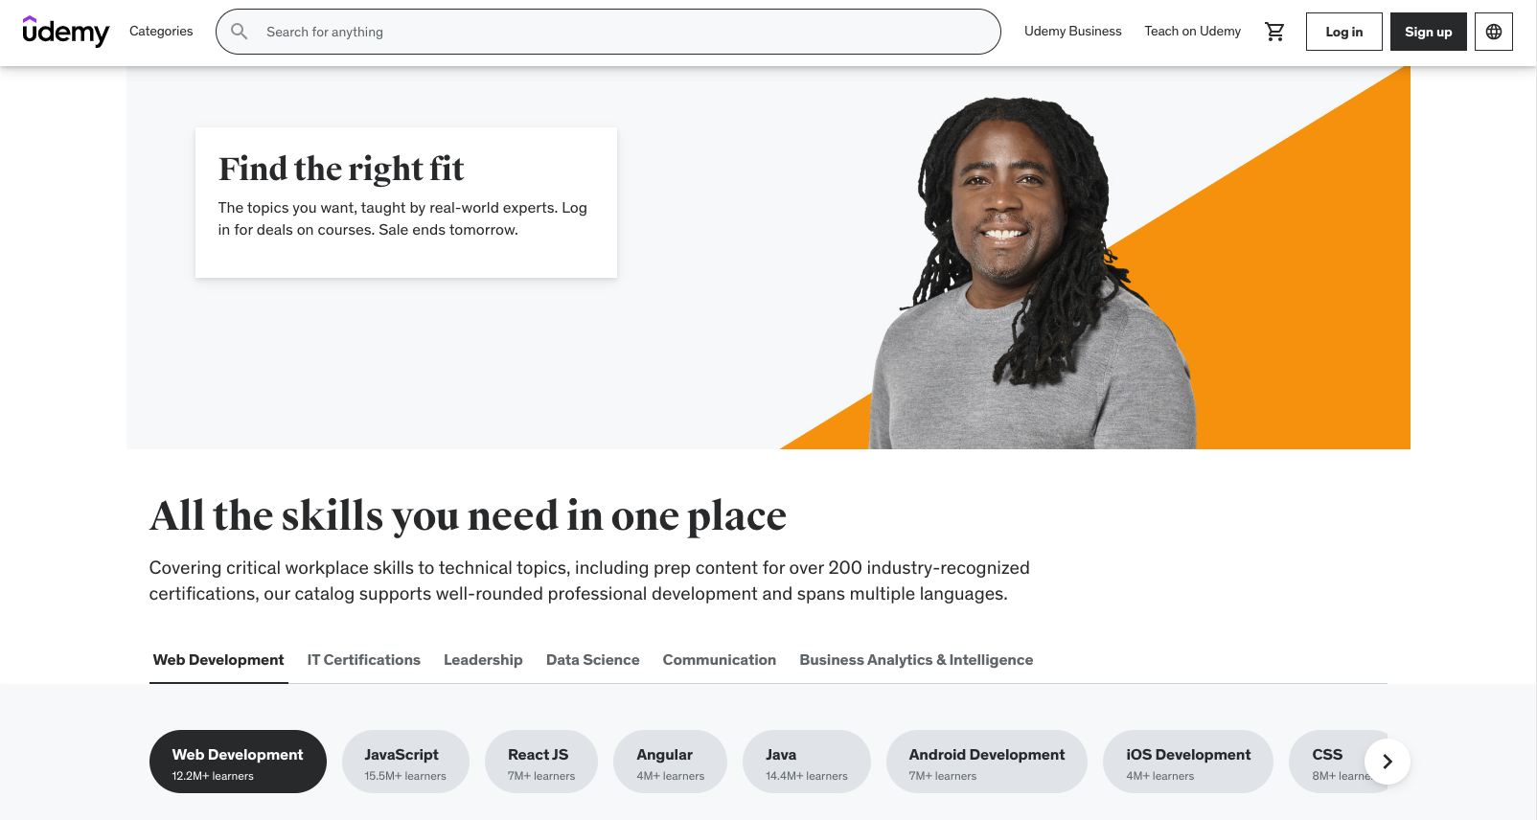
Feature 1: Learning modules
What is it and how it relates to which core requirement(s)?
Achieve online learning objectives. Ability to connect the user’s account to their desired social media platforms to showcase their own learning and progress while encouraging collaboration among friends in the field.
Why is it innovative and useful to users?
It will be innovative and useful to users because it will enable users to connect with like-minded learners and create a sense of community within their learning journey. Peers could offer potential solutions and discuss various topics within big data.
URL: https://www.udemy.com/

Slide 5
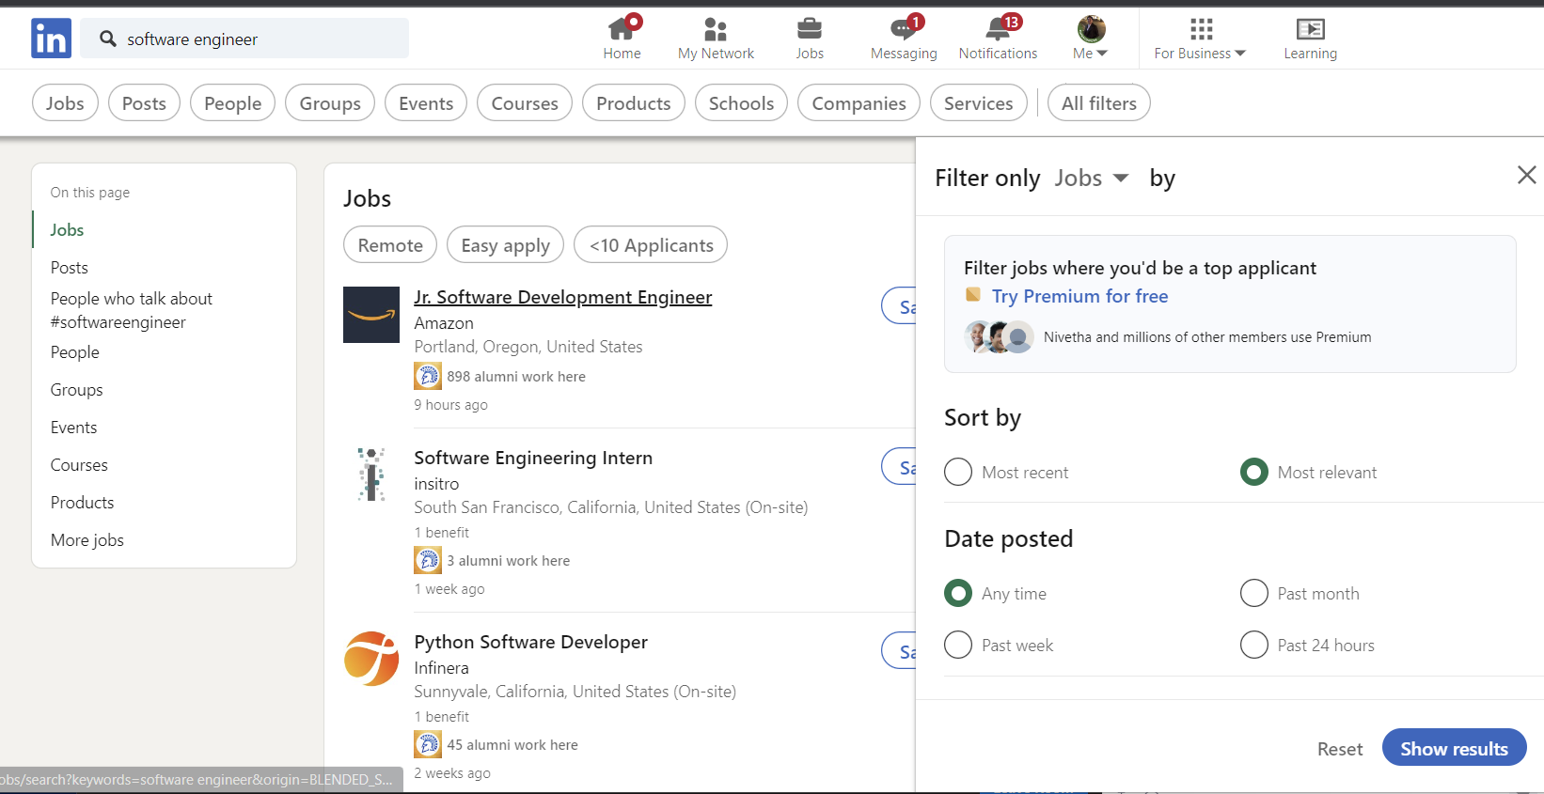
Feature 2: Specialization filtering
- What is it and how it relates to which core requirement(s)?
Users can utilize specialization filtering to focus the course catalog on their most relevant interests. Giving users a user-centered and individualized learning experience is strongly related to core requirements.
- Why is it innovative and useful to users?
Because users may easily identify courses that suit their specific learning objectives without having to go through a large course library.
- Provide a reference site URL and snapshot
URL: https://www.linkedin.com/jobs/search/

Slide 6
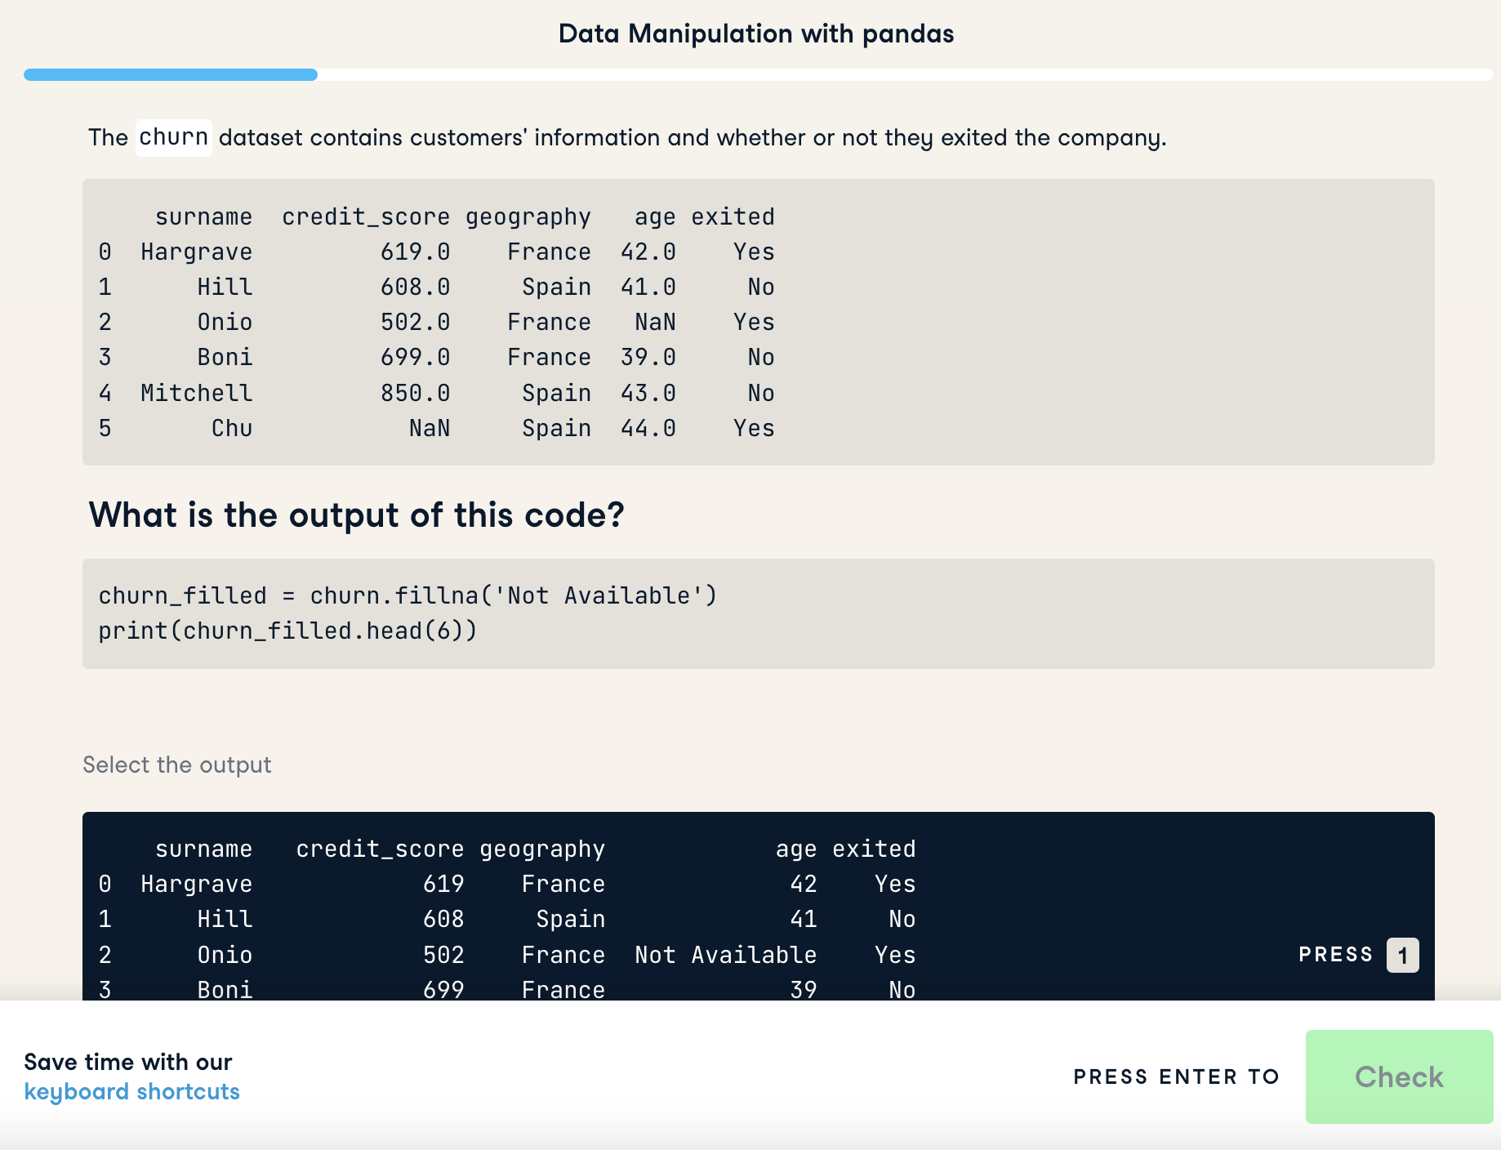
Feature 3: Visual data interactive modules
What is it and how it relates to core requirement(s)?
Achieve online learning objectives. Interactive visuals and multimedia learning content will provide a more interactive learning experience to users in a way that traditional textbooks or lectures do not.
Why is it innovative and useful to users?
Dynamic course contents such as inline code editors, interactive data visualizations, multimedia contents such as videos to provide a more interactive learning experience. It’s important for users to see a direct correlation between their code and data, and how it changes the output. Having our modules be interactive is essential for learners to understand this relationship.
Source: datacamp.com

Slide 7
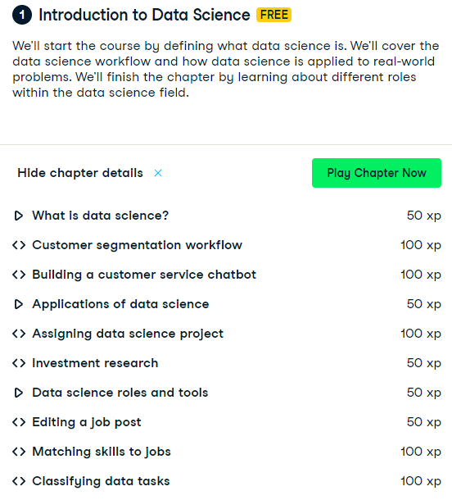
Feature 4: Gamification and progress rewards
- What is it and how does it relates to which core requirement(s)?
Meeting both beginner/professional needs
Gamify progress as users progress through the course contents by providing progress rewards, progress bar, experience points, and rewards.
- Why is it innovative and useful to users?
This encourages users to use progress and learn content through positive-reinforcement and makes learning more fun.
Source: https://www.datacamp.com/courses/understanding-data-science

Slide 8

Feature 5: Social media integration
What is it and how it relates to core requirement(s)?
Achieve online learning objectives. Ability to connect the user’s account to their desired social media platforms to showcase their own learning and progress while encouraging collaboration among friends in the field.
Why is it innovative and useful to users?
It will enable users to connect with like-minded learners and create a sense of community within their learning journey. Peers could offer potential solutions and discuss various topics within big data.
Source: reddit.com

Slide 9
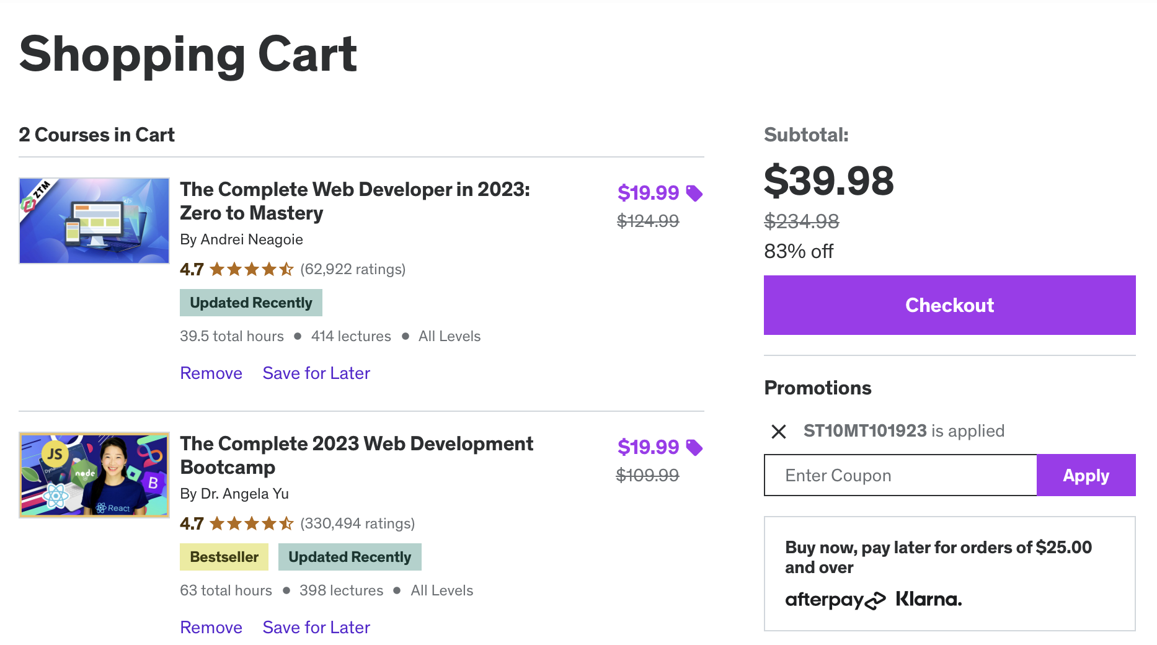
Feature 6: Integrated payments for each course
What is it and how it relates to which core requirement(s)?
Integrated payment system is a seamless way to provide secure transactions.
Relates to C3 and C4.
Why is it innovative and useful to users?
It is innovative and useful to users because it allows a convenient and flexible experience for users. Users would save time and not have to worry about switching between different systems. It will organize their learning progress to understand a member’s preferences and in this way, personalized their learning content and experience.
Do you see any conflict or overlap with other features?
It could conflict with learning modules since some learning module feature since some features may be paywalled.
https://www.udemy.com/cart/
Notes:
C3) Because many features would be available for free to beginners, but professionals can pay for a more advanced version of each course
C4)
b) Personalized learning: the system will show content matching individual member’s profile — For example, if a member frequently purchases content related to a specific topic, the system can use this information to recommend more content in that area.
c) Recommendation engine: the system will recommend content based on the member’s profile and/or usage → the system can make more accurate and personalized content recommendations
In summary, an integrated payment system for courses simplifies the enrollment process, enhances convenience, and provides a secure, data-driven approach to managing payments, ultimately benefiting users by improving their overall learning experience.
But this will be because more advanced professionals would require more advanced features and learning experience.

