Slide 1
Big Data & Analytics
bigdata.io
Team 2: Bao Nguyen, Antoine Vo, Kyle Domen, Ivana Chen, Henri Wood, Sai Avadhanam
CS160 | Section 80

Slide 2
Feature List
Learning Modules
Visual data and interactive modules
Specialization filtering
Social Media Integration & Sharing Progress

Slide 3
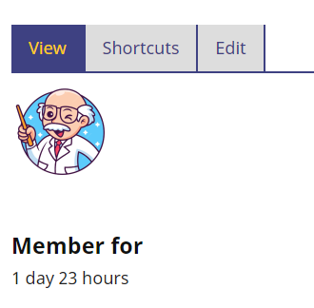
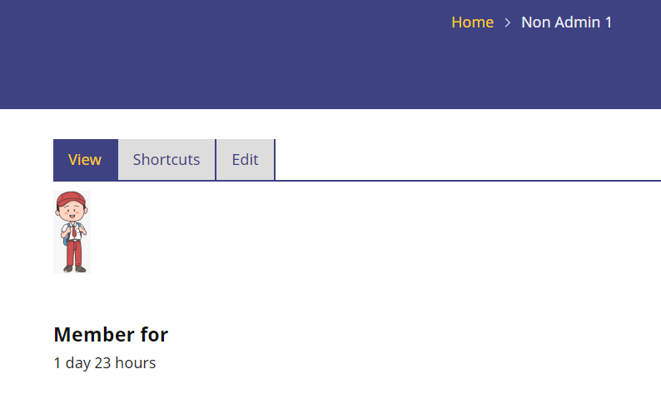
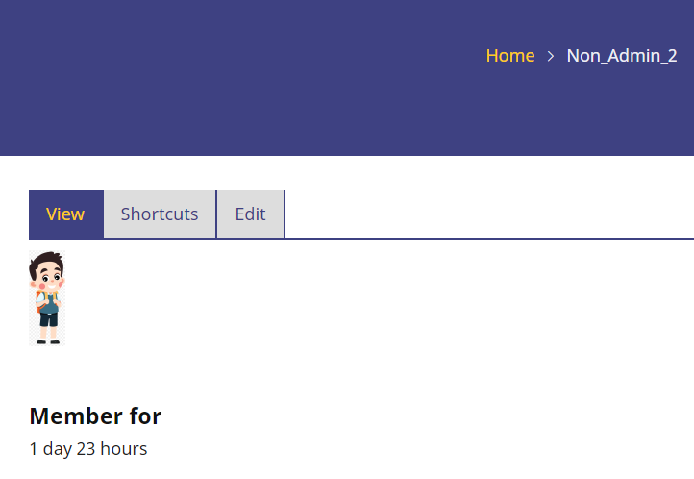
Non-admin users
Admin
To validate personalized content, here are our non-administrator testing accounts:

Slide 4

Homepage

Slide 5
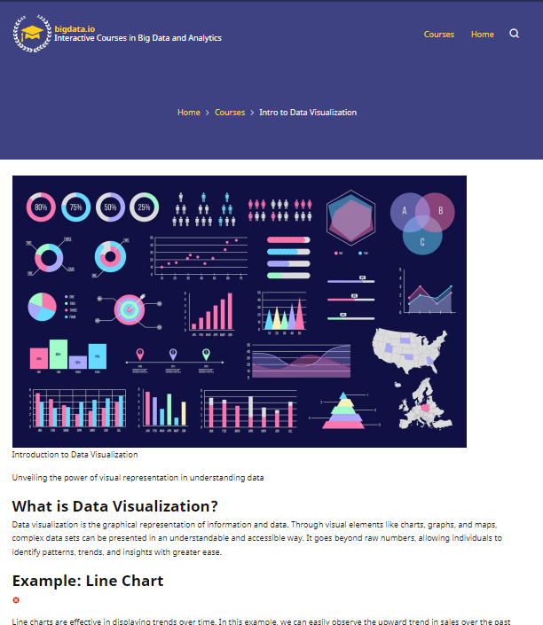
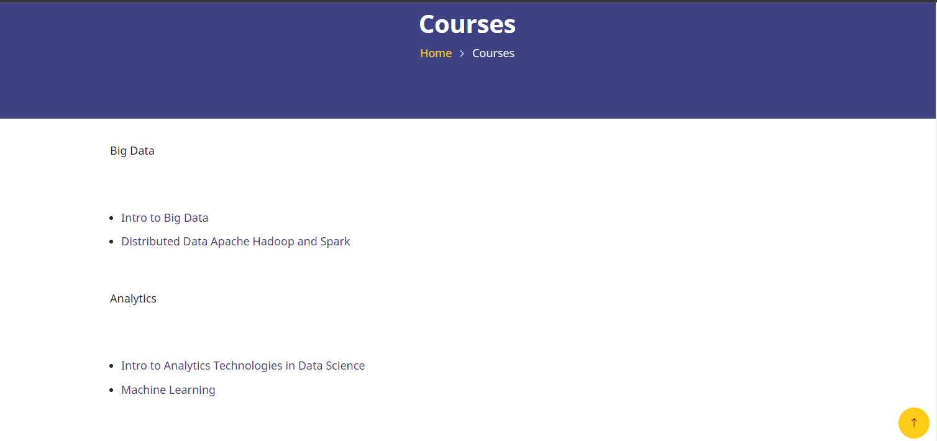
Learning Modules

Slide 6
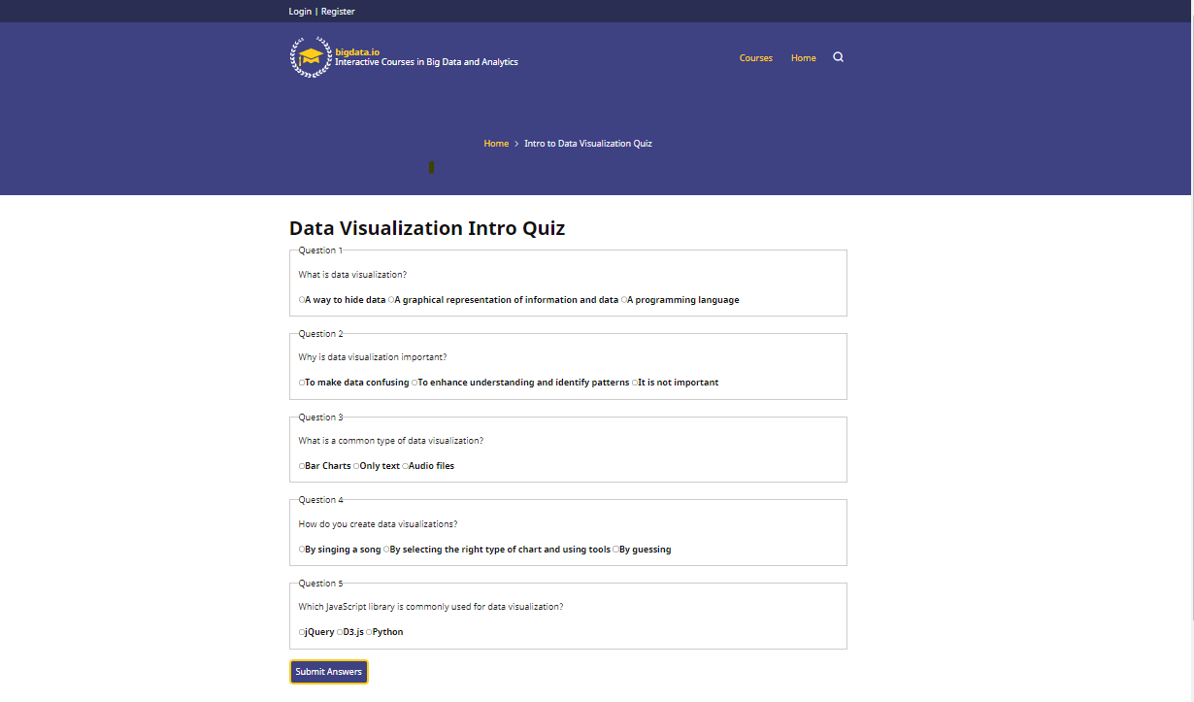
Interactive Modules - Quizzes Section

Slide 7
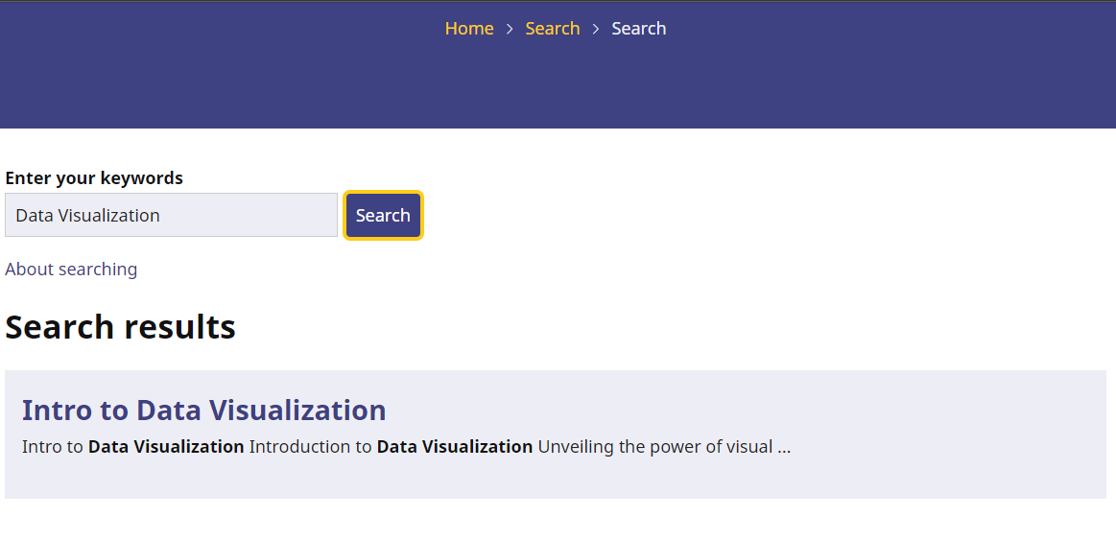
Specialization Filtering - Search Bar

Slide 8
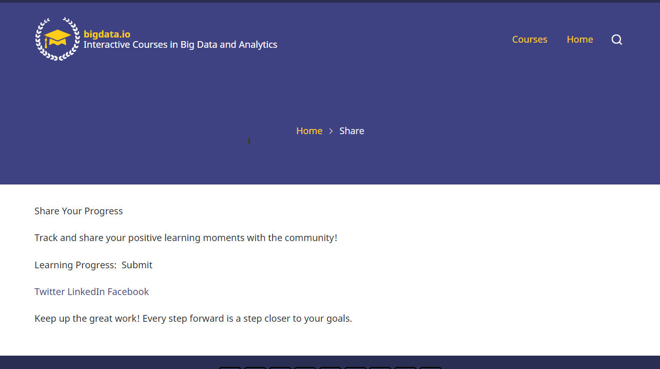

Social Media Integration & Progress Sharing

Slide 9
Next Steps
Fill in the rest of the content
Add dynamic elements to existing feature pages
Upload via FTP
Visual cleanup

