Slide 1

Imperceptible Honey Encryption with Large Language Models
NaNA 2025

Slide 2
BACKGROUND

Slide 3

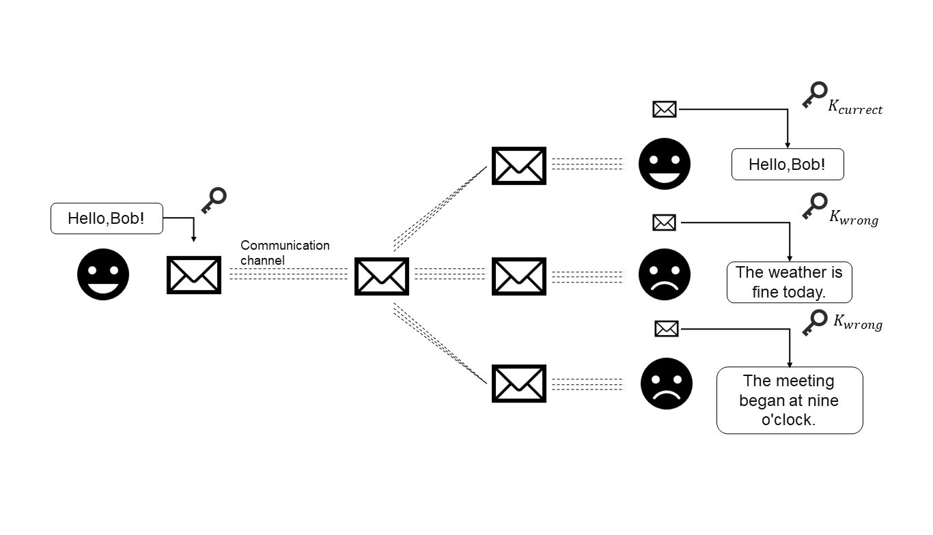
BACKGROUND
Conventional cryptographic algorithms are only effective in protecting the original message; however, they are susceptible to attack themselves. Honey encryption produces fluent natural language text regardless of the success of decryption, achieving a degree of imperceptibility that traditional cryptographic algorithms lack.

Slide 4
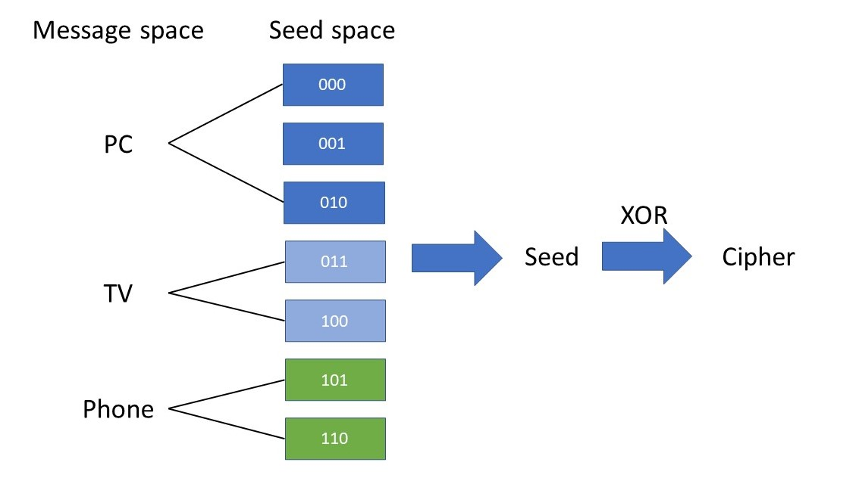
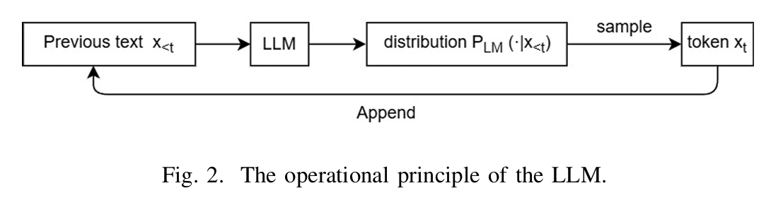
BACKGROUND

Slide 5
SYSTEM DESIGN

Slide 6
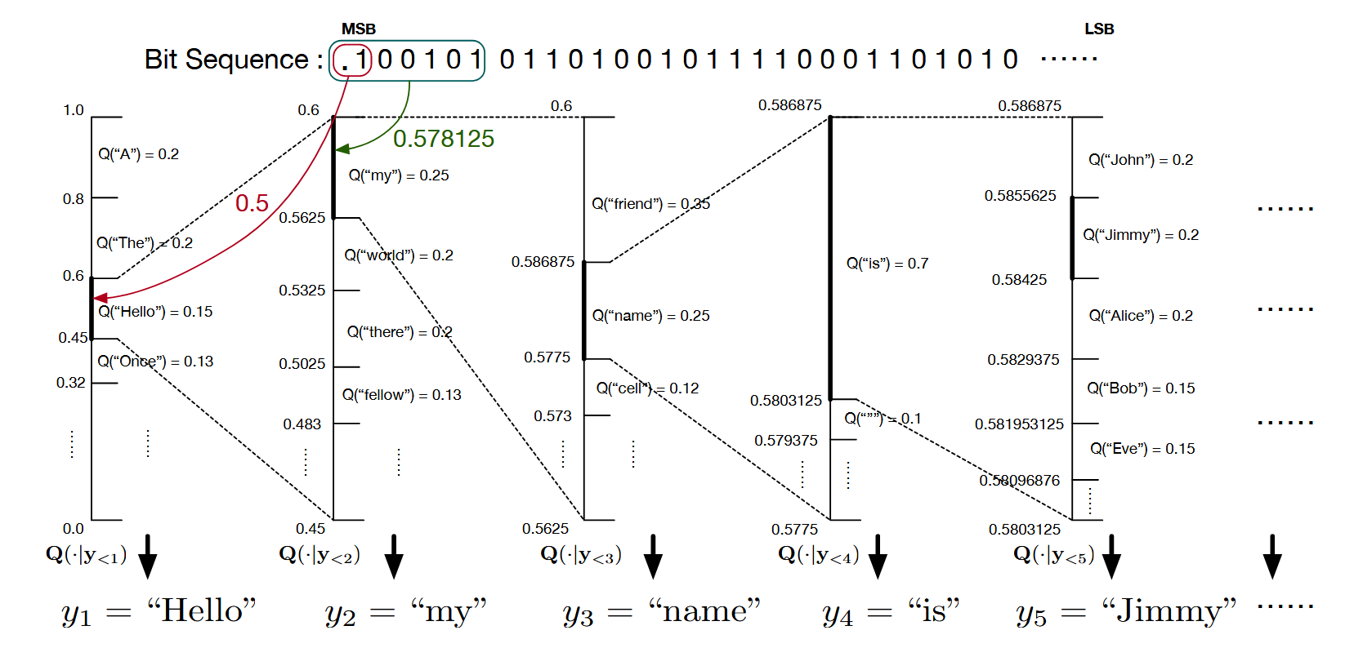
SYSTEM DESIGN

Slide 7
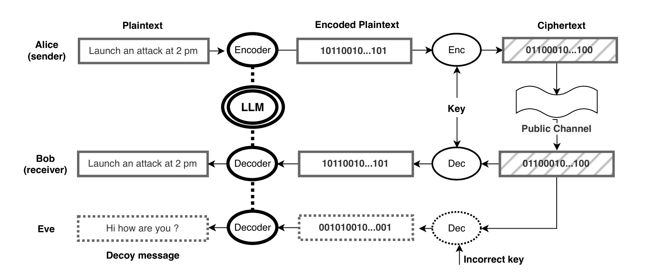
SYSTEM DESIGN

Slide 8
EXPERIMENT

Slide 9
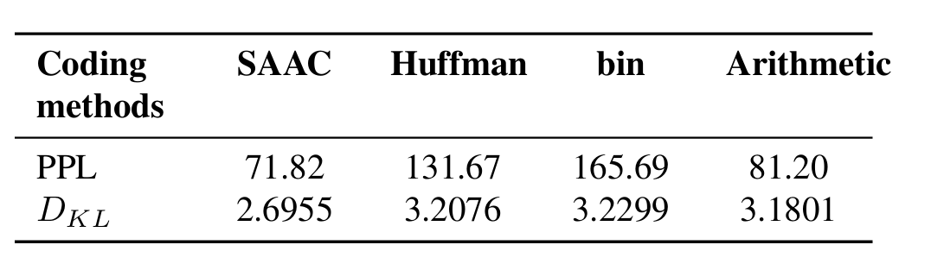
Distilling step-by-step
Dataset:COVID-19, which is a subset of research papers related to COVID-19 in the CORD-19 dataset.
Metric:
Perplexity (PPL) Perplexity quantifies a language model’s predictive accuracy by measuring the exponential average of negative log-likelihood per token.
Kullback-Leibler Divergence (DKL): DKL provides anasymmetric measure of dissimilarity between the true distribution P and approximated distribution Q. In steganographic applications, minimized DKL values between decoy and genuine message distributions demonstrate enhanced security through statistical indistinguishability.

Slide 10
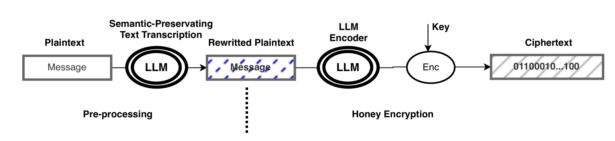

Distilling step-by-step
$x_{i}代表$问题或者输入文本， $y_{i}$代表标签， $r_{i}$代表推理，$L$代表损失函数。

Slide 11
END

