Slide 1

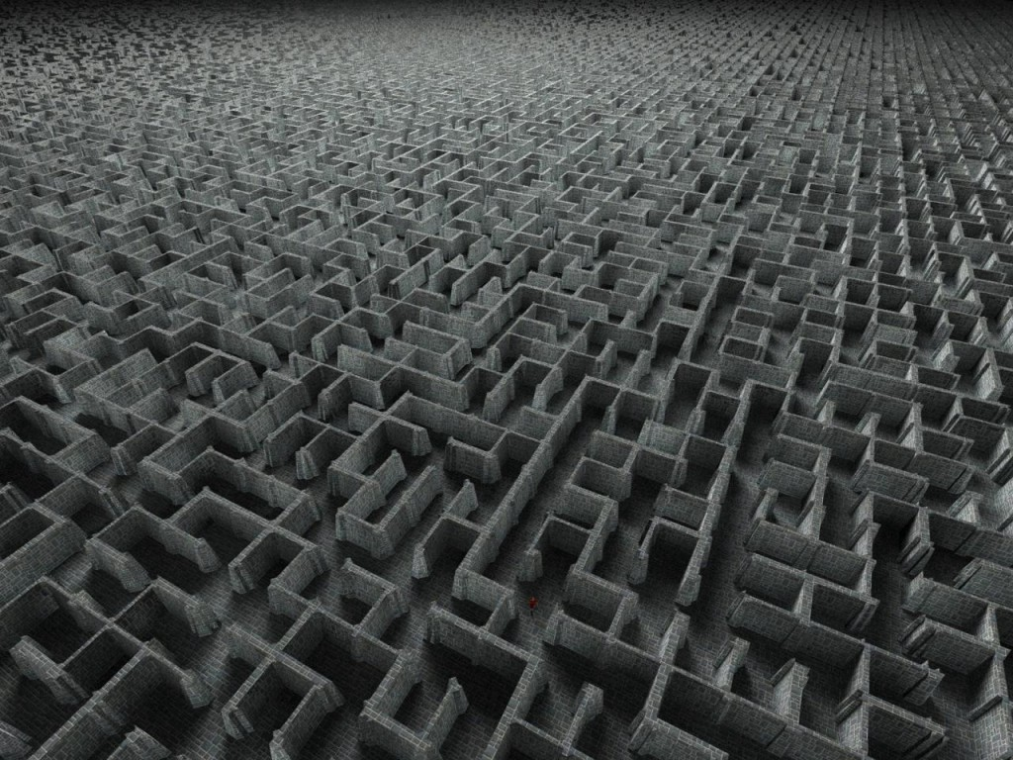
NameInProgress : Labyrinth Game
Jalsovszky Gábor
Kinceli Antal
Molnár Dávid

Slide 2

Project status:
  General refactoring
  Additional features added
  Playable state
  No known errors
NameInProgress

Slide 3
Optional features developed:
  Direction reveal display
  Item inventory
  Smooth display and movement
  Custom start and endpoints
  Additional maps
NameInProgress

Slide 4
Technical details:
  Major refactoring
  Clean code
  Generalization of movement
  Error handling
  Dynamic main menu
  Map scanning
NameInProgress

Slide 5
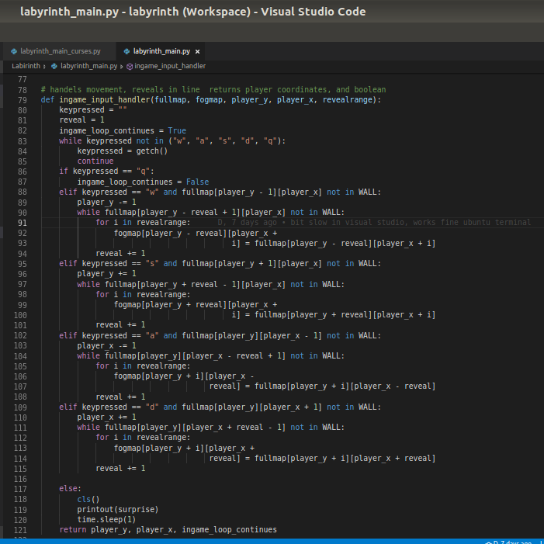
Previous movement handling:
NameInProgress

Slide 6
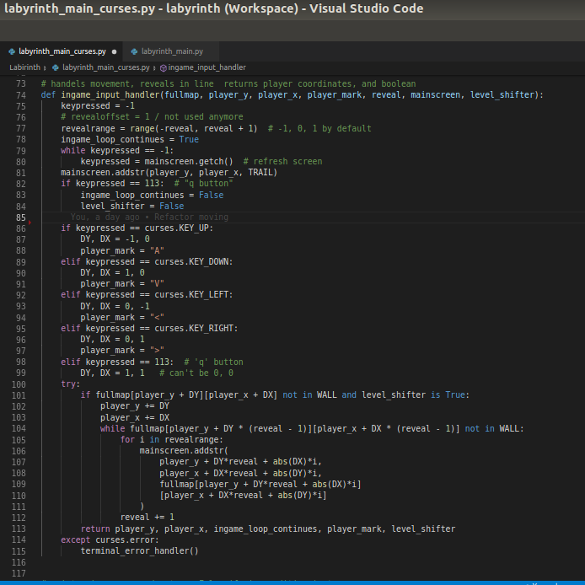
Current movement handling:
NameInProgress

Slide 7
Future plans:
  Improve to a rogue like game with story
  Random map generation
  Diagonal movement
  Pause mode with options
  Colors and sounds
NameInProgress

Slide 8
Workflow experience:
  Very fast progress
  Sense of achievement
  Good communication and teamwork
  - Slower work process on English day
  - Part of project time spent on dojos
NameInProgress

