Slide 1
A survey of BWT variants for string collections – 2024 – Z. Liptak, D. Cenzato
6 variants of BWT:
  eBWT
  dolEBWT
  mdolBWT
  colexBWT
  optBWT
  concBWT
Different ways of separating strings
Input order sensitive or not
Different results, (number of runs)
Comparison on 8 real life datasets

Slide 2
Description of important order
colex(T) = lexicographic order from right to left
Example : (ACT, GCT, AG) = AG, ACT, GCT
colex(T) = lexicographic order from right to left
Example : (ACT, GCT, AG) = AG, ACT, GCT
Omega order(T) = each string gives a root and an expansion
Root = Smallest repeating prefix
Expansion = Number of repetitions
Order : lexicographic omega order (lexicographic on string were we repeat the root an infinite time) : ex = TAG < TA
opt(T) = order given by the algorithm of Bentley et al. (2020), which minimizes the number of runs

Slide 3
Description eBWT
eBWT:
concatenation of last character of permutation of string, sorted by omega order.
Example : T = {GTC, GT}
Permutation : GTC, TCG, CGT, GT, TG
Omega order : CGT, GTC, GT, TCG, TG
eBWT(T) = TCTGG
For details : Mantaci et al. (2007)

Slide 4
Properties of variants
Compute BWT on T = {T¹, T², T³}
T$ = T¹$T²$T³$
eBWT:
- eBWT(T)
mdolBWT:
- BWT(T¹$¹T²$²T³$³)
dolEBWT:
- eBWT(T$)
colexBWT:
- mdolBWT(colex(T))
optEBWT:
- mdolBWT(opt(T))
concatBWT:
- BWT(T$#)

Slide 5
Properties of variants
eBWT:
- no end-of-string
- independent of input order
mdolBWT:
- end-of-string
- dependent of input order
dolEBWT:
- end-of-string
- independent of input order
colexBWT:
- end-of-string
- independent of input order
optEBWT:
- end-of-string
- independent of input order
concatBWT:
- end-of-string
- dependent of input order

Slide 6
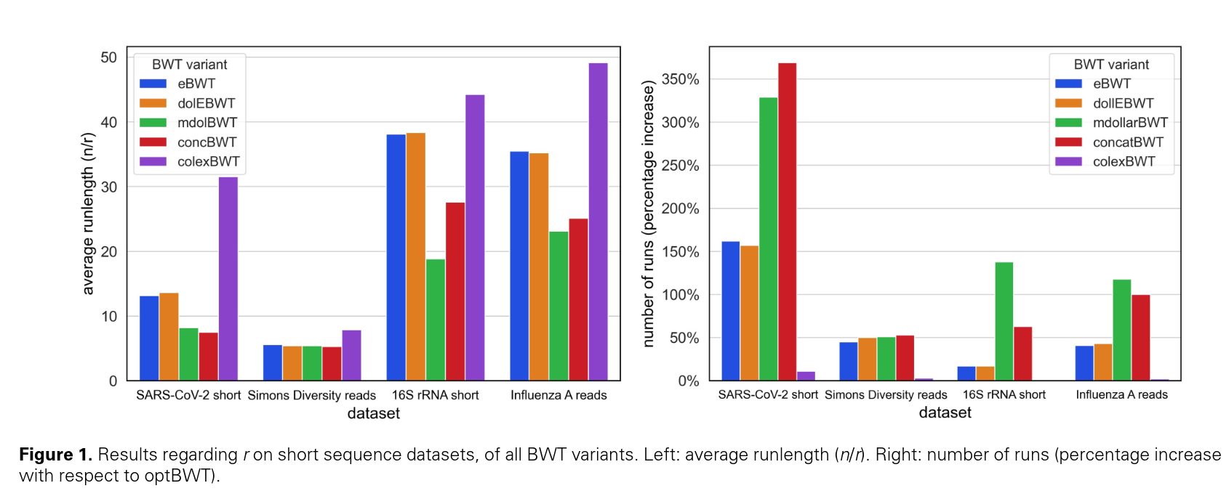
Results: Comparison between variants
ColexBWT achieves best results on real life dataset

Slide 7
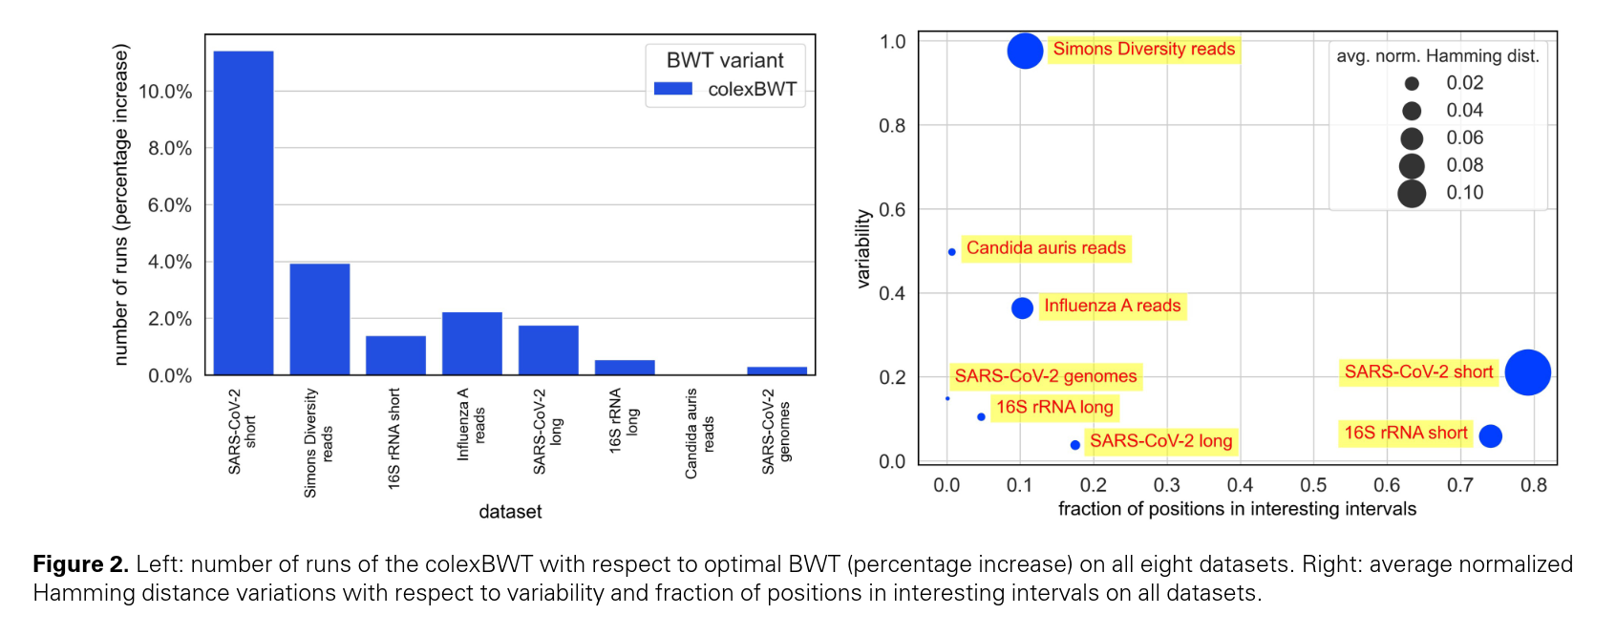
Results: colexBWT vs optBWT

Slide 8
Experiment on Neisseria gonorrhoeae batch nb 1
Specificities:
  4000 genomes
  1.1M sequences
  8.7G symbols
Tests (BWT on several configurations):
  Lexicographical order of genome
  Random order --
  Phylogenetic order --
  1 string
  1 genome = 1 string
  1 sequence = 1 string

Slide 9
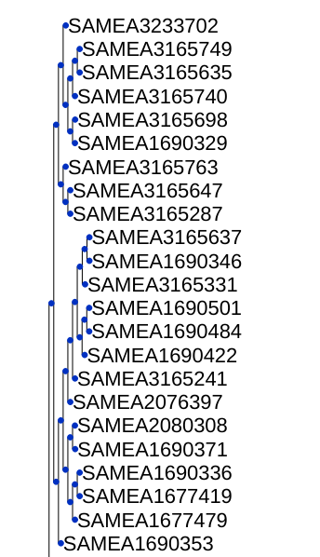
Phylogenetic order
I use ete3 then attotree in order to create and print the phylogenetic tree from the list of genome
Next, we can follow the order of the tree to obtain the phylogenetic classification.

Slide 10
Comparison of order
We sort the 4000 genomes, then we create one string and compute the BWT on this string.
Lexicographic:
64.32M runs
135.62 symbols/runs
Random:
64.77M runs
134.69 symbols/runs
Phylogenetic:
64.03M runs
136.15 symbols/runs
The order is not very important on the BWT results here.

Slide 11
Comparison of encoding
1 string:
1 test
64.32M runs
135.62 symbols/runs
1 genome = 1 string:
4000 tests
5.88G runs
1.48 symbols/runs
1 sequence = 1 string:
1.1M tests
5.99G runs
1.43 symbols/runs
Significant impact.
The single string is logically much more efficient than other methods.

Slide 12
Attotree performances
Method:
  attotree *.fa > tree.txt
  Empirically test command duration
    File number
    File size
    One or several batchs

Slide 13
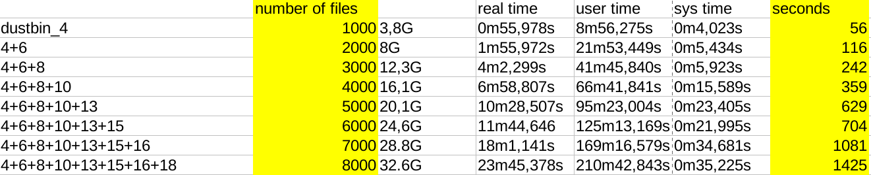
Attotree performance - Results
Main endpoint: number of files
On my computer:

Slide 14
Neisseria gonorrhoeae Streptococcus pneumoniae
Comparison between two datasets
  NG1 + NG2 (8k files)
  NG1 + SP1 (8k files)
Sort: random, lexicographic, phylogenetic

Slide 15
Method
1. Phylogenetic tree : attotree *.fa > tree.txt
2. Sorting genomes
3. Create ropebwt3 command
4. Make .fmr file
5. Analyse with ropebwt3 stat _.fmr

Slide 16
Results
NG1 + NG2:
Random
run length: 123.09
Lexicographic
run length: 124.02
Phylogenetic
run length: 124.56
NG1 + SP1:
Random
run length: 131.63
Lexicographic
run length:
Phylogenetic
run length: 133.63

Slide 17
dustbin
Comparison between 1k randomly selected genomes from all dustbin batches
Sort: random, lexicographic, phylogenetic
Objective: consider whether taking genomes from further away could have a positive impact on the use of phylogenetic order

Slide 18
Method
1. Selecting genomes from dustbin batches
2. Phylogenetic tree : attotree *.fa > tree.txt
3. Sorting genomes
4. Create ropebwt3 command
5. Make .fmr file
6. Analyse with ropebwt3 stat _.fmr

Slide 19
Results
Random
run length: 1.79
Lexicographic
run length: 1.79
Phylogenetic
run length: 1.79
Completely equivalent results.
Very low run length (dustbin so no organization)

Slide 20
10k genomes
Same experiment but increasing the number of genomes considered, using genouest
Using parallelization
Calculation of a histogram of run sizes

Slide 21
Next steps
Do the same thing by combining dustbin and NG, for example, to merge organization and non-organization.
If there are still no results, look at it from a theoretical perspective to determine on which set of genomes an improvement could be observed → construct a simulated example where it would work.

