Slide 1
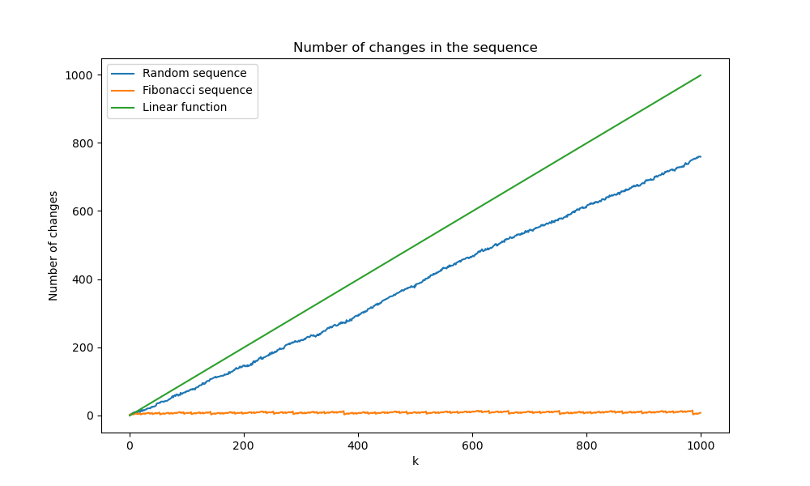
Week 1
- Setting up my computer (shortcuts, 661k)
- First use of ropeBWT3
- Start a small biblio

Slide 2
Week 2
- A survey of BWT variants for string collections, Z. Liptak, D. Cenzato, 2024
  Several methods: end-of-string-symbol(s) eBWT mdolBWT
- Experiments : BWT on list of becteria genes
  wolbachia_endosymbiont_of_drosophila_melanogaster
  exploration with ropeBWT3

Slide 3
ropeBWT3:
  build:
  -L (single string) -R (no reverse) -F (no forward)
  -b (.fmr) -d -(.fmd)
  get toto.fmr 2i: forward
  get toto.fmr 2i+1: reverse
Questions:
  impact of phylogenetic compression on BWT => only r parameter?
  How I compare? File? Folder? On the all collection? Thrice?

