Slide 1

Goodcabs
Optimizing Performance : Key Insights to Enhance Goodcabs Passenger Experience & Growth
Domain: Transportation & Mobility
Function: Operations
Presented by: Antara Ghosh

Slide 2
Company Overview:
Founded 2 years ago , operating across 10 Tier-II cities.
Empowers local drivers, helping them build sustainable livelihoods.
Focuses on passenger satisfaction and driver well-being, establishing itself as a trusted mobility partner.

Slide 3
AGENDA:
Project Objective
Data Overview
Ad-Hoc Business Requests
Dashboard Overview
Recommendations

Slide 4
Project Objective:
Goodcabs aims to evaluate its performance in tier-2 cities by analyzing key metrics—trip volume, passenger satisfaction, repeat passenger rate, trip distribution, and the balance between new and repeat passengers. Due to the analytics manager being occupied with another project, the task has been assigned to data analyst, who must generate these insights urgently for the Chief of Operations.

Slide 5
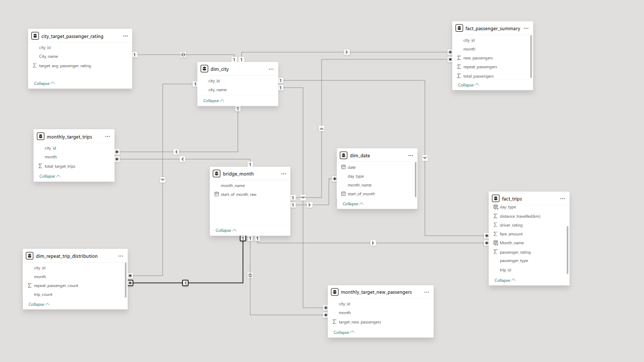
Data Overview:

Slide 6
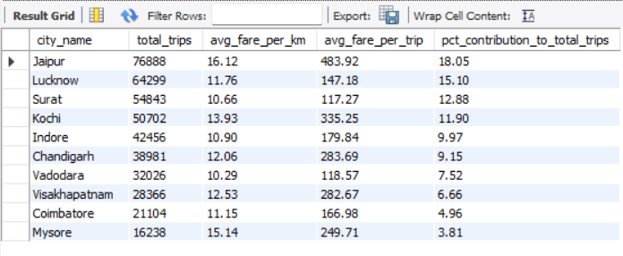
Ad-Hoc Business Requests:
Business Request - 1: City-Level Fare and Trip Summary Report
Generate a report that displays the total trips, average fare per km, average fare per trip, and the percentage contribution of each city’s trips to the overall trips.
Insights: Jaipur & Lucknow drive growth, while Kochi shows premium potential and Surat , Vadodara need revenue optimization.

Slide 7
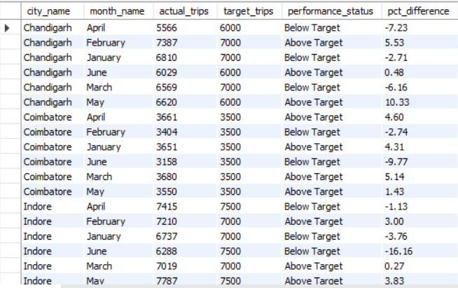
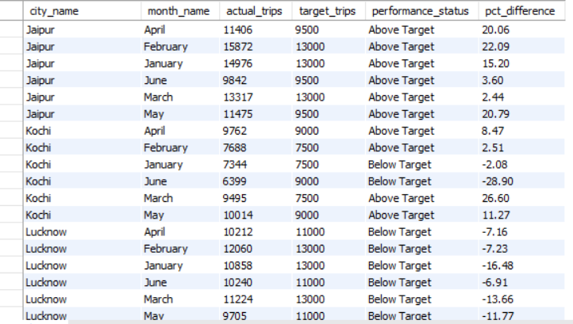
Ad-Hoc Business Requests:
Business Request - 2: Monthly City-Level Trips Target Performance Report
Generate a report that evaluates the target performance for trips at the monthly and city
level. For each city and month, compare the actual total trips with the target trips and categorize the performance as follows:
If actual trips are greater than target trips, mark it as "Above Target“.
If actual trips are less than or equal to target trips, mark it as "Below Target".
Additionally, calculate the % difference between actual and target trips to quantify the performance gap.

Slide 8
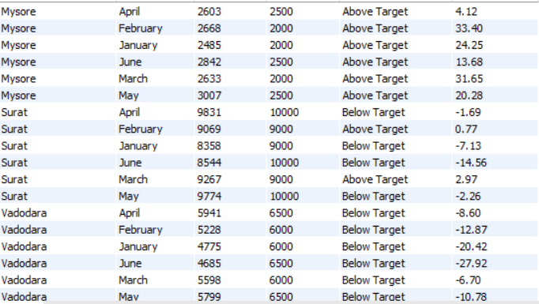
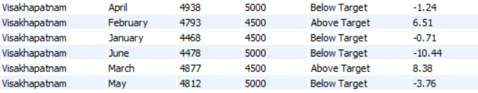
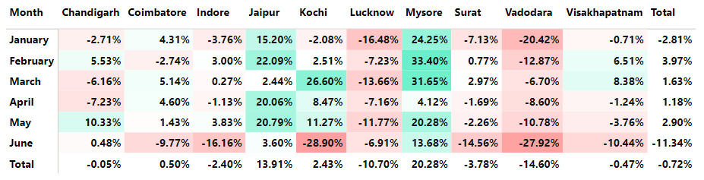
Insights: JJaipur recorded steady double-digit growth (~14% overall), with Mysore emerging as the fastest-growing city (+20%). In contrast, Lucknow (~-11%) and Vadodara (~-15%) experienced notable declines so it’s signaling the need for focused recovery initiatives.

Slide 9
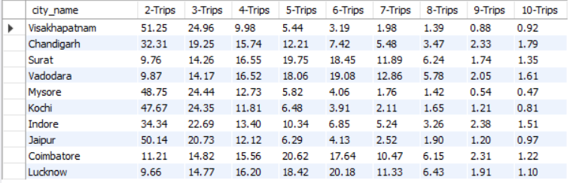
Ad-Hoc Business Requests:
Business Request - 3: City-Level Repeat Passenger Trip Frequency Report
Generate a report that shows the percentage distribution of repeat passengers by the number of trips they have taken in each city. Calculate the percentage of repeat passengers who took 2 trips, 3 trips, and so on, up to 10 trips.
Insights: Visakhapatnam & Jaipur lead in first-time trips while Surat ,Vadodara and Coimbatore show stronger repeat usage.

Slide 10
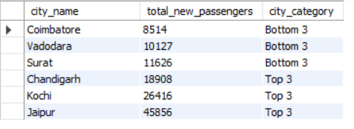
Ad-Hoc Business Requests:
Business Request - 4: Identify Cities with Highest and Lowest Total New Passengers
Generate a report that calculates the total new passengers for each city and ranks them based on this value. Identify the top 3 cities with the highest number of new passengers as well as the bottom 3 cities with the lowest number of new passengers, categorizing them as "Top 3" or "Bottom 3" accordingly.
Insights: Jaipur (45.8K), Kochi (26.4K), and Chandigarh (18.9K) together form the Top 3 cities, contributing the highest share of new passengers. In contrast, Coimbatore, Vadodara, and Surat collectively add only ~30K new passengers, highlighting a significant gap in onboarding performance.

Slide 11
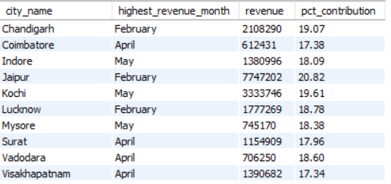
Ad-Hoc Business Requests:
Business Request - 5: Identify Month with Highest Revenue for Each City
Generate a report that identifies the month with the highest revenue for each city. For each city, display the month_name, the revenue amount for that month, and the percentage contribution of that month’s revenue to the city’s total revenue.
Insights: Jaipur (₹7.7M) and Kochi (₹3.3M) recorded the highest revenues in February and May respectively, while Chandigarh also delivered a strong performance with ₹2.1M in February.

Slide 12
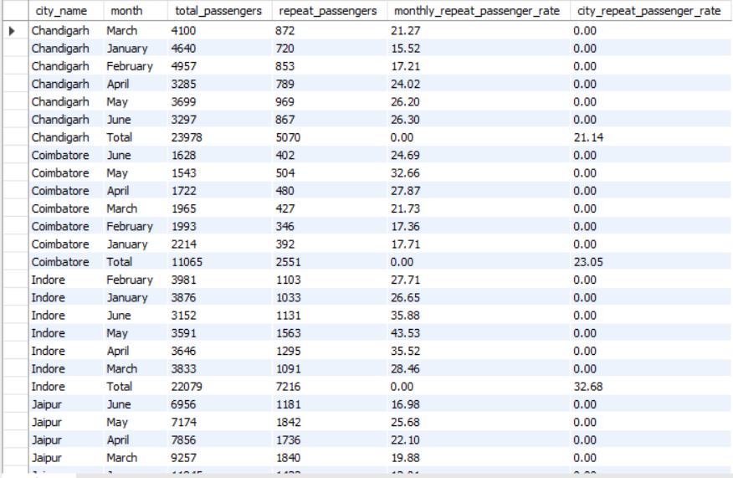
Ad-Hoc Business Requests:
Business Request - 6: Repeat Passenger Rate Analysis
Generate a report that calculates two metrics:
1. Monthly Repeat Passenger Rate: Calculate the repeat passenger rate for each city and month by comparing the number of repeat passengers to the total passengers.
2. City-wide Repeat Passenger Rate: Calculate the overall repeat passenger rate for each city, considering all passengers across months.

Slide 13
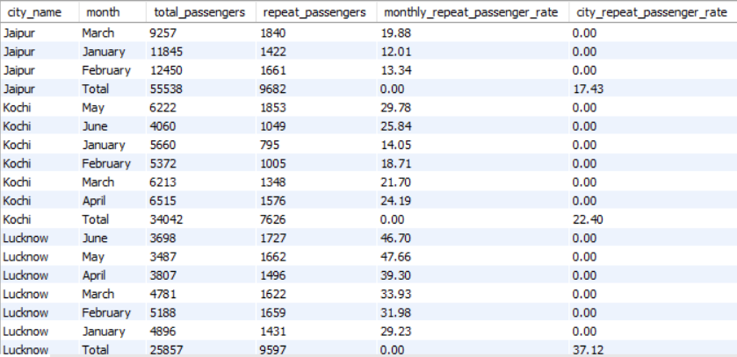
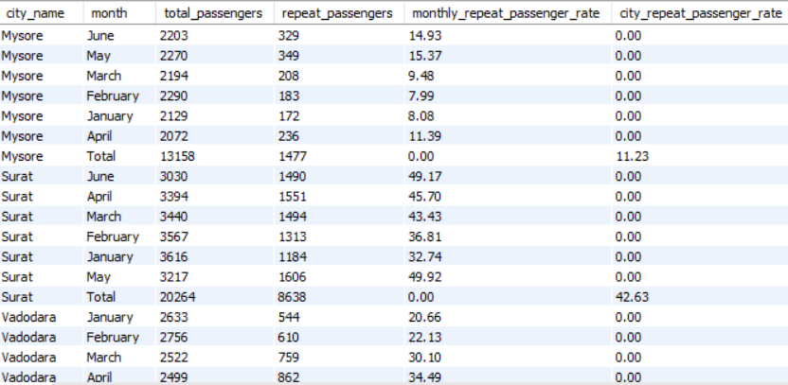
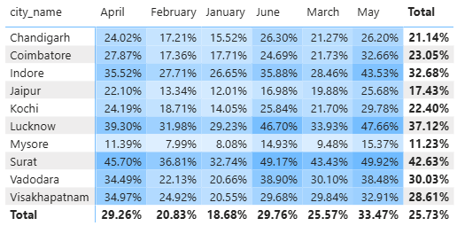
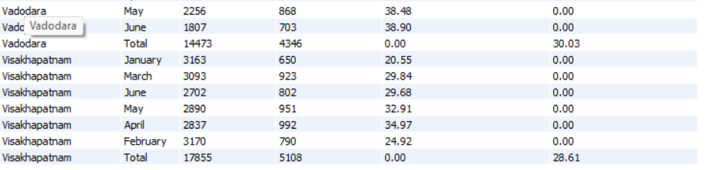
Insights: Surat (42.63%) Lucknow(37.12%) and Indore(32.68%) recorded the highest RPR also has a positive pattern in January , May and June respectively, while Mysore has the lowest with 11.23%.

Slide 14
Dashboard Overview:
I have divided the whole dashboard in four tabs – Trip_Summary : Highlights total trips, demand patterns across cities, weekdays vs weekends, and target achievement status.
Revenue Analysis :Shows total revenue, trip cost trends, and contribution by city, month, and weekday vs weekend.
Passenger Summary : Breaks down total passengers into new vs repeat, city-wise distribution, and passenger retention rates.
Target & Rating Analysis : Compares actual vs target performance for trips and passengers, along with driver and passenger ratings.

Slide 15
Recommendations:
Boost Repeat Passenger Rate
Launch loyalty programs and discounts for frequent riders to improve repeat passenger percentage (currently only ~26%).
Focus on Underperforming Cities Cities like Mysore, Coimbatore, and Surat show low passenger counts and ratings; run targeted campaigns to increase adoption.
Stabilize Monthly Performance
Revenue and trips show fluctuations across months; introduce city-wise demand forecasting and seasonal strategies to maintain consistency.
Balance Weekday vs Weekend Demand
Trips and revenue are higher on weekdays; explore weekend promotions to improve utilization.
Improve Passenger Experience
Average passenger rating is 7.85; invest in driver training and service quality to push it 8.5+.
Optimize Target Setting
Some cities consistently miss targets; use historical performance trends to set more achievable, data- driven goals.

Slide 16
Thank You

