Slide 1
Health Care Website
The Presentation Begins

Slide 2
Introduction of the Website
Full Stack Application: Healthcare Website.
In this Website anyone can see the home page.
Admin can sign in .
There is a Doctors page where everyone can see the doctor’s details.
There is also contact us and about us page for more details.
A Patient page is created where,
Admin can insert any patient details for check up.
Admin can update the inserted details of the patient.
Admin can delete any details of the patient.

Slide 3
Frontend Technologies
01
02
03
04
05
AngularJS
HTML
CSS
AngularJS is perfect for Single Page Applications (SPAs)..
Hypertext Markup Language
Cascading Style Sheets
Bootstrap
TypeScript
Open source front-end development framework for the creation of websites and web apps.
Extends JavaScript and improves the developer experience.

Slide 4



Backend Framework
Spring Boot
Hibernate
JDBC
Spring Boot helps developers create applications that just run.
Hibernate reduces lines of code by maintaining object-table mapping itself and returns result to application in form of Java objects.
Connect to a data source, like a database. Send queries and update statements to the database.

Slide 5

Language
For server-side
Programming
Language

Slide 6

Backend Framework
Structured Query Language

Slide 7
CRUD Operations
01
02
03
04
05
CREATE
READ
Create a Insert
Component to out new details.
Create a patient component to view the details what we already inserted.
UPDATE
DELETE
Create a update component to update any details what we already inserted.
Create a delete component to delete any data from the database.

Slide 8
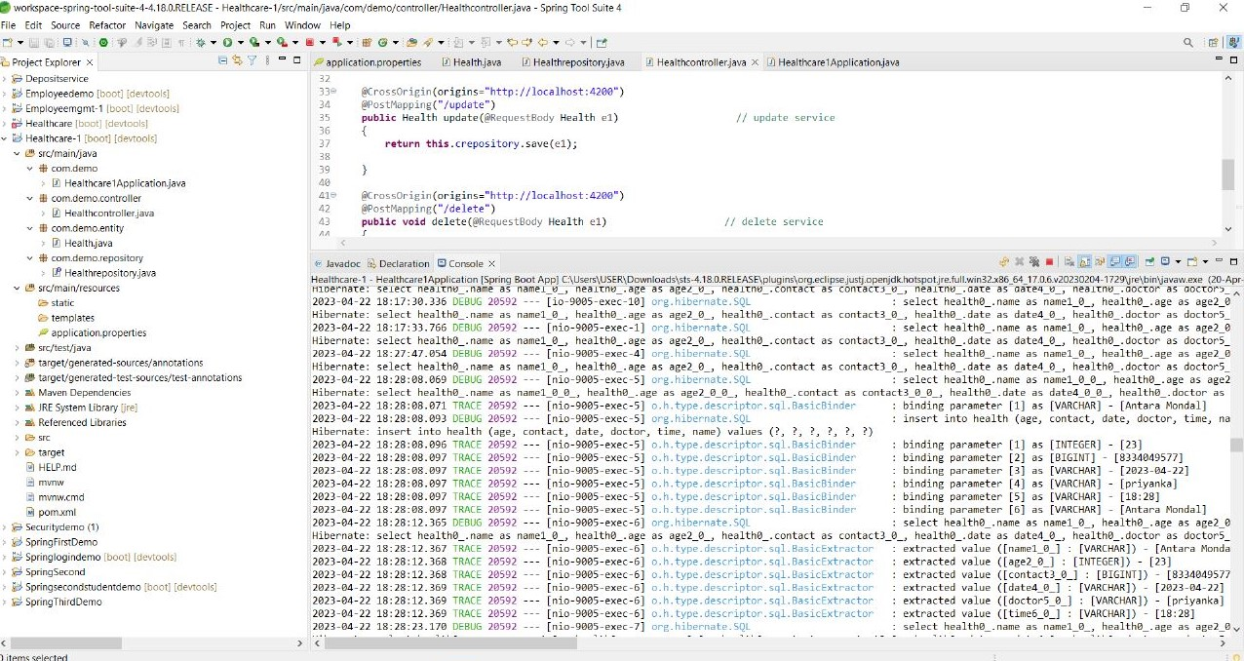
Spring Boot Application

Slide 9
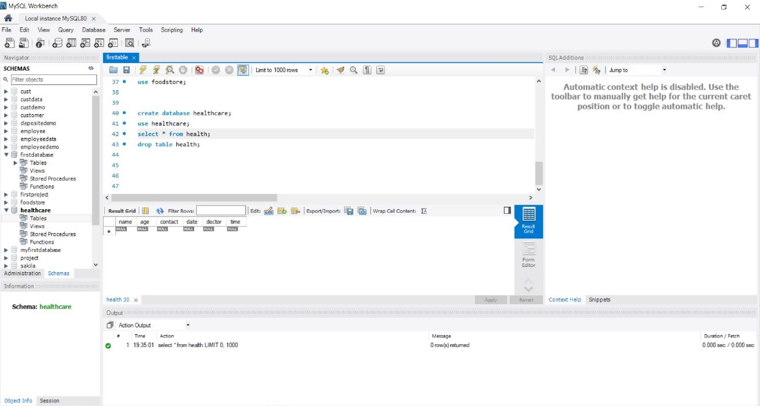
MySql Database

Slide 10
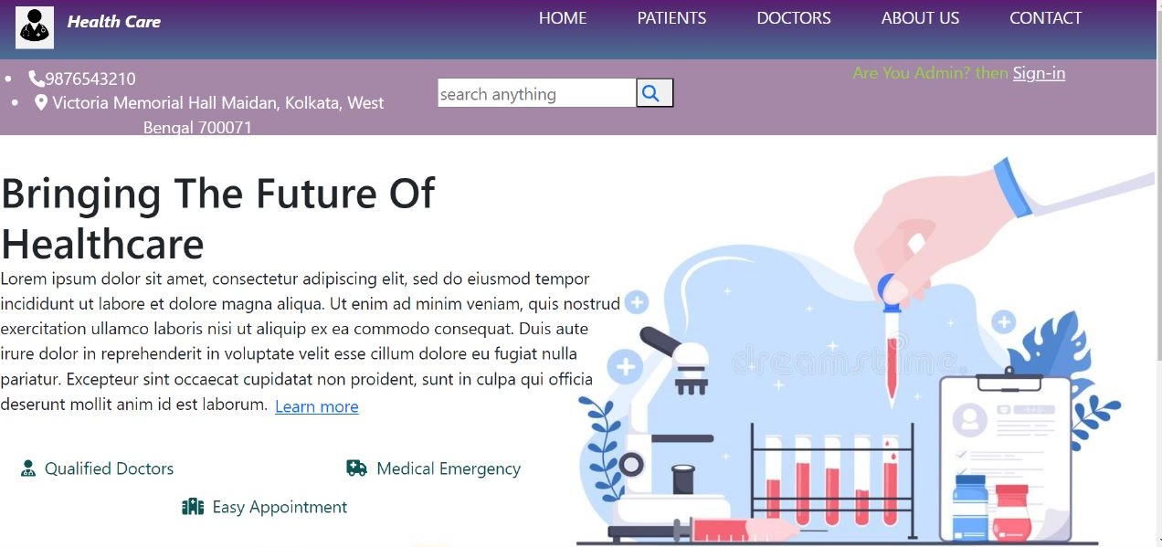
Home Page

Slide 11
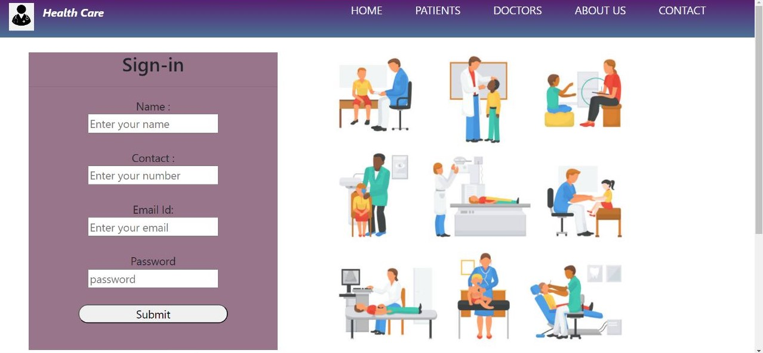
Sign-In Page

Slide 12
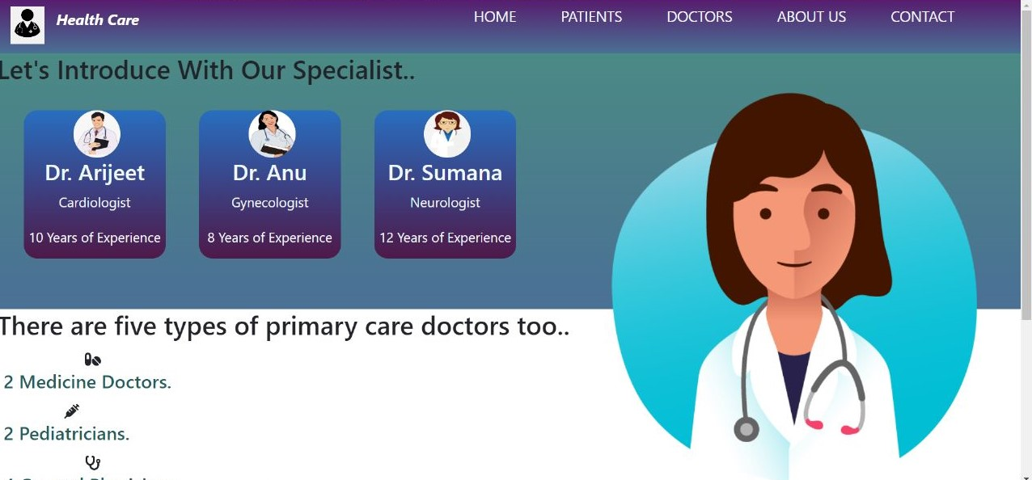
Doctors Page

Slide 13
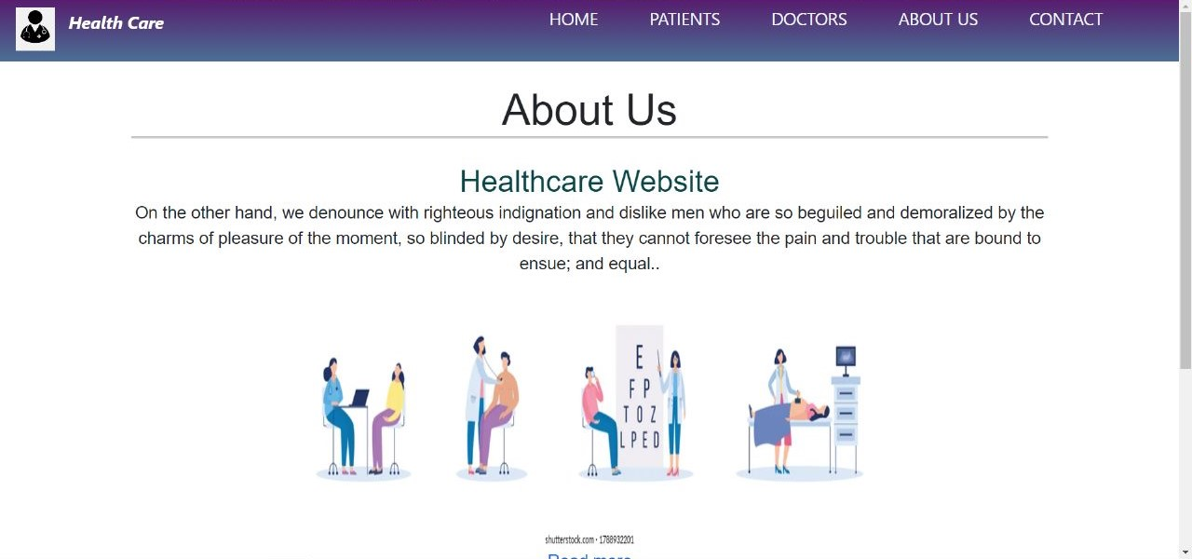
About Us Page

Slide 14
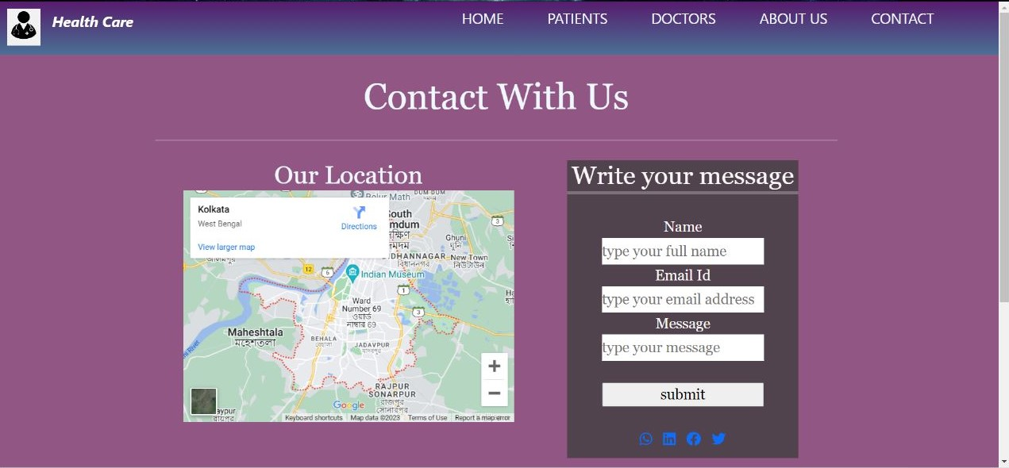
Contact Us Page

Slide 15
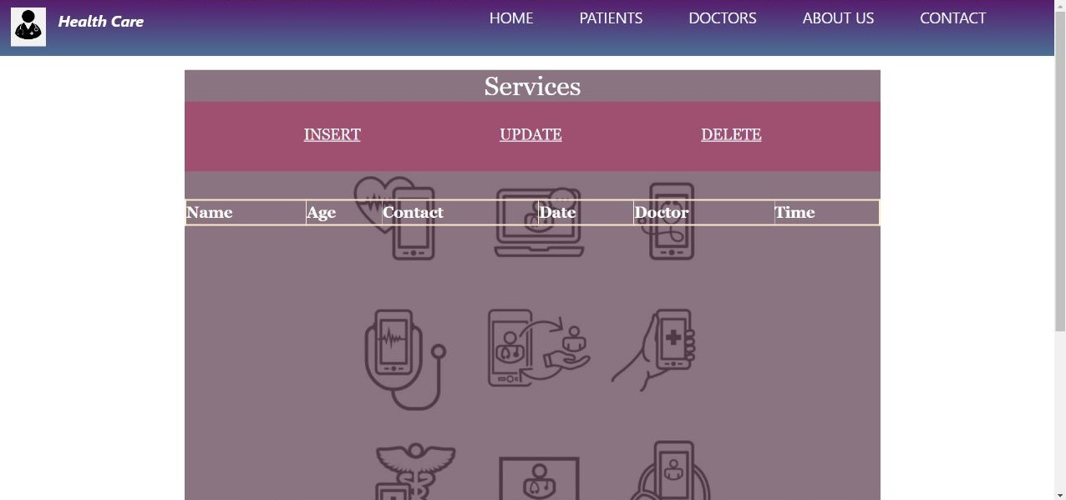
Patient Page

Slide 16
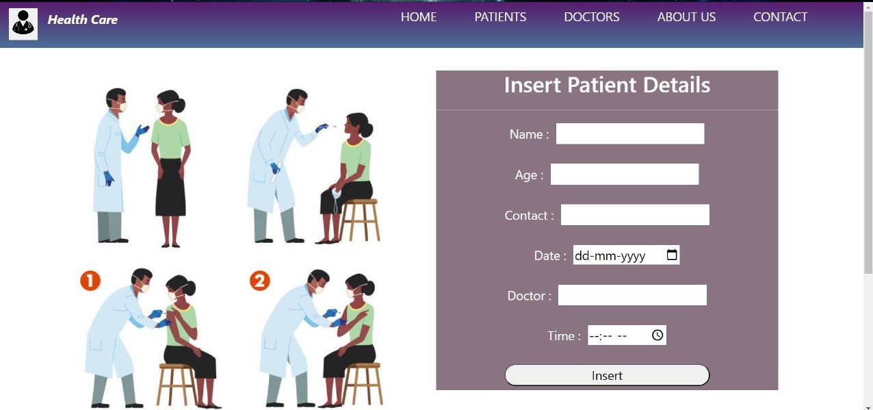
Insert Page

Slide 17
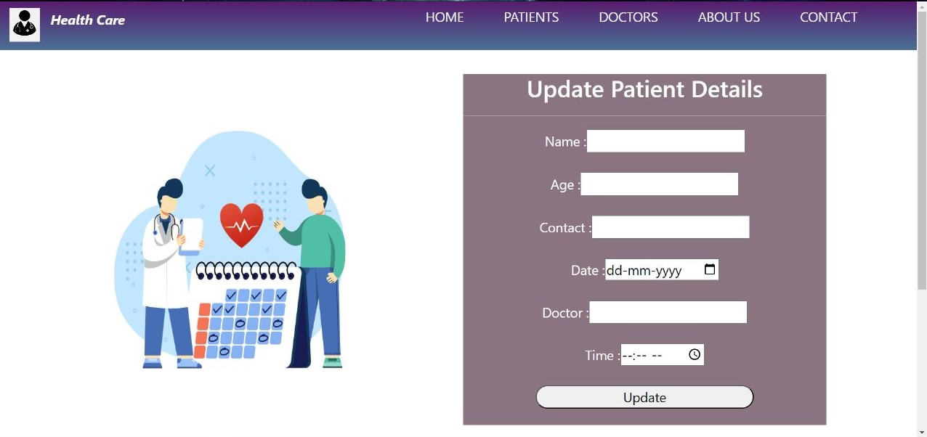
Update Page

Slide 18
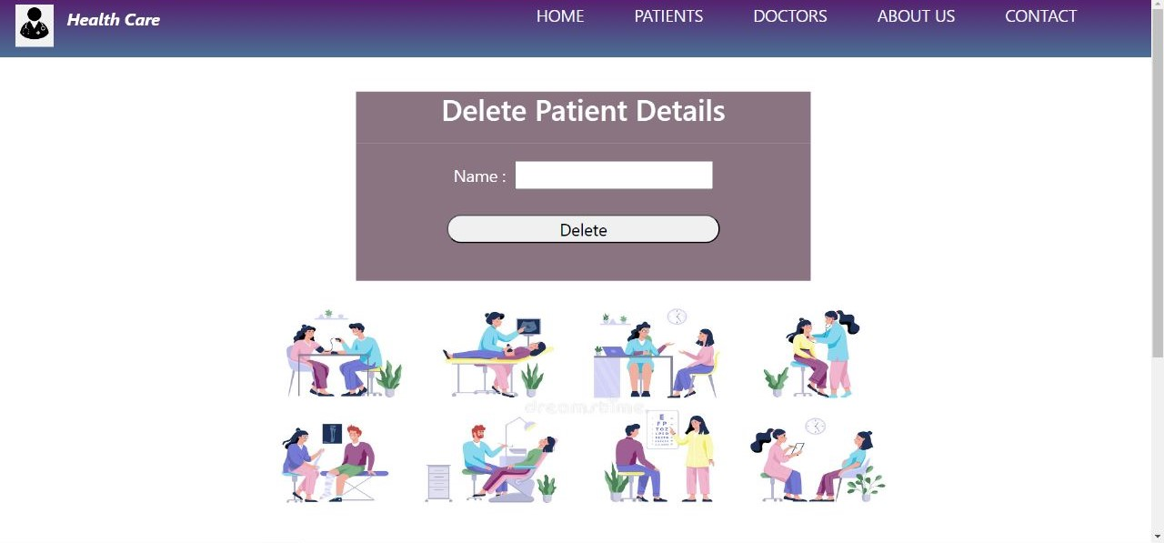
Delete Page

Slide 19
Future Of This Website
Future Improvement
We can create a proper list of the patient.
Everyone can view the doctors details
Everyone can contact with us via email, phone or write a message.
Validation
For the form the validation will create.
Design
Later add more services to do online consult with the doctors.

Slide 20

https://github.com/Antara7890?tab=repositories
Thank You

