Slide 1
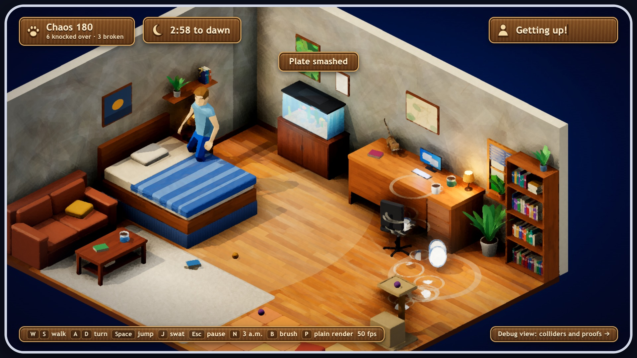
CS 549 · MID-CRIT · OCT 29, 2026
Last One Awake
It's 3 a.m. and you're the cat: wreck the apartment before dawn. But every crash is noise, and noise wakes the owner.
PHYSICS & DYNAMICS · RUSHI
Our own contact solver, props, the cat.
COLLISION DETECTION · DHARM
Grid broadphase, tunneling guard, rays.
NOISE & GAME LOOP · ANTARA
Impulses become noise; menu and HUD.
NPC AI · CHRISTINA
Wake stages, behaviour tree, sight.
Progress: a playable alpha, from the menu to caught or dawn · 254 automated tests
Three.js + cannon-es in the browser, no engine
Notes:
(Rushi, ~30 s) Last One Awake is a 3D stealth game in the browser. It's 3 a.m., you're the cat, and you wreck the apartment before dawn. Every object is a rigid body, every crash makes noise, and noise wakes the owner, who then hunts you.
We are four, and each of us presents our own part: I do physics and dynamics, Dharm collision detection, Antara noise and the game loop, and Christina the owner's AI. The alpha is playable from the menu to caught or dawn, with 254 automated tests.
We go deep on two challenges: contacts you can trust, at rest and at speed (me, then Dharm), and how the owner hears the physics (Antara, then Christina).

Slide 2
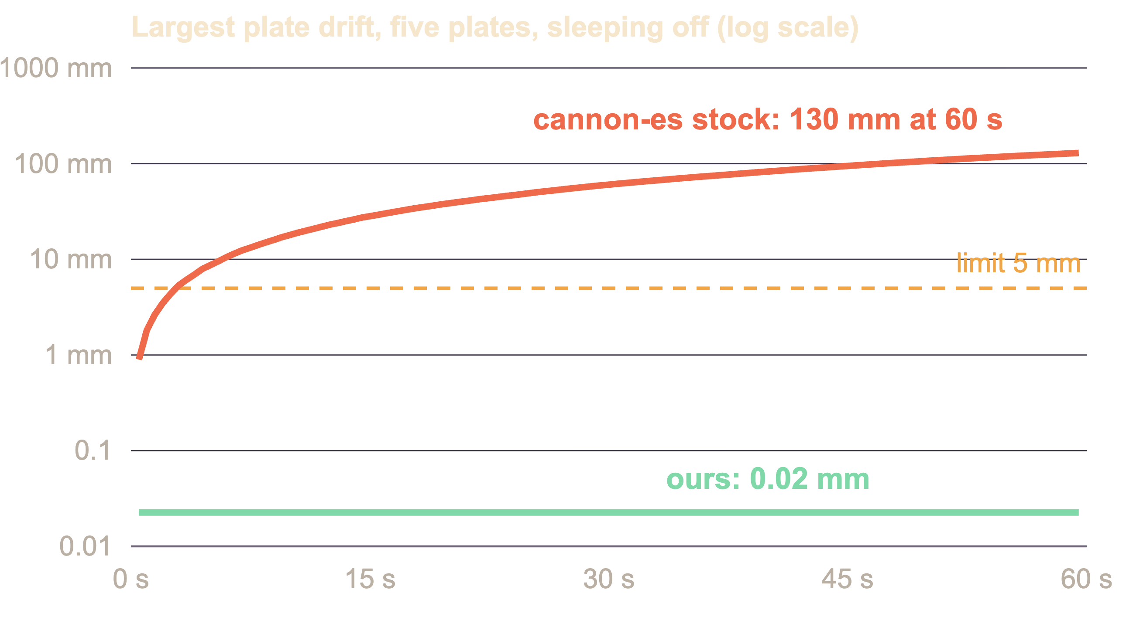
CHALLENGE 1 · CONTACTS AT REST · RUSHI PATEL
Five plates that stand still
The proof: five plates, sleeping off, 60 s. Pass: penetration under 2 mm, no plate drifts 5 mm.
Why it's hard: 12 contact points per plate pair, five layers each carrying the weight above, and no sleeping to hide jitter.
cannon-es as shipped: the stack walks 130 mm
Cold start. Each step solves from zero; 20 passes never reach the bottom of a tall stack.
Flicker. Resting contacts come and go between steps.
Friction 120× too strong. Its force cap μ·m·g is applied to a per-step impulse, so μ does nothing.
Our solve step, about 320 lines
Warm start: each contact begins from last step's impulse.
Coulomb bound: friction ≤ μ × this step's normal impulse.
Contact reduction: the six outermost points per pair.
Soft contacts for light props, spawned 10 µm compressed.
 | cannon-es stock | Ours
Plate drift, 60 s | 130 mm | 0.02 mm
Box slide vs. v²/2μg | stops in 3 mm, any μ | within 2%
Plates that hold 60 s | fails at 5 | 13
Cost, 60 awake bodies | 3.6 ms/step | 3.6 ms/step
Trade-offs: soft contacts sink tens of µm (invisible) · 14 plates still walk off · a cat landing a full jump dips 1.6 cm for one frame
Notes:
(Rushi, ~70 s) My part is the physics. Every prop is a rigid body, and the test we committed to was five plates stacked with sleeping off for 60 seconds: under 2 mm of penetration and under 5 mm of drift.
Thin cylinders are the hardest case for an iterative solver: 12 contact points per pair, five layers, each carrying the weight above. cannon-es as shipped failed badly: the stack walks 130 mm in a minute, the red line. I traced three causes. Every step solves from zero, so 20 passes never carry the support to the bottom of a tall stack. Resting contact points flicker in and out. And its friction cap is a force applied to a per-step impulse, so at 120 Hz friction is 120 times too strong and mu does nothing.
So I replaced just the solve step, about 320 lines: warm starting from last step's impulse, a true Coulomb bound, the six outermost contact points per pair kept the same from step to step, and soft contacts for light props. Result: 0.02 mm of drift, the green line. Friction lands within 2% of v squared over 2 mu g, 13 plates hold for the full minute, and the cost is unchanged at 3.6 ms per step.
Trade-offs: soft contacts sink tens of microns, 14 plates still walk off, and a cat landing a full jump dips 1.6 cm for one frame. Dharm takes the other end: contacts at speed.

Slide 3
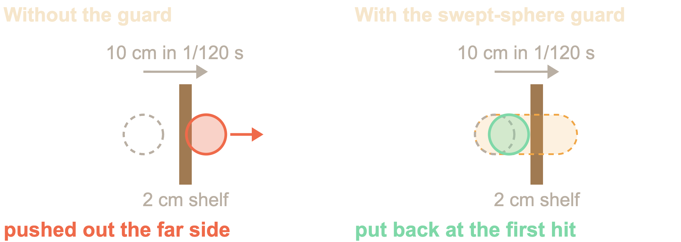
CHALLENGE 1 · CONTACTS AT SPEED · DHARM PATEL
Fast swats that don't tunnel
Why it's hard: at 120 Hz a 12 m/s swat moves a mug 10 cm per substep, five times our 2 cm shelf. Discrete collision only sees where it ends up, past the middle, so it is pushed out the far side.
Continuous collision for all 400 props costs too much, and clamping eagerly makes resting stacks jitter.
Our approach: a swept-sphere guard
After each substep, any body that moved more than 1 cm (about 1.2 m/s) is swept as a sphere from its old centre to its new one, against the static boxes.
On a real crossing it goes back to the first hit, 2 mm short, and loses its speed into the surface; the narrowphase then resolves it from the right side.
It clamps only when discrete collision would fail, so sliding props and resting stacks are left alone.
Candidates come from our uniform-grid broadphase (0.5 m cells); its ray queries are what the owner sees with.
100 swats at 12 m/s | Guard off | Guard on
Through the 2 cm shelf | 22 | 0
First fails at | 12 m/s | over 100 m/s
Clamps on a resting stack, 60 s | – | 0
400 bodies, Chrome | Naive | Our grid
Pairs to the narrowphase | 1,454 | 270
Step, props moving | 8.0 ms | 6.2 ms
Step, settled | 3.5 ms | 2.5 ms
Trade-offs: only static geometry is guarded, so two fast props can still pass through each other.
Notes:
(Dharm, ~65 s) My part is the collision layer. Rushi's plates are contacts at rest; the other end is contacts at speed.
At 120 hertz, a mug swatted at 12 metres per second moves 10 centimetres per substep, five times the thickness of our 2 cm shelf. Discrete collision only looks at where the mug ends up. It lands past the middle of the shelf, so the solver pushes it out the far side: the left picture.
Continuous collision for every body would cost too much at 400 props, and clamping eagerly would make resting stacks jitter. So after every substep, each body that moved more than a centimetre is swept as a sphere from its old centre to its new one, against the static boxes. If it would really have crossed, it goes back to the first hit, 2 mm short, and loses its speed into the surface; next substep the narrowphase resolves the contact from the right side. It clamps only when discrete collision would actually fail, so sliding props and resting stacks are untouched.
Results, with the game's real swat: 22 of 100 swats pass through without the guard and none with it, the first failure moves from 12 metres per second to over 100, and on the resting stack it clamps zero times. The grid broadphase hands the narrowphase 270 pairs instead of 1,454 at 400 bodies, 6.2 instead of 8 ms a step, and its ray queries are what the owner sees with.
Trade-off: only static geometry is guarded, so two fast props can still pass through each other. Antara now shows how all these contacts become noise.

Slide 4
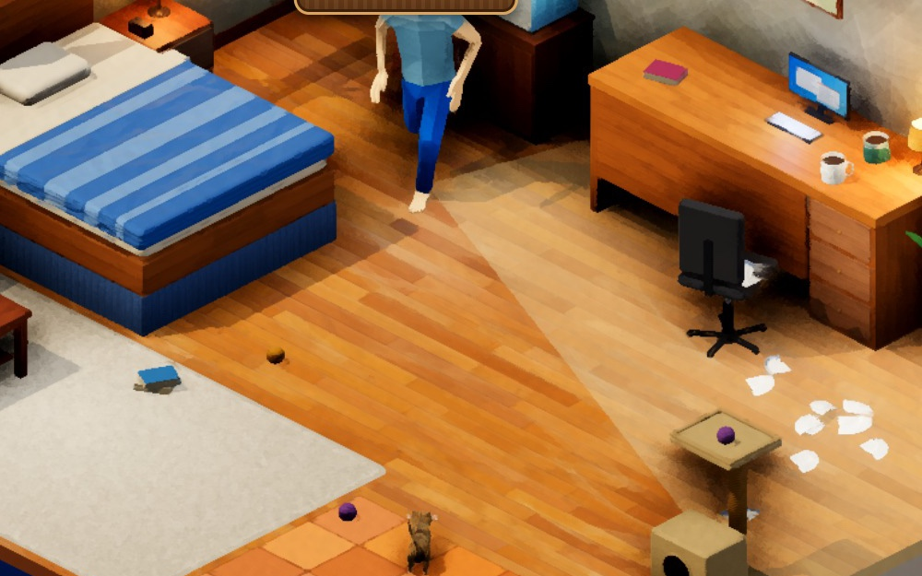
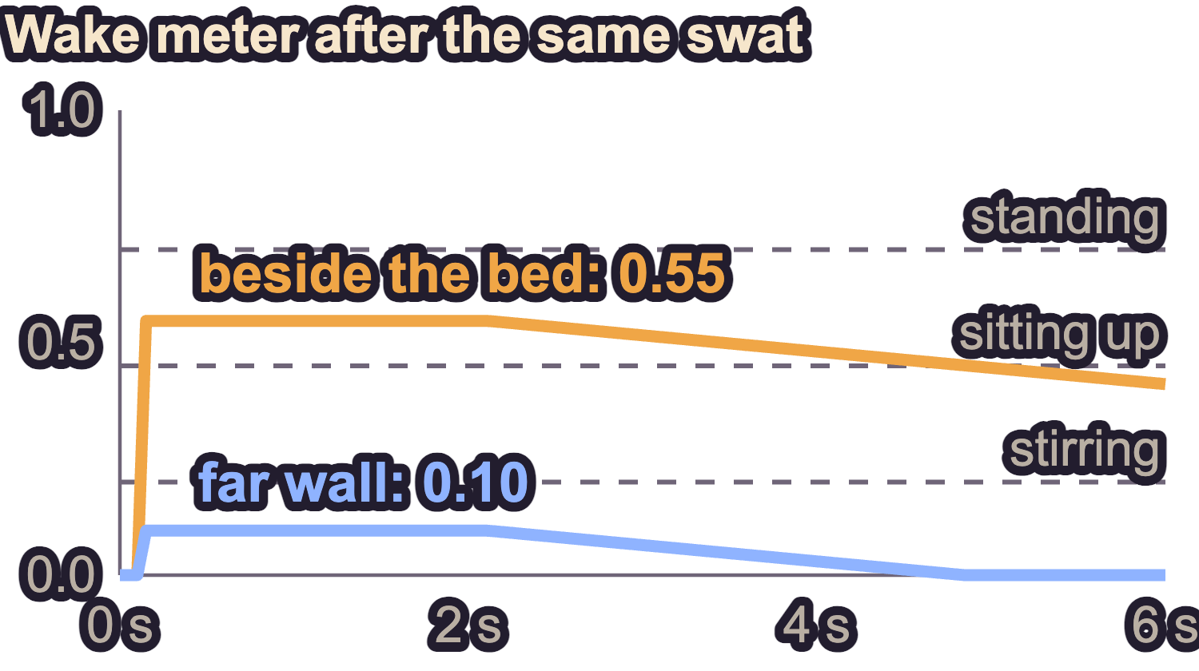
CHALLENGE 2 · NOISE → NPC AI · ANTARA THAPLIYAL & CHRISTINA ROSS
The owner hears the physics
Why it's hard: raw impulses are noise (every resting contact pushes every step, one crash is dozens of contacts), loudness has to be fair and testable, and hiding has to come from geometry, not a flag.
NOISE → WAKE METER · ANTARA
OWNER AI · CHRISTINA
New contacts
per body pair
Loudness
log of impulse
Falloff
to his head
Wake meter
drains slowly
Asleep
below 0.2
Stirring
≥ 0.2
Sitting up
≥ 0.45
Standing
≥ 0.7
Awake
≥ 0.85
loudness = material pair × ln(1 + J / 0.3 N·s) × distance falloff
Behaviour tree
Sitting up + noise → investigate
Standing + loud → search
Otherwise → check hiding spots
Quiet again → back to bed
In the game he walks A* paths between 12 waypoints and sees with a view cone confirmed by line-of-sight rays: the bed skirt hides you, the desk doesn't.
Limits: stages don't step back down yet as he calms (the game works around it) · under the bed is always safe.
Coupling proof passes: the same swat sits him up beside the bed (0.55) and leaves him asleep from the far wall (0.10).
Notes:
(Antara, ~40 s) My workstream is the game loop, the HUD and noise. The owner can't simply listen to the solver: every resting contact pushes on every step, and one crash is dozens of contact points. So after each solve we keep only new contacts and sum the impulse per pair of bodies.
Loudness is the material pair's loudness times the log of that impulse, the model from my MVP: ceramic rings, paper thuds, and the cat's paws are padded. It falls off with distance to his head and fills a wake meter that drains slowly after two seconds of quiet. The coupling proof passes: the same swat, a mug into a wall, sits him up from beside the bed at 0.55 and leaves him asleep from the far wall at 0.10. Christina?
(Christina, ~50 s) My part is the owner's AI. The wake meter drives my state machine through five stages: asleep, stirring at 0.2, sitting up at 0.45, standing at 0.7 and awake at 0.85, so he wakes gradually instead of flipping on.
A behaviour tree picks his action: stirring or sitting up with a noise, he investigates; standing with a loud noise, he searches; otherwise he checks the hiding spots; and once it is quiet he goes back to bed.
In the game he walks A* paths between 12 waypoints and sees with a view cone confirmed by Dharm's line-of-sight rays, so under the bed the skirt hides you, but under the desk he kneels and sees you. Limits: the stages don't step back down yet as he calms, which the game works around, and under the bed is always safe for now. Thank you.

