Slide 1
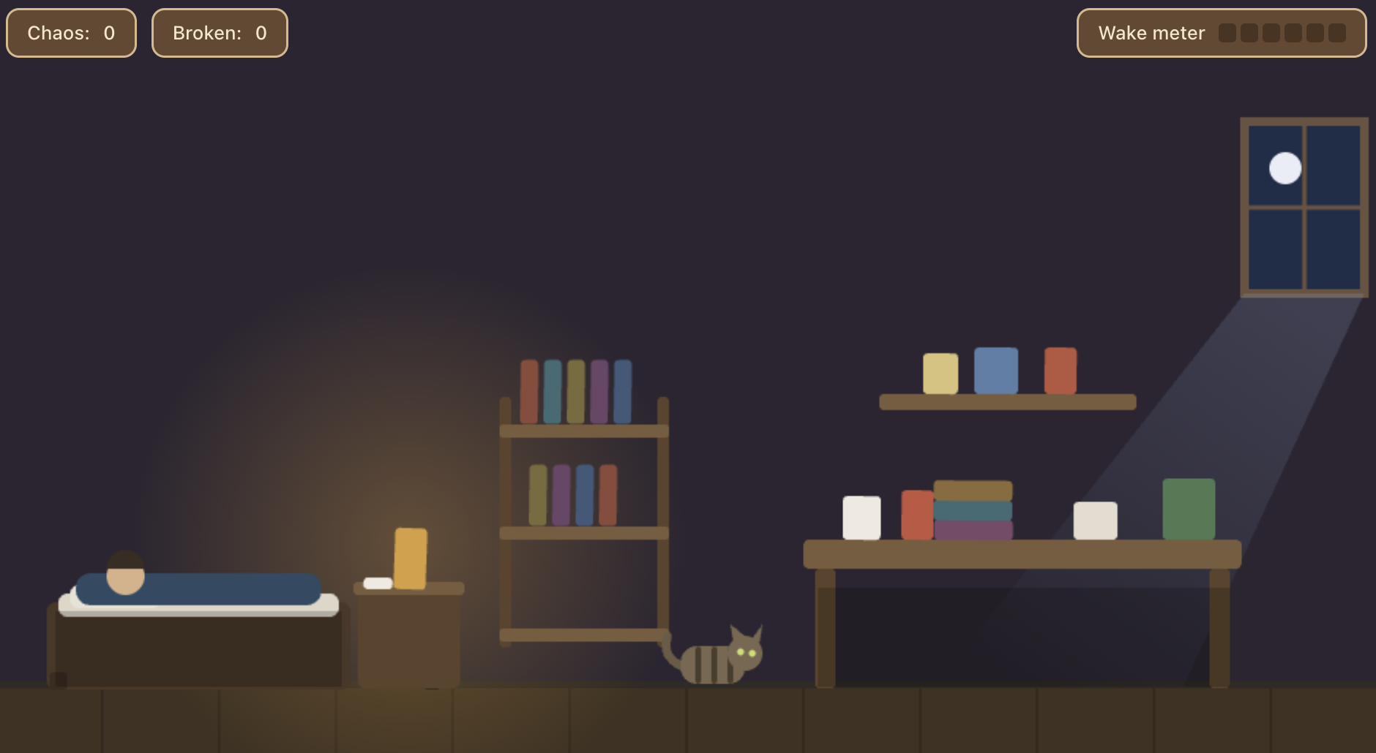

Last One Awake
A 3D isometric stealth game. It's 3 a.m. You're the cat. Wreck the apartment before the owner wakes up.
Rushi Patel · Dharm Patel · Antara Thapliyal · Christina Ross
CS 549 · Project briefing · Sept 24, 2026
Notes:
One line: it's 3 a.m., you are the cat, and your goal is to wreck the apartment before the owner wakes up and catches you. Every object is a physics body, every crash makes noise, noise fills a wake meter, and once the owner is up he hunts you. Nothing about the destruction is scripted.

Slide 2





The loop
Swat
Crash
Noise
Wake meter
Owner hunts
player input
rigid-body physics
from contact impulse
attenuated by distance
behavior tree
The physics solver's contact impulses are the input to the AI's perception. The two systems share one data path.
Notes:
Walk the loop left to right. The thing to stress: the impulse magnitude from the collision solver is literally the number that becomes loudness. Bigger crash, louder noise, faster wake. That coupling is the point of the project.

Slide 3
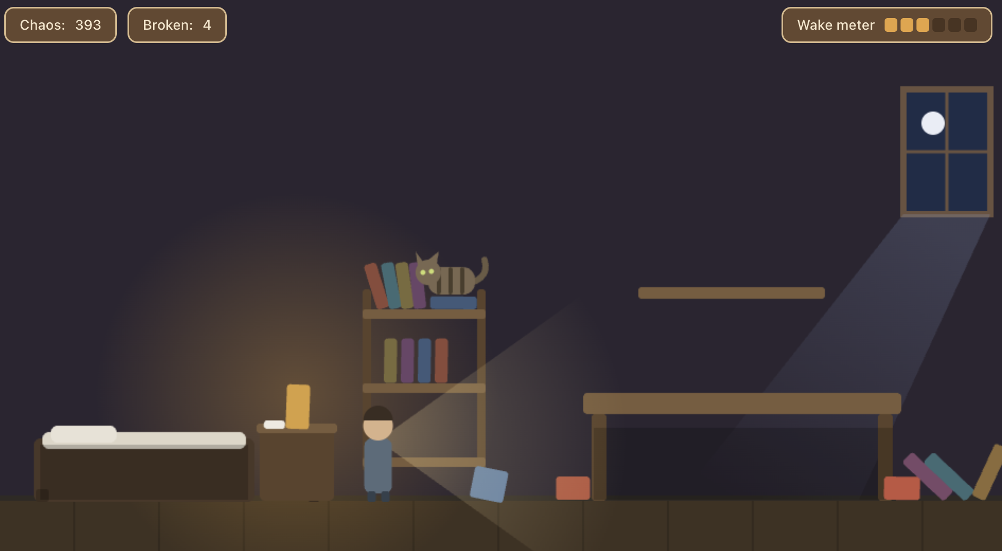

Live demo: the 2D plan
lastoneawake.netlify.app
What to watch for
A mug teeters on the desk edge, then tips on its own
Pulling one book brings the stack down differently each run
The wake meter climbs; the owner stirs, sits up, stands
2D mockup (Matter.js) made only to communicate the idea. The game we are building is 3D (next slide).
Hide under the desk to break his line of sight
Notes:
Say it up front: this 2D mockup only communicates our idea; it is not a build of the game. Switch to the browser and do four things: nudge a mug to the edge and let it teeter, pull a book from a stack, let the wake meter climb until he sits up, then hide under the desk. Narrate the pillar each time: the teeter is angular momentum, the collapse is emergent contacts, the meter is impulse-derived noise, the escape is a raycast hitting the desk. Then: the same loop moves into 3D, which is where the hard problems live.

Slide 4
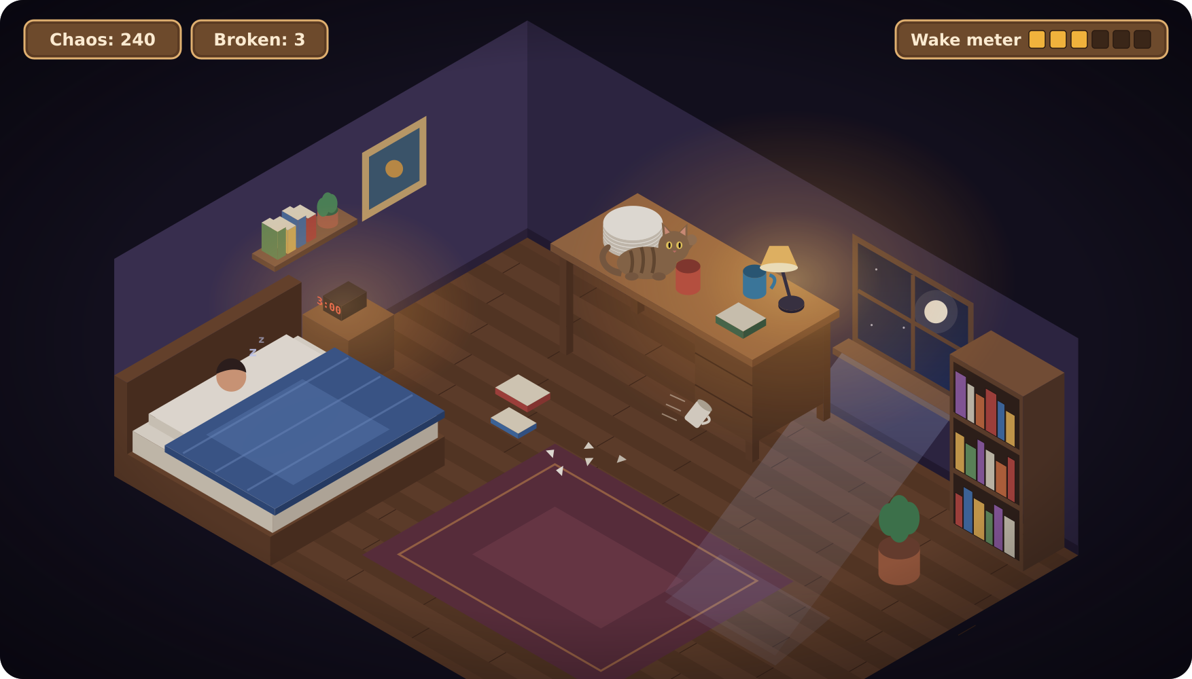


The goal: a 3D isometric room
Same loop and pillars, built in Three.js + cannon-es
What changes in 3D
Fixed isometric camera over a cut-away room
Detailed 3D props rendered over simple colliders we author
Night lighting: warm desk lamp + cool moonlight, baked in Blender
Concept art of our target: the room at 3 a.m., owner asleep, cat on the desk, one mug already falling.
An outline keeps the cat visible when it hides under furniture
Notes:
This is where we are going: a 3D isometric room. The image is concept art of our own scene: 3 a.m., the owner asleep, the cat on the desk next to the plate stack, and a mug already on its way to the floor. Notice it is the same room as our vertical slice. Four things change in 3D. A fixed isometric camera looks into a cut-away room. Props are detailed 3D models, but each one sits on a simple collider we author, so the look and the physics stay separate. Lighting is one warm desk lamp and cool moonlight, baked in Blender for the static room, with real-time light only for moving objects. And because the camera is fixed, we draw an outline so the player can still see the cat when it hides under the bed.

Slide 5


Three pillars
Physics & Dynamics
Collision Detection
NPC AI / Behavior Trees
Every object is a 3D rigid body: mass, friction, restitution, angular momentum. Stacking, resting contacts, teetering before a tip. Impulses feed the noise model.
Our 3D spatial-grid broad phase, a tunneling guard for fast swatted objects, and ray-vs-box queries for line of sight and ledge checks. Narrow phase comes from cannon-es.
Asleep: a wake-state machine fed by noise. Awake: a behavior tree that investigates the last noise, searches, checks hiding spots, and returns to bed. Sight is a 3D vision cone with raycasts.
Notes:
One sentence each. Physics is what makes the chaos emergent. Collision detection is its own system because there are dozens of active bodies and thin geometry. The AI only knows what it can perceive: noise and line of sight, not global state.

Slide 6
Framework and stack
Three.js (WebGL) · JavaScript · cannon-es physics · Vite · Netlify · Blender for assets
The library does
We write
Numerical integration of motion
Impulse-based contact resolution
Resting contacts and sleeping bodies
Convex shape narrow phase
3D model loading and clip playback (Three.js)
Uniform spatial-grid broad phase (plugged into cannon-es)
Ray-vs-box queries for vision cone and ledge checks
Tunneling guard: substepping + swept-sphere
Noise model: impulse → loudness → attenuation → wake meter
Wake-state machine and behavior tree
3D scene: isometric camera, baked night lighting, cat controller, HUD
Notes:
Three.js renders, cannon-es integrates motion and resolves contacts, Blender is for assets and baked lighting. What we implement is the collision layer around the solver, the coupling into the AI, and the AI itself. If asked why not Rapier: Rapier ships continuous collision detection, which would remove the tunneling problem, and collision is one of our pillars, so we want that work to be ours. If asked why not Godot or Unity: an engine would do the collision layer for us, and staying in the browser means anyone can play from a link. cannon-es lets you replace its broad phase with your own class, so that is real code, not configuration.

Slide 7




The hard problems
Where coding agents alone will not get us there
Stacking stability
Tunneling
Thin 3D plates jitter or explode at rest. Our tunneling guard injects contacts that make it worse, so the two fixes fight. Solved by measurement.
A mug swatted at 12 m/s passing through a 2 cm shelf. Substeps + a swept test, gated by speed, traded against frame rate.
A noise curve that feels fair
An owner that reads as smart
Impulse to loudness is easy to code, hard to tune so a mug and a plant feel right and the wake meter feels tense, not random.
A behavior tree is trivial. One that searches believably and still gives the cat a fair chance takes playtesting.
Notes:
These are the four things we expect to spend real time on. The first two are the 3D slice, and they pull against each other: clamping a fast object outside the solver injects contacts the solver did not generate, which is a known way to make a resting stack jitter. So the swept test only runs above a speed threshold. No agent can tell us the right thresholds; we find them by measuring. Our mid-term proof is a 3D slice of one desk and the bed, measured on a debug overlay: five plates at rest for 60 seconds with under 2 mm penetration, 100 swats at 12 m/s with zero pass-throughs, and the same swat waking him from beside the bed but not from the far wall, all at 60 FPS. If plates will not settle by the mid-term, we fall back to books. The last two are tuning problems that need a human at the keyboard.

Slide 8
The 3D plan: our vertical slice
Narrow on purpose: the physics-to-AI path working cleanly in 3D
In the 3D slice
How we prove it by mid-term
One desk against a wall, and the bed with the sleeping owner
A stack of five plates, two mugs and a book
The cat walks, jumps onto the desk and swats
Every impact makes noise and fills the wake meter
The owner stirs, sits up and stands
Stacking: five plates at rest for 60 s, under 2 mm penetration and 5 mm drift
Tunneling: 100 swats at 12 m/s into a 2 cm shelf, zero pass-throughs
Coupling: a swat by the bed wakes him; from the far wall it does not
All at 60 FPS, read off our debug overlay
After the mid-term: search AI, hiding, full room, polish
Notes:
Close with the plan. The next thing we build is a deliberately narrow 3D slice: one desk, the bed, the cat, and the physics-to-AI path working end to end. Every test on the right is a number read off our debug overlay, so the mid-term demo proves the hard parts with measurements, not screenshots. The coupling test is the one that proves our core idea: the same swat must wake him from beside the bed but not from the far wall. Everything else waits until the slice is solid.

