Slide 1
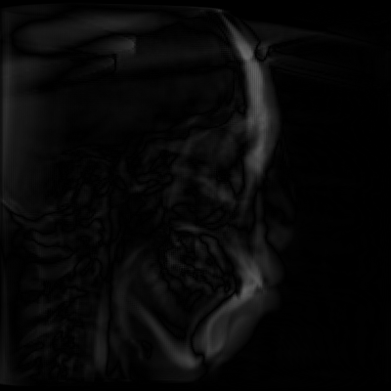
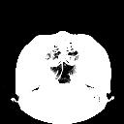
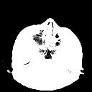
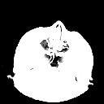

Temporal Consistent 2D-3D Registration 刘浚哲 1500011370
Problem statement:
1.Image Registration: transforming different sets of data into one coordinate system.
2. Gauss-Newton method to solve the optimization problem.
Numerical solution:
Image distance: l2 & l1 norm, compute difference matrix.
Proved the derivatives of the
Loss function using chain rule.
Use Gauss-Newton method
To solve the target function.
Compute the loss Er.
ACB slices generated by a1 &
a2:
Algorithm:
PCA: extract principal component
Gauss-Newton method: Using Jacobian matrix in the iteration:
Conclusion:
Completed Image Registration using Gauss-Newton method, master some techniques handling image processing and numerical skills such as cubic spline interpolation.

