Slide 1
iTCP
Submitted by:
Antariksh 1ms15cs022
Ashutosh 1ms15cs029
Ankush 1ms15cs020
Darshil 1ms15cs038

Slide 2
What is WMN ?

Slide 3
WMNs or wireless mesh networks are a series of connected nodes over a network.
The nodes are essentially network users who forward data to the next node.
The whole networking structure is decentralized and a single node can pass data as far as it’s next neighboring nodes.
The places where WMNs relied upon are:
Wireless city wide connections
Wireless emergency response
Community networks
Urban sensornet

Slide 4
What is TCP ?

Slide 5
TCP is one of the main protocol of internet protocol suite.
It provides reliable, ordered, and error checked delivery of a stream of octets between applications running on hosts communicating by an IP network.
TCP provides the main basis of the reliable data transfer.
Congestion control of TCP .
Internet applications using TCP are:
World wide web
Email
Remote administration.
File transfer

Slide 6
Why the need of a better version of TCP ?

Slide 7
Problems in Conventional WMNs
Wireless network.
Multi hop communication.
Lossy medium
Non-deterministic medium.
Absence of base stations.
Similar Traffic patterns in neighboring nodes.{due to peer to peer random data flow from source to destination nodes and absence of gateway.}
Hidden Station problem.
Propagation loss.
Absorption loss.
Multipath Effect.
Data transmission occurs over higher bandwidth ratio which causes more congestion.

Slide 8
What is Congestion?

Slide 9
Unconditional Queuing of data in network nodes is known as congestion.
The phenomenon of overcoming this hardship is called congestion control.{by reducing the rate of packets}
Congestion control should not be confused with flow control , as in flow control {prevent the senders from overwhelming the receiver}we dictate over the data flow at the destination end.
The original congestion control techniques was designed for wired networks
TCP detects congestion when it fails to receive an ACK for a packet within estimated time.

Slide 10
Specific Problems solved by iTCP
Improvement of the total throughput of the network.
Decrease in average energy consumption of the transmitted data bit.

Slide 11
Approach for the designing of the iTCP
The congestion window size is the main factor around which the whole idea of iTCP revolves.
iTCP is implemented with the help of intelligent neural networks.
It has to be considered that the original structure of TCP should not be compromised while designing iTCP.
Reinforced learning is implemented in iTCP.
RTT is not considered while designing the iTCP because as in wireless transmission there need not be a large RTT to mean a congestion, as it may also mean data loss.

Slide 12
The attributes considered for reinforced learning in iTCP are:
No of duplicate ACKs
No of consecutive timeouts
Current congestion window size.

Slide 13
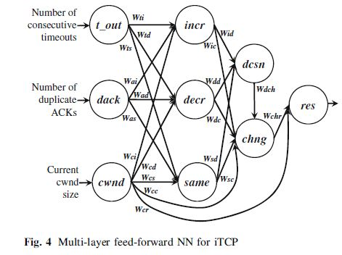
Implementation of Neural Networks in iTCP

Slide 14
Neural Network is used to implement congestion control of iTCP.
It consist of input , two hidden and output layer.
The direction of flow of data for decision making in the neutral network is in the forward direction . Hence, it is also known as Forward Feed.
Input from the previous layer determines the output in the next layers.
Hence, the flow continues on and on.
All the nodes in the neural network have a certain weight which may be fixed or dynamic.
A weight of 1.0 is assigned to a particular node if it’s value matters in the decision making of the latter output else the value is taken as 0.0
Since, the current window size always matters to decide the congestion window size of the output .All the weights associated with the cwnd node are taken as 1.

Slide 15
The other attributes like no of duplicate ACKs and no of consecutive timeouts are also taken into accounts but they are not the main deciding factor.
The neural network is cyclic in nature.
Relative strength of input from previous layer is taken into account to calculate the output of the latter layer . The highest relative strength of the input always wins.
Relative strength of the inputs in the first layer are calculated based on the weighted sum of the no of consecutive timeouts , duplicate ACKs and current cwnd size.

Slide 16
Selecting the Activation Function
Activation function defines the output of a node depending on the inputs from the same nodes.
The Activation function helps in the calculation of the weights of all the nodes.
Hence , the best possible activation function should be selected.

Slide 17
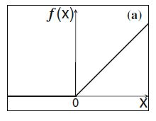


The different functions selected as follows:
For input layer positive linear function is taken.
For the inner hidden layer the congestion window size should be decreasing with the increase in the no of ACKs and timeouts.

Slide 18
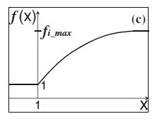

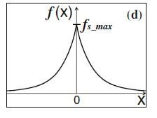

For the inner layers , when the congestion window is increasing a logarithmic function is a better choice.
When the congestion window is to remain the same, we select a function which is symmetric and whose Fmax is 0.

Slide 19
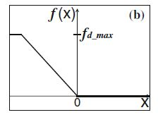
It has to kept in mind that all the threshold values are assigned to the activation function.

Slide 20
Performance Evaluation
Two kinds of network topologies are considered for ns-2 simulation :
Linear Topology
Grid Topology.
The congestion window size is the primal attribute for the experimentation in the ns-2.
We consider the comparison of the iTCP congestion control with TCP Vegus , TCP Reno and TCP Westwood.

Slide 21
Environmental Impact
In case of low no of nodes TCP fails to differentiate between congestion and normal traffic drop . But iTCP is a mode intelligent option.
iTCP can detect congestion in case of hidden station problem.
The increase in coverage area in total no of nodes do not prevent iTCP from doing a good job.
The increase in flow of traffic negatively impact congestion control in iTCP nut the overall picture is better than conventional TCPs.

Slide 22
Bandwidth Ratio
The variation of the result in bandwidth ratio is same as that of environmental impacts.
Large Scale Dense Deployment
Normal TCP is unable to differentiate between congestion and sparse node setup.
But iTCP helps in this condition of bottleneck in TCP connections.
Application limited data transfer is applied at the application layer to overcome this problem.

Slide 23
Congestion window analysis
CWND size in iTCP size is larger than conventional TCPs which help in reliable data transfer.
Throughput Analysis
The throughput of the conventional TCP are quite less compared to the iTCP as the cwnd size helps in more passage of data.
Fairness Analysis
The analysis of fairness of a network is the same as that of network throughput analysis. iTCP attains better fairness over the other network TCP. Fairness Index represents the normalized sum of the difference in throughput over all the possible flows of networks.

Slide 24
Energy consumption analysis
The iTCP consumes lower energy per unit bit of the transmitted data. The lower consumption is in accordance to the higher network throughput.
End to end analysis
In case of end to end delay in the network we see that TCP Vegas has the upper hand over iTCP. But it doesn’t matter as the data transfer need to be reliable and not time management specific. It doesn’t matter whether the data reaches in the given time or it reaches late in most of the cases.
Network condition analysis
The network quality and network strength are one of the most important factors when it comes to network analysis. Both the factors play a major role in the experimentation of our assumptions.

Slide 25
System overhead analysis
When we analyze the memory buffer and the cache memory we see that in case of iTCP there is significant less usage of these two structures. The other TCP structures use much more memory than iTCP.
Advantages
The iTCP has the ability to distinguish between a case of congestion and fewer number of data in the network as its more intelligent than the conventional TCPs.
iTCP handles traffic with network hidden station problem better.
The implementation of iTCP requires lesser energy per unit transmitted bit in the media.

Slide 26
It can work on a larger congestion area than the other congestion control which is a quite advantageous thing.
The implementation doesn’t require very radical changes or we can say that it requires no changes at all in the present structure of the TCP.
The high convergence problem is a boon in disguise as it can be said that the synchronization problem is solved in this regard.
Resource constraining is not there in WMNs.
Applicable in mobile nodes in network.
Synchronization problem arises in ideal cases but in practical cases it is solved automatically because of time delay between the nodes.

Slide 27
Comparison
The comparison of the iTCP is done with TCP Reno, TCP Westwood and TCP Vegas.
iTCP does better evaluation of the network in case of the hidden network problem.
It works better in case the area coverage or the number of nodes is increased.
In increase of the flow of traffic the performance is negatively impacted but its still better than the other TCPs.
The cwnd size is quite big in case of the iTCP rather than the others.
The throughput in case of iTCP is lesser than that of the others.
iTCP is fairer over the other networks.
It consumes lesser energy compared to the other TCPs available.
TCP Vegas has upper hand in case of end to end time analysis but it doesn’t matter as reliable data transfer doesn’t depend on the time constraint as much it depends on whether or not the data reaches the other end.
The memory buffer and cache memory used in case of iTCP is very less as compared to the other means of TCPs.

Slide 28
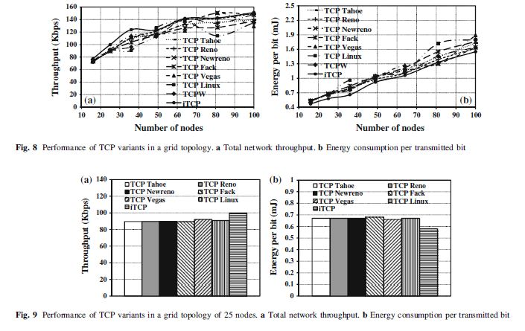

Slide 29
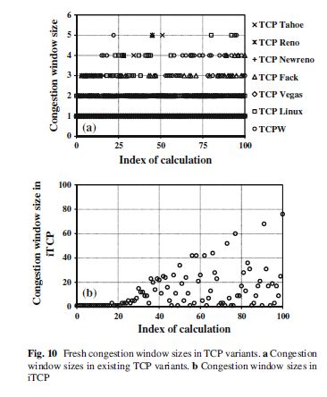

Slide 30
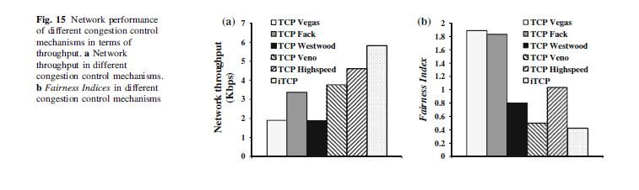
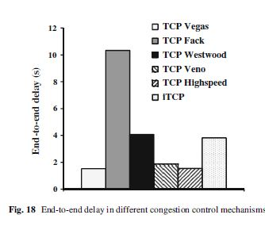

Slide 31
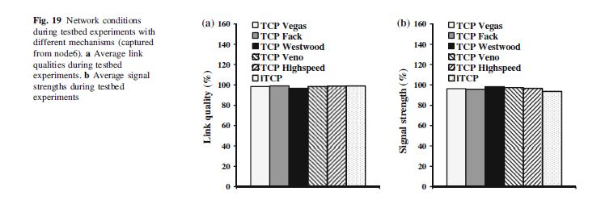
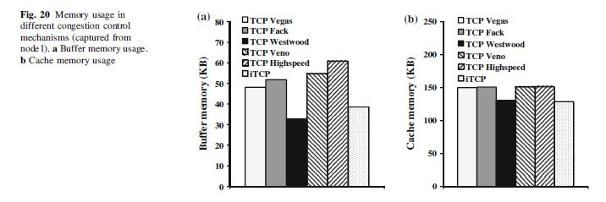

Slide 32
Limitations
The main issues of the iTCP are:
Training of the neural network: The training set is not fixed and hence training a model is quite a challenge.
The quick convergence wherein the cwnd size quickly increase or decrease is a limitation. The congestion window attain their highest value very quickly in case of both increase and decrease of the congestion window size.
In case of greedy data transfer congestion control , iTCP is inefficient because the congestion window retains a small size due to consecutive timeouts and duplicate ACKs.
Selecting the sensitivity granularity (a) is difficult and should be done based on the best possible outcome

Slide 33
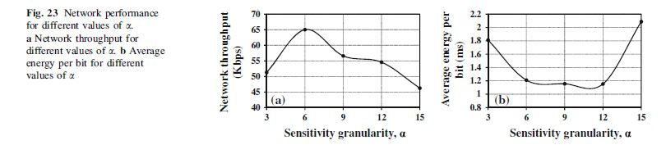
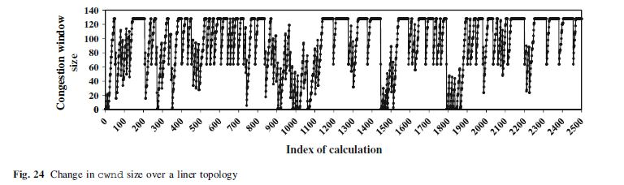

Slide 34
Solution to the Limitation
Newer TCP congestion control techniques are being proposed like Smesh, Wing.
Here gateways are implemented which may act as both destination or source but congestion occurs here also.
The field of congestion control required quite a lot of work.
Implementation of application limited data transfer (method) to prevent iTCP from retaining small congestion window size .
The time period for training may be decreased instead of keeping it in real time but again it loses efficacy or accuracy.
Doing the above thing may decrease the convergence problem also.

