Slide 1
BREADTH FIRST SEARCH (BFS)
Graph Traversal Technique & Its Applications
Presented By : Antar Karati
Instructor : MD. TOHIDUL ISLAM, ASSOCIATE PROFESSOR
Course : Data Structure
Department : Department of Computer Science & Engineering
University : University of Rajshahi
Date: 23 November, 2025

Slide 2
Presentation Roadmap
Introduction & Motivation
What is BFS? (Core Concept)
How BFS Works (Visual Logic + Queue)
BFS Algorithm (Steps + Pseudocode)
BFS Simulation
Complexity Analysis (Time & Space)
Real-World Applications of BFS
Common Mistakes when Learning BFS
Conclusion & Final Takeaways

Slide 3
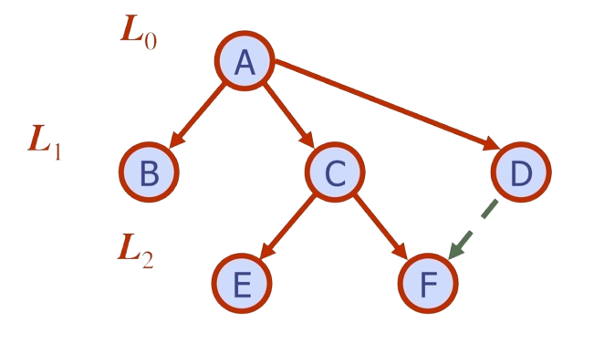
Why Learn Breadth-First Search (BFS)?
Core Technique in Graph Theory & Competitive Programming
Guarantees Shortest Path in Unweighted Graphs
Level-Order Exploration: Explores Level by Level / Explores neighbors before moving deeper (unlike DFS)
Works Efficiently Using a Queue (FIFO)
Practical Motivation:
Social Network Connections (Friends of Friends)
Network Routing & GPS Shortest Stops
Web Crawling and Search Indexing

Slide 4
Definition & Core Concept of BFS
• BFS (Breadth-First Search) is a graph traversal technique that explores vertices in increasing order of distance from the starting node.
• It visits nodes level-by-level (Layered Exploration).
• BFS ensures the shortest path in an unweighted graph.
• Primary Data Structure: Queue (FIFO-First In, First Out)
Working Logic:
Begin from a source node.
Visit all direct neighbors (Level 1).
​Move to neighbors of neighbors (Level 2) and so on.

Slide 5
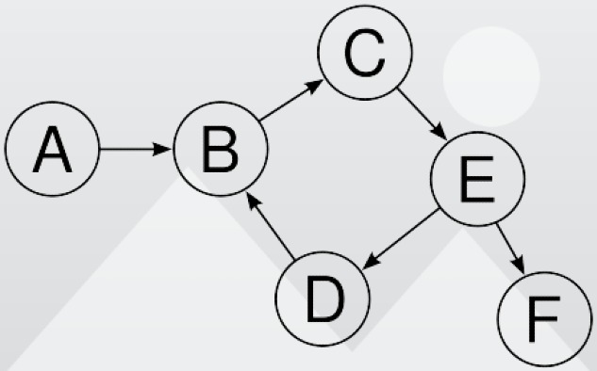
Algorithm: Breadth-First Search (BFS)
Initialize all nodes as Ready (STATUS = 1)
Select a source node (e.g., A):
• Enqueue it
• Mark as Waiting (STATUS = 2)
3) While the queue is not empty:
a) Dequeue the front node N
b) Process N and mark as Processed (STATUS = 3)
c) For each neighbor of N:
If STATUS = 1 (Ready):
• Enqueue the neighbor
• Mark it as Waiting (STATUS = 2)
4) Stop after all reachable nodes are processed.

Slide 6
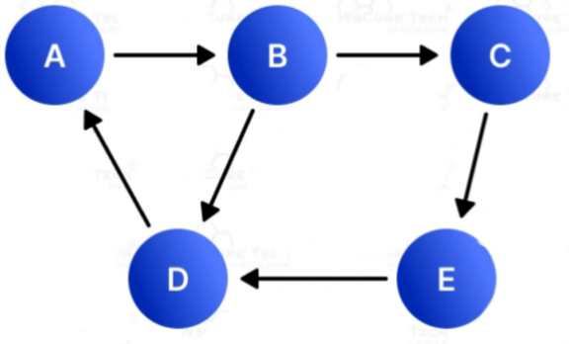
Step-by-Step Example ​(Visualizing the Traversal)
To illustrate the operational behavior of BFS, we will now perform a step-by-step simulation on the selected graph with source node A.
Adjacency List
Nodes Neighbors
A B
B C,D
C E
D A
E D
Adjacency List
Nodes Neighbors
A B
B C,D
C E
D A
E D

Slide 7
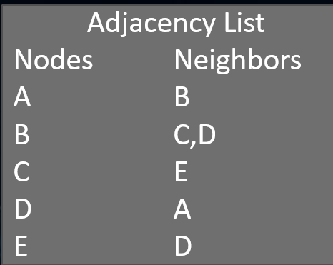
Step-by-Step Example ​(Visualizing the Traversal)
🔹 Step 0 — Initialization
Queue: [ ]
Status: A,B,C,D,E = Ready(1)
Processed: —
🔹 Step 1 — Enqueue A (Start)
Queue: [A]
Status: A=Waiting(2)
Processed: —
🔹 Step 2 — Dequeue A → Process & Neighbors Added: B
Queue: [B]
Status: A=3, B=2
Processed: A
🔹 Step 3 — Dequeue B → Process & Neighbors Added: C, D
Queue: [C, D]
Status: A=3, B=3, C=2, D=2
Processed: A, B

Slide 8
Step-by-Step Example ​(Visualizing the Traversal)
🔹 Step 4 — Dequeue C → Process & Neighbor Added: E
Queue: [D, E]
Status: C=3, E=2
Processed: A, B, C
🔹 Step 5 — Dequeue D → Process & Neighbor A already processed → Skip
Queue: [E]
Status: D=3
Processed: A, B, C, D
🔹 Step 6 — Dequeue E → Process & Neighbor D processed → Skip
Queue: [ ]
Status: E=3
Processed: A, B, C, D, E (Final Output)
Stop — queue empty; all reachable nodes processed.

Slide 9
Complexity Analysis (BFS)
Time Complexity: O(V + E)
V: Number of vertices (nodes)
E: Number of edges
Why?
✔ Every vertex is visited once
✔ Every edge is checked once (directed) or twice (undirected)
2) Space Complexity: O(V)
Required for:
✔ Queue
✔ Visited/Status Array
3) Special Case (Adjacency Matrix):
Time Complexity = O(V²)

Slide 10
Applications of BFS
Shortest Path (Unweighted Graphs)
➤ Example: Minimum hops in network routing
2. Web Crawling
➤ Pages are indexed layer-by-layer from a source URL
3. Social Media Connections
➤ Finding users within k levels (friends-of-friends)
4. Peer-to-Peer Networks
➤ Locating nearest resource/peer (e.g., BitTorrent)
5. Cycle Detection (Undirected Graphs)
➤ Detects cycles using level-wise visitation
6. Flood Fill / Region Filling
➤ Used in paint bucket tools & game map coloring

Slide 11
Critical Considerations in BFS
Not Suitable for Weighted Graphs
➤ BFS does NOT guarantee shortest path in weighted graphs (Use Dijkstra instead).
2. High Memory Usage
➤ Can consume significant memory if the graph is very wide (large branching factor).
3. Risk of Infinite Loops
➤ Forgetting the visited array causes cycles to trap the algorithm.
4. Edge Direction Handling
➤ Be careful with Directed vs. Undirected edges when adding neighbors

Slide 12
Summary & References
What We Learned from BFS
Recap:
✔ Level-Order Traversal (Explore layer by layer)
✔ Uses Queue (FIFO Model)
✔ Time Complexity: O(V + E)
✔ Ideal for Shortest Path in Unweighted Graphs
References
Cormen et al. (CLRS) – Introduction to Algorithms, Chapter 22
GeeksforGeeks / LeetCode – BFS Practice Problems
VisualAlgo.net – Interactive Graph Animations

Slide 13
Thank You

