Slide 1
Packet Capture and Analysis
Ally Saha-C22002
Antarlin Chanda-C22003
Joy Bhowmick-C22012
Shramana Bhattacharya-C22022
Tamosa Sur-C22027

Slide 2
What is Packet Capture
Capturing packets is a common troubleshooting technique for network administrators, and is also used to examine network traffic for security threats
From a threat actor’s perspective, packet captures might be used to steal passwords and other sensitive data
Packet Capture refers to the action of capturing Internet Protocol (IP) packets for review or analysis

Slide 3
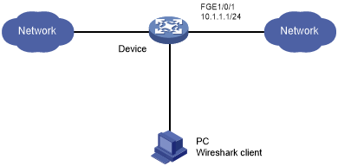
How Does It Look Like?
Generally, a client (as a software) is used to capture packets in a connection between a server and a client. Packets are typically a container that carries data over TCP/IP networks.
WireShark is an open source application that captures and analyzes packets in a TCP/IP connection

Slide 4
How Does Packet Capture Work?
Packet Capture works by creating copies of some or all packets passing through one point in a network.
Packets can be captured from a router, local machine and other network communicating devices.

Slide 5
How To Interpret a Packet Capture?
A packet contains the source and destination IP address of the network nodes.
IP packets have a total of 14 headers covering everything from Class of Service to Protocol Type.
Understanding the meaning behind a packet’s payload can require knowledge of the protocol in use

Slide 6
Analysis Using WireShark

Slide 7
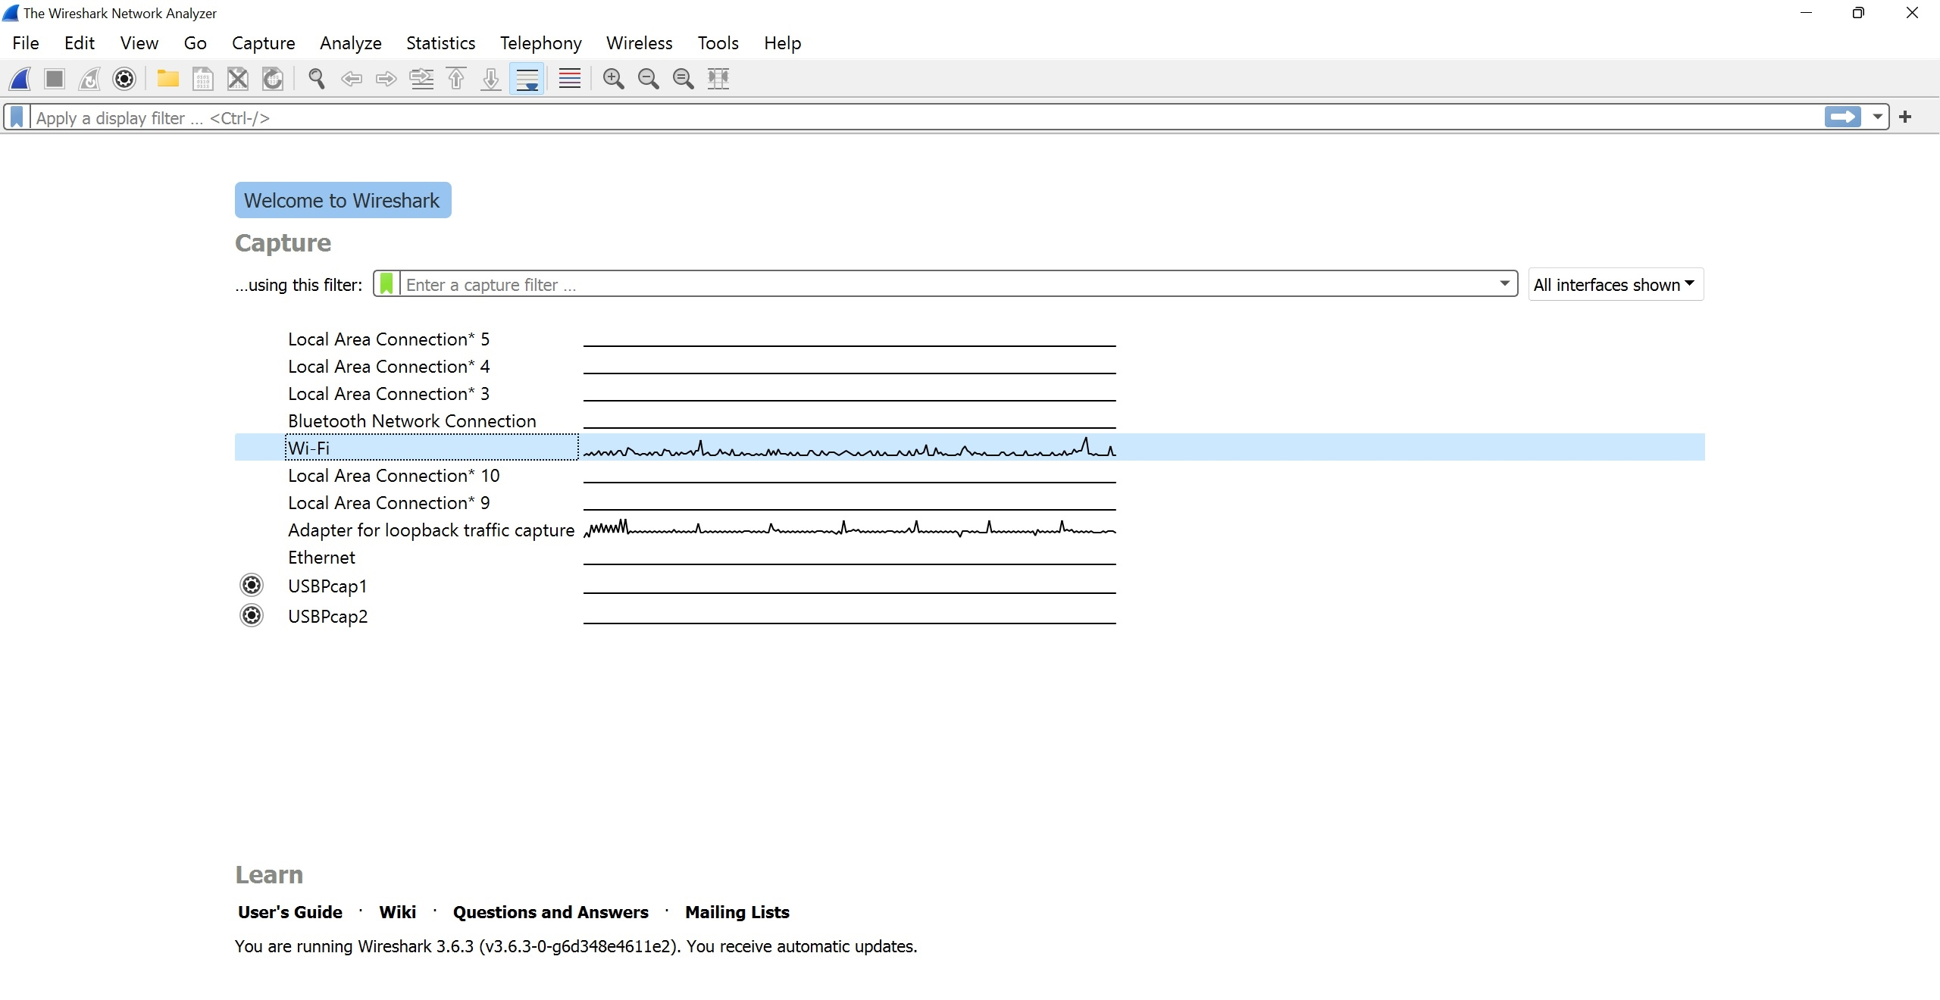
Where are we capturing from?
We are capturing the packets from the WiFi we are connected to.
As we expect here, there are multiple computers connected to the WiFi router. Hence we expect a lot of traffic here.

Slide 8
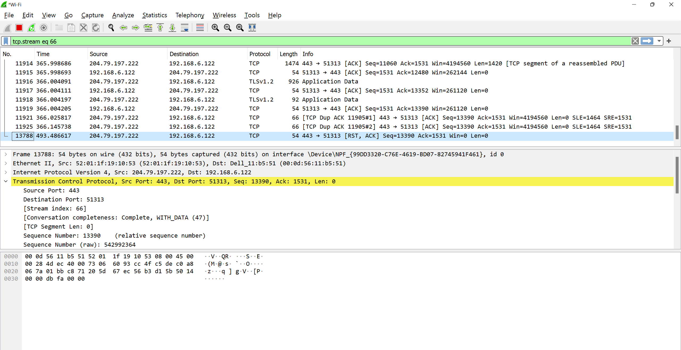
At a Glance..
As soon as we tap into the network and start capturing packets, we see a lot of packets being captured. As you can see, all of these packets contains the source and destination IP address and also the protocol being used. In addition to that DNS network protocols also come with the DNS resolved name. We can look into more details once we follow a packet trail

Slide 9
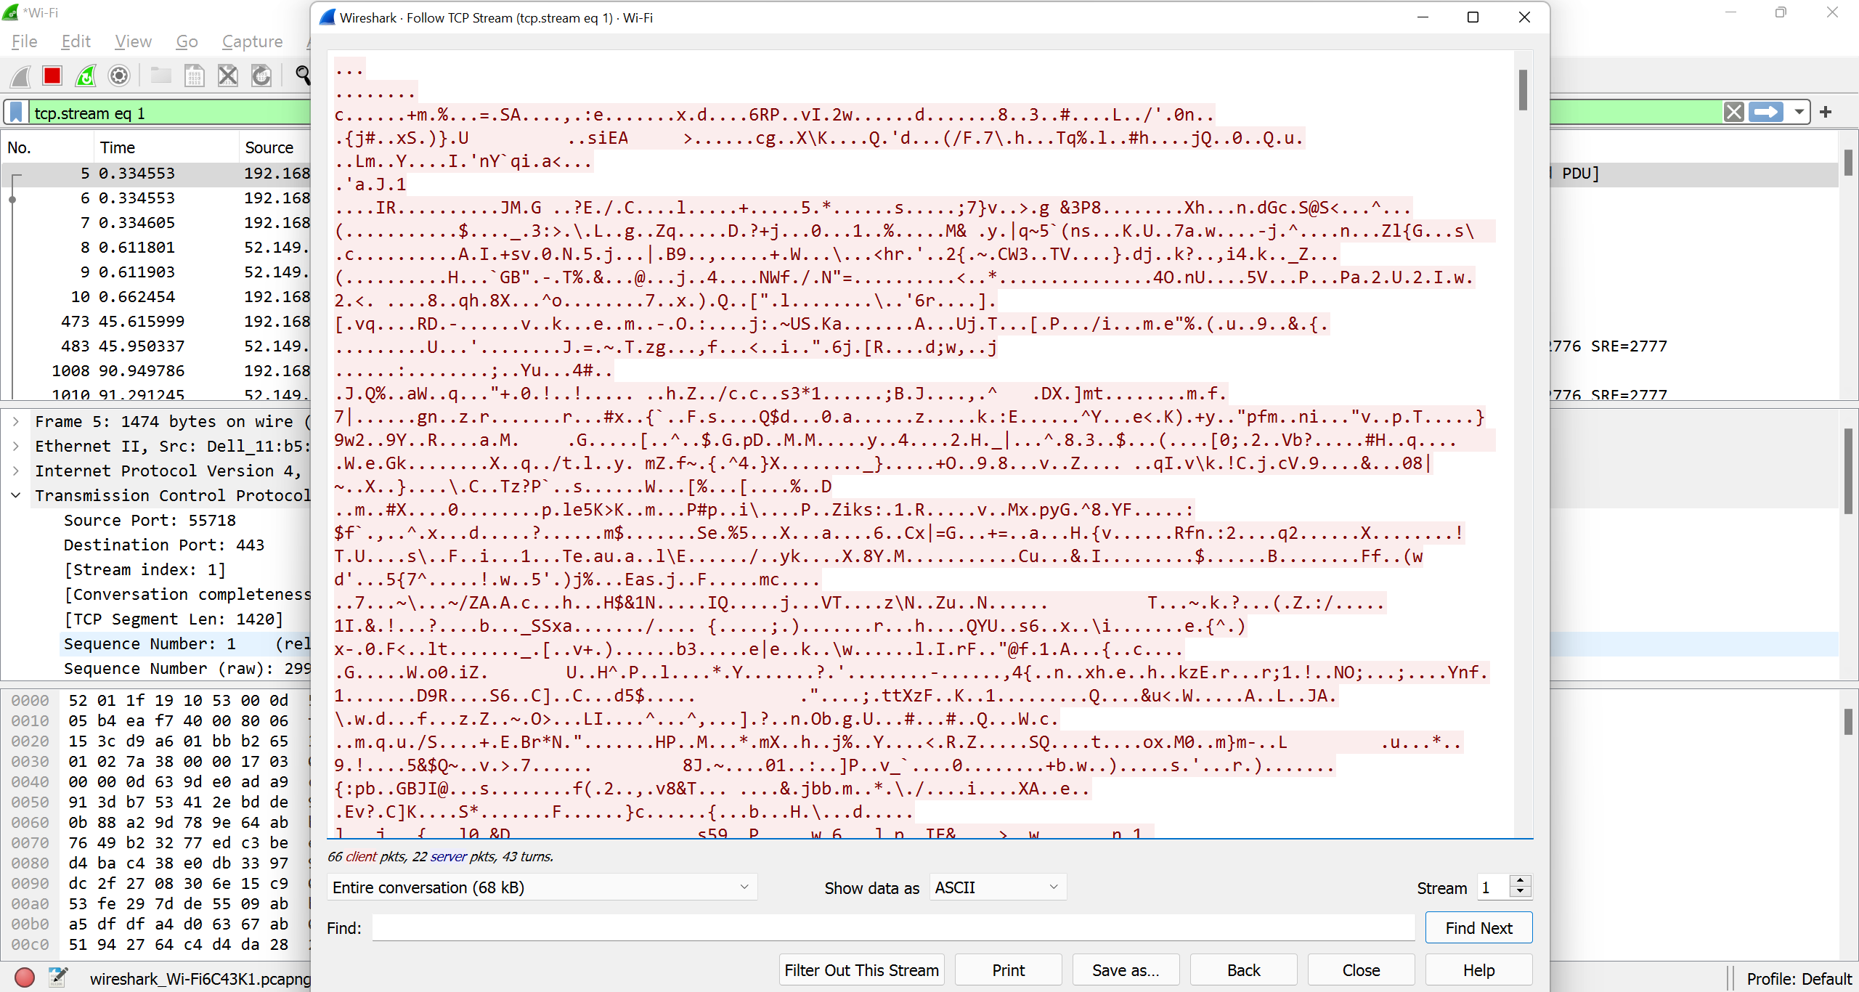
Let’s open a packet and inspect…
As soon as we follow the TCP stream of the server client, we start to see the communication between the server and the client. This communication is encrypted and hence we can see it in encrypted ASCII literals. However, if we tap an unencrypted connection, we will be able to see the unencrypted communication.

Slide 10
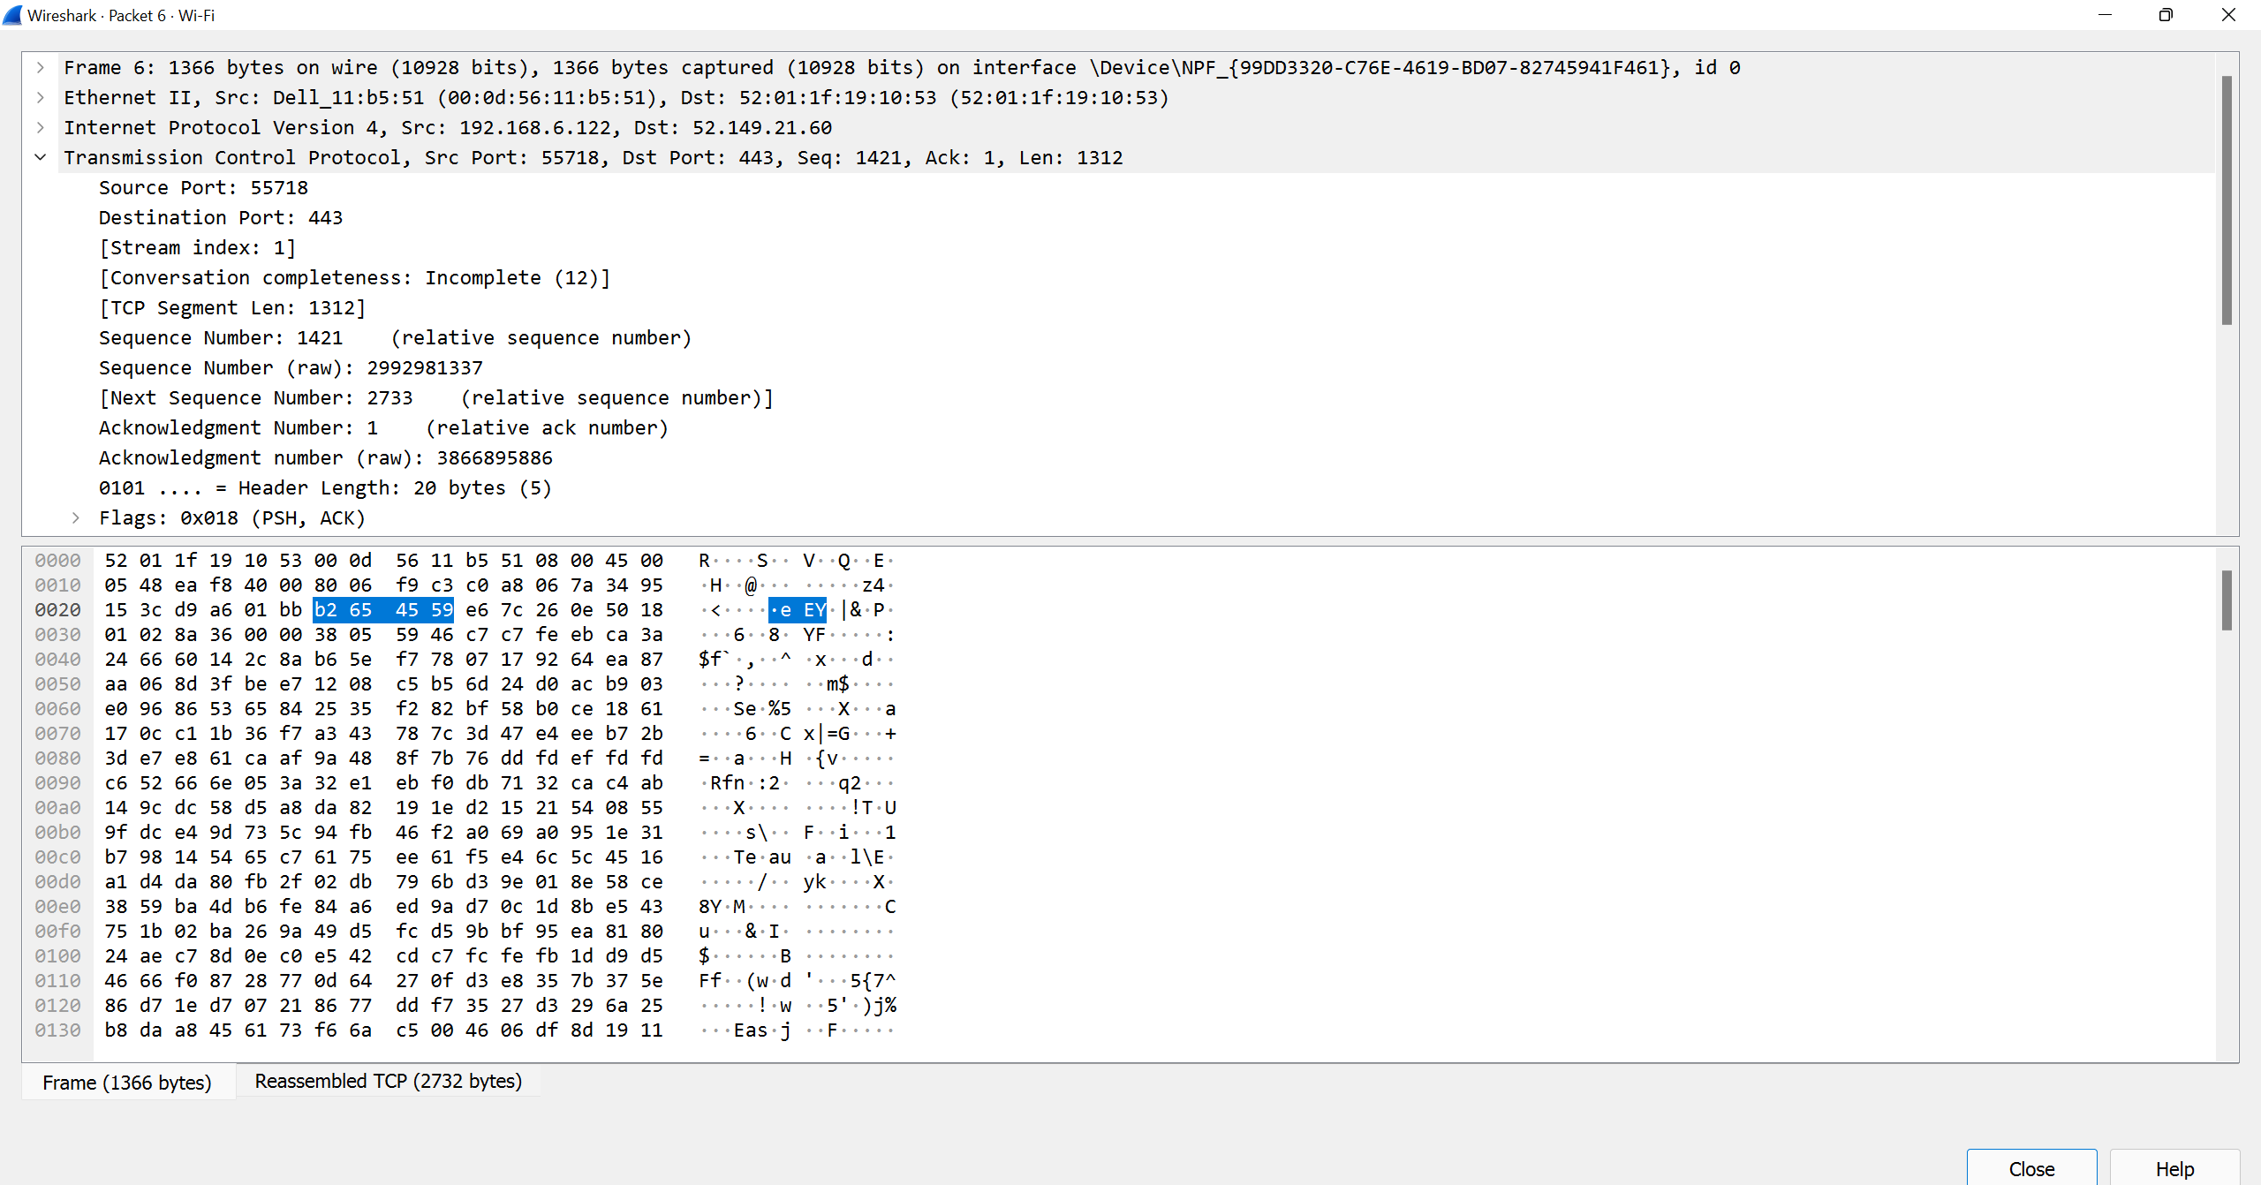
Let’s open a packet and inspect contd..
We can also investigate on the different packet characteristics. If we see the screenshot, we will be able to see the source port, destination port, internet protocol being used, the MAC address of the communicating devices, the packet size and much more.

Slide 11
Analyzing packet in an unencrypted connection
To create an unencrypted connection, we created a Python SimpleHTTP Server.
We hit the server endpoint from our client machine to start a connection
Using ifconfig, we find out the IP address of the server and the client and then filtered the packets captured from the wireshark using the IP address and the protocol being HTTP
ip.dst == 192.168.0.135 && ip.src == 192.168.0.108 && http
In an unencrypted connection, we will be able to see the communication between the communicating nodes since the packets are unencrypted.

Slide 12
Creating the Unencrypted HTTP Python Server

Slide 13
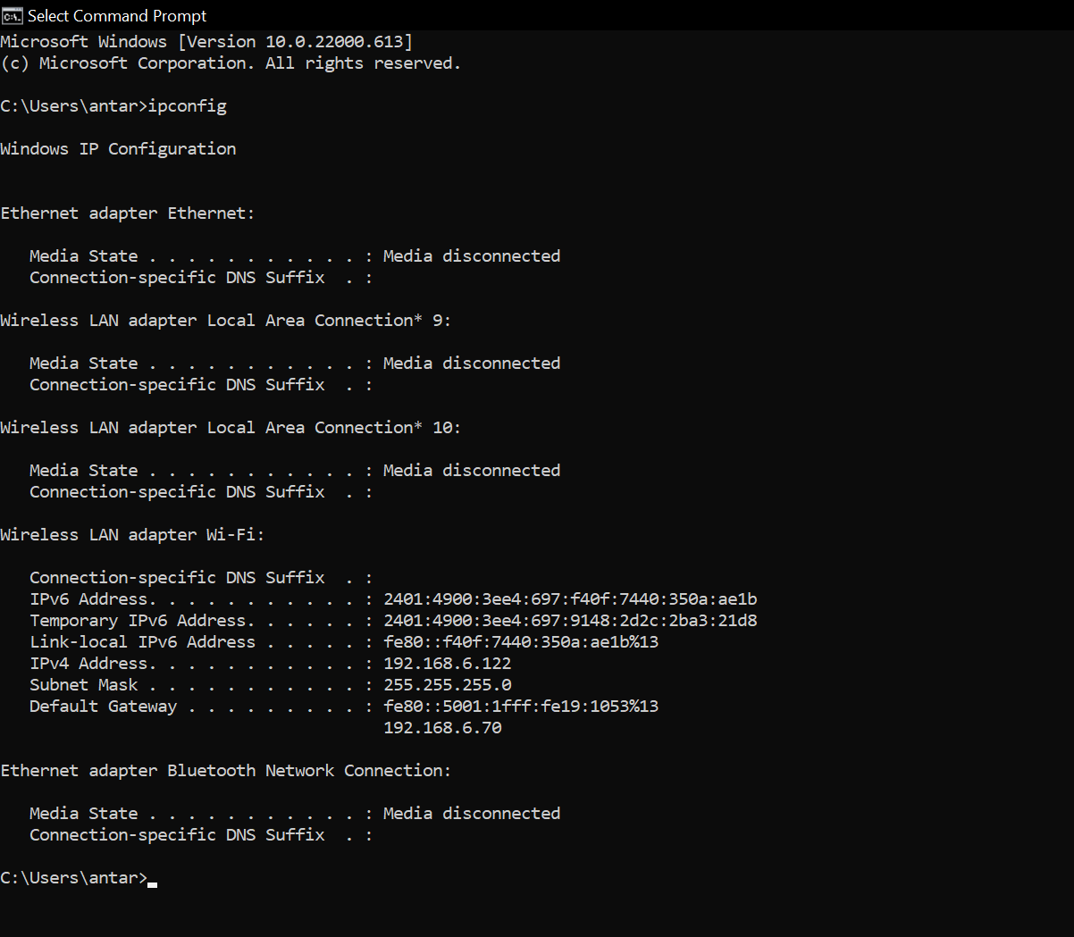
Getting IP Address

Slide 14
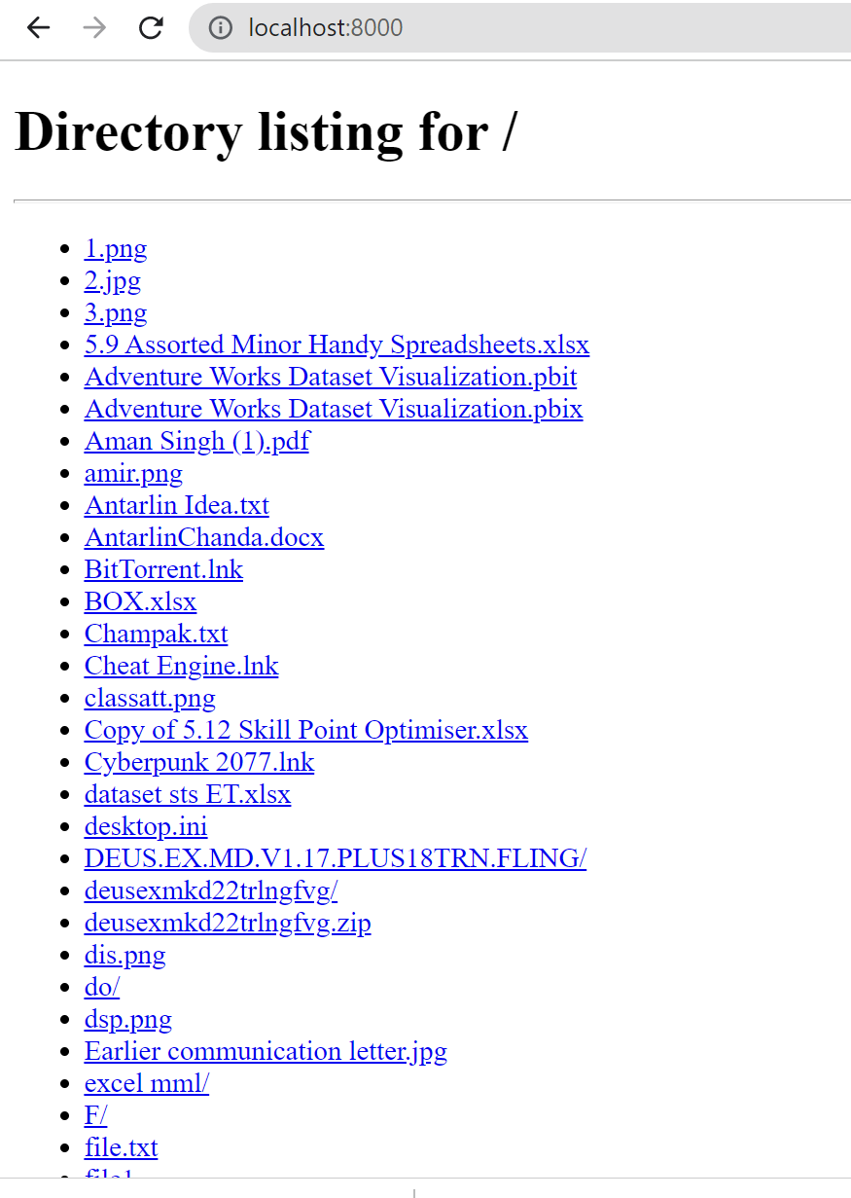
Local Server View
We type in the localhost:portnumber to see the server contents in our own pc

Slide 15
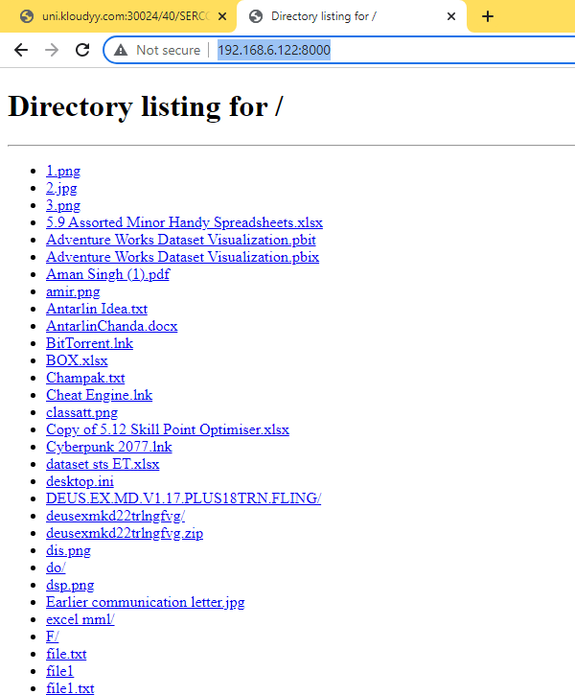
We hit the server endpoint from our client machine to start a connection
We write IP address of server machine and the port the server is running on and type it in the 2nd machine to connect the client machine to server pc

Slide 16
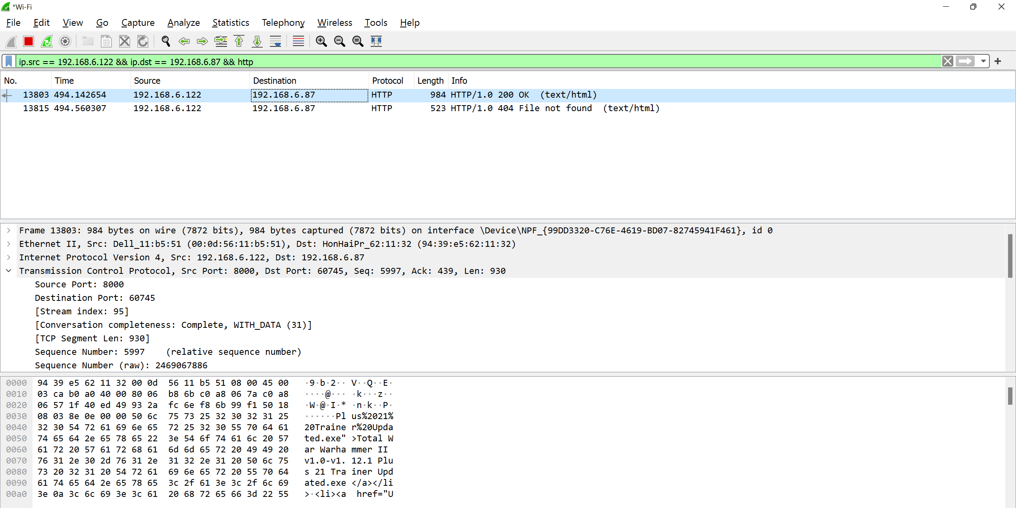
Inspecting the Filtered Packets
We see these are the HTTP packets captured between the communication of our unencrypted server and the client. Now let’s analyse the packets captured from WireShark. At first glance we see the destination port is 8000 which is the default port of Python SimpleHTTPServer

Slide 17
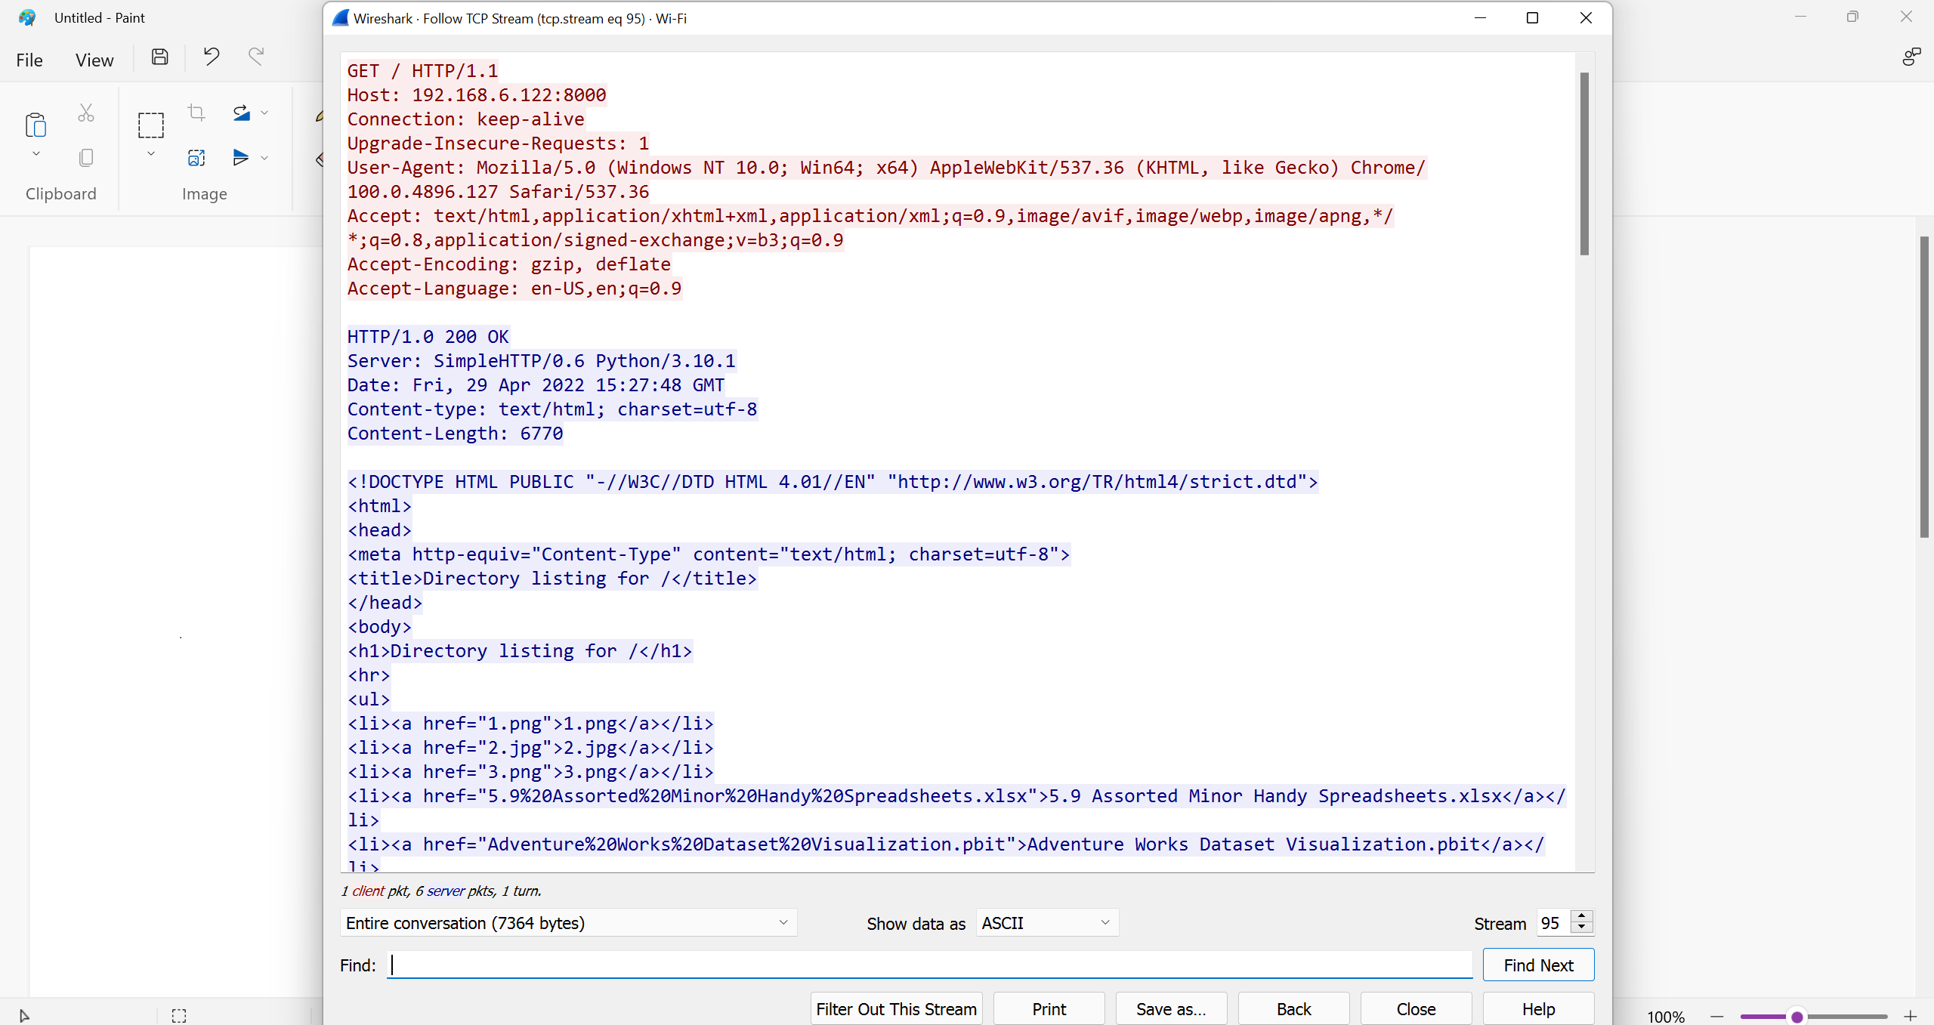
Inspecting the Filtered Packets…
We catch a TCP packet propagating in the same network and upon analyzing, we were able to see the communication in plain text, because of the unencrypted connection. We are able to see the endpoint, host, port and the request type (GET) and even the content returned by the server (which is an HTML file).

Slide 18
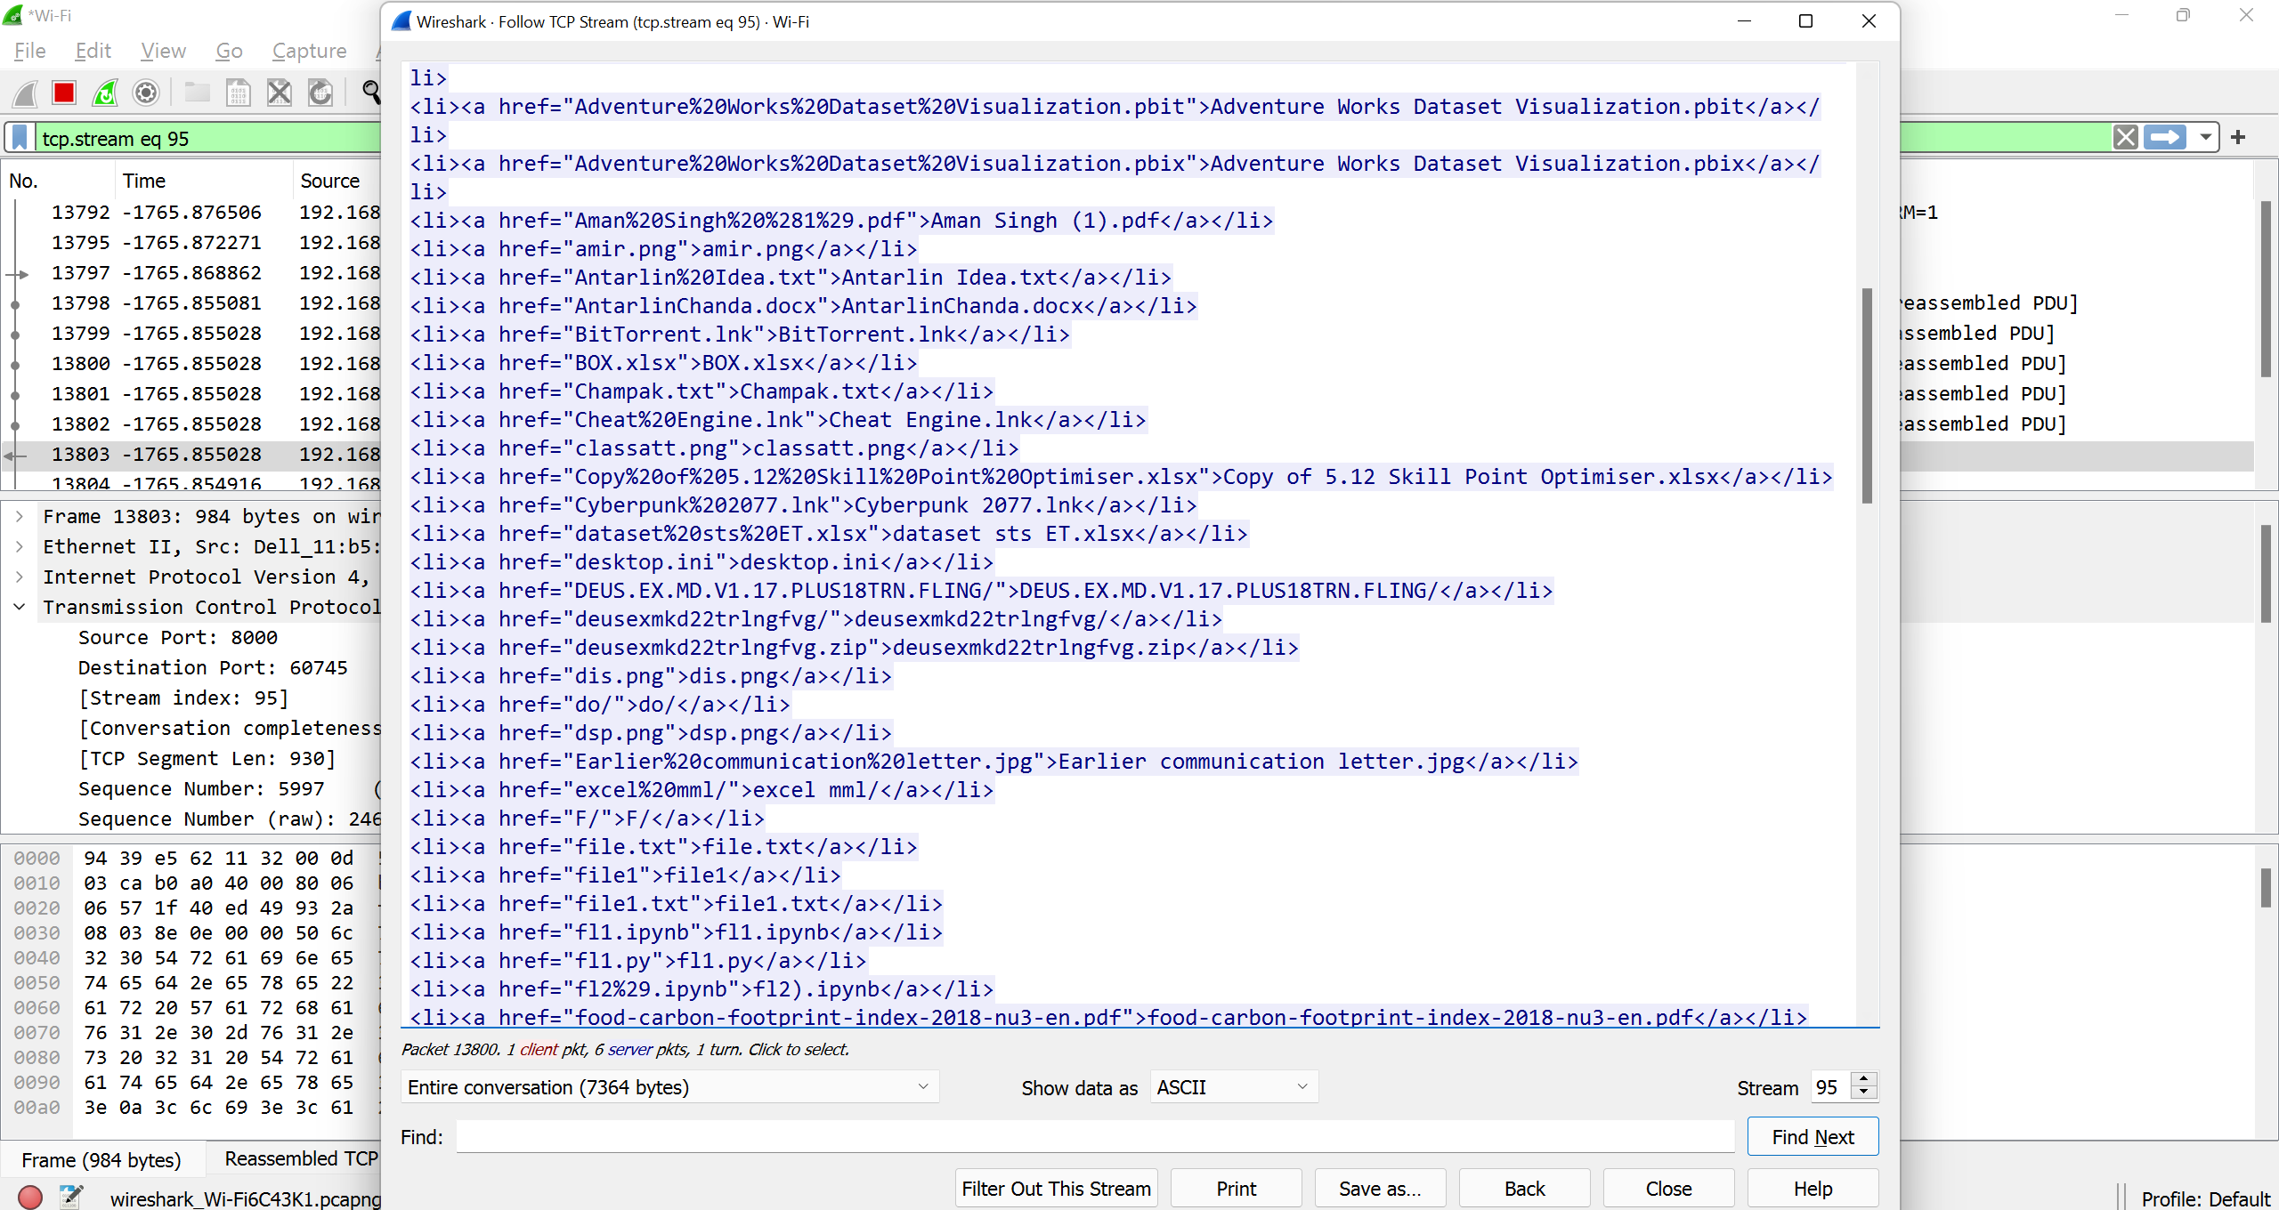
Inspecting the Filtered Packets…

Slide 19
Final Words..
Packet Capture is an invaluable from security and troubleshooting perspective, but should never be solely relied upon
The increased use of encryption for both legitimate and illegitimate purposes limits the effectiveness of tools like Wireshark
Also, even if a packet might be captured, the files could have been modified thus resulting in false negatives.

