Slide 1
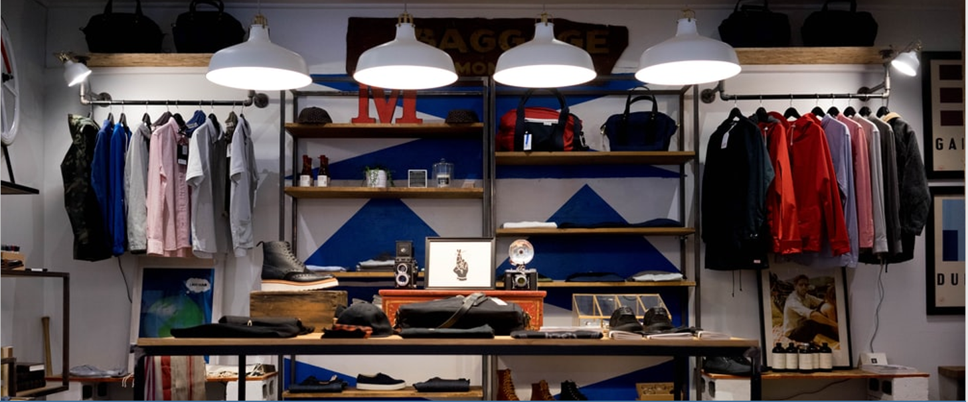
UNDERSTANDING THE REASONS FOR LOWER SALES & LOSS IN RETAIL STORE 2
PRESENTED BY:
ANTARLIN CHANDA, MADHURIMA PANDE, NAVAM PRADHAN, SAMRAT CHOUDHARY, SK AHTESHAM HUSSAIN

Slide 2

INTRODUCTION
Objective –Comparing 2 Modern-Format retail stores of almost equal size and stocking similar products and analyzing the reasons for difference in performance between the 2 stores
Annual sales and profits from store 1 is 29.8 cr and 2.9 cr
Annual sales and profits from store 2 is 13.1 cr and -0.5 cr
Store 2 has low Revenue and is loss making and hence we need to analyze and diagnose the various factors behind the low sales and loss of Store 2.

Slide 3
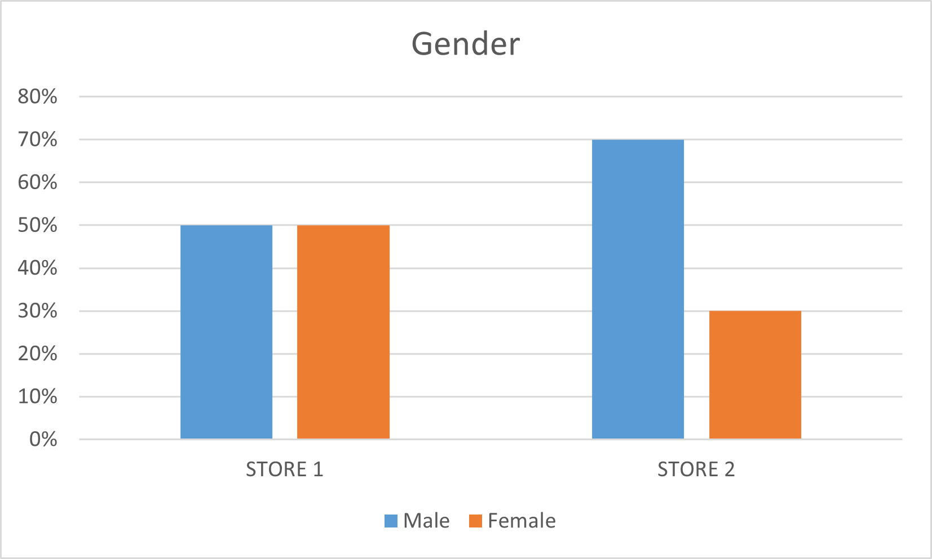
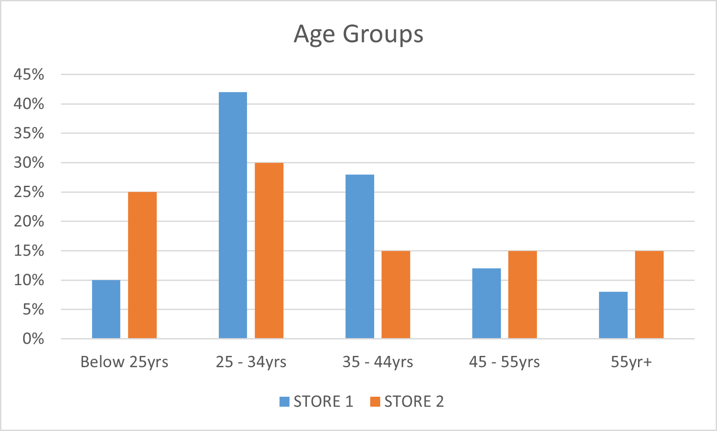
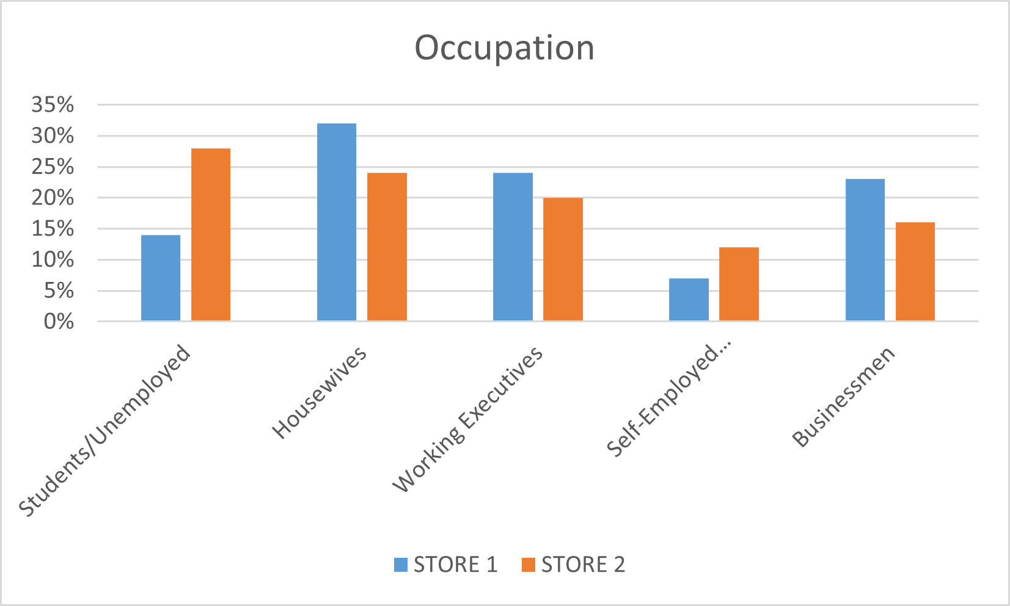
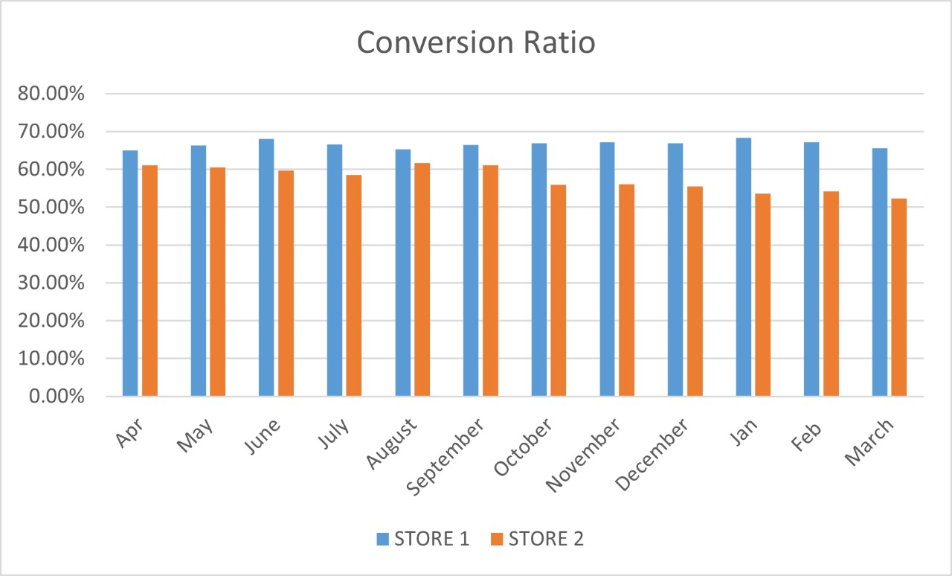
COMPARING DIFFERENT PROFILES OF STORE 1 & STORE 2

Slide 4
Hypothesis Testing
Conversion Ratio Test
Average Bill Value Test
t-Test: Two-Sample Assuming Unequal Variances
BilltoFootfallRatiobymonth:Hypothesis One tail assumption mean1<=mean2
BilltoFootfallRatiobymonth:Hypothesis Two Tail Assumtion mean1=mean2
 | Store 1 | Store 2
Mean | 0.6664 | 0.5751
Variance | 0.0001 | 0.0011
Observations | 12.0000 | 12.0000
Hypothesized Mean Difference | 0.0000
df | 13.0000
t Stat | 9.1366
P(T<=t) one-tail | 0.0000
t Critical one-tail | 1.7709
P(T<=t) two-tail | 0.0000
t Critical two-tail | 2.1604
t-Test: Two-Sample Assuming Unequal Variances
One tail test hypothesis Average Bill value mean1>=mean2
Two tail test hypothesi AverageBillValue mean1<mean2
 | Store 1 | Store 2
Mean | 174.0000 | 1491.0000
Variance | 9772.8140 | 36877.7143
Observations | 87.0000 | 8.0000
Hypothesized Mean Difference | 0.0000
df | 7.0000
t Stat | -19.1655
P(T<=t) one-tail | 0.0000
t Critical one-tail | 1.8946
P(T<=t) two-tail | 0.0000
t Critical two-tail | 2.3646

Slide 5
ISSUE TREE
Gradual increase in footfall coupled with Decrease in number of bills generated
Dangerous trend as working expense scales with footfalls where as sales is not scaling
Low Conversion Rate
Persons with the highest purchasing power that is around 25-44 lower in numbers here
Unable to capture the most important subgroups.
Store ambience is good and enticing
People coming just for visiting and ambience
Younger Age Group
Located near colleges, schools.
Younger population with no purchasing power
STORE-2
Females are dissatisfied with item choice and stock, female attendees are less
Female Centric Products Catalogue may not be up to the mark female-Centric
High Gender Disparity(F:M=30:70)
Females feel safety issues or have problems reaching the store
Unsafe Locality/ Remote or away from residential areas
Less Private Tag Sales
Variety and item perception issues
Low Average Bill Value
Primary Catchment Area Sales very less
Competition,Location,Nearby Reputation

Slide 6
Suggestions and Solutions
Low Bill Value addressing-
Lower sales of private labels may be addressed by looking into their branding look and feel.
Some R&D can be done to better suit the local area needs of the people.
Good initial discounts can help entice and switchover people to private labels and may increase overall profit in the long run.
Item Stock restructuring.
Increase stocking of high-margin apparel products. Use techniques like Market Basket Analysis and association mining to boost sales.
Low festive season sales addressed by providing season offers along with the above entertainments and community engagement activities should help a lot in this regard.
Low Conversion Rate –
Store 2 on average has been found to be more beautiful than store 1. Now, this was a double-edged sword as this is causing young people with no purchasing power to visit and leaves so not much income there. If we can do something to capture this young crowd like recreation, entertainment quiz activities and associated food courts giving higher discount then over the long term we can capture this young crowd and they make actually become long term customers due to nostalgia effects of younger times.

Slide 7
Younger Age Group-
Most likely the inventory of store 2 is more geared towards the very young crowd but since purchasing power is lower in that category so this is backfiring. Diversified products for all age groups may be a good idea to start.
Gender Disparity-
Gender disparity and lower amount of housewives can be addressed by giving weekday shopping discounts for enticing housewives. Products and promotions can be targeted for them.
Some entertainments and recreation activities may be planned to further attract this very important segment.
Female-centric products may be less in stock that’s why low amount of females coming. So the product catalog has to be looked into. Increase number of female attendees may also help if low previously.

Slide 8
THANK YOU

