Slide 1

Praxis Business School
Psychographic Segmentation
Prepared by:
Antarlin Chanda (C22003)
Madhurima Pande (C22015)
Navam Pradhan (C22016)
SK Ahtesham Hussain (C22024)

Slide 2
Segmentation of consumers into 3 highly distinct and discriminatory groups And properly identifying and naming them through USE of Psychographic Analysis.
Objective

Slide 3
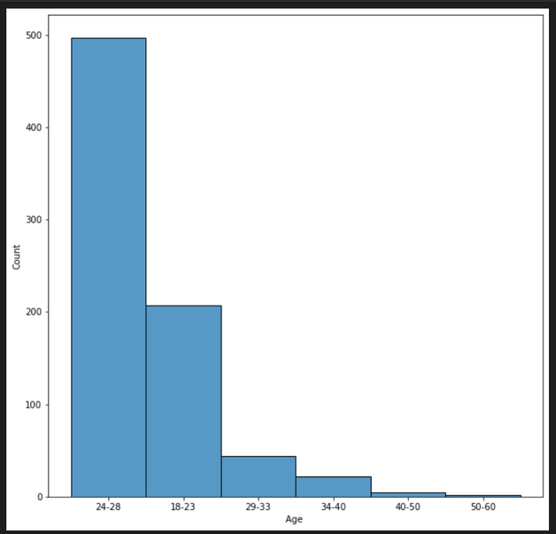
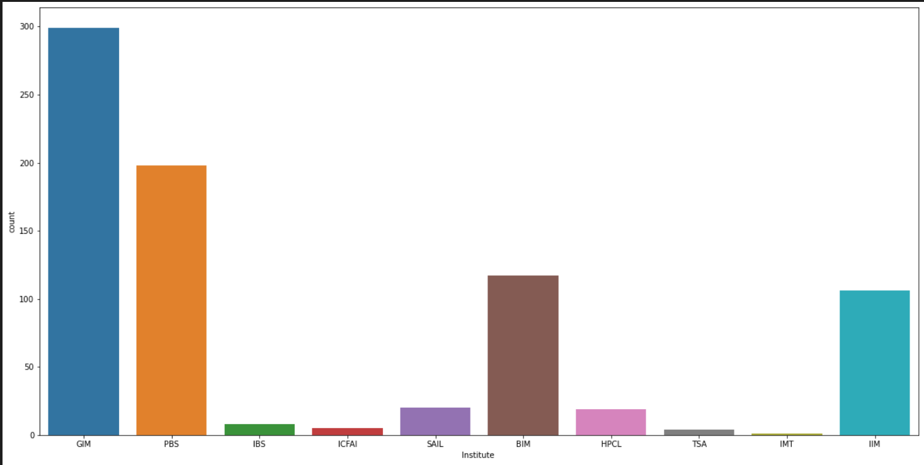
Exploratory Data Analysis
Institute Count Plot
Overall Age Distribution

Slide 4
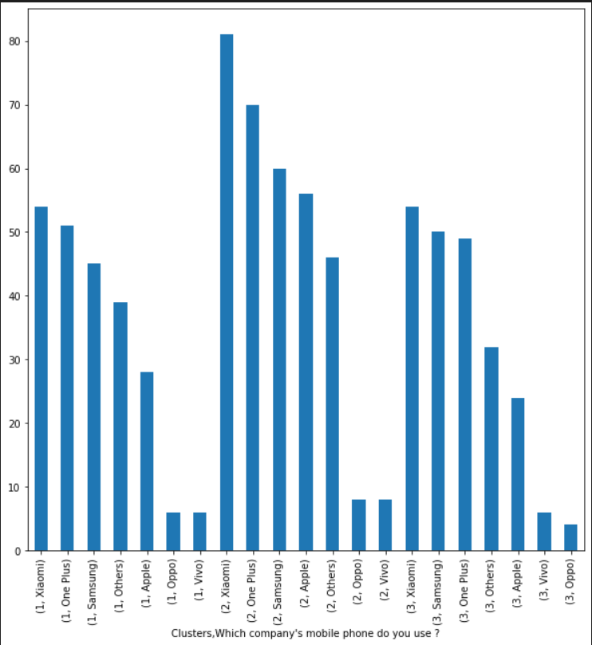
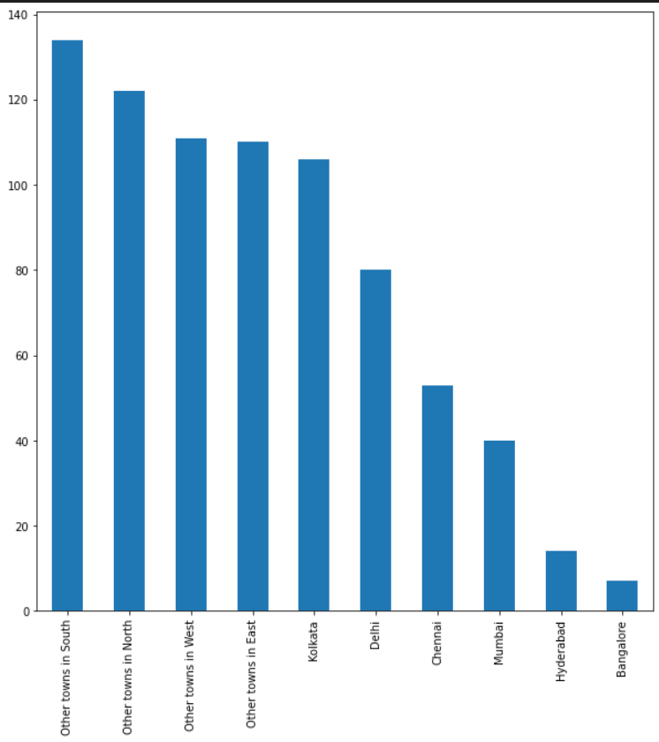
Exploratory Data Analysis
Mobile Company Clusterwise
Hometown Clusterwise

Slide 5
Clustering and segment conclusions (Psychographic)
SL No. | Cluster Centers | Cluster1 | Cluster2 | Cluster3
1 | I generally plan my expenses and never spend more than my budget | 1.61 | -0.60 | -1.01
2 | I often take opinions or check reviews before buying | 0.80 | -0.67 | -0.13
3 | I often experiment with new brands rather than just sticking to old ones | 0.13 | -0.10 | -0.03
4 | I prefer to spend my weekend at home than partying /going out with friends | -0.37 | 0.48 | -0.11
5 | My favorite subjects in school were Mathematics & Science rather than Literature | 1.19 | -0.34 | -0.85
6 | I make it a point to do some physical exercises (like swimming, walking, yoga) almost everyday | 1.65 | 0.44 | -2.09
7 | When I go out for shopping, I end up buying more items just by impulse | -1.84 | 0.55 | 1.29
8 | I am active on almost all Social media | -1.29 | 1.09 | 0.20
9 | I like light, sober colors to bright, exciting colors when it comes to clothing | 0.40 | -0.49 | 0.09
10 | I prefer watching videos/shows online rather than watching them in the television | 0.40 | -0.66 | 0.26
11 | I prefer ordering in from online apps than dining out | -0.34 | -0.63 | 0.97
12 | I follow Brands, celebrities, influencers on social media | -1.18 | 1.15 | 0.03
13 | I always try to keep up with new fashion trends | -1.03 | 1.14 | -0.11
14 | I prefer reading or listening to music rather than exercising or playing a sport | -0.12 | -1.39 | 1.51
Cluster 1 Size:229 ,Cluster 2 Size:329 ,Cluster 3 Size:219

Slide 6
Brand/Celebrity Followers
Music and Book Lovers
Highly Logical
and planned buyers
Fashion Consious
Impulse Buyers
Fitness Conscious
FASHIONISTAS
JACK OF ALL TRADES
CRAFTY BUYERS
Very active Social Media Users
Maths/Science Lovers
Prefers Dining-In than going out
Medium Impulse Buyers
High level of involvement
Not Health Consious

Slide 7
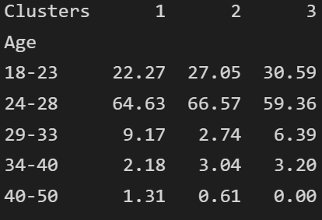
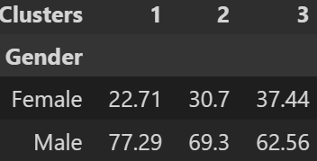
Clustering and segment conclusions (Demographic )
Gender had some change in sex ratio across the clusters.This maybe due to the fact that women may be more impulse buyers and are thus showing higher numbers in cluster 3.Age and occupation remained about same .

Slide 8

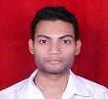
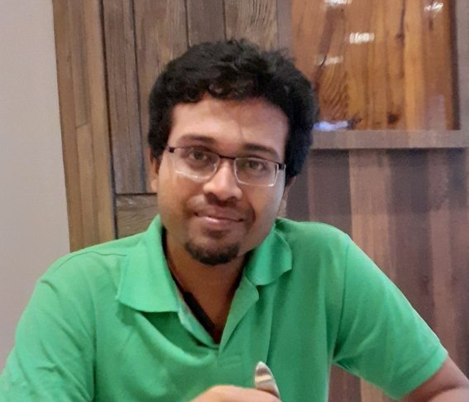
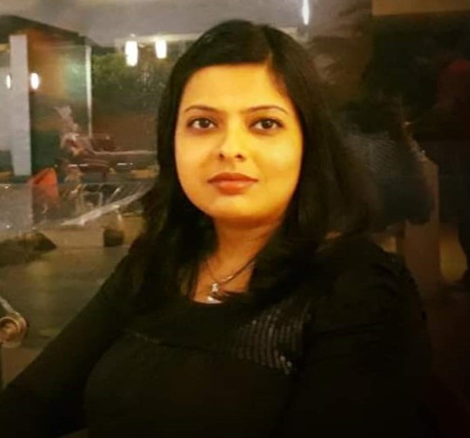
Group Members Cluster Associations
Jack of All Trades
Fasionistas

Slide 9
Brand Recommendations for each cluster
JACK OF ALL TRADES
FASHIONISTAS
CRAFTY BUYERS
1.HRX
2.Gap
1.Louis Vuitton
2.Zara
1.Audible
2.Starmark

Slide 10
Thank You

