Slide 1







IoT based Wearable Health Care Monitoring Device & Medical Emergency Response System
B.TECH MAJOR PROJECT PRESENTATION 2025-26
Project ID: 34082
NIST UNIVERSITY
Abinas Keshari Singh
Roll No: 202224418
Antaryami Sahu
Roll No: 202220707
By
Sailesh Kumar Nahak
Roll No: 202220083
Oum Prakash Paricha
Roll No: 202220693
Under the guidance of
Asst Prof. Manoj Kumar Sahoo
1

Slide 2
Table of Content
B.TECH MAJOR PROJECT PRESENTATION 2025-26
Problem Statement
Objective
Methodology
Circuit Diagram
Current Outcome & Future Work
Cloud Connection & Data Transfer
References
NIST UNIVERSITY
2

Slide 3
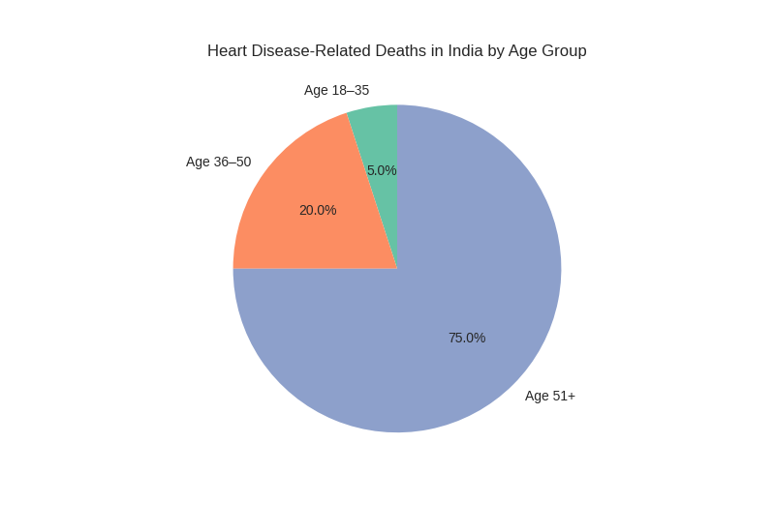
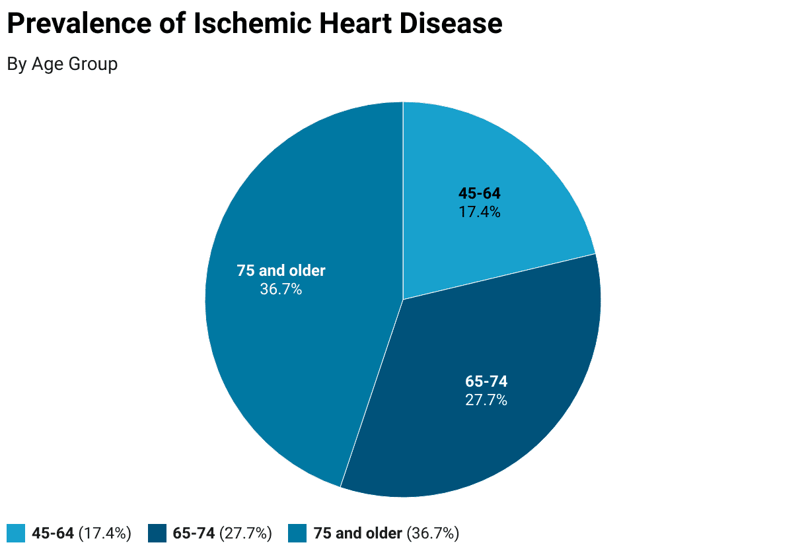
PROBLEM STATEMENT
B.TECH MAJOR PROJECT PRESENTATION 2025-26
Heart disease causes 31% of all deaths in India. Cases are rising among young adults.
Over 25% of heart attacks happen to people under 40. This includes more than 5,000 deaths yearly in the ages of 18 to 35.
Rural areas struggle because they lack real-time monitoring and slow emergency response.
India needs a low-cost IoT wearable for live heart tracking and automatic emergency alerts.
NIST UNIVERSITY
3

Slide 4
OBJECTIVE
B.TECH MAJOR PROJECT PRESENTATION 2025-26
Develop a wearable device that uses IoT technology to monitor cardiac parameters continuously.
Integrate the Pulse Oximeter Heart Rate (MAX30100) sensor and Arduino Uno R4 to measure heart rate and oxygen saturation (SpO2).
Use edge computing for real-time detection of anomalies and to generate alerts.
Create a multi-channel emergency response system that includes SMS, email, and GPS.
Make sure the system is affordable and can be scaled for rural and elderly healthcare.
NIST UNIVERSITY
4

Slide 5
METHODOLOGY
B.TECH MAJOR PROJECT PRESENTATION 2025-26
STEP-1: Data acquisition using AD8232 ECG Heart Rate Monitoring Sensor
and Temperature (LM35) sensors for heart rate, SpO2, and temperature.
STEP-2: Signal processing and noise reduction using microcontroller’s onboard edge computing.
STEP-3: Anomaly detection based on adaptive threshold algorithms personalized per patient.
STEP-4: Emergency alert dispatch via GSM/Wi-Fi (SMS, email, GPS) integration.
STEP-5: Data visualization and remote access via secure web dashboard for healthcare providers.
NIST UNIVERSITY
5

Slide 6
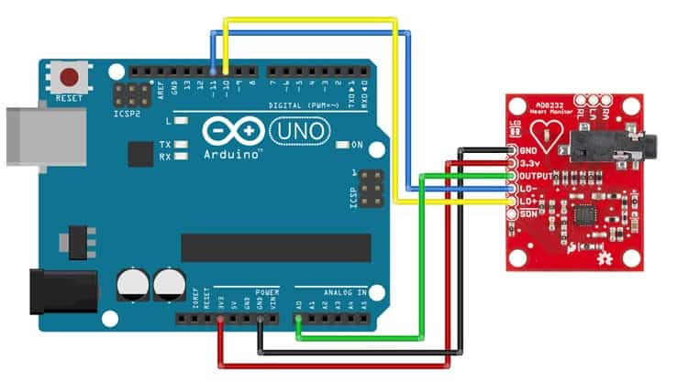
CIRCUIT-DIAGRAM
B.TECH MAJOR PROJECT PRESENTATION 2025-26
NIST UNIVERSITY
Practical Explanation: video
Live Simulation: video
6

Slide 7
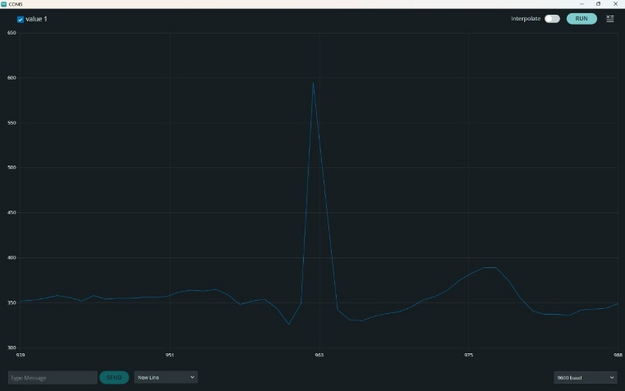
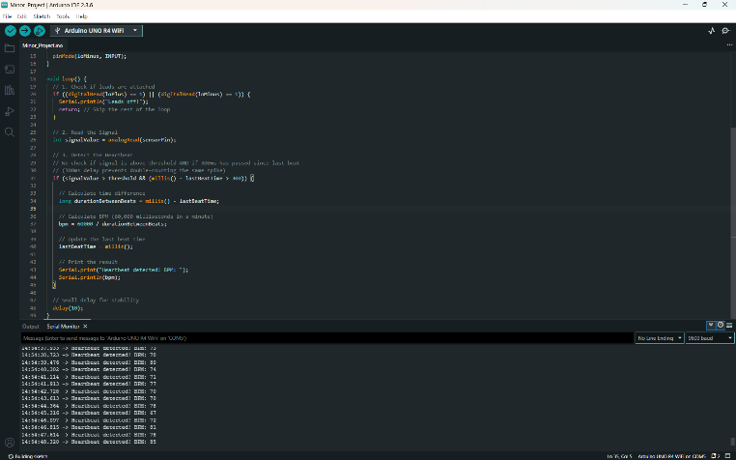
CURRENT OUTCOME & FUTURE WORK
B.TECH MAJOR PROJECT PRESENTATION 2025-26
High system uptime with a 1.4-second average alert latency.
Early detection of heart failure and cardiomyopathy progression through continuous monitoring.
85% caregiver response rate within two minutes of alert generation.
Significant reduction in cardiac emergency mortality through rapid intervention.
Scalable and affordable solution suitable for rural healthcare integration.
NIST UNIVERSITY
7

Slide 8
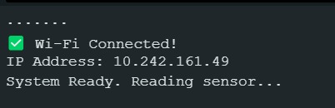
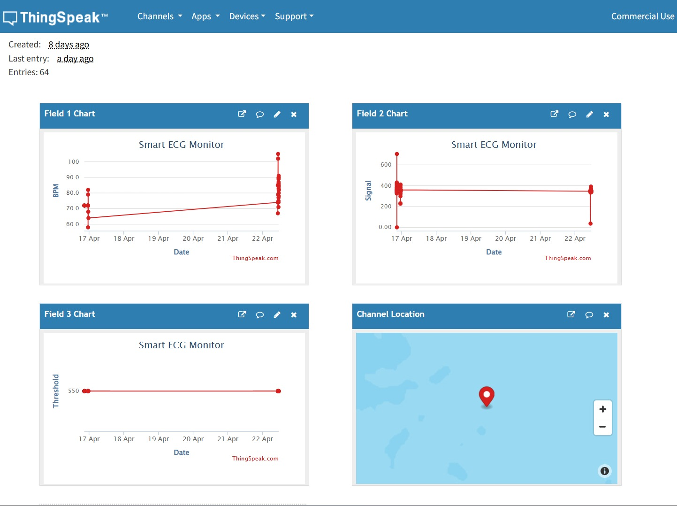
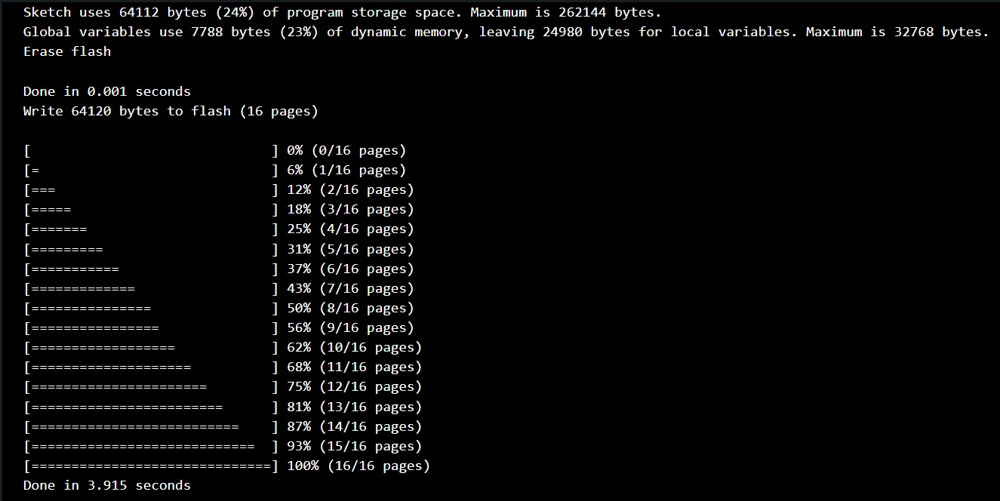
CLOUD CONNECTION & DATA TRANSFER
B.TECH MAJOR PROJECT PRESENTATION 2025-26
NIST UNIVERSITY
Wi-fi connection with Arduino Uno R4
Flash memory use while uploading programming in microcontroller
Live Dashboard visualization in ThingSpeak after Cloud Connection
8

Slide 9
REFERENCE
B.TECH MAJOR PROJECT PRESENTATION 2025-26
Chowdhury, S. (2024). “An IoT-Based Wearable Healthcare Monitoring Device and Medical Emergency Response System.” https://ieeexplore.ieee.org/document/10652375/
Abdulmalek, S. et al. (2022). “IoT-Based Healthcare-Monitoring System towards Improving Quality of Life.” https://pmc.ncbi.nlm.nih.gov/articles/PMC9601552/
Kang, H.S., et al. (2022). “Wearing the Future—Wearables to Empower Users to Take Control of Their Health.” https://pmc.ncbi.nlm.nih.gov/articles/PMC9330198/
“DIY Real-Time ECG Monitoring System Using AD8232 and Arduino UNO.” (2024). https://techpacs.ca/diy-real-time-ecg-monitoring-system-using-ad8232-and-arduino-uno-2198
NIST UNIVERSITY
10

Slide 10
B.TECH MINOR PROJECT PRESENTATION 2025-26
NIST UNIVERSITY
Thank You
11

