Slide 1
AML and fraud detection in banking, based on event-driven microservices
Andreas Lundsten
Notes:
Thank you for letting me speak.
I will continue on Morvarids path on applying Kafka to design microservices but abit more in a real case scenario. Focus/Use case is on AML and fraud transaction in a Swedish finance environment, but can be applied in most BPM like usecases.
Andreas Lundsten
Forefront 1y
Project on Swedish bank
Working with Kafka implementations daily

Slide 2

01. AML and Fraud Detection
02. Traditional implementation
03. Kafka quick walkthrough
04. Utilize kafka for AML
05. The streaming data platform
Notes:
Agenda quickly.
* Start by presenting what AML and fraud detection is in general and how a baseline implementation might look.
Quick walkthrough on Kafkas basic concept and functionality
How we can we utilize Kafka in a banking use-case
And finally how we can see Kafka as the central messaging hub within our entire organization.

Slide 3
Aspects
Financial regulations
Anti money laundering (AML)
Know your customer (KYC)
Data protection (GDPR)
Payment service directive (PSD2)
Economic losses
Etc…
Notes:
There is several regulations to take into account
AML, money laundery
GDPR current topic
Psd2 = bank transparency
Close to 40 thousands cardfrauds in Sweden 2016 enligt BRÅ.
Till det tillkommer 29000 kreditbedrägerier. (Bla lånbedrägeri)

Slide 4

Baseline implementation view
Customer
100
1000
Us
3rd party
UC
Notes:
Customer product application process.
We have the customers, often loan broker
Us the bank with its processes
What does the process contains:
Validation
Collection internal data, eg customer information, transaction history
Collection external data (väntar så länge som möjligt)
Risk calculation and automatic decision (score, AML osv)
Possibility of manual controls
Signing and validation( kanske tom. på papper) (loan-application)
Approvement
Reporting, statistics etc
And potential 3rd party partners, UC, sanction lists

Slide 5

01. AML and Fraud Detection
02. Traditional Implementation
03. Kafka quick walkthough
04. Utilize kafka for AML
05. The streaming data platform
Notes:
SO how could a traditional implementation of such a process look like.

Slide 6
Loan application process system
Service layer
Service layer
100
100
1000
1000
Rules
Rules
UC
UC
Domain model
Data proxies
Domain model
Data proxies
Ansökan
DB
Notes:
Traditionally a monolit based on a BPM engine.
In its simplest form might look like this –
Our business process (possibly BPM-platform) including kredit rules or other bizz rules.
CLICK domainmodel– Mutable objects that travel through the process with changing flags, statuses etc.
CLICK Data-proxys – external systems, opportunity for requests to fetche credit checks(UC)
CLICK Servicelayer for klienter, loan broakers, customer service GUI etc.
CLICK And ofc we have a DB with the current ”state” of the transaction.
CLICK and ofc we want redundans, so we have atleast 2 instances of the application.
And as a part of that we get transactional locking problems etc. as a part of keeping mutable data in a distributed environment.
We get persistence problems with evolving mutable objects

Slide 7
Application evolvement…
Servicelayer
Data cleanup
(GDPR)
100
1000
Rules
AML/KYC risk module
UC
Domainmodel
Data-proxys
Ansökan
DB
Notes:
When there are new requirements, for example through new compliance laws/rules, the usuall way is to expand the application.
CLICK For example through new GDPR rules
CLICK Or risk assessment through new AML rules.

Slide 8
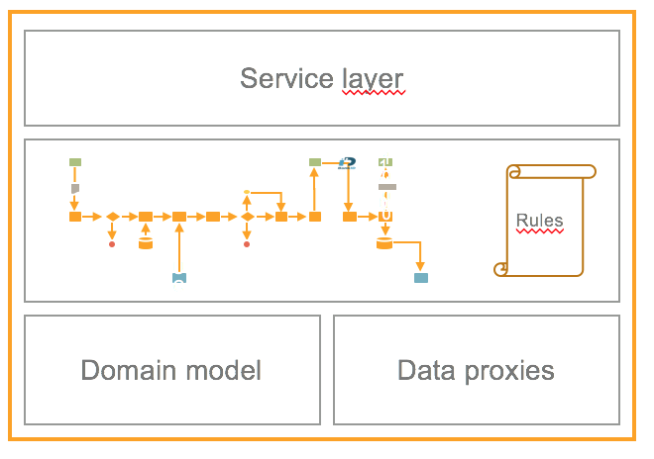
Uppgradering
v1
v2
Notes:
As mentioned ealier these application could be monolithic in its structure. These creates a upgrade problems. One big release = complicated and non agile.
(CLICK)
One big application/system
High demand on memory, CPU and storage
Why? Complicate business process, hard to divide into smaller parts, as we have mutable data stored in a single datasource.

Slide 9

01. AML and Fraud Detection
02. Traditional implementation
03. Kafka quick walkthrough
04. Utilize kafka for AML
05. The streaming data platform
Notes:
So how can we solve the problems that these traditional architectual designs inflicts?
* We can use Kafka. First a quick walkthrough

Slide 10

Apache Kafka - 2012
A
B
Notes:
Kafka was created as there was a need of a distributed scalable messaging system that could handle high possible throughput.
In this business segment it is competing with traditionall messaging frameworks like JMS.
Though there is some fundamental differences.

Slide 11
The log
Producer
Produce
1
2
3
4
5
6
7
8
9
10
11
12
Consume
Consumer B
Offset=3
Consumer A
Offset=8
Notes:
The foundation of Kafka is the topics. The topics is a ”append only” log of immutable objects.
New messages are added by the producers at the end of the que with an offset and will never change.
Consumers consume messages as it wants to, from the start or from a specific offset.
Big difference from tradtitionall messaging system, is that it is OK to never remove messages.
Consumers and producers are completely decoupled. They do not need to know about eachother.

Slide 12
Apache Kafka - 2018
Notes:
So how does Kafka look like today and what possibilies does it gives the users
(CLICK) Still a message broker, which can stream data with high troughput.
(CLICK) Also includes a framework to process data as streams for through filtering, aggregation and transformation etc.
(CLICK) And as it is ok to keep messages forever, it can be used as a storage medium similar like a database.

Slide 13
Processor topology
stream processor
streams
Notes:
You can see it as a tool for creating processing nodes which creates streaming application.
Its not just a message broker, its something more and thats important.

Slide 14

01. AML and Fraud Detection
02. Traditional implementation
03. Kafka quick walkthough
04. Utilizing Kafka for AML
05. The streaming data platform
Notes:
How can we utilize Kafka to improve the design we had earlier

Slide 15
Application management system – on Kafka
100
100
1000
1000
UC
UC
Notes:
So if we move back,we have a overview design of the business process.
We have losely coupled nodes, each responsible for a specific task.
We want to realise this as a IT system.
(CLICK) Kafka is the obvious choice where..
Each node is implemented as a Kafka stream application. And messaging between them is drive by Kafka topics.
So what might a node look like

Slide 16
Asynchronism and persistence…
Signing completed event
Unsigned Loan application
Signed application
Notes:
Communication in Kafka is in its nature asyncronous. Streams of data can be affected by other streams.
Unsigned-> event-> Signed
Note, we never update a mutable object store in a state. We only handle immutable objects (could also be seen as events)
We do not need to care about persistence or long process times…
Everything is stored within the Kafka cluster and therefor replicated and quick.

Slide 17
Processing and business rules
Loan Application
Application with score
Rules
Notes:
Business rule engine fits perfectly in a Kafka Stream.
Ex, credit rules, AML rules etc.

Slide 18
Utilize Kafka as a datasource
Application
Application with Customer information
Customer data
Customer events
Notes:
The possibility for persistance in the Kafka cluster gives us possibility to enrich applications in a streaming process with external data
Ex with customer- data. Populated through other topics which could be implemented as a core functionality in ex a CMS system.
This database (or state-store in Kafka terms) is optimized as it only holds the specific data needed for this particular process.
Quick (Its in the same cluster)
Secure (redundant as default the same way as the Kafka cluster (same as the rest of the process)

Slide 19
Aggregation and data reusability
Loan Application
Enriched
Loan application
Aggegated
transaction history
Notes:
…the incomming stream can also be modeled as a data source. (That can affect results)
Ex we can aggegate transaction history into a state store.
No need to implement a seperate data source. We take advantage of the Kafka stream API to improve decisionmaking.

Slide 20
Releasing and upgrading…
v1
v1
v2
v1
Notes:
Each node is indivudual,
(CLICK) scalable, Ex calculation heavy nodes could be replicated in more nodes then others.
(CLICK) Upgradable
Testable, possibility to mock incomming stream.

Slide 21
Microservices…
100
1000
UC
Notes:
If we look at our process with microservices and Kafka in mind, we can see that there is nothing stopping us from dividing it into smaller streaming application.
(CLICK)
It gives us a process with different nodes or steps – but these are connected in a more concrete way through Kafka streams.
It also gives us possibility to ”intercept” messages in ever step of the process and react thereafter without further complicating application structure.

Slide 22
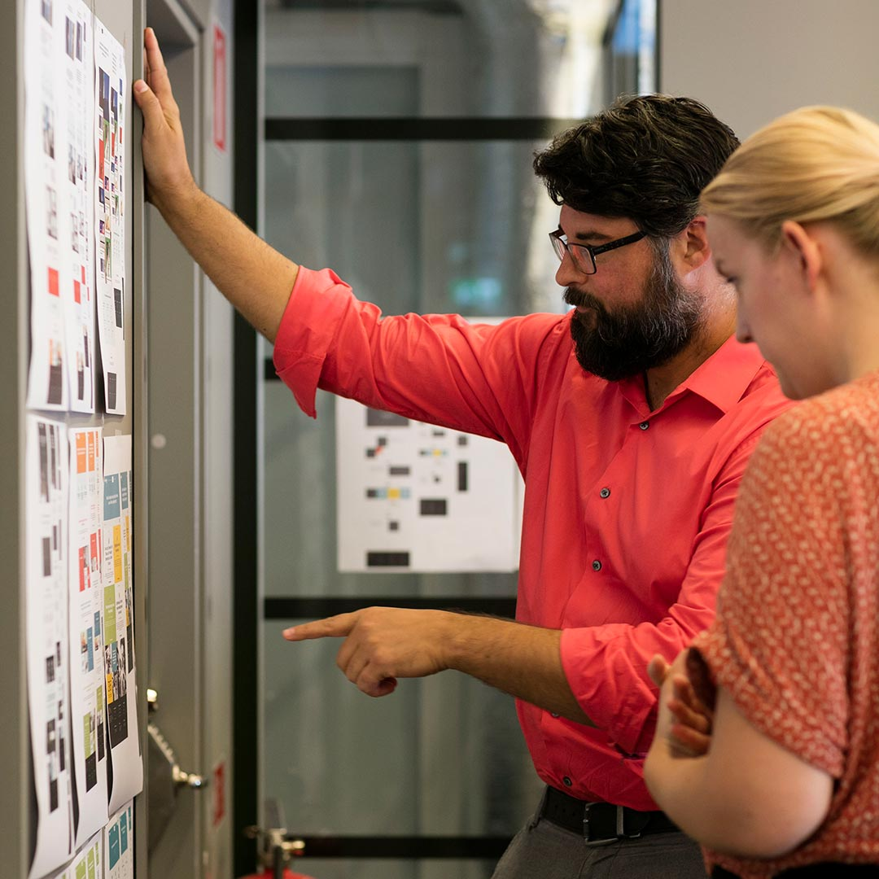
01. AML and Fraud Detection
02. Traditional implementation
03. Kafka quick walkthough
04. Utilize kafka for AML
05. The streaming data platform
06. Agendapunkt 6
07. Agendapunkt 7
08. Agendapunkt 8
09. Agendapunkt 9
10. Agendapunkt 10
Notes:
So in a bigger picture

Slide 23
One part in a larger picture
APP
APP
APP
APP
Streaming data platform
Approved
Loan application
Creditcheck taken
100
1000
UC
Notes:
Ofc more then one application
In the bigger perspective we can design our messages in a way so they can be easily reused, they communicate data from the domain they exist.
CLICK – trigger notification to related internal business that are interested, or even the customer when transactions or applications are made.
CLICK – or a CMS system that needs to subscribe on customer applications or transactions.
And ofcourse it needs to be robust, decoupled, scalable and fault tolerant.
CLICK - This way of modeling our domains we use to call a ”Streaming data platform”
CLICK – And that is why Kafka is a great fit for such use-cases. Thank you.

Slide 24

www.ffcg.se

