Slide 1
Implementing Anti Money Laundering with Apache Kafka®
Andreas Lundsten
Pär Eriksson
Notes:
Really excited to be here, hope you will enjoy
We both work as consultants at a consumer bank in Sweden.

Slide 2

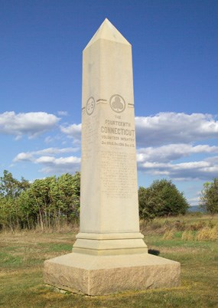
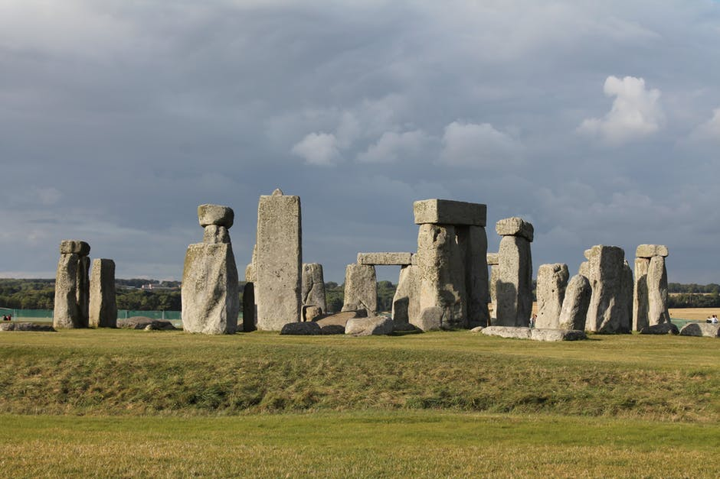


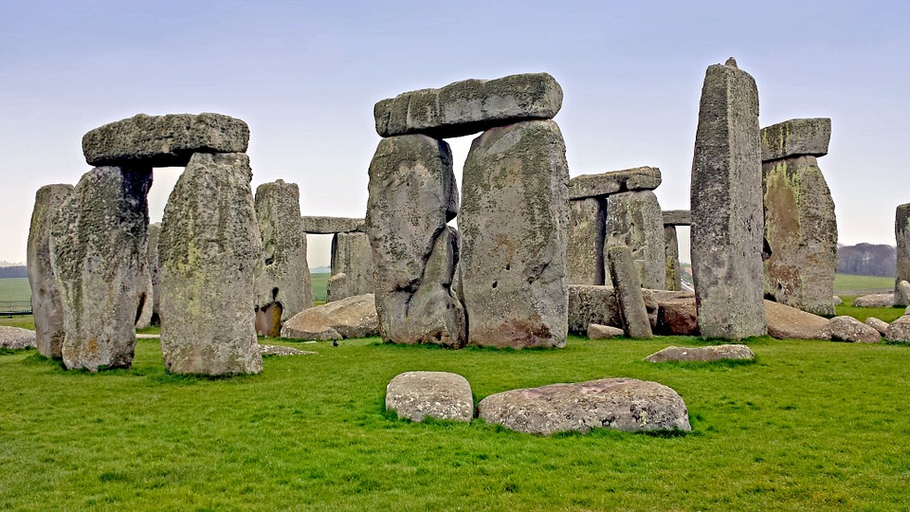
Notes:
So, banking...
If we picture google the word ”Bank”, we get pictures similar to this (CLICK)
Pretty expected - what is funny...
If we picture google the word ”Monolith”, we get pictures similar to this (CLICK)
Remarkable resemblence
Big ”pillars” of some content…
One might ask: Is this also something visible in the IT architechture – unfortunately yes…
Can be challiging when adapting to changes

Slide 3
AML
KYC
GDPR
PSD2
Notes:
As a bank, we have a lot of regulatory requirements that we need to fullfill, to continue operate as a bank.
Some examples – gå igenom
Can be challanging when the architecture is not agile enough
Lot of lecagy
One common aspect is that these affects many of our core systems
In our case, how do our architecture look?
Lets go back one decade and see how it has evolved!

Slide 4

1st gen
TCP
File
MQ
Notes:
We open up the bank
A few systems: a couple of monoliths
Communication patterns: pretty old
Custom TCP protocols,
File batches,
MQ
Then we needed to expose the data to a web layer

Slide 5
2nd gen
WS/SOAP
Notes:
Introduction of integration bus/ESB
Communication patterns, Adapters, WebServices
After a while, we realized the ESB became a monolith itself

Slide 6
3rd gen
WS/SOAP
WS/REST
Notes:
Microservices pattern
Decoupling responsibilities on a system level
Enabling faster changes and time to market
However, since replacing old legacy system can be expensive and hard, we still live with those also.
Where we were, a year ago...

Slide 7




RISK
AML
Notes:
Our goal: Implement AML
AML for banks – 4 basic requrements
Verifying customers identity – authentication: need to know we’re dealing with the correct person
Screening – need to look up the customer in public PEP and sanction lists. PEP stands for Politically Exposed Persons.
Risk evaluation on our customers. Not a credit risk, but risk for commiting money laundering, terrorist finance, or identity theft
This risk is base for transaction monitoring – making sure the transaction patterns matches what can be expected.
So, how did we map these requirements to a IT solution?

Slide 8

4th gen
Card transactions
Monitoring
Customer information
Events!
Notes:
Of course - we had our architecture as a starting point
Microservice enabled and stuff
CLICK - But dynamically - actual data flows– it was organized into ”silos” or isolated flows
Describe each… "one isolated flow handling..."
CLICK - Communication between these was often based on daily file batches.
Since all these was relevant for AML ,to make a great solution, we needed to integrate these flows much closer to each other
CLICK - Luckily – there was hope! One of these apps (couple of years old) was built with a event-centric design
Customer info app where each state change -> event
CLICK – We saw the possibility to publish these events to Kafka
We saw the dawn of a 4th generation of the architecture
How did we go forward with this idea?

Slide 9
”All systems should communicate asynchronously over a pretty new technology called Kafka!”
”NO!”
”Sounds expensive!”
”Transactional guarantees?”
”We like the old and proven”
Notes:
Did we introduce it as a radical change in the architecture?
CLICK – risk of getting these kind of "objections"
After all: it's a "bank" we're talking about
We had to start of small to keep the initial risks low

Slide 10

Impact
”Radar” line
Time
Notes:
We in the dev team saw the potential in Kafka, and a way of "re-thinking the way we treat data and services" (as Ben Stopford put it)
But that can be a bit freigthning for the rest of the organization
CLICK - So we wanted to stay ”under the radar” initially by starting small - a way to integrate services
Then, over time, let the technology and mindset have a larger impact - replacing more and more of our integrations, databases and processes

Slide 11
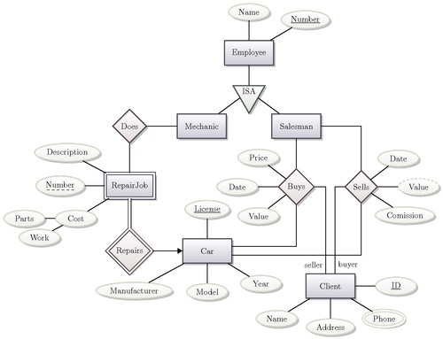
Event
VS.
DB-model
Notes:
As we started to talk about information being present in the form of events on Kafka, instead of being stored in databases behind CRUD APIs, we saw a shift in the way we could communicate with the business side.
It’s all about our primary way of modelling and discussing about information. For most businesses, the interesting parts lies in what _happens_ in the bussiness – the dynamic flows.
E.g. ”A item is placed in the shopping card”
”A sum of money is moved from one account to another”
SO, If the right hand side is our primary way….

Slide 12
Relations
Restrictions
Cardinality
Inheritence
etc...
Dynamic operations on a static model
Notes:
Then, to be able to reason about the information, you need to understand the model mechanics, which includes things like
Relations, restrictions, cardinality, inheritence. other data structure related concepts
This can be a bit ”hard to get your head around” if you’re not familiar with data-models.
Which business people seldom are.
CLICK - The dynamic flow consist of operations on this static model.
Inserts, updates, deletes
On the other hand, if events are our primary way of modelling…

Slide 13
Event
What happened?
What meta-data is related?
Dynamic events are ”first class”
Notes:
We have a much less complex data structure to work with
Full focus can be placed on reasoning about information – what happened and what can be told about this?
CLICK – This way focuses on the dynamic flow
Dynamic information is our first class citizen
A lot simpler to work closely with the business side with this way of modelling information. - simpler data structure
A tight collaboration can be beneficial

Slide 14
Requirements/solution match
Testability
Reuseability
Business
IT
Notes:
If we can work together with business side, and agree on information and modeles, our experience are that:
CLICK
Less problem with requirement/solution mismatch.
We increase testability – business side can understand /be resonsible for acceptance testing
Increase the chance of reuseability – models are business domain centric and not invented by developers for developers

Slide 15

IMPLEMENTATION
Notes:
Let’s go a bit deeper on the technical side and look at the implementation
Thanks for me and I will hand over to Andreas.
Alright so now I will talk more of a technical and architectual point of view. And try to focus on how Kafka created value for us.

Slide 16


What we started with
CMS
Master customer application
Marketing
…
…
Notes:
We didnt completely start from the beginning. We have some legacy, but also some applications already suited for the architecture that we were aiming for. So we were not completely wandering in the dark.
(CLICK) For example we had a Master customer application . Containing customer data. Such as adresses, and engagements (bank products).
(CLICK) It is the main point for fetching customer related information for customer service, the app & website etc.
(CLICK) And also delivers data for CMS, marketing etc.
The java application was ”ta fördel av?” MongoDB with REST-services and AMQ queues..designed in a event-driven CQRS architecture.
So more or less we had event-sourced customer-application, we actually did store events in a mongoDB collection. But it was only used for minor processes.
One flow to handle customer data.
Separated from risk process. Decoupled the way we want it.
Either though we were unaware of Kafka when it was initially built, the design was well fitted for adding it later.

Slide 17

Transaction flow
ATM
Card-terminal
Transaction authorization master
Card ledger
Online
Transaction analysis
Notes:
We also had a master transaction application responsible for managing payment authorizations and transactions.
It was responsible for collection transactions from several different sources souch as ATM’s card-terminals and online payments.
Much of this flow is unchanged.
On the other side it communicates with a Card-ledger to handle card-validity etc.
It was also exporting data batchwise for monitoring etc.
The central part of the application is a drools based rule-engine with static rules to decide on payment authorizations requests.
The application has a great need of low latency and availability. (Obviosly) Which was OK.
Problem was with the availability of data in the rule engine. So the challenge we were standing for was a way to make smarter rules without affecting latency.

Slide 18
Original architecture
C
Transaction authorization master
Rules
Transaction
Approval decision
Card ledger
Customer
information
Notes:
In the broader picture we had something looking like this.
Not connected
Strictly ”hardcoded” rules, only based on data from the transaction itself.
SOAP/JMS/TCP kommunikation
Customer information:
Transaction history:
SQL
Gammal skit säger vi
Batchbaserad arkitektur
It was fast, but static rules with lack of avalible data was a problem.

Slide 19
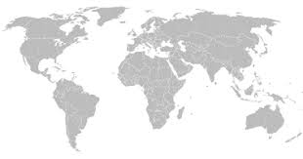

Technical challenges
Testing
How to test a global transaction process?
Lack of monitoring
Complicated and negative performance
Evolvment
Slow moving
Notes:
Problems:
Either though the bank only has Swedish customers, transactions are global.
Hard to test payment terminals in Brazil.
Lack of monitoring, based on application logs.
Intense application logging would affect performence.
Evolvment:
Slow
Implementation needs dual point of work.
Part lack of microservice environment.
Lägg till slide för extern applikationer.
Lägg till extra slides för aggregering
LÄgg till demo slide i slutet
Bygg ut demo-appen med state-stores etc.http://mba-admin-atlassian1/bitbucket/projects/POC/repos/kim-event-processor/browse/stream-processor/src/main/java/se/kf/cm1/streams/util/CustomerEventMerger.java

Slide 20

Solution
Transaction decision platform
Card ledger
Customer
state store
Aggr. transaction
state store
Transaction History
state store
Customer
information
Notes:
Solution:
Gives possibility to complex rules based on several datasources.
Real-time machine learning -> Possibility to find anomalies in real time.
CustomerInformation app
Small change.
Publishing events on Kafka topic
Still keepeing seperation of concernes
Customer state store:
Constructs customer state strictly based on customer events.
Also input from historic transaction decision results
Transaction state store
Holds transaction history
Möjlighet för andra applikationer att konsumera utgående & inkommande events i realtid. Ex CRM, pushnotiser till användare etc.
Replikering
Fokus på plattformen, inte applikationsgränser.
Framtida use-cases, klura påt.

Slide 21
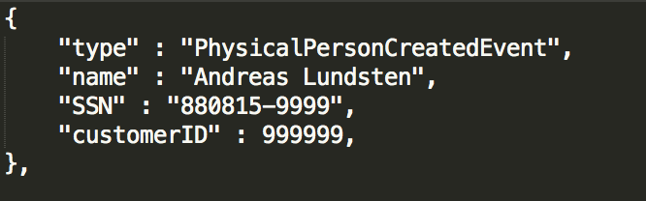
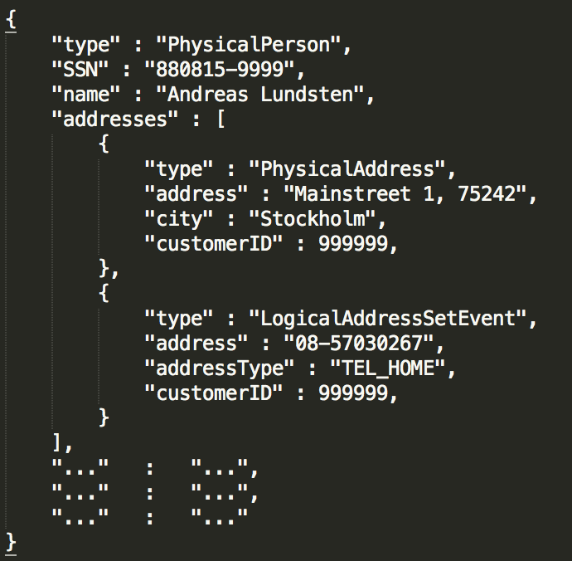
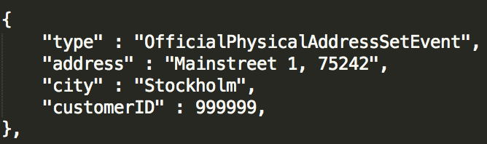
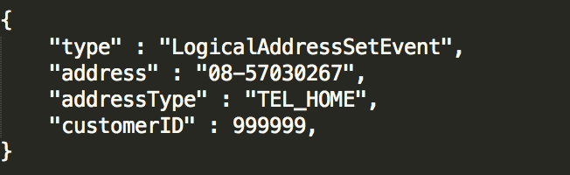
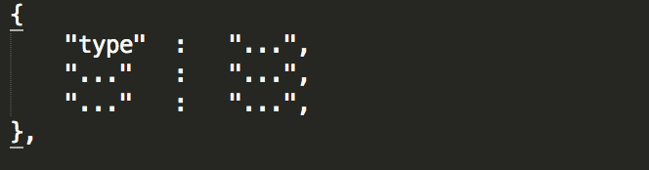
Local state store
(Rocks DB)
Notes:
So we wanted to take advantage of other part of Kafka then just messaging handling
As we had a CQRS event architecture already in place for our customer information application. It was easy for us to also publish these to a Kafka topic.
We quickly realised that the data in these events were interesting from a risk-evaluation point of view. But how could we in a streaming-application build a statefull dataview of a customers aggregated data?
(CLICK) heres an example of how these events look like.
(CLICK) By implementing a local state store that are streaming events, we could build create quirable customer dataviews. Everything within a Kafka streams application.
(CLICK) A request to that state store could return something like this.

Slide 22
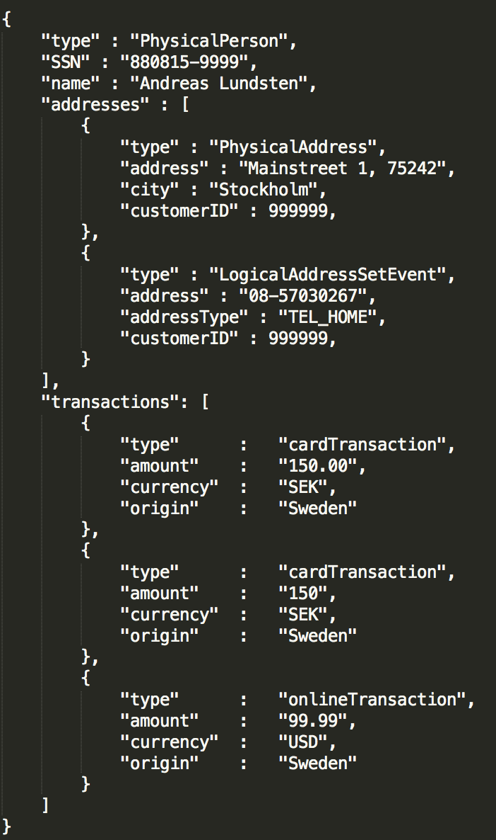
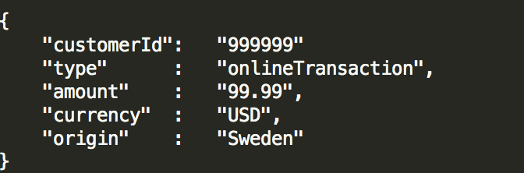
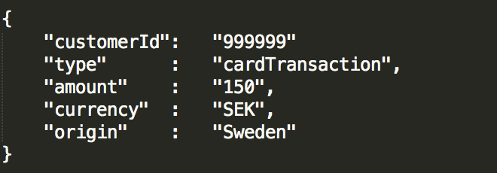
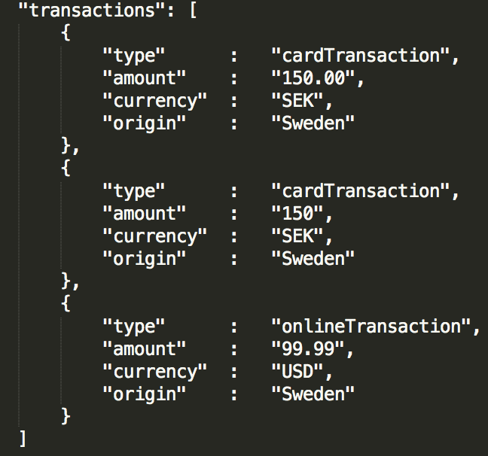
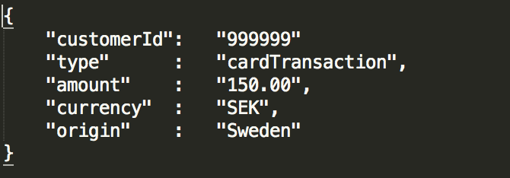
Local state store
(Rocks DB)
C
Notes:
Another example is how we include historical transactions in the folded customer view. This is then used to write more intelligent rules.
The input data is a kafka topic which includes transactions. They look like this.
(CLICK)
We then process these in a kafka-streaming application and enrich the customer view.
(CLICK)
Finished result might look something like this, where transactions are included in the customer view.
Interesting about this is that historic transactions plays a part in decision-making of future transactions. So you can say that IN a way we built a machine learning architecture strictly by taking advantage of Kafkas persistence functionality through state-stores.
Besides customer and transaction information we also store customer-risk evaluation

Slide 23

Mob app
CRM
Kibana
Notes:
By contaning data within the kafka cluster we can easily connect external applications.
Keeping seperation of concerne.
The mobile app still have customer data availible, but now without putting heavy load on customer master though REST-requests. Instead it is consuming directly from a Kafka topic.
It also solves the problem with monitoring that we had earlier.
We can monitor the tecnical architecture out from the dataflow.
Aswell as a BI point of view with business data.
As a sideeffect it gives us flexibility to add new apps later. Which is in line with the business plan to grow.
Etc.
Build for the future
Flexibility
Scalability through Kafka cluster in place
Business growth

Slide 24
KYC
Risk-scores
Transactions
Transactions
Data
REST
Monitoring
Analytics
Batch-jobs
Interface
Bank-giro
Customer service
Mobile app
Web
Consumers
Notes:
My managing the different funktionality in Kafka we build a robust streaming platform where Kafka is the key compontent.
Data is contained in Kafka.
Interface are updated to support streaming data.
Consumers are still consuming the same services. They see now change except real-time streaming data, lower response times and better availability.

Slide 25

DEMO

Slide 26
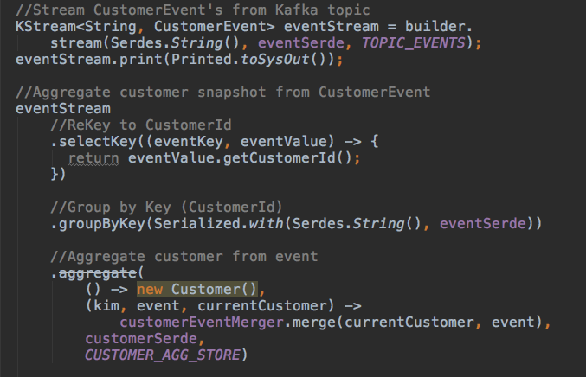
Notes:
By contaning data within the kafka cluster we can easily connect external applications.
Keeping seperation of concerne.
The mobile app still have customer data availible, but now without putting heavy load on customer master though REST-requests. Instead it is consuming directly from a Kafka topic.
It also solves the problem with monitoring that we had earlier.
We can monitor the tecnical architecture out from the dataflow.
Aswell as a BI point of view with business data.
As a sideeffect it gives us flexibility to add new apps later. Which is in line with the business plan to grow.
Etc.
Build for the future
Flexibility
Scalability through Kafka cluster in place
Business growth

Slide 27
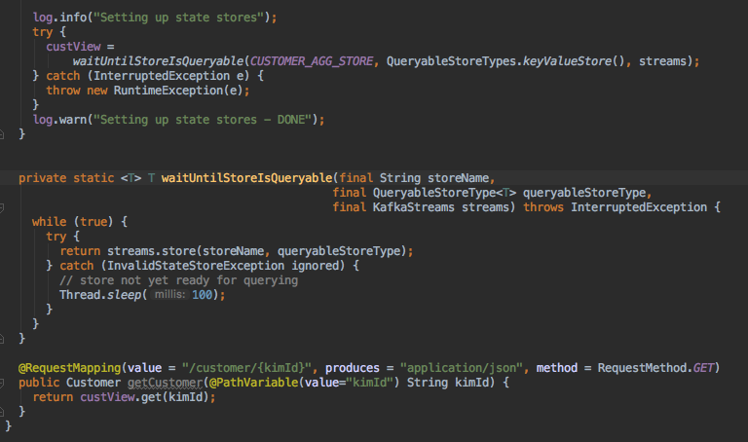
Notes:
By contaning data within the kafka cluster we can easily connect external applications.
Keeping seperation of concerne.
The mobile app still have customer data availible, but now without putting heavy load on customer master though REST-requests. Instead it is consuming directly from a Kafka topic.
It also solves the problem with monitoring that we had earlier.
We can monitor the tecnical architecture out from the dataflow.
Aswell as a BI point of view with business data.
As a sideeffect it gives us flexibility to add new apps later. Which is in line with the business plan to grow.
Etc.
Build for the future
Flexibility
Scalability through Kafka cluster in place
Business growth

Slide 28


Questions
Pär Eriksson
par.eriksson@ffcg.se
Andreas Lundsten
andreas.lundsten@ffcg.se

