Slide 1
GPU acceleration of Smith Waterman and PairHMM algorithms
Antonio Marusic
antonio.Marusic@mail.polimi.it June 30, 2024
DEIB – Dipartimento di Elettronica Informazione e Bioingegneria

Slide 2
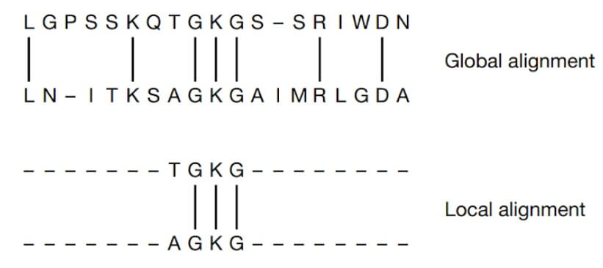
Background

Slide 3
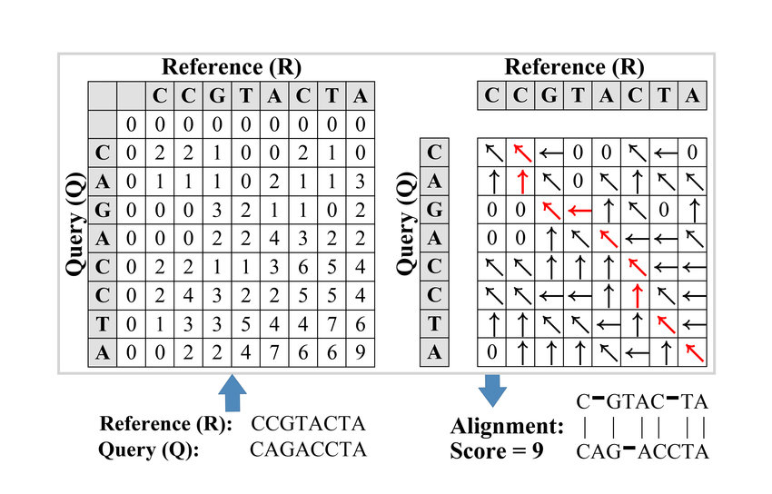
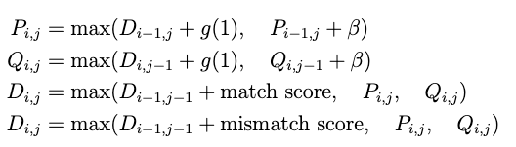
Smith Waterman

Slide 4
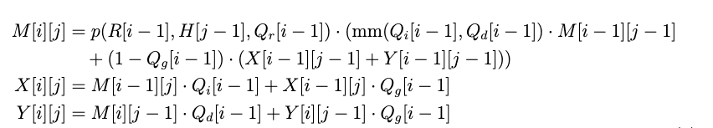
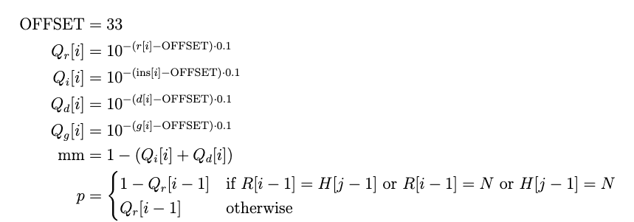
Pair Hidden Marcov Model

Slide 5
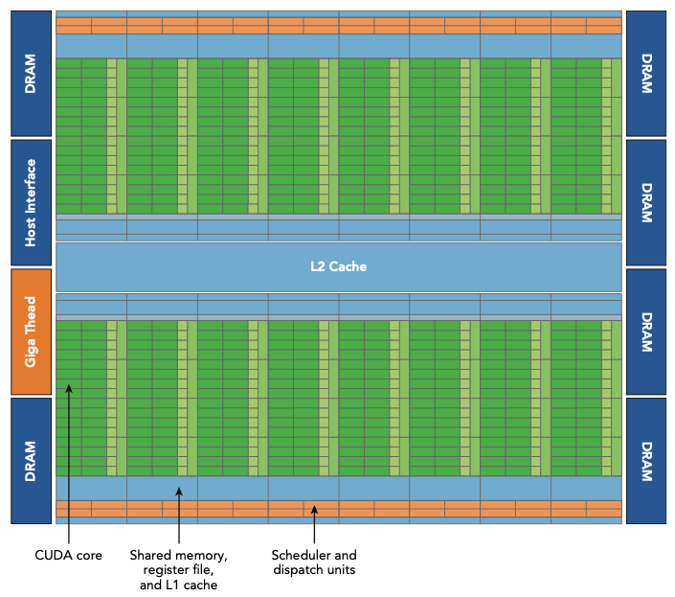
Architectural overview of a GPU
Streaming multiprocessors
L1 and L2 cache
Device memory
Registers
Threads and Blocks
Warp execution

Slide 6
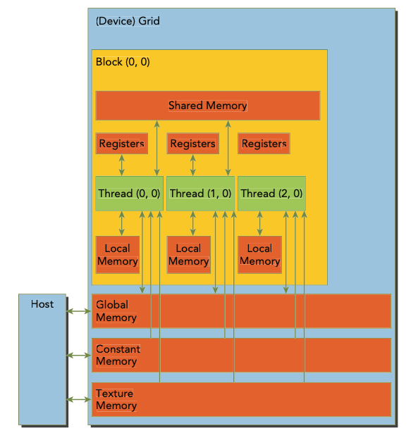
Memory hierarchy of a GPU
Allocation of global memory from the host
Declarations of kernel variables
Device memory contains local memory
How to use shared memory

Slide 7
GPU implementation
Parse data
Copy data in global memory
Copy in reverse to allow coalesced data access
Declare shared memory space
Declare block and grid size
Start the kernel
Attention on sinchronization

Slide 8
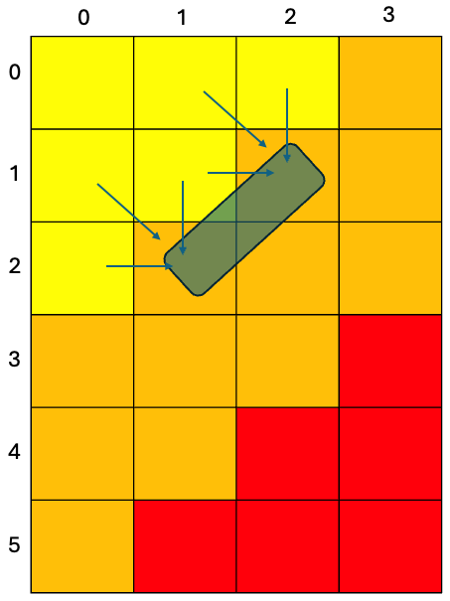
GPU implementation 2
3 phases of the algorithm
Dependent data
Sliding window

Slide 9
Tests and results
50k sequences aligned pairwise
Inputs with sequences of variable length
Parameter tuning of block size

Slide 10
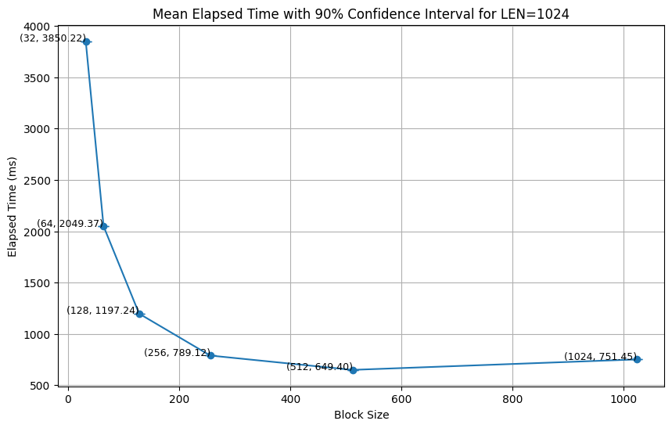
Input length 1024

Slide 11
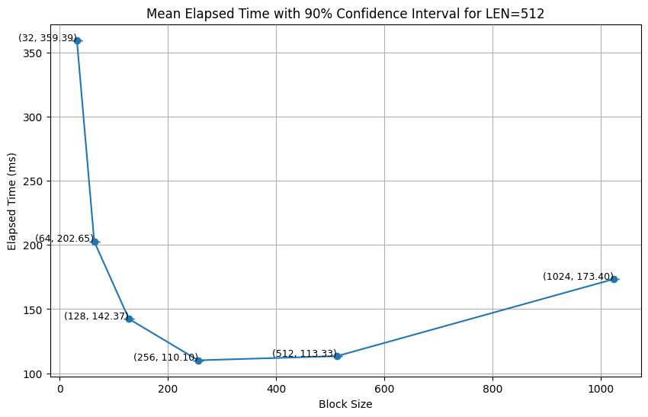
Input length 512

Slide 12
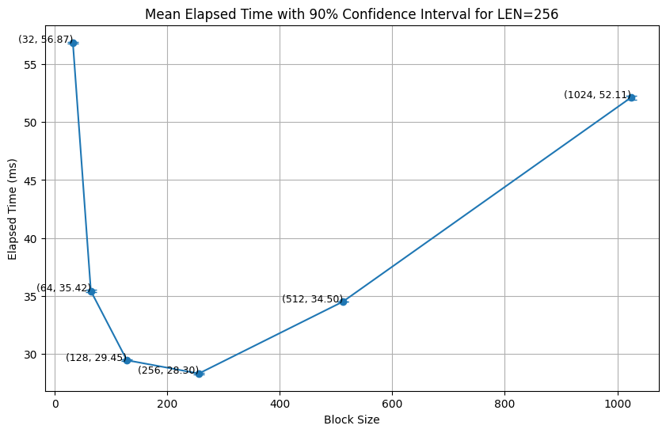
Input length 256

Slide 13
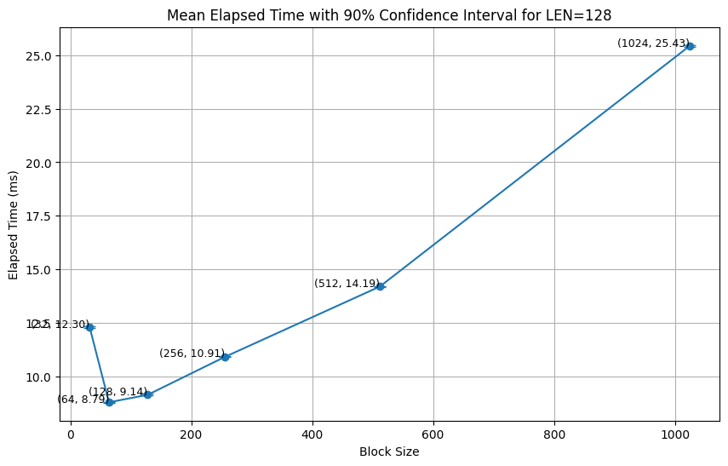
Input length 128

Slide 14
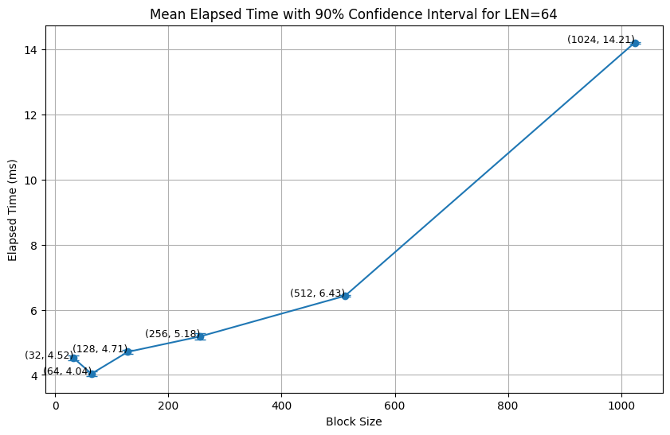
Input length 64

Slide 15
Thank you for the attention

Slide 16
0
1
2
3
0
1
2
3
4
5

