Slide 1
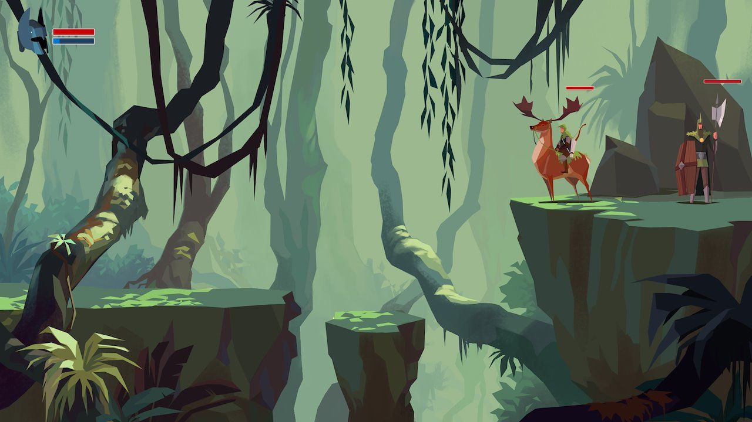
FLABBY
ANTHEA ASOBOLA

Slide 2
wHo I @m
I'm an eighteen year old girl .
I love music , basketball , Iove to read and to create both stories and music, last and most importantly I love food(GOOD food).
And recently I really enjoy code.

Slide 3
wH@T I BU!Lt
I built a game called flabby which is a replica of flappy bird.
I used u-tube w3 schools geeks for geeks and so many other code platforms
I intend to keep developing it and I believe it will look better next year when iv heard more time and research.

Slide 4
Q&A
I'm open to your questions feel free to ask.
Or send questions
@ asobolaanthea@icloud.com

