Slide 1
Chapter 2 - UNIX History
Born in 1969, developed as an alternative to the batch process computer systems.
Brainchild of Ken Thompson and Dennis Ritchie from Bell Labs.
  At the time, Ken Thompson was developing a program named Space Travel under Multics on General Electic 6000 series computer.
    Multics, one of the first OSs the provided multiuser environment. Large, slow and required substantial resources.
  Then Thompson Transfer the Space Travel to PDP-7, and created UNIX.
Take advantages of Multics and other OSs.
08/31/09
Notes:
08/31/09

Slide 2
UNIX History
Originally written in assembly language, then rewritten in C language(95%) in 1973.
  A very small part, is still written in assembly language considering the performance. That part concentrated in kern, interacts directly with hardware.
Used mostly by researchers & colleges
  In 1975, Bell labs offered UNIX to educational institutes at minimal cost.
  Students learned UNIX and brought it to commercial world.
08/31/09
Notes:
08/31/09

Slide 3
UNIX History
Two major versions of UNIX exist
  AT&T UNIX version V
  Berkeley UNIX
Every other version of UNIX is based on one of these two
Berkeley software distribution (BSD) UNIX was released by CRG ( Computer Reseach Group, Berkeley)in 1980
AT&T released UNIX System V in 1983
1991, Linus Torvald started Linux development.
08/31/09
Notes:
08/31/09

Slide 4
UNIX History
AT&T prosecuted BSDI company and CRG of Berkeley in 1992.
UNIX was sold to Novell company in 1993.
Novell renamed it’s UNIX version to UnixWare, and contributed UNIX brand to X/Open. Novell also allowed BSD continued to release if the codes in UNIX from AT&T was deleted.
After deleted codes from AT&T, BSD 4.4 lite was released, and CRG was dismissed.
08/31/09
Notes:
08/31/09

Slide 5
UNIX Standards
Several variants of UNIX exist today
AT&T UNIX conforms to SVID
  System V Interface Definition
Other UNIX companies use to POSIX
  Portable Operating System Interface for Computer Environments
  based on the System V interface
08/31/09
Notes:
08/31/09

Slide 6
Other UNIX Systems
Linux
Solaris
UnixWare
Open Source BSD UNIX
  FreeBSD, focus on Intel-based PC
  NetBSD, focus on cross platform.
  OpenBSD, focus on security.
Which UNIX to Learn
  Linux is UNIX in all aspects but name
  Linux. Easy, lowest cost, anything you learn with Linux is directly transferable to other UNIX systems.
08/31/09
Notes:
08/31/09

Slide 7
UNIX Overview
UNIX operates in layers, like any other operating system
  Kernel
  Resident Modules Layer
  Utility Layer
  Virtual Computer
  Processes
See Figure 2.1 P24
08/31/09
Notes:
08/31/09

Slide 8
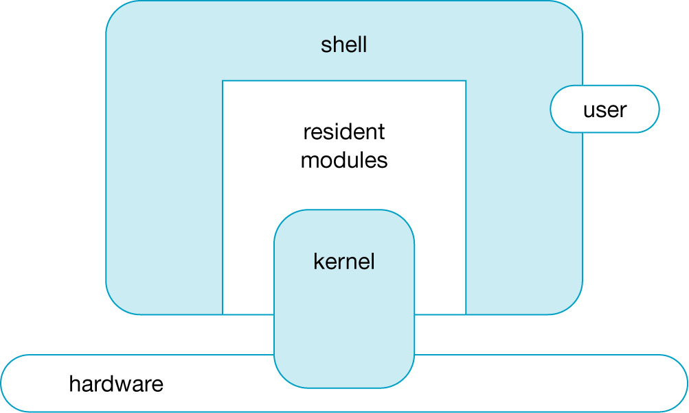
Figure 2-1: The Unix System Components
08/31/09
Notes:
08/31/09

Slide 9
UNIX Overview
Kernel (a.k.a. Base Operating System)
  Manages all hardware dependent functions
  Hardware functions are spread across a number of kernel modules
  Users have no direct access to the kernel
  Utility programs and UNIX commands are not part of the kernel
  The kernel protects a user’s applications from accidental access by other users
08/31/09
Notes:
08/31/09

Slide 10
UNIX Overview
Resident Modules Layer
  Service routines to perform user-requested services
  Controls ...
    Input/Output
    File & disk access (the file system)
    Create & terminate processes
  Applications use system calls to access the Resident Modules Layer
08/31/09
Notes:
08/31/09

Slide 11
UNIX Overview
Utility Layer (a.k.a. The Shell)
  UNIX user interface.
  Command layer of UNIX
  The shell, associated commands & utilities are part of UNIX ... but are not part of the kernel
  Over 100 commands provide services to users & applications
08/31/09
Notes:
08/31/09

Slide 12
UNIX Overview
Virtual Computer
  Allocates an separate execution environment to each user
  Consist of a terminal for user interface and shared access to the other computer resources such as memory,disks,CPU.
  The user appears to have their own isolated machine, a pseudo-computer
  Each virtual pseudo-computer is slower than the actual hardware, due to the sharing of resources
08/31/09
Notes:
08/31/09

Slide 13
UNIX Overview
Process
  Unix allocate resources to users & applications by the way of processes.
  Each process has a distinct ID number(pid), a set of resources is associated with the ID.
  Each process executes in a virtual computer environment
08/31/09
Notes:
08/31/09

Slide 14
UNIX Features
Portability
  OS written in C
  Easily ported to new hardware platforms
Multi-User Capability
  Many users can share resources
  Resources can be locked based on security preferences
08/31/09
Notes:
08/31/09

Slide 15
UNIX Features
Multi-Tasking
  Run multi tasks simultaneously.
  Users can switch between various tasks
Hierarchical File System
  Group data & programs for easy access
Device Independent I/O
  UNIX treats all I/O access as file access
  Just redirect I/O from one place to another
08/31/09
Notes:
08/31/09

Slide 16
UNIX Features
User Interface (Shell)
  simple, concise commands
  designed by programmers for programmers
  but ... no warnings, no feedback, no nets!
  Many kind of Shells. Command-driven, menu-driven, GUI
  the shell can be exchanged, based on user preferences.
  shell script allows programming
    Shell Script, is a file that consists of a series of commands.
08/31/09
Notes:
08/31/09

Slide 17
UNIX Features
Utilities (a.k.a. commands)
  text editing & formatting
  file manipulation
  e-mail & communications
  programming tools
System Services
  System administration service
  System reconfiguration service
  File system maintemance
  File Transfer Service, and more
08/31/09
Notes:
08/31/09

Slide 18

多选题
1分
Which Two major versions of UNIX exist today？
A
AT&T UNIX version V
B
Linux
C
Berkeley UNIX
D
FreeBSD
08/31/09
提交

Slide 19
多选题
1分
Which two major standards of UNIX exist today?
A
Common UNIX Standard(CUS)
B
Portable Operating System Interface for Computer Environments(POSIX)
C
General Interface of UNIX(GIOU)
D
System V Interface Definition(SVID)
08/31/09
提交

Slide 20
单选题
1分
The shell, associated commands & utilities are part of UNIX, but are not part of the kernel
A
true
B
false
08/31/09
提交

Slide 21
Review Exercises
Page 27
  Exercise 1,2,3,4,10
08/31/09
Notes:
08/31/09

