Slide 1

单选题
1分
The kernel layer manages all the hardware dependent functions.
A
True
B
False
提交

Slide 2
单选题
1分
The utility layer provides the user-interface.
A
True
B
False
提交

Slide 3
单选题
1分
The resident modules layer provides service routines that perform user-requested services.
A
True
B
False
提交

Slide 4
Chapter 3 - Getting Started
Establish Contact ... Logging In
Simple UNIX Commands
Getting Help In UNIX
Correcting Typing Mistakes
Shells & Utilities
More about Loggin In Process
Notes:
08/31/09

Slide 5

Logging Into UNIX
Users login to a multi-user system from a terminal
  Connected directly to the computer
    X Windows
    Command line
  Virtual terminal over a network
  telnet 202.112.123.67
ssh username@server_name or ip_addr
ssh student@172.112.126.11
System will display the UNIX version, and a login prompt
Figure 3-1 The Login Prompt
Notes:
08/31/09

Slide 6

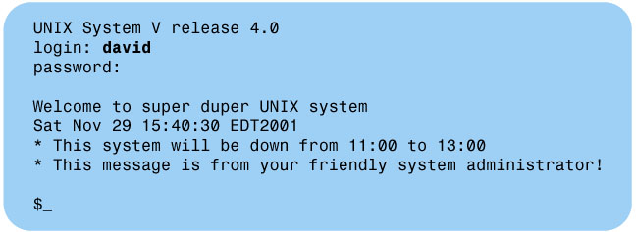
Figure 3-3 The Logging-in Process
Figure 3-2 The Password Prompt
Notes:
08/31/09

Slide 7
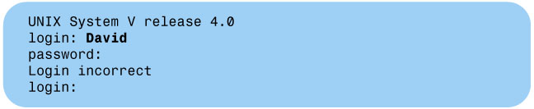
Incorrect Login
Figure 3-4 Incorrect Login

Slide 8
Don’t Like Your Password ...
Changing your password is often required the first time a user logs into a system
New password must
  Differ from the old one by at least three characters.
  At least six characters long, must contain at least two characters and one number
  Differ from your User ID
Use this command ... passwd
  Note: the passwords are never displayed on the screen
Notes:
08/31/09

Slide 9

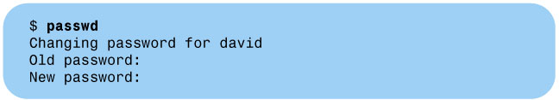
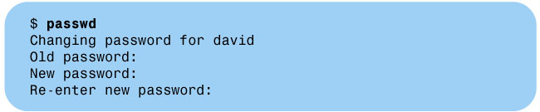
Figure 3-5: The Old Password Prompt
Figure 3-6 New Password Prompt
Figure 3-7 Re-Enter New Password Prompt
Notes:
08/31/09

Slide 10
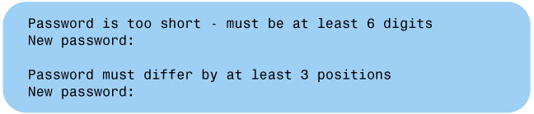
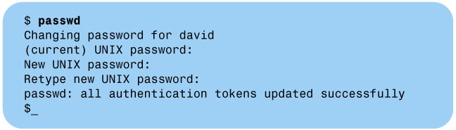
Figure 3-9 Changing a Password in the Linux Environment
Figure 3-8 Sample of Error Messages
Notes:
08/31/09

Slide 11
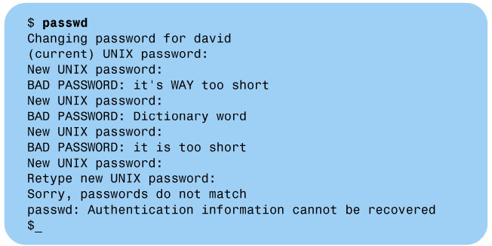
Figure 3-10 Sample of Error Messages
Notes:
08/31/09

Slide 12
Rules for Choosing Passwords
Do not use a dictionary word
Do not use the name of a person, pet, location, or a character from book.
Do not use any variation of your name and ID/account name
Do not use information about you,such as phone number, birthday, and so on.
Do not use a simple pattern for easy sequence of keyboard keys, such as 123456,abcdef.
Notes:
08/31/09

Slide 13
Safeguarding Your Password
Do not write down your password.
Do not place your password in a file.
Do not use the same password for all of your password-protected systems and activities.
Do not reveal your password to anyone.
Do not let anyone watch you entering your password.
Choose a hard-to-guess password.
Notes:
08/31/09

Slide 14
Ready To Go Home ...
When done at the terminal, a user should log out
  Releases resources
  Keeps others from accessing the user’s accounts
Hit <CTRL><D> to logout
  exit command
This returns you to the login prompt
Figure 3.11 (next slide).
Notes:
08/31/09

Slide 15
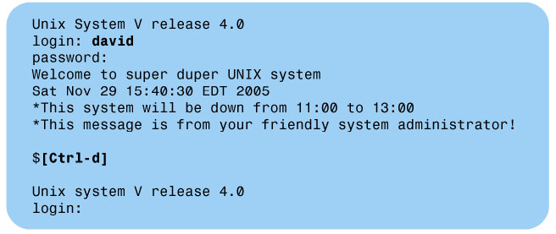
Figure 3-11: The Logging-In and Logging-Out Process
Note: Turning off terminal without logging out does not terminate your session with UNIX
Notes:
08/31/09

Slide 16

What Happens Next
Once logged in, you will see some system messages and the prompt
  Standard prompt is a dollar sign ($)
  This is the interface between user & shell
Now let’s run some commands
Type ‘date’ at the prompt and hit <Return>
  Wow ... the date and time showed up
Figure 3-13 The date Command
Notes:
08/31/09

Slide 17
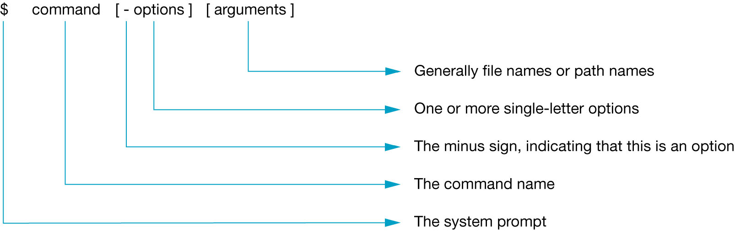
Command Line Structure
Each command line consists of three fields:
  command name
  options
  Arguments
Case-sensitive, command names in lowercase letters.
Figure 3-12 The Command Line Format
Notes:
08/31/09

Slide 18
Basic UNIX Commands
date ... what time is it?
who ... who’s logged into this system?
  try using ‘who am i’ instead
  use ‘who’ with options ...
cal ... make a calendar
  input determines month/year
  no arguments displays current month
  unless specified, current year is used
Figure 3.13 to Figure 3.21 (see the following slides)
Notes:
08/31/09

Slide 19
Figure 3-13 The date Command
Date and Time Display: The date Command
Notes:
08/31/09

Slide 20
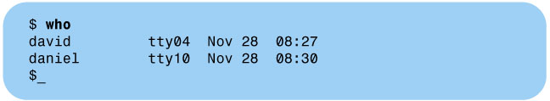
Figure 3-14 The who Command
Information on Users: The who Command
1. The first column shows the login name of the user
2. The second column identifies the terminal being used
3. The tty number gives you some indication about the location of the terminal
4. The third and fourth columns show the date and time that each user logged in
Notes:
08/31/09

Slide 21

Figure 3-15: The who Command with am i Argument
who am I
Notes:
08/31/09

Slide 22
who Options
Table 3.1 The who Command Options
Option | Linux | Operation
-q | --count | The quick who; just displays the name and number of users
-H | --heading | Displays heading above each column
-b |  | Displays the time and date of the last reboot
 | --help | Displays a usage message
Notes:
08/31/09

Slide 23
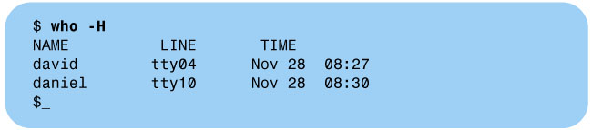
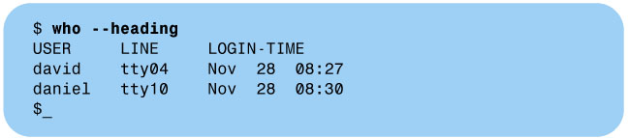
Figure 3-16A The who Command with -H Option
Figure 3-16B The who Command Using Linux --heading Option
Notes:
08/31/09

Slide 24
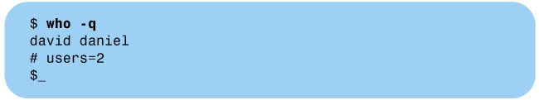
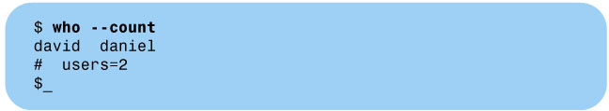
Figure 3-17A The who Command with -q Option
Figure 3-17B The who Command Using Linux --count Option
Notes:
08/31/09

Slide 25

Figure 3-18 The who Command with -b Option
Notes:
08/31/09

Slide 26
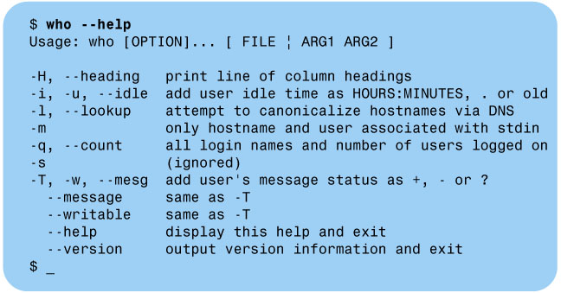
Figure 3-19 The who Command Using Linux --help Option
Notes:
08/31/09

Slide 27
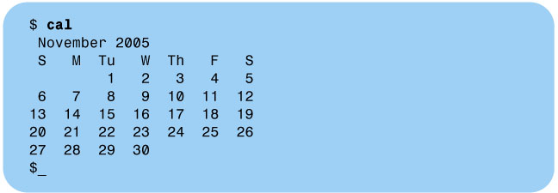
Figure 3-20 The cal Command with No Option
Display a Calendar: The cal Command
Notes:
08/31/09

Slide 28
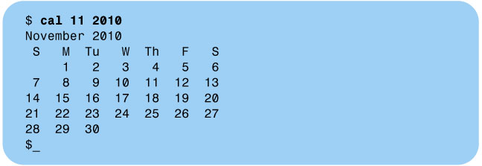
Figure 3-21 The cal Command Output
Displaying the calendar for November 2010.
Notes:
08/31/09

Slide 29
What about other commands?
We will cover many of the UNIX commands in this class, but not all of them
Use various help facilities in UNIX to get information on commands
  learn ... computer-aided instruction
  help ... menus of UNIX instructions
  man ... manual pages, organized by the command name (very useful)
Notes:
08/31/09

Slide 30
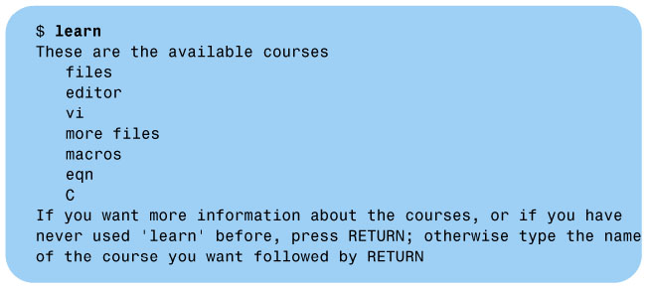
Figure 3-22 Learn Utility Main Menu
Using the Learn command
The learn command brings up a computer-aided instruction program that is arranged in a series of courses and lessons.
learn is not always installed on all UNIX systems
Notes:
08/31/09

Slide 31
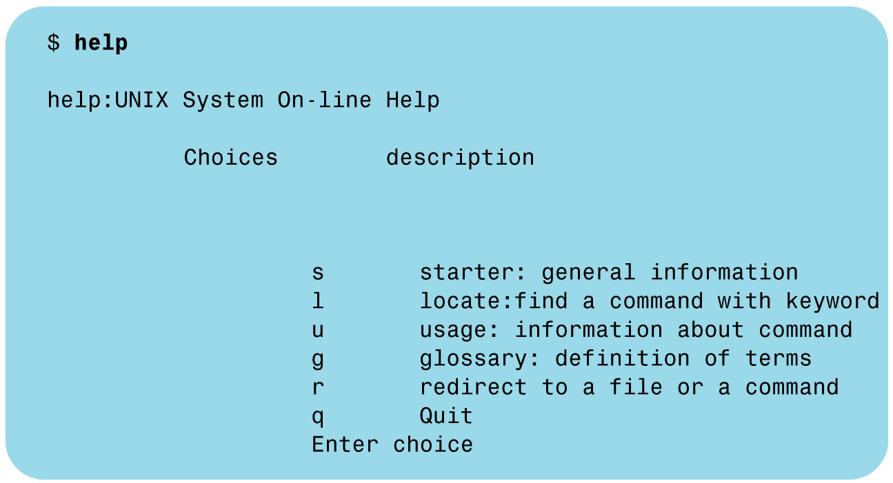
Figure 3-23 Help Utility Main Menu
Using the help Command
The help command is more popular than the learn command and is available on many UNIX systems.
help is not always installed on all UNIX systems
Notes:
08/31/09

Slide 32
Using the Electronic Manual: The man Command
Of those three, ‘man’ is the most common and provides the most information
  Type man followed by the name of the command
  You can use man to get the details about the commands
For example type:
man cal [Return]
(UNIX responds by showing a page similar to Figure 3.24)
Note:
Nearly all UNIX installations provide the man pages, and the man command is the most popular way to obtain detailed information about command usage and options.
Notes:
08/31/09

Slide 33
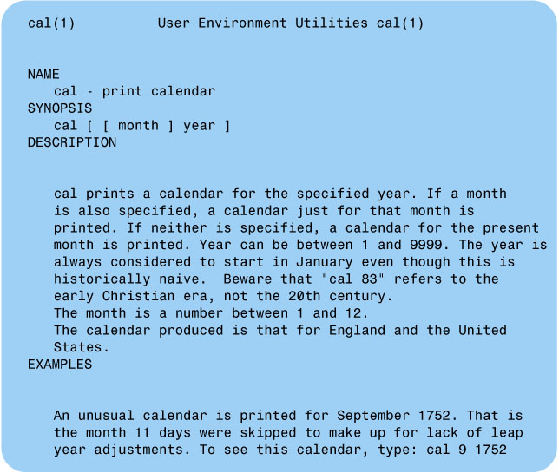
Figure 3-24 man Utility Display of cal
Notes:
08/31/09

Slide 34
Erasing Typing Mistakes
Erase character: the character that erases the command line a character at a time.
  [backspace]
  [Ctrl-h]
Kill character: the character that erase an entire line.
  [CTRL-U]
Notes:
08/31/09

Slide 35
Killing Programs
Interrupt character,the character that terminates your running program.
  [CTRL-C] or [del]
  Brings you back to the shell ($)
  Doesn’t work on background applications, just the current foreground task ... more on this later
Notes:
08/31/09

Slide 36
Shells & Utilities
The ‘shell’ lies between the user & the rest of UNIX
Shell Commands
  Part of the particular shell the user has selected (shells can be interchanged)
  Executed within the shell program
Utility Programs
  executable programs separate from the shell program used by UNIX
Notes:
08/31/09

Slide 37
Different Shells
There are dozens of UNIX shells today, but we will focus on the most common
  Bourne Shell (sh), standard shell that is part of most UNIX. Promt is $.
  Korn Shell (ksh), superset of the Bourne Shell. Promt is $
  C Shell (csh), part of BSD UNIX. C language style syntax. Promt is %
  Bourne Again Shell(bash), part of Linux. Based on Bourne Shell. Promt is $.
The book ‘s default shell Bourne Shell.
  Commands applicable to the korn shell or bourne again shell only will be identified by the ksh designation or bash designation.
Notes:
08/31/09

Slide 38
Changing Your Shell
Whatever shell you are using when you login to a UNIX system is assigned to your account by the system administrator
You can easily change your current shell by typing the name of the shell you want to use
  For example:
  $_ . . . . . . . . . . . . . . . . . . . . . Assuming you have Linux and your current shell is (ksh)
  $ bash [Return] . . . . . . . . . . Change the current shell to bash
  bash$_ . . . . . . . . . . . . . . . . . Prompt indicating the shell in use is bash
  bash$ exit [Return] . . . . . . . Exit bash and return to ksh
  $_ . . . . . . . . . . . . . . . . . . . . . .Prompt shows the shell in use is ksh
Notes:
08/31/09

Slide 39
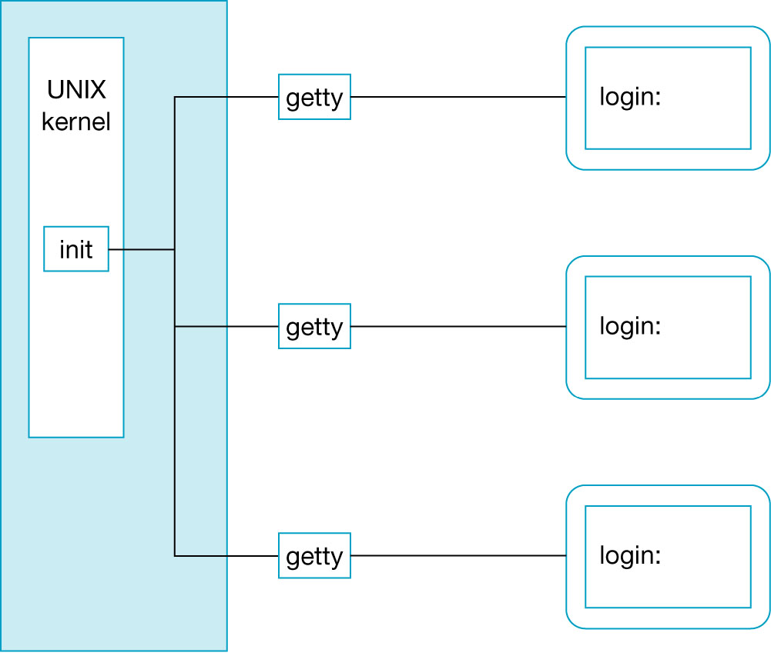
Figure 3-26 getty Displays the login: Prompt
MORE ABOUT THE LOGGING-IN PROCESS
Notes:
08/31/09

Slide 40
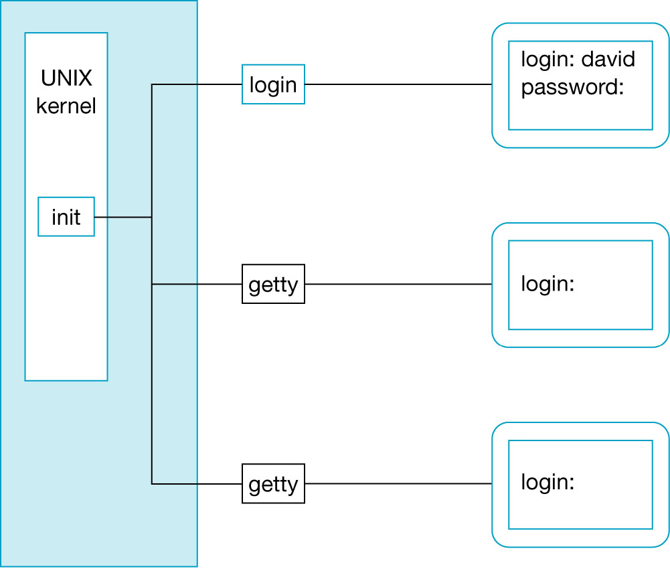
Figure 3-27 login Displays the password: Prompt
Notes:
08/31/09

Slide 41
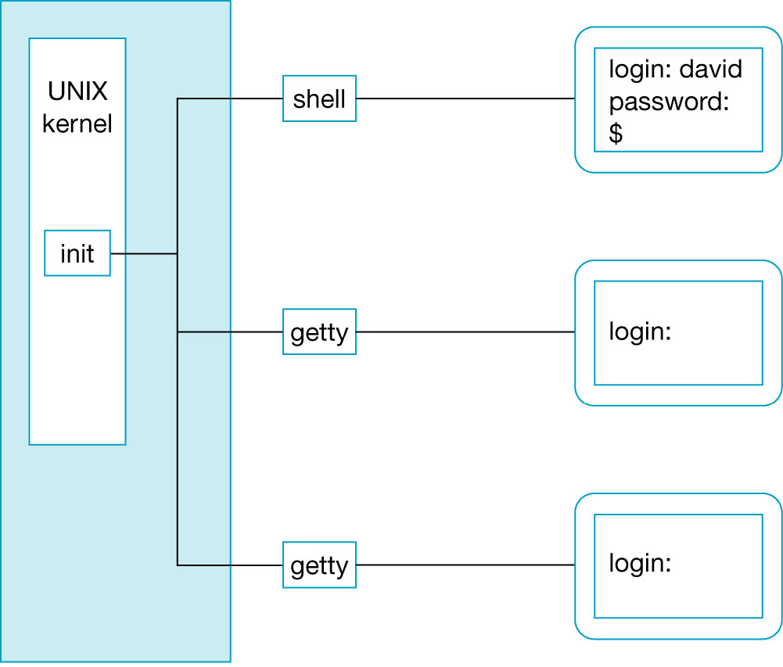
Figure 3-28 The Shell Program Displays the $ Prompt
Notes:
08/31/09

Slide 42
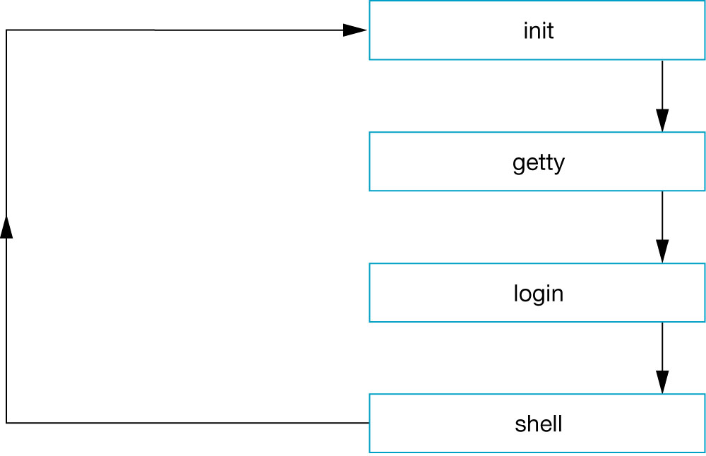
Figure 3-29 Logging-In and Logging-Off Cycle
Notes:
08/31/09

Slide 43
Quick Summary
Introduced the concept of the OS
  Separation of layers
We have introduced UNIX
  What it is
  Basic layers
  How to login
Introduced some simple UNIX commands.
Notes:
08/31/09

Slide 44
单选题
1分
The argument part in the command line cal 2 2001 is
A
cal
B
2 and 2001
C
only 2001
提交

Slide 45
单选题
1分
The option part in the command line “who -H am I” is
A
who
B
am i
C
-H
D
-H and am i
提交

Slide 46
单选题
1分
You log off from the system by
A
typing exit command or [Ctrl-d] key
B
typing good bye
C
just turning the terminal off
D
none of the above
提交

Slide 47
单选题
1分
The command to change your password is
A
passwd
B
pass
C
pwd
D
chpass
提交

Slide 48
单选题
1分
The command arguments are
A
mandatory part of the command lin
B
optional part of the command line
C
the same for all commands
D
placed before the command name
提交

Slide 49
单选题
1分
Which one of the followings is the most popular way to obtain detailed information about command usage and options?
A
learn
B
info
C
man
D
help
提交

Slide 50
投票
最多可选1项
Did you install the WSL and Ubuntu on you personal computer after last lesson?
A
Yes
B
No
提交

Slide 51
投票
最多可选1项
Did you rent a host in the public cloud computing platform such as Ali cloud or Tecent cloud?
A
Yes
B
No
提交

Slide 52
Review Exercises
Exercise 7,8,13,14,15
Notes:
08/31/09

