Slide 1
Chapter 4 - vi
You won’t get far in UNIX without learning something about ‘vi’
  vi is a text editor
  vi is in every version of UNIX
  confusing, yet powerful

Slide 2
So what’s an editor?
A program that allows users to create and modify files
  Sort of a cut-down word processor
Two types of editors
  Line editor
    changes are applied one line at a time
  Screen editor
    display the file on the screen
    see the whole file, can move the cursor around the screen and make changes.

Slide 3
Editors in UNIX
ed - the original line editor
ex- A more sophisticated superset of the ed editor.
vi - a visual version of the ‘ex’ line editor, developed as its own program
emacs - an editor with macro capabilities
nroff & troff - text formatters, preparing text for publication

Slide 4
vi
vi is a screen editor
Two versions of vi
  view
    is the same as vi, except it will only view files (read-only)
  vedit
    is vi with some settings changed for beginners
Not every UNIX system has these two versions on it.

Slide 5

单选题
1分
The vi editor
A
is a line oriented editor
B
is a screen oriented editor
C
is supported in most of the UNIX installations
D
is a text formatter
E
B and C
提交

Slide 6
vi - Modes of Operation
Command Mode
Text Input Mode
Status Line (Exit Mode)

Slide 7
Command Mode
The mode vi starts in
any keys are interpreted as commands
  delete lines
  search/replace
  move the cursor
  all sorts of things
some commands begin with :, ? and /
  more on this later

Slide 8
Text Input Mode
well, it is a text editor
entering text mode allows stuff to be put into the text file
exit text mode and you’re back into command mode

Slide 9
Status Line(Exit Mode)
feedback on line 24
shows error messages & information
shows some commands typed in command mode
  commands starting with :, / , ?

Slide 10
Basic vi
This section explains how to ...
  Create a new file (or open an existing one)
  Entering text
  Deleting text
  Searching text
  Changing text
  Save the changes & exit vi

Slide 11
Access to the vi Editor
Starting vi, initially in command mode
  vi myfirst [Enter]
Changing to text input mode
  Press i key on keyboard(for insert)
Back to command mode to left vi
  Press [Esc]
Ending vi
  type : to display status line
  type wq [Enter] to left vi
See figure 4.1-4.3 in following slides

Slide 12

Figure 4-1 The vi Editor Blank Screen
$vi myfirst [Enter]
initially in command mode

Slide 13
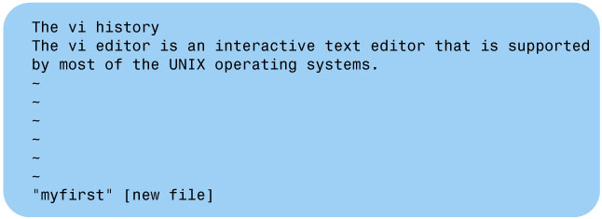
Figure 4-2 The vi Editor Display Screen
Press i key on keyboard(for insert),
Changing to text input mode

Slide 14
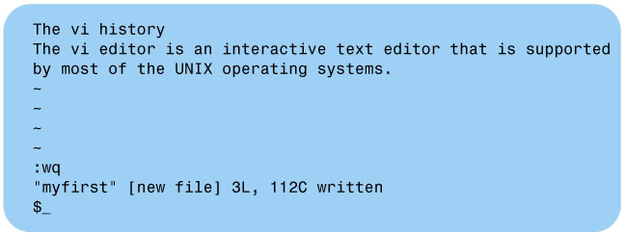
Figure 4-3 The vi Editor Screen After the wq Command
Press [Esc] back to command mode,
type : to display status line
type wq [Enter] to left vi

Slide 15
单选题
1分
Pressing the letter i in command mode places the vi in the insert mode (text mode).
A
True
B
False
提交

Slide 16
单选题
1分
The command to exit vi and save your file is
A
w!q
B
qw
C
wq
D
WQ
提交

Slide 17
Cursor Movement keys
Under commnad mode, use the cursor movement keys to move the cursor around the screen.
Table 4.2 Partial List of the Cursor Movement Keys
Key | Operation
h or [Left Arrow] | Moves the cursor position one space to the left.
j or [Down Arrow] | Moves the cursor position one line down.
k or [Up Arrow] | Moves the cursor position one line up.
l or [Right Arrow] | Moves the cursor position one space to the right.

Slide 18
Working in text input mode
Table 4.3 The vi Change Mode Keys
Key | Operation
i | Inserts the text you enter before the character that the cursor is on.
I | Places the text you enter at the beginning of the current line.
a | Appends the text you enter after the character that the cursor is on.
A | Places the text you enter after the last character of the current line.
o | Opens a blank line below the current line and places the cursor at the beginning of the new line.
O | Opens a blank line above the current line and places the cursor at the beginning of the new line.

Slide 19
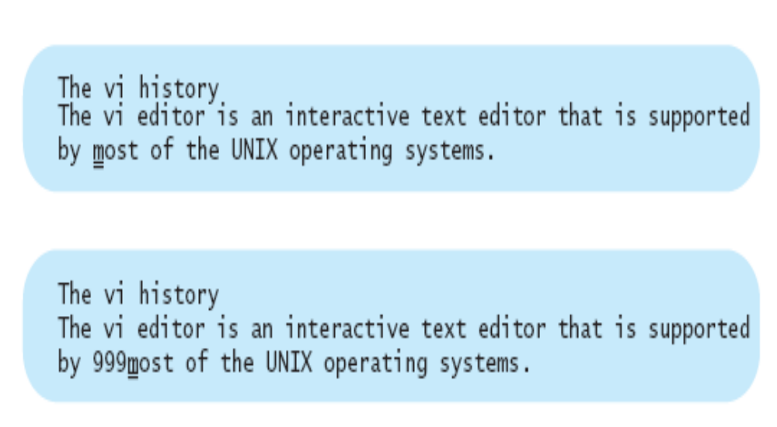
Experiment with i:
Press i
(vi enters the text input mode)
2. Press 9 three times (999 appears before the m)
(Cursor remains on the letter m, and the vi editor remains in the text input mode)

Slide 20
Experiment with I:
Use the cursor movement keys to place the cursor on the letter s of supported
Press I
(vi enters the text input mode and moves the cursor to the beginning of the current line)
Press 9 three times
(999 appears at the beginning of the current line, and the cursor moves to the T)
The vi history
999The vi editor is an interactive text editor that is supported
by 999most of the UNIX operating systems.
The vi history
999The vi editor is an interactive text editor that is supported
by 999most of the UNIX operating systems.

Slide 21
Experiment with a:
Use the cursor movement keys to place the cursor on the letter m of most
Press a
(vi enters the text input mode, and the cursor moves to the o)
Press 9 three times
(999 appears after the m)
The vi history
The vi editor is an interactive text editor that is supported
by most of the UNIX operating systems.
The vi history
The vi editor is an interactive text editor that is supported
by m999ost of the UNIX operating systems.

Slide 22
Experiment with A:
Use the cursor movement keys to place the cursor on the letter o
Press A
(vi enters the text input mode, and the cursor moves to the end of the current line)
Press 9 three times
(999 appears after the period)
The vi history
The vi editor is an interactive text editor that is supported
by m999ost of the UNIX operating systems.
The vi history
The vi editor is an interactive text editor that is supported
by m999ost of the UNIX operating systems.999₌

Slide 23
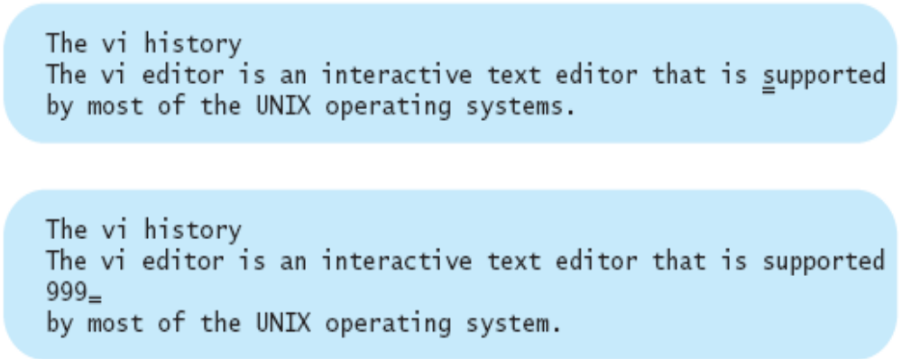
Experiment with o:
Use the cursor movement keys to place the cursor on the letter s of supported
Press o
(vi enters the text input mode, opens a line below the current line, and moves the
cursor to the beginning of the new line)
Press 9 three times
(999 appears on the new line)

Slide 24
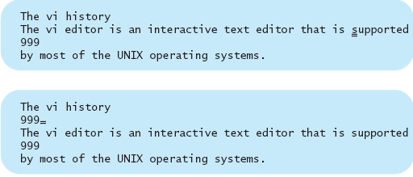
Experiment with O:
Use the cursor movement keys to place the cursor on the letter s of supported
Press O
(vi enters the text input mode, opens a line above the current line, and moves the
cursor to the beginning of the new line)
Press 9 three times
(999 appears on the new line)

Slide 25
Working in command mode
vi’s cursor movement keys
  See table 4.4 (the following slides)
Keys for correcting text in command mode
  See table 4.5 (the following slides)
Pattern search: using / and ?
  /UNIX, searching forward for word UNIX.
  ?UNIX, searching backward for word UNIX
  Press n for next occurrence of UNIX
Repeating the previous change: using . (dot)

Slide 26
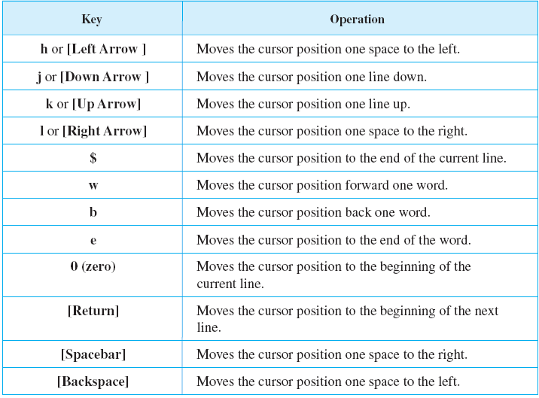
Table 4.4 vi’s Cursor Movement Keys

Slide 27
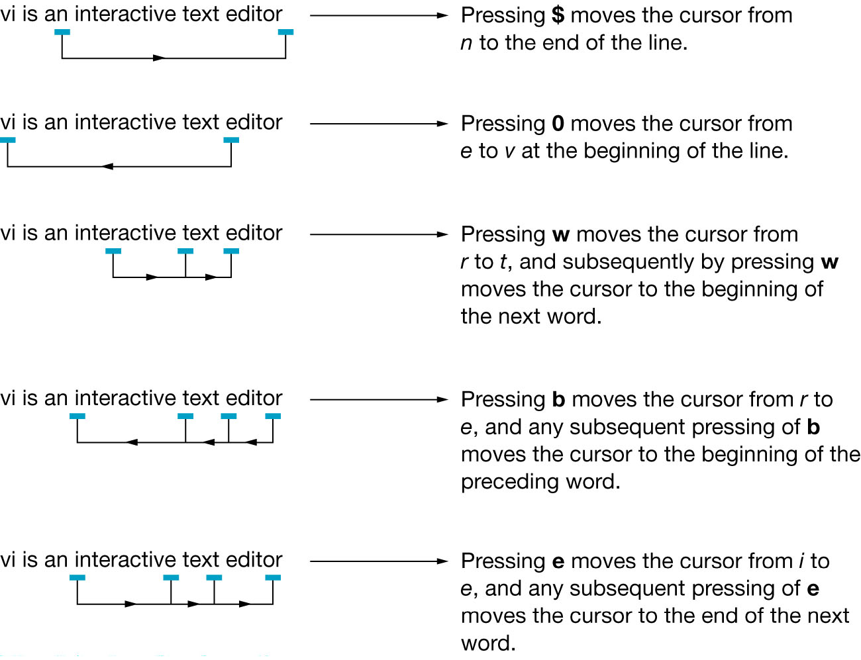
Figure 4-4 The Movement of the Cursor on the Screen

Slide 28
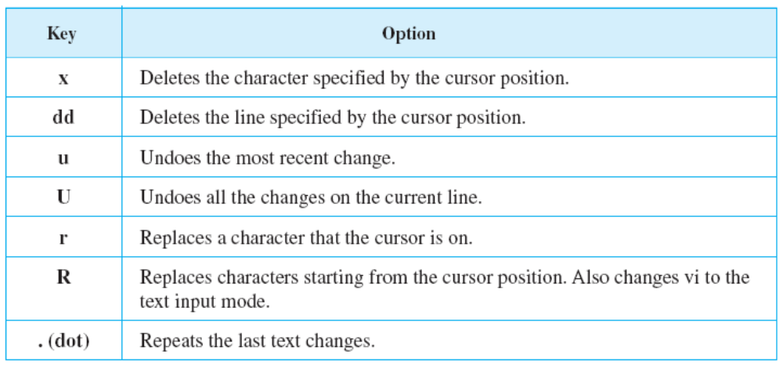
Table 4.5 The vi Editor Keys for Correcting Text in Command Mode

Slide 29
Character Deletion: Using x
Using x, you can delete characters starting from the cursor position:
Press x
(vi deletes the m, and the cursor moves to o, the next letter to the right)
(vi remains in command mode)
The vi history
The vi editor is an interactive text editor that is supported
by most of the UNIX operating systems.
The vi history
The vi editor is an interactive text editor that is supported
by ost of the UNIX operating systems.

Slide 30
Character Deletion: Using x
Press x three more times
(vi deletes o, s, and t, respectively, as you press x repeatedly)
The vi history
The vi editor is an interactive text editor that is supported
by _of the UNIX operating systems.
3. Press 5x
(vi editor deletes five characters and the cursor moves to the letter h)
The vi history
The vi editor is an interactive text editor that is supported
by he UNIX operating systems.

Slide 31
Deletion and Recovery: Using dd and u
By pressing d twice, you can delete a line, starting from the current line
1. Use the cursor movement keys to place the cursor on the letter m of most
The vi history
The vi editor is an interactive text editor that is supported
by most of the UNIX operating systems.
2. Press d twice
(vi deletes the current line, regardless of the cursor position on the line)
The vi history
The vi editor is an interactive text editor that is supported
3. Press u
(vi undoes your last delete)
The vi history
The vi editor is an interactive text editor that is supported
by most of the UNIX operating systems.

Slide 32
Deletion and Recovery: Using dd and u
Place the cursor on the letter T of The on the first line
Press 3dd
(This deletes three lines starting from the current line)
(vi remains in the command mode)
The vi history
The vi editor is an interactive text editor that is supported
by most of the UNIX operating systems.
_
~
~
6. Press u
(vi undoes your last delete)
The vi history
The vi editor is an interactive text editor that is supported
by most of the UNIX operating systems.

Slide 33
Experiment with r:
Place the cursor on the letter m of most
Press r
(To replace (overwrite) the character that the cursor is on)
Press 9
(vi changes the m to 9)
(vi remains in the command mode)
The vi history
The vi editor is an interactive text editor that is supported
by most of the UNIX operating systems.
The vi history
The vi editor is an interactive text editor that is supported
by 9ost of the UNIX operating systems.

Slide 34
  Experiment with R and U:
  Press R
  (to replace the characters starting from the cursor position)
  (vi enters the text input mode)
  Press 9 three times
  (vi editor adds 999 after the cursor position, overwriting ost)
  (The vi editor remains in the text input mode)
The vi history
The vi editor is an interactive text editor that is supported
by 9999 of the UNIX operating systems.
6. Press [Esc]
(to change to the command mode)
7. Press U to undo all your changes on the current line
(vi restores the current line to its previous state)
The vi history
The vi editor is an interactive text editor that is supported
by most of the UNIX operating systems.

Slide 35
Pattern Search: Using / and ?
  Forward slash (/) for searching forward through a file
  Question mark (?) for searching backward through a file
Example:
1. Press [Esc]
(To make sure vi is in command mode)
2. Type /UNIX and press [Return]
(vi looks for the word UNIX in your file, and positions the cursor on its first occurrence of the word UNIX)
3. Press n
(vi looks for the nest occurrence of the word UNIX)
If you prefer to search backward through the file:
4. Type ?UNIX and press [Return]
(vi continues to search backward as long as you press n)

Slide 36
Repeating the Previous Change: Using . (dot)
Experiment with . (dot):
Press [Esc] to make sure vi is in command mode.
1. Position the cursor on the letter m of most
2. Press dd
The vi history
The vi editor is an interactive text editor that is supported
by most of the UNIX operating systems.
The vi history
The vi editor is an interactive text editor that is supported
3. Press . (dot)
The vi history
~
~
~

Slide 37
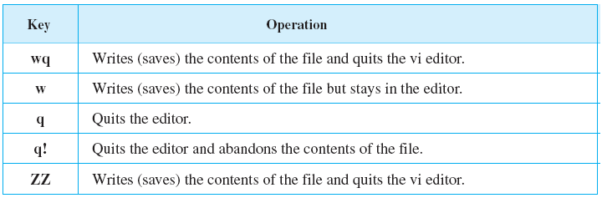
Exiting the vi editor
Table 4.6 The vi Editor Quit Commands
The vi editor modes of operation
  See Figure 4.5 p74

Slide 38
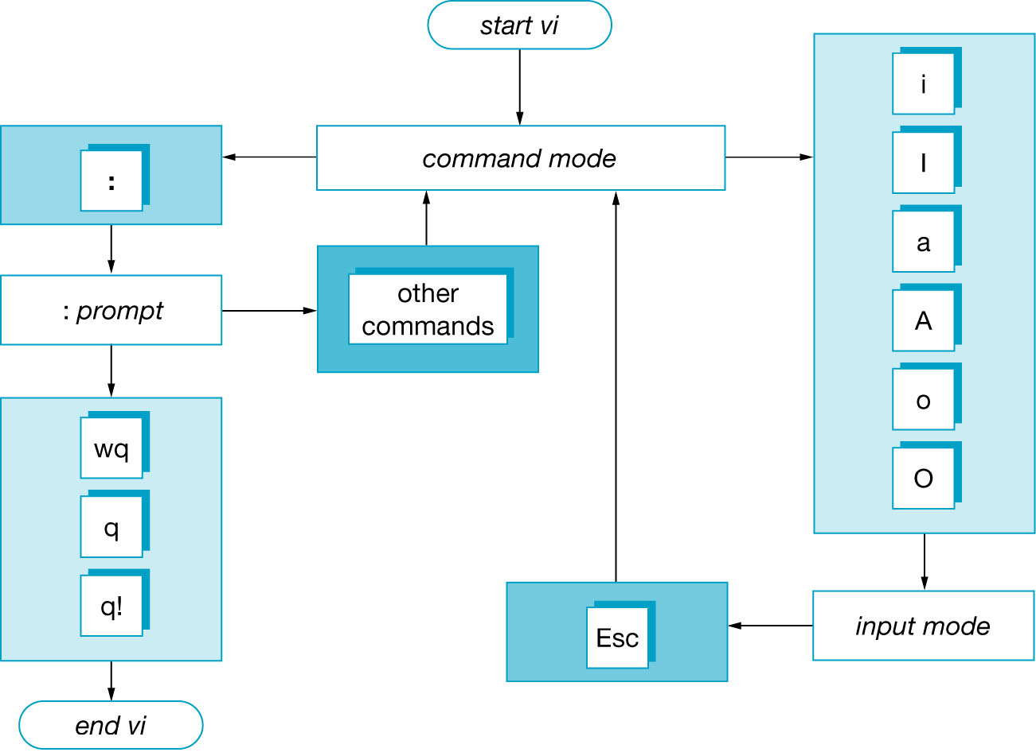
The vi Editor Modes of Operation
Figure 4-5 The vi Editor Modes of Operation

Slide 39
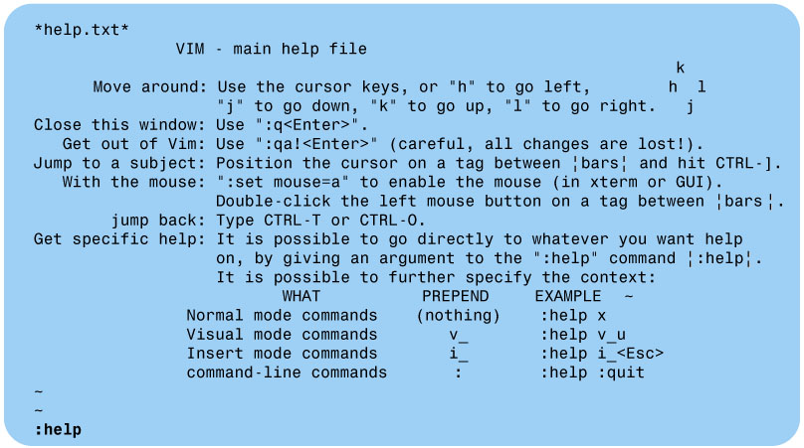
Figure 4-6 vim Help Screen
Linux: vi Online Help
Linux supports an enhanced version of vi called vim (vi improved). This version provides some extra command and features including an online help.
1. Type :help [Return]
(This will show a general help command)

Slide 40
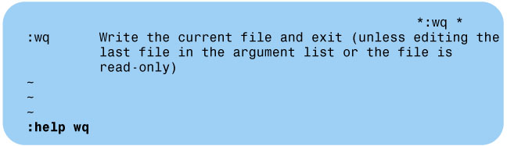
Figure 4-7 vim Help Screen for wq Command
To get help for a specific command:
1. Type :help wq [Return]
(Displays help screen for the wq command)

Slide 41
The Memory Buffer
vi places the text file into memory
the file is manipulated in memory
user must write changes back to disk before they are put back in the file

Slide 42
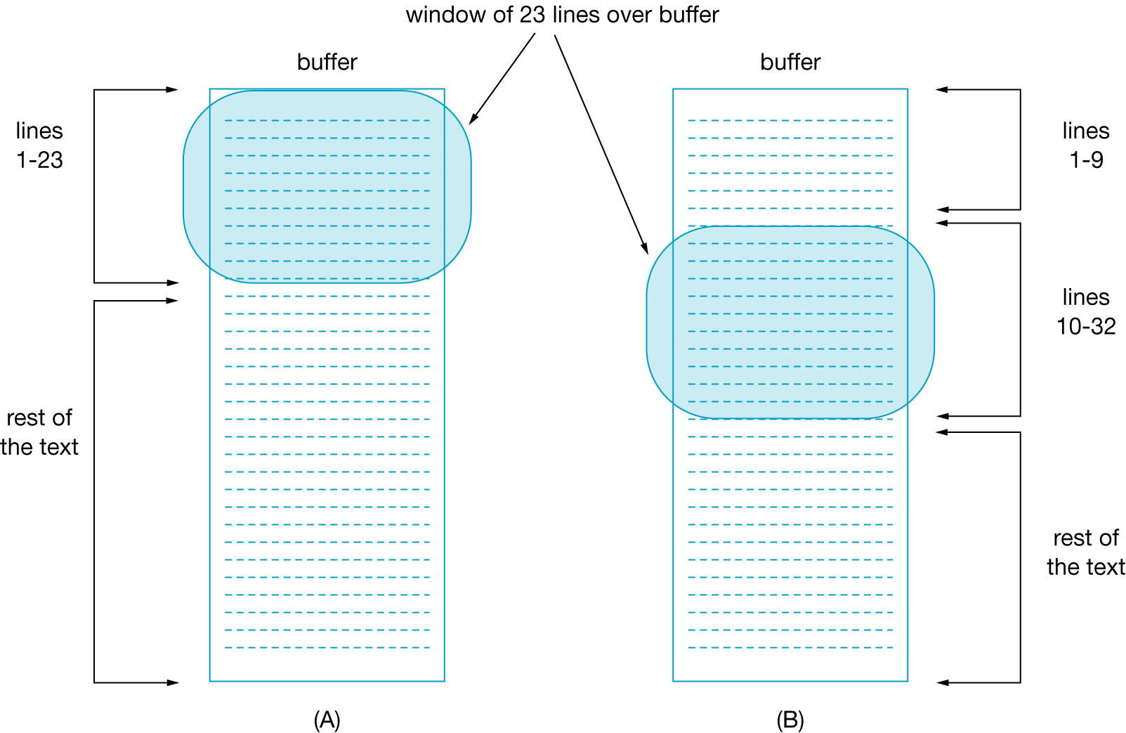
Figure 4-8 The vi Editor Temporary Buffer
THE MEMORY BUFFER

Slide 43
单选题
1分
The commands that place vi in the text input mode are
A
A and O
B
a and o
C
I and i
D
all of the above
E
none of the above
提交

Slide 44
单选题
1分
The command to delete 5 lines in the file you are editing is
A
dd5!
B
5dd
C
5delete
D
del 5
E
d5
提交

Slide 45
单选题
1分
The command to search for the word "hello" in the file you are editing is
A
/hello
B
\hello
C
s\hello
D
/hello/
E
hello?
提交

Slide 46
单选题
1分
In the text input mode of vi
A
keyboard becomes your typewriter
B
keys you press appear on the screen
C
keys you press are not interpreted as commands
D
pressing the space bar produces one space before the cursor position
E
all of the above
提交

Slide 47
单选题
1分
Pressing the Esc key twice places the vi in the command mode.
A
True
B
False
提交

Slide 48

Command Summary
Figure 4-9 The vi Editor Modes of Operation

Slide 49
Homework
P79
  Review Exercises 4~5, 7~20

