Slide 1
Chaper 5 - Intro to UNIX File System
Files are the basic system used by UNIX to store & organize your information
UNIX divides the system into smaller units of storage
  Directories
  Sub-Directories (nested under directories)
This sets up the basic file system used by UNIX (and most other OS)

Slide 2
File Types
A file is a sequence of bytes
UNIX has three categories of files:
  Regular Files - code, text, data, etc.
  Directory Files - info about other files
  Special Files - info for I/O and peripherals*
* UNIX treats I/O devices as files, so each system device has a file

Slide 3
Directories
A simple system of organizing files on your UNIX disk
UNIX organizes directories in levels
  “Hierarchical” structure
  The top directory is called ‘root’
  All other directories branch from ‘root’
Directories don’t contain your files, they provide a reference path for the files
See Figure 5.1 (as following slide)

Slide 4
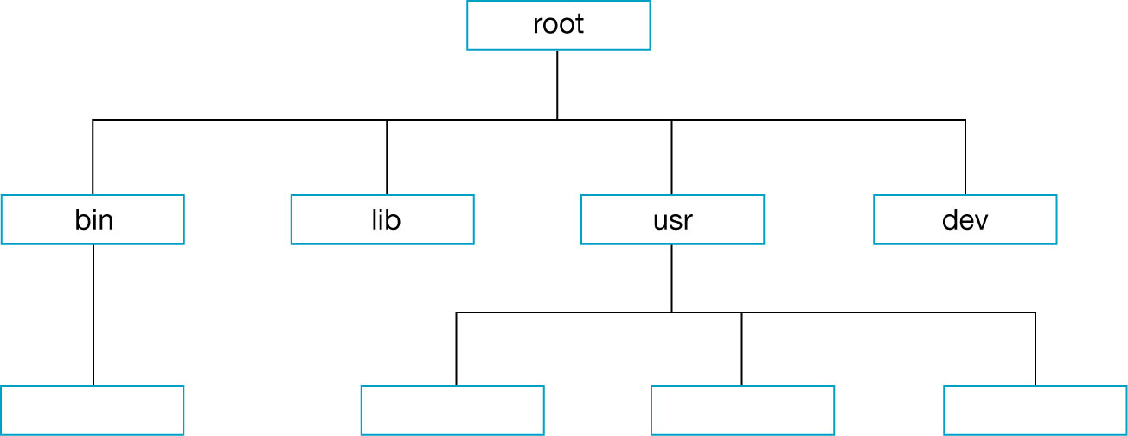
Figure 5-1 Directory Structure

Slide 5

单选题
1分
The directory structure is arranged in levels and is known as a hierarchical
A
True
B
False
提交

Slide 6
Parent & Child
The levels in the hierarchy are described using a parent/child relationship
  Parent is above the child in the hierarchy
  A parent may be the child of another directory
  Only the ‘root’ directory has no parent directory
  All directories trace back to ‘root’
  See Figure 5.2(as following slides).

Slide 7
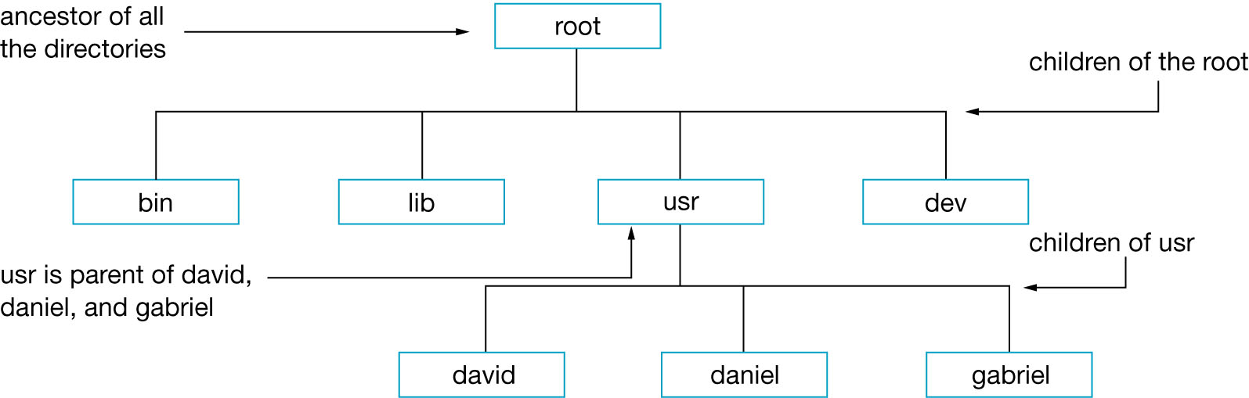
Figure 5-2 Parent and Child Relationship

Slide 8
Important Directories
/
  Root directory
/usr
  Holds many other user-oriented directories
    /usr/docs, /usr/man, /usr/bin…….
  In UNIX also hold users’ home directories,but linux don’t.
/bin
  Basic UNIX program files
/dev
  Holds device files
/sbin
  Holds system files that usually are are automatically by the UNIX system.
/etc
  Holds UINX configuration files

Slide 9
The Home Directory
A particular directory associated with user account
When log on, you are placed automatically into your home directory.
You can create files and subdirectories under it.
Usually has the same name as your account
Other user can’t access it.
See Figure 5.3 (as following slide)

Slide 10
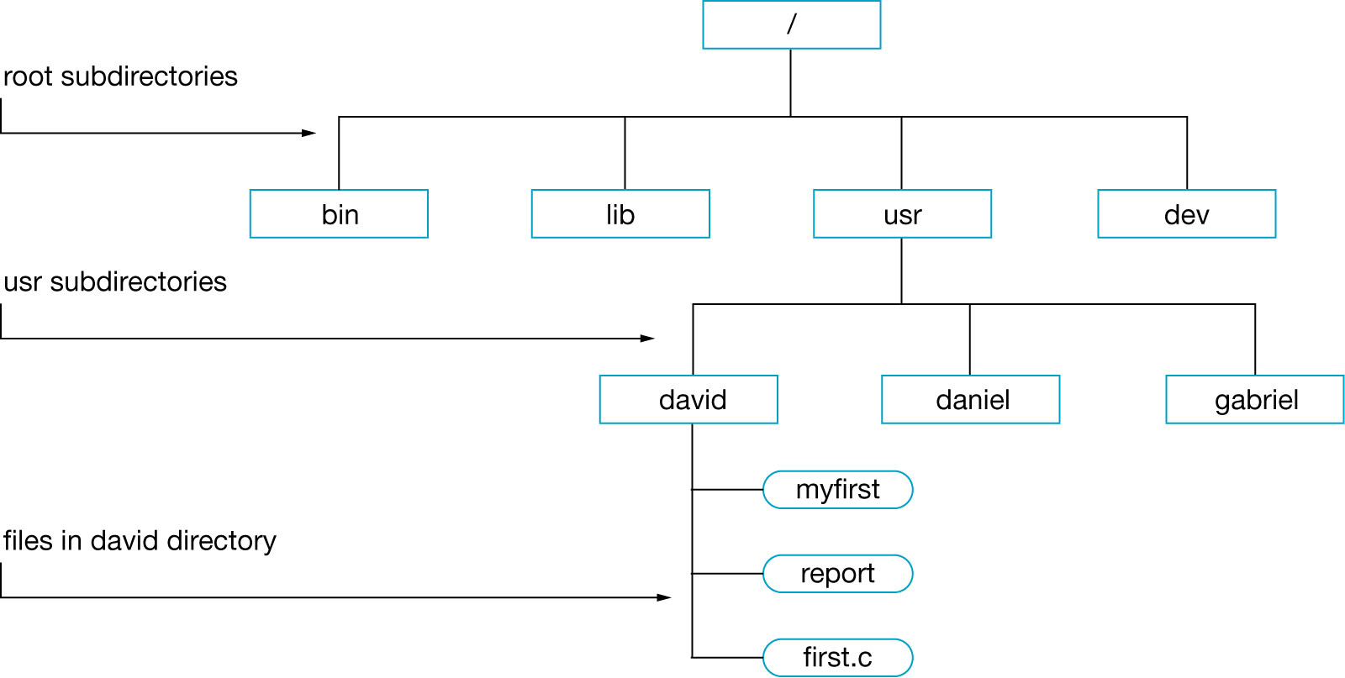
Figure 5-3 Directories, Subdirectories, and Files
home
For Linux systems

Slide 11
Working Directory
The ‘working directory’ is the directory you are currently working in
Accessing files in another directory requires that you …
  Make that directory the working directory
  OR
  Reference that directory when accessing the files in that directory
  (examples will be shown later)

Slide 12
Paths & Pathnames
Pathname … a reference to a file’s directory within the file system
  The pathname traces a ‘path’ for the file from the root directory down
A path ends with a file
  Ordinary file OR
  Directory file, which can have another branch of directories underneath
See Figure 5.4 (as following slide)

Slide 13
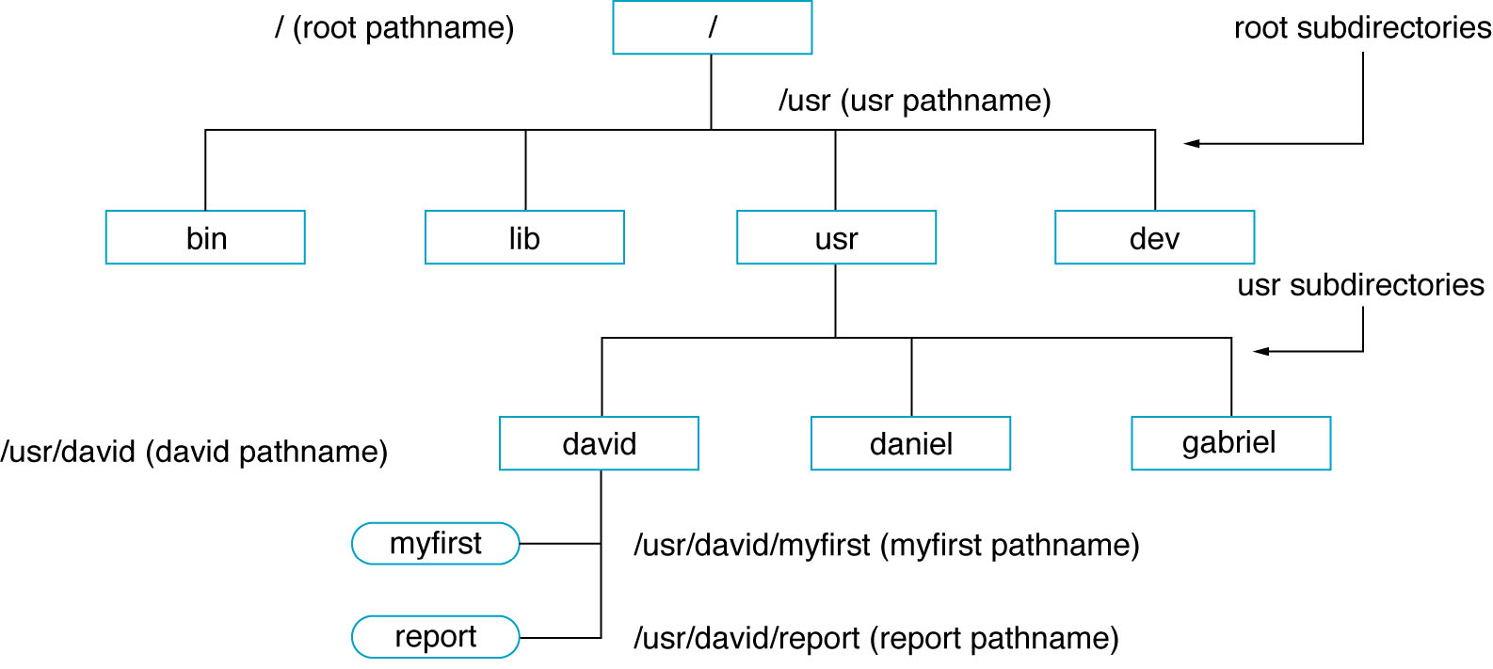
Figure 5-4 Pathnames in a Directory Structure

Slide 14
Pathnames
Absolute Pathname
  Path from ‘root’ (/) downward
  /usr/local/stuff/file.txt
Relative Pathname
  Path from working directory
  stuff/file.txt … which is only valid if the working directory happens to be /usr/local

Slide 15
单选题
1分
Every UNIX file system has a root directory named / (slash).
A
True
B
False
提交

Slide 16
单选题
1分
Which one of the following pathnames is considered an absolute pathname?
A
absolute/xyz
B
/bin/usr/u/se-bin
C
david/memo/c
D
Y/../xyz
E
YY/xyz/xxx/memo
提交

Slide 17
Filenames & Directory Names
Section 5.3.5 covers the rules for naming files in UNIX (see p90)
  Recommendation: combination of A-Z,a-z,0-9,_,.
  These apply to any version of UNIX, including FreeBSD & LINUX
  Remember, UNIX names are case sensitive
    file.txt , File.Txt & FILE.TXT are different
  Since UNIX names can be very long, use them to describe the file/directory contents
  NO SPACES! EVER! WE MEAN IT!

Slide 18
Extensions
Extensions further help to organize filenames
  Different types of files have different extensions (.txt for text, .c for C, …)
  Multiple extensions can be used
  file.has.more.txt
  Extensions are optional for files

Slide 19
单选题
1分
In UNIX filenames XYZ and xyz are indicating the same filename.
A
True
B
False
提交

Slide 20
单选题
1分
In UNIX filename extension is absolutely necessary.
A
True
B
False
提交

Slide 21
Directory Commands
So how do you navigate directories in UNIX?
  The shell has specific commands
  To try these out, login to your system
  See Figure 5-5 for an example file system(as the following slide)

Slide 22
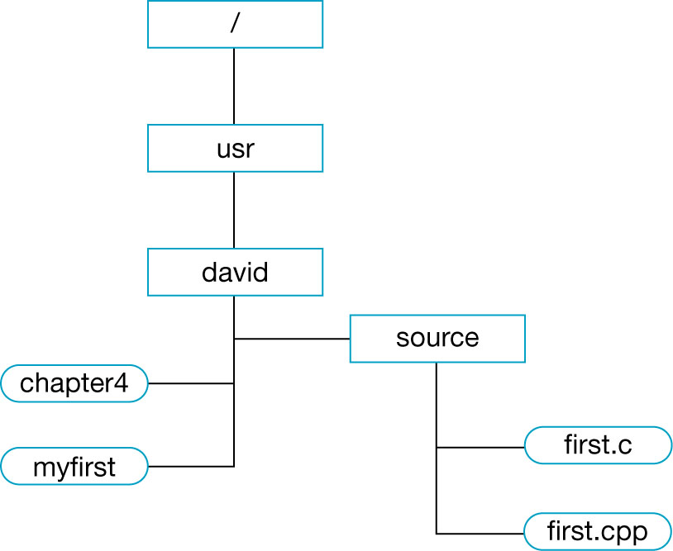
Figure 5-5 An Example of a Directory Structure

Slide 23
Where Am I?
pwd - print working directory
  shows absolute path
  note: in most UNIX systems, the working directory you login to usually has the same name as your username
  this doesn’t show the files in the directory, just the absolute path
  $ pwd [Return] . . . . . . Display your HOME directory path.
  /usr/david
  $_ . . . . . . . . . . . . . . . . .Prompt for next command.

Slide 24
Where Am I Going?
cd - change directory
  cd source
    goes to the directory named ‘source’ which is a child of the current directory
  cd /usr/david
    goes to the directory named ‘david’, which is a child of ‘usr’, which is a subdirectory of root
  cd
    goes to the user’s home directory
  See examples as the following two slides

Slide 25
  Example 1
  $ pwd [Return] . . . . . . . . . . Check your current directory.
  /usr/david
  $ cd source [Return] . . . . . .Change to source directory.
  $ pwd [Return] . . . . . . . . . . Display your working directory.
  /usr/david/source
  $_ . . . . . . . . . . . . . . . . . . . . . Prompt for the next command.

Slide 26
  Example 2
Assuming you have permission, you can change your working directory to /dev
by using the following command sequence:
  $ cd /dev [Return] . . . . Change to /dev directory.
  $ pwd [Return] . . . . . . Check your working directory.
  /dev . . . . . . . . . . . . . . . Your current directory is /dev.
  $_ . . . . . . . . . . . . . . . . Prompt for next command.

Slide 27
单选题
1分
If your current directory is /usr/david, the command cd / changes your current directory to
A
root
B
usr
C
david
D
/usr
E
none of the above
提交

Slide 28
I Need A Directory!
Let’s make a directory …
  A ‘fresh’ UNIX account has no subdirectories in the user’s home directory
  Directories are useful for grouping files
  Some planning makes it easier to organize and handle your files in the long run
Use the mkdir command to make a new directory

Slide 29
mkdir
mkdir memos … make the ‘memos’ directory, a child of the current working directory
mkdir /usr/david/text … make a directory under ‘/usr/david’ named ‘text’
mkdir memos/old … make a directory under ‘memos’ named ‘old’, assuming ‘memos’ is a child of the current working directory
mkdir -p xx/yy/zz … make a the entire path specified (assumes they don’t exist)
See the following slides

Slide 30
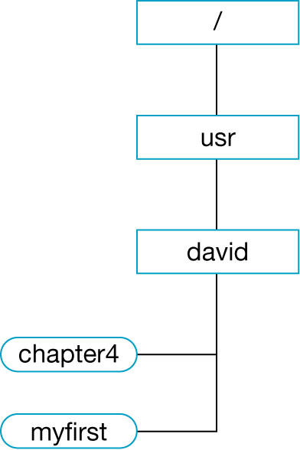
Figure 5-6 Your Directory Structure at the Beginning
Directory Structure
Let’s start with the directory structure presented in Figure 5.6. Depending on your system configuration and administration requirements, you might have other files or subdirectories in your HOME directory.

Slide 31
5.4.4 Directory Creation: The mkdir Command
The mkdir (make directory) command creates a new subdirectory under your working
directory or any other directory you specify as part of the command.
Create a directory called memos under your HOME directory:
  $ cd [Return] . . . . . . . . . . . . . . . Make sure you are in your HOME directory.
  $ mkdir memos [Return] . . . . . . . Create a directory called memos.
  $ pwd [Return] . . . . . . . . . . . . . . Check your working directory.
  /usr/david
  $ cd memos [Return]. . . . . . . . . .Change to memos directory.
  $ pwd [Return] . . . . . . . . . . . . . . Check your working directory.
  /usr/david/memos . . . . . . . . . . . . Your current directory is memos.
  $_ . . . . . . . . . . . . . . . . . . . . . . . Prompt for next command.

Slide 32
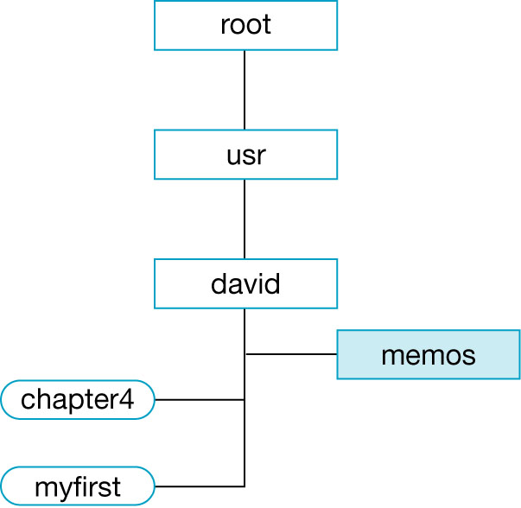
Figure 5-7 Your Directory Structure After Adding the memos Subdirectories
Before
After

Slide 33
While you are in your HOME directory, create a new subdirectory called important in
the memos directory.
  $ cd [Return] . . . . . . . . . . . . . . . Make sure you are in your HOME directory.
  $ mkdir memos/important [Return] . . . Specify the important directory
  pathname.
  $ cd memos/important [Return] . . . .Change to important directory.
  $ pwd [Return] . . . . . . . . . . . . . . . .Check your working directory.
  /usr/david/memos/important
  $_ . . . . . . . . . . . . . . . . . . . . . . . . . Now your working directory is important.
Figure 5.8 shows your directory structure after adding memos and important subdirectories.

Slide 34
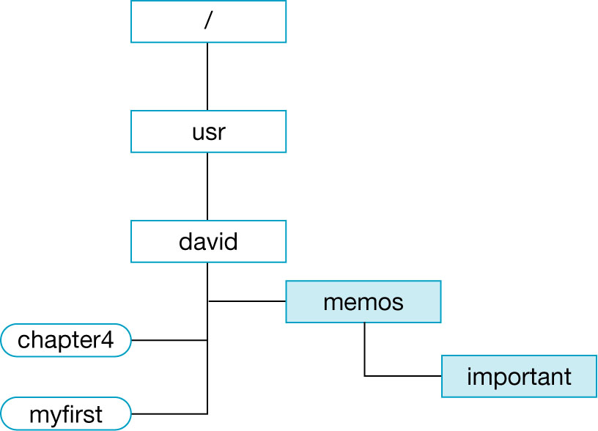
Figure 5-8 Your Directory Structure After Adding the memos and important Subdirectories

Slide 35
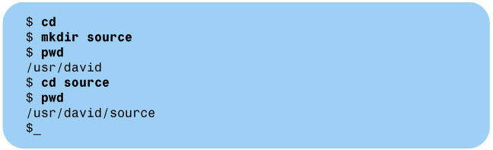
Figure 5-9 Creating the source Directory
Figure 5.9 shows how to create a directory called source under your HOME directory.
Figure 5.10 shows your directory structure after adding the source subdirectory.
  A directory structure can be created according to your specific needs.


Slide 36
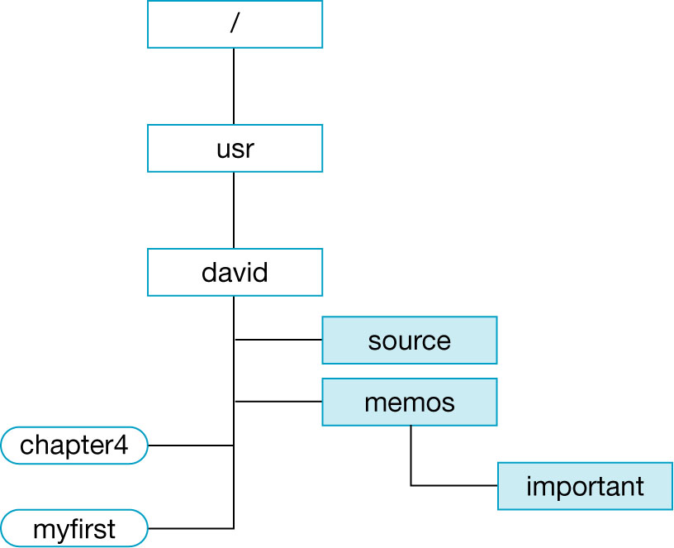
Figure 5-10 Your Directory Structure After Adding the source Directory
Before
After

Slide 37
The mkdir Command: -p Option
The -p option creates levels of directories under your current directory.
Create a directory structure three levels deep, starting in the HOME directory:
  $ cd [Return] . . . . . . . . . . . . . . . . . . Make sure you are in your HOME directory.
  $ mkdir -p xx/yy/zz [Return] . . . . . . Create a directory called xx; in xx create
  a directory called yy, and in yy create a
  directory called zz.
  $_ . . . . . . . . . . . . . . . . . . . . . . . . . . Ready for next command.
--parents Option The alternative option in Linux. Like the -p option, --parents
creates levels of directories under your current or the specified directory.
The command line for using the --parents is:
$ mkdir --parents xx/yy/zz [Return] . . . . . Create a directory called xx;
in xx, create a directory called yy;
and in yy, create a directory called zz.
Figure 5.11 depicts the directory structure after this command sequence has been
applied.

Slide 38
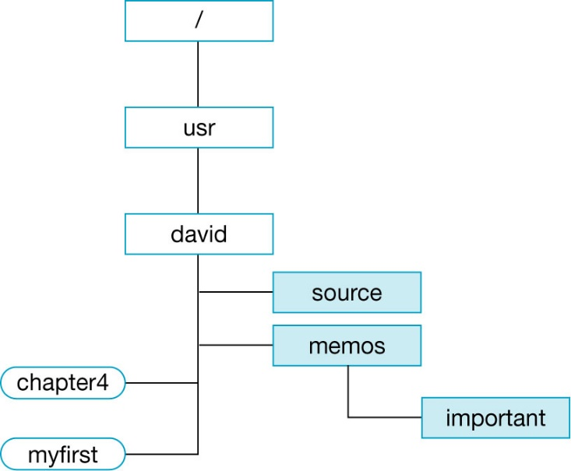
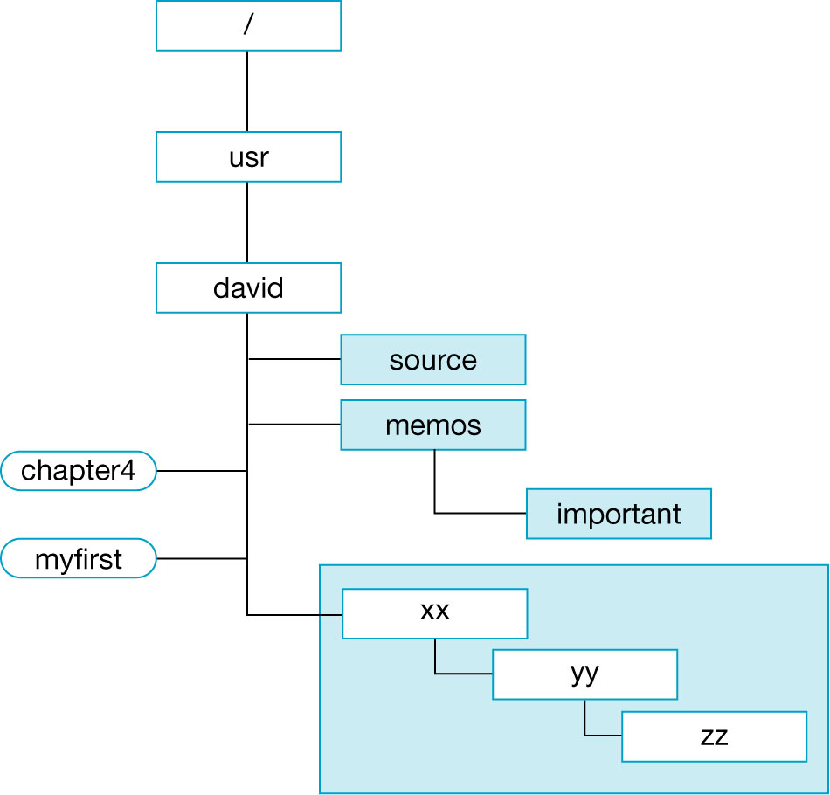
Figure 5-11 Your Directory Structure After Adding the Three-Levels Deep Subdirectories
Before
After

Slide 39
I Don’t Want It Anymore!
rmdir … remove directory
But, there are conditions …
  must be in a parent directory
  cannot remove a directory unless it is empty (no files)
rmdir will return an error if the directory does not exist, or if it isn’t empty
See examples as the following two slides

Slide 40
Example 1
Remove the important directory from your memos directory:
  $ cd [Return] . . . . . . . . . . . . . . . . Make sure you are in your HOME directory.
  $ cd memos [Return] . . . . . . . . . . Change your working directory to memos.
  $ pwd [Return] . . . . . . . . . . . . . . Make sure you are in memos.
  /usr/david/memos
  $_ . . . . . . . . . . . . . . . . . . . . . . . . Yes, you are in memos.
  $ rmdir important [Return] . . . . . Remove the important directory.
  $_ . . . . . . . . . . . . . . . . . . . . . . . . Ready for next command.

  1. You were able to remove the important subdirectory because it was an
  empty directory.
  2. You must be in a parent directory to remove a subdirectory.

Slide 41
Example 2
From the david directory, remove the source subdirectory:
  $ cd [Return] . . . . . . . . . . . . . . Change to david directory.
  $ rmdir source [Return] . . . . . . Remove the source directory.
  rmdir: source: Directory not empty
  $ rmdir xyz [Return] . . . . . . . . Remove a directory called xyz.
  rmdir: xyz: Directory does not exist
  $_ . . . . . . . . . . . . . . . . . . . . . . Ready for next command.
  1. You could not remove the source subdirectory because it was not an
  empty directory.
  2. rmdir returns an error message if you give a wrong directory name
  or if it cannot locate the directory name in the specified pathname.
  3. You must be in the parent directory or a higher level of directory
  to remove subdirectories (children).


Slide 42
What’s In Here?
ls … list contents of directory
  lists files in current directory by name ,in alphabetical order (files & directories)
  ls code … lists contents of the child directory ‘code’, or any files named ‘code’ in the current working directory
  ls has numerous options (see Table 5-1, as the following slides)
    make sure there is a space between the command name and the option
  See examples as the following slides

Slide 43
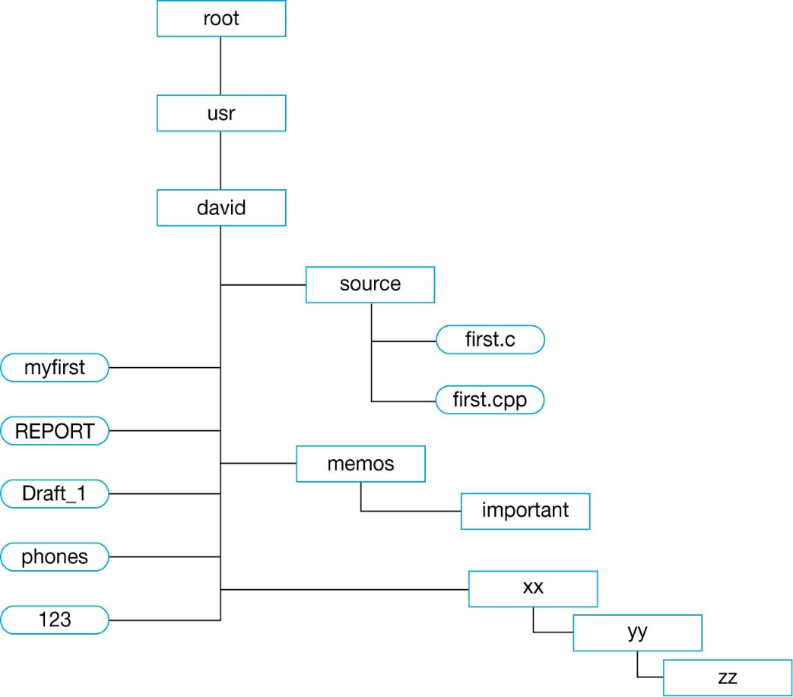
Assuming your current directory is david, show the contents of your HOME directory by typing ls [Return].
$ ls
123
Draft_1
REPORT
memos
myfirst
phones
source
xx
$_

Slide 44
In some systems, the output of the ls command is not vertical in one column and the default format is set to display filenames across the screen.
$ ls
123 Draft_1 REPORT memos myfirst phones source xx
$_

Slide 45
You may want to list the contents of directories other than your current directory.
While in your HOME directory david, list files in the source directory:
  $ cd [Return] . . . . . . . . . . . Make sure you are in the david directory.
  $ ls source [Return] . . . . . .While in david, display list of files in the
  source directory.
  first.c
  first.cpp
  $_ . . . . . . . . . . . . . . . . . . .Ready for next command.
While in your HOME directory, check whether first.c exists in the source directory:
  $ ls source/first.c [Return]. . . . . . Display the first.c filename in the source
  directory to see whether it exists. It does
  exist, so the file-name is displayed.
  source first.c
  $ ls xyz [Return] . . . . . . . . . . . . . Display a file called xyz if it exists. If
  it does not exist, you get the error
  message.
  xyz: No such file or directory
  $_ . . . . . . . . . . . . . . . . . . . . . . . . . .You get the prompt sign again.

Slide 46
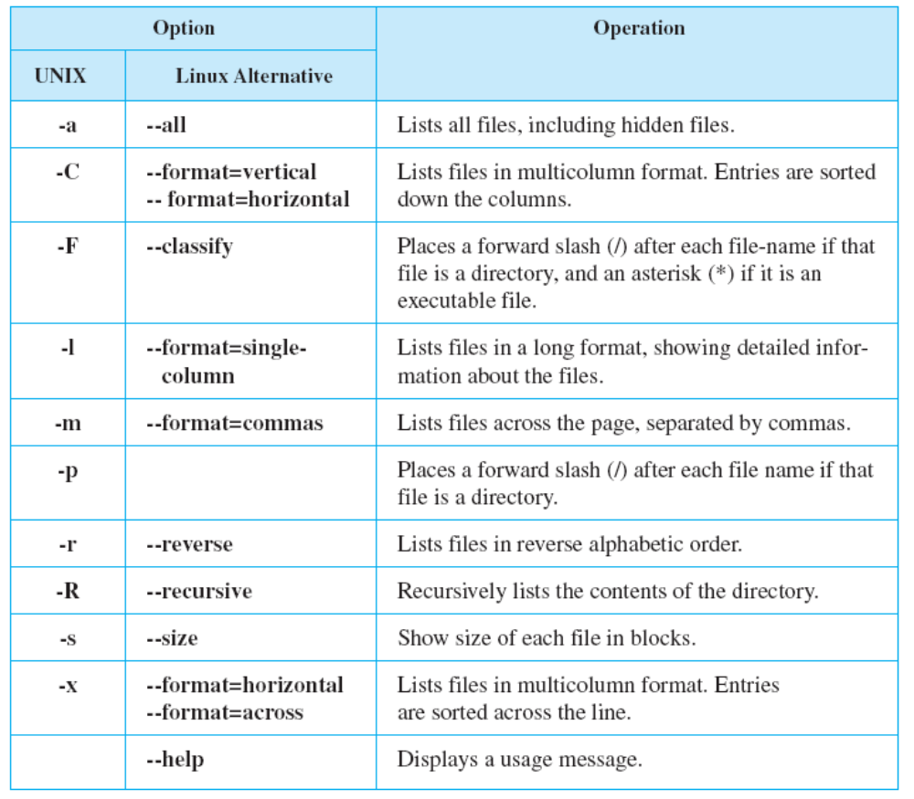
ls Options
When you need more information about your files or you want the listing in a different Format, use the ls command with options.
Table 5.1 The ls Command Options

Slide 47
The wonders of ls
ls -l … long format
ls -a … show all(including hidden) files
  Hidden files begin with “.” sign
  . & .. represent current directory and parent directory
ls -F … designate directories using / and executable files using *

Slide 48
单选题
1分
If your current directory pathname is /usr/david, the command ls ..
A
displays the current directory
B
lists files in the working directory
C
lists files in david directory
D
lists files in the usr directory
E
displays invalid command message
提交

Slide 49
File Permissions
As a multi-user operating system, UNIX must setup a way to restrict access to files based on user preferences
Every file has an attribute, or ‘permission’
  Read permission (r)
  Write permission (w)
  Executable permission (x)
Permissions are set for owners, groups and the world (everybody, others)
See the following slides

Slide 50
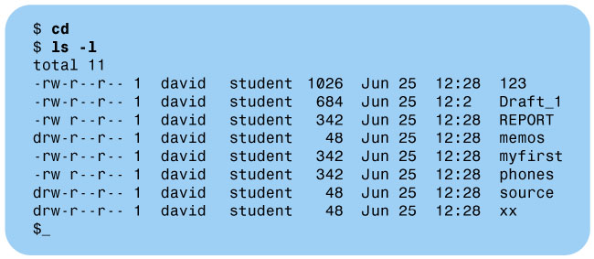
Figure 5-13 The ls Command and the -l Option

Slide 51
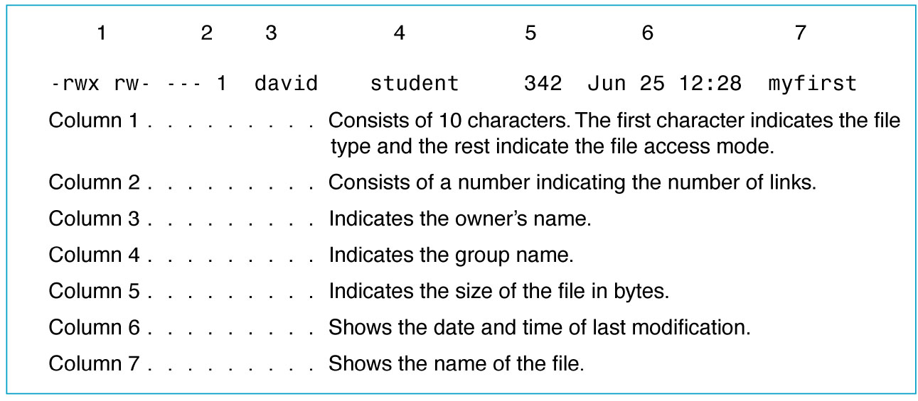
Figure 5-14 The ls Command-Long Format
File type
- Ordinary file
d directory file
b block-oriented special (device) file, such as disk
c character-oriented special (device) file, such as printer
l a link to another file

Slide 52
More about files
UNIX has utilities to set permissions
  chmod … we will cover this later
Note that every file has a modification date, owner (user name), group and size
  these are only seen in long (-l) format of ls command
What about hidden files?
  These start with a period (.)
  What do they do … we’ll hit that in Chapter 7

Slide 53
What’s In My File?
cat … displays the content of a file on screen
  There’s no scrolling or movement control, so cat just lets the ASCII fly!
    Well, <CTRL><S> and <CTRL><P> will stop/start scrolling on some terminals, but it’s not an exact science
  How to avoid this … we’ll use ‘more’ later
$ cat myfirst [Return] . . . . . . . . . Display the myfirst file.
$ cat myfirst yourfirst [Return] . . . Display the myfirst and yourfirst files.

Slide 54
Putting Bits On Paper
lp … line printer
  sends files to the printer, if your system has one installed (Section 5.6.2, p113)
    not your local PC’s printer, but the network printer attached to the UNIX server
  lp fred.txt … send ‘fred.txt’ to the printer
  lpstat … print status (queue)
  lpstat -d … name of default printer
  cancel lp1 … kill jobs on printer ‘lp1’
lpr … printing command in Linux

Slide 55
Cleaning Out The Files
rm … remove (delete) files
  rm text.txt … delete the file ‘text.txt’
  rm fred.txt iso9000.txt … delete the files ‘fred.txt’ and ‘iso9000.txt’
    rm will give an error if a specified file isn’t there
  by default, rm does not confirm a delete job

Slide 56
Remove group of files
Wanna clean out a whole group of files in one pass … use a wildcard
  rm *.txt … delete all files with the extension ‘.txt’
  rm * … delete all files in the working dir
  rm -r * … remove recursively, which means removing all files in this directory or any subdirectories

Slide 57
Whoops!
Be very … very, very careful using rm
  no confirmation & no recovery
  -i should be used often
  -r should be used rarely
  wildcards are very dangerous, yet extremely useful

Slide 58
单选题
1分
The command to delete a file called xyz with confirmation option is
A
del xyz
B
rm xyz
C
rm -c xyz
D
rm -i xyz
E
rm xyz -i
提交

Slide 59
单选题
1分
The command to delete a directory and all the subdirectories and files in it is
A
rm -r directory-name
B
rm directory-name
C
rm -all directory-name
D
rm -sub directory-name
E
rm all
提交

Slide 60
Homework
P120
Review Exercises 5~7,9

