Slide 1
Chapter 6 – The vi Editor:Last Look
Don’t worry, it’s the last chapter we’ll do on the blessed/cursed editor
This chapter shows the real power of vi
  moving and copying text
  using buffers
  customizing vi
  Using shell commands in vi
  search & replace

Slide 2
Invoking vi
Last time, we started vi with a filename
  What happens if no filename is given?
    vi starts with a blank file
    you set the filename on the first save
    :w filename.txt or :wq filename.txt
vi -R file.txt … view file.txt as read-only
vi –c /most file.txt … edit file.txt, and search the file for the word ‘most’
See the following examples

Slide 3

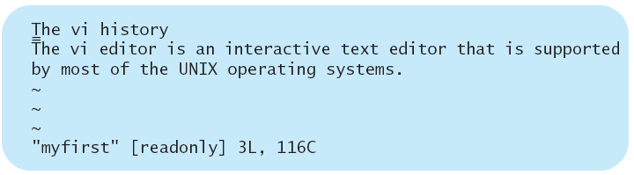
The Read Only Option
The -R (for read only) option makes a file a read only file.
$ vi –R myfirst [Return] . . . . . Use the read only option.
vi opens the myfirst file and shows a message that indicates this is a read only file.

Slide 4
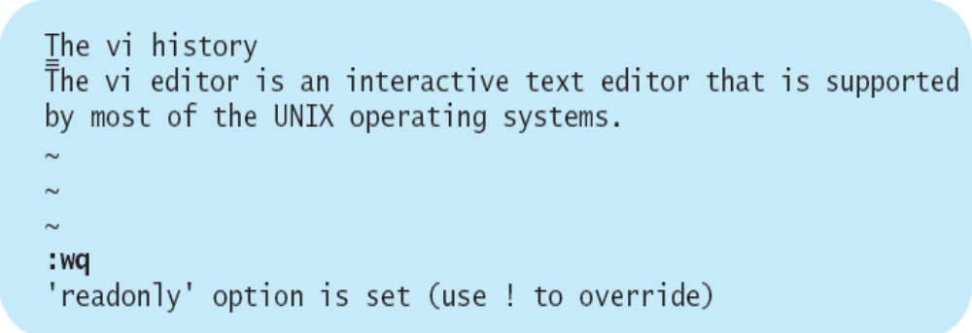
Try to save a read only file, using the :w or :wq command.
vi displays a message indicating this is a read only file.
Quitting a Read-Only File:
To quit a read-only file:
❏ Type :q! [Return]

Slide 5
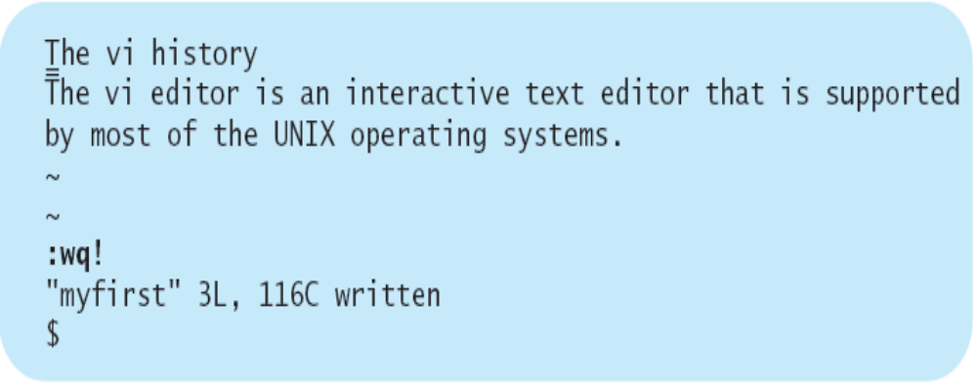

To save a read-only file, you must force the write operation by using the ! option.
The command :wq! overrides the read-only option and writes the file.
You can override read-only files that are your files or if you have access to them. Most of the system files are read-only files, and a normal user cannot change this option for them.

Slide 6
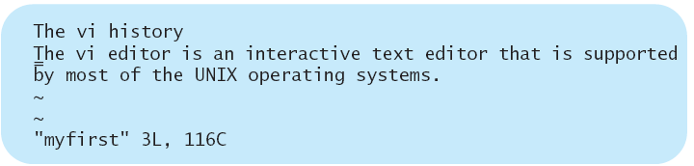
The Command Option
The -c (for command) option allows you to give specific vi commands as
part of the command line.
Useing the -c option with the myfirst file:
$ vi –c /most myfirst [Return] . . . . . . Use the –c command option.
-c indicates the command option is used.
/most indicates you are giving a search command as part of the command line.
vi places the cursor on line two that happens to have the first occurrence
of the word most.

Slide 7
Other vi options
You can start vi with multiple filenames, then switch between them using :n
  vi will prompt you if changes have been made but haven’t saved before switching
  override this using :n!
  :ar shows all loaded files, with the active filename surrounded in brackets
  No way to go back and open the previous file.
Once in vi, use :e to load another file
  :e another.file.txt
See the following examples

Slide 8
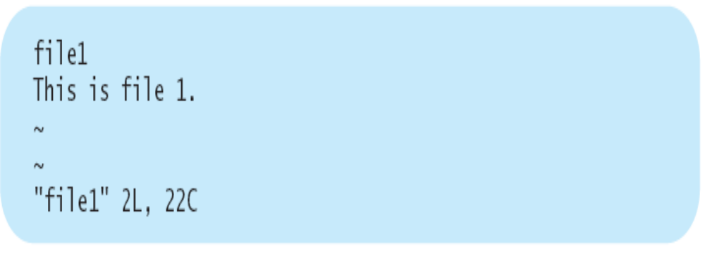
❏ Type vi file1 file2 and press [Return]
This invokes vi with two editing files, file1 and file2

Slide 9
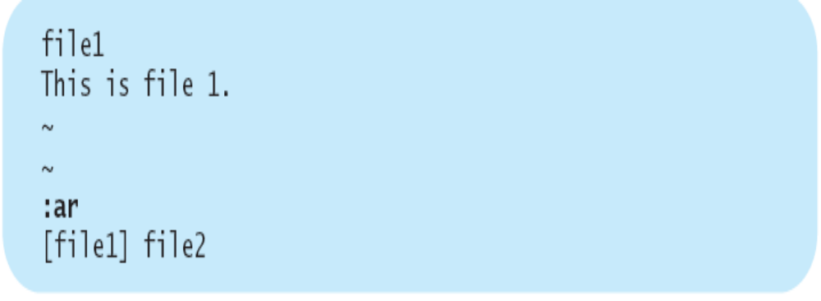
❏ Type :w and press [Return]
This saves file1.
❏ Type :ar and press [Return]
This displays the names of the files.
[file1] file2

Slide 10
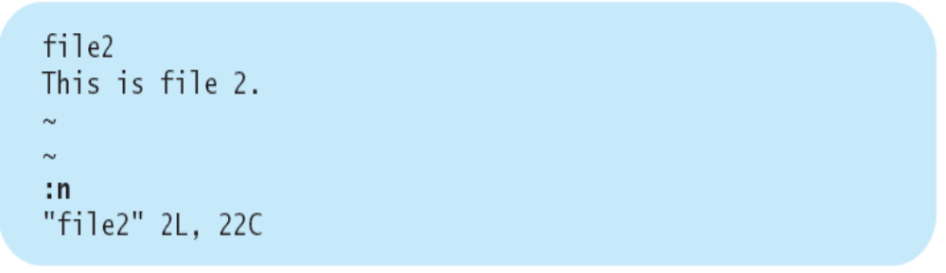
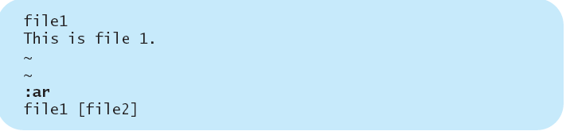
  ❏ Type :n and press [Return]
  This starts file2 for editing
  ❏ Type :ar and press [Return]
  This displays the names of the files.

Slide 11

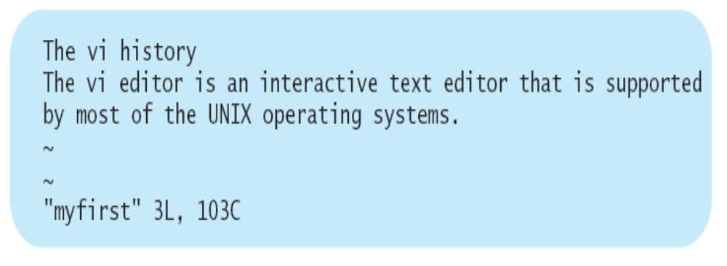
Editing Another File
  ❏ Type :e myfirst and press [Return]
  This calls in the myfirst file.

Slide 12
Other vi options
:r … Read (import) another file
  :r yet.another.file.txt
  the new file is inserted at the current cursor position
:w can be used to save part content of the file to another file.
  :5,20 w too.many.files.txt
  writes lines 5-20 to this file
See the following examples

Slide 13
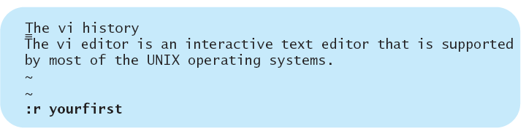
Reading Another File
  ❏ Type vi myfirst and press [Return]
  This invokes the vi editor to edit myfirst.
  ❏ Type :r yourfirst and press [Return]
  This adds the contents of yourfirst to the current editing file.

Slide 14
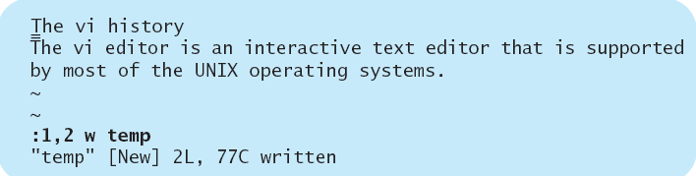
Writing to Another File
Save the first two lines in myfirst in a file called temp.
  ❏ Type vi myfirst and press [Return]
  vi editor is invoked with myfirst file.
  ❏ Type :1,2 w temp and press [Return]
  The first two lines are saved in temp.

Slide 15

单选题
1分
You can start vi by giving it a list of filenames.
A
True
B
False
提交

Slide 16
单选题
1分
You can invoke vi with the -R option to prevent accidental changes.
A
True
B
False
提交

Slide 17
单选题
1分
vi could let you read (import) other files into your current editing file.
A
True
B
False
提交

Slide 18
Rearranging Text
[d] - Deletes text and put it in the buffer
[y] - Copies text to the buffer
[P] – Places(paste) text above cursor
[p] - Places (paste) text below cursor
[c] - Deletes text & places vi in text mode （c-change)
[d][d] to delete a line, [p] or [P] to insert
[y][y] to copy a line, [p] or [P] to insert(y-yank)
See the following examples

Slide 19
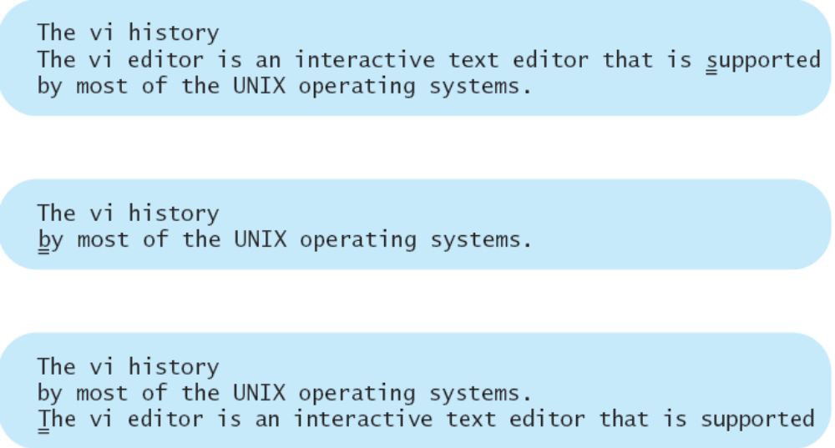
Moving Lines: dd and p or P
Using the delete and the put operators, you can move text from one part
of a file to another:
  ❏ Press dd
  vi deletes the current line, saves a copy of it in the temporary buffer, and
  moves the cursor to the b.
  ❏ Press p
  vi places the deleted line below the current line.

Slide 20
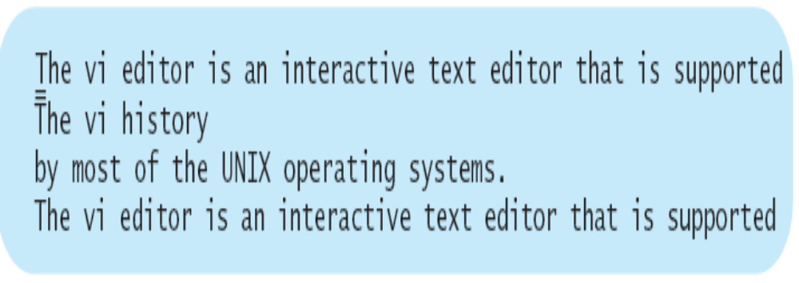
  ❏ Use the cursor movement keys and place the cursor on any character
  on the first line.
  ❏ Press P
  vi places the deleted line above the current line.
The deleted text remains in the temporary buffer, and you can move a copy of it to different places in the file.

Slide 21
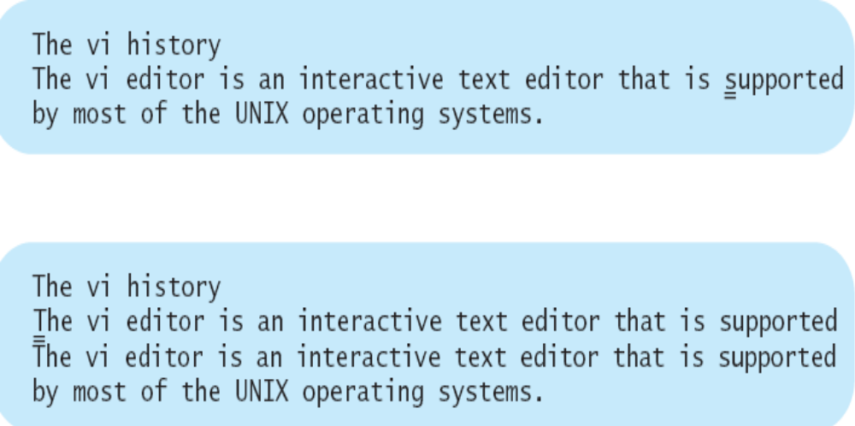
Copying Lines: yy and p or P
Using the yank and the put operators, you can copy text from one part
of the file to another:
  ❏ Press yy
  vi copies the current line into a temporary buffer.
  ❏ Use the cursor movement keys to place the cursor on the first line.
  ❏ Press p
  vi copies the contents of the temporary buffer below the current line.

Slide 22
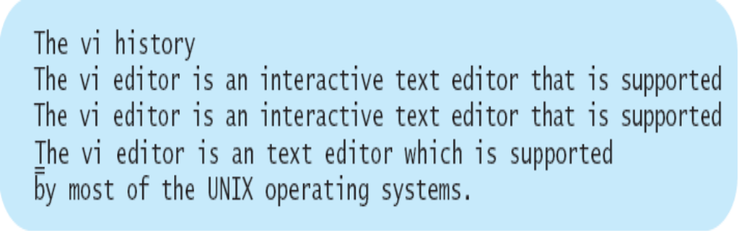
  ❏ Use the cursor movement keys to move the cursor to the last line.
  ❏ Press P
  vi copies the contents of the temporary buffer above the current line.
The copied text remains in the temporary buffer until the next delete or copy operation. You can copy the contents of this buffer to anywhere in the file and as many times as you
wish.

Slide 23
Scope Keys
Add scope operators to commands
  [$] - cursor position to end of line
  [0] - just before cursor to start of line
  [e] - cursor position to end of word
  [b] - just before cursor backward to beginning of the current word
[d][$] - delete from cursor to end of line
Remember, [u] is UNDO

Slide 24
More Scope Operations
Do the same command multiple times, put a number in front of it
  [3][d][w] - delete three words
  [3][d][d] - delete three lines
Scope operators work with ‘yank’
  [y][$] - copy from cursor to end of line
See the following examples

Slide 25
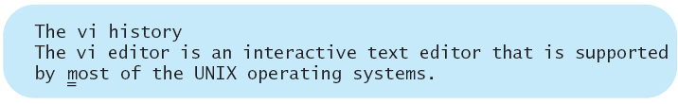
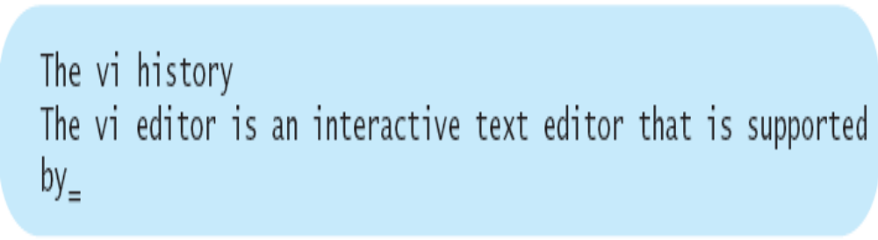
Using the Delete Operator with Scope Keys
To delete text from the current cursor position to the end of the current line:
❏ Press d$
vi deletes text starting from the cursor position to the end of the current
line and moves the cursor to the space after the word by.

Slide 26
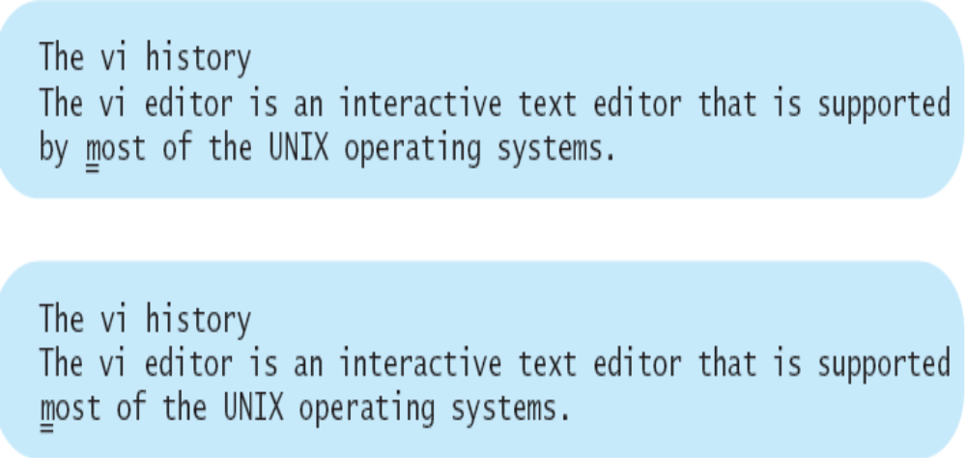
To delete text starting from the cursor position to the beginning of the current line:
❏ Press d0
vi deletes the text and the cursor remains on the letter m.

Slide 27
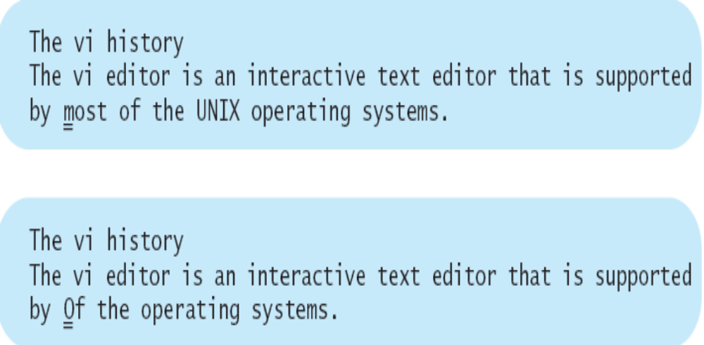
To delete a word after the cursor position:
❏ Press dw
vi deletes the word most and the space after it, and moves the cursor to
the letter o.

Slide 28
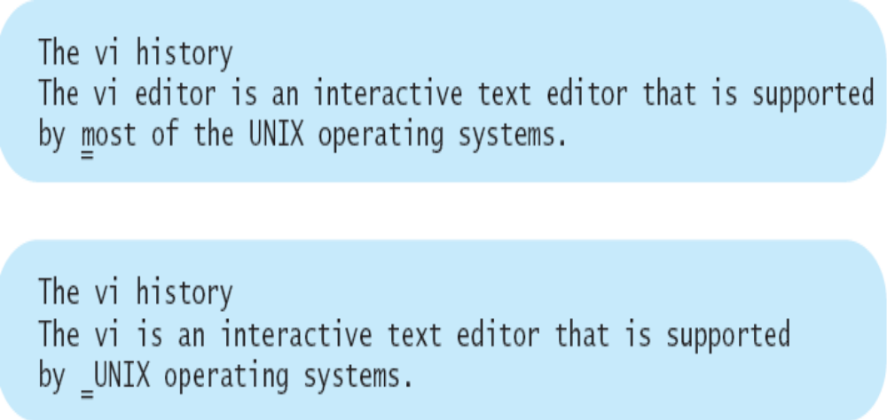
To delete more than one word after the cursor position
(for example, three words):
❏ Press 3dw
vi deletes three words, most, of, and the, and the space after the,
and moves the cursor to the space after the word by.

Slide 29
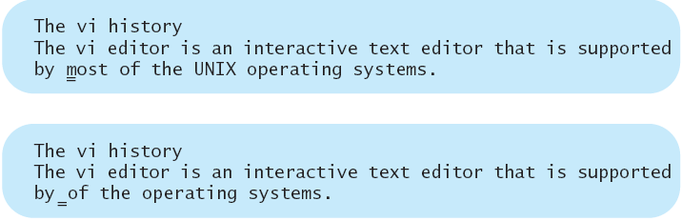
To delete to the end of a word:
❏ Press de
vi deletes the word most and moves the cursor to the space before the letter o.

Slide 30
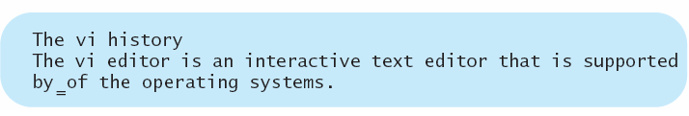

To delete to the beginning of the previous word:
❏ Press db
vi deletes the word by, and the cursor remains on the space before the letter o.

Slide 31
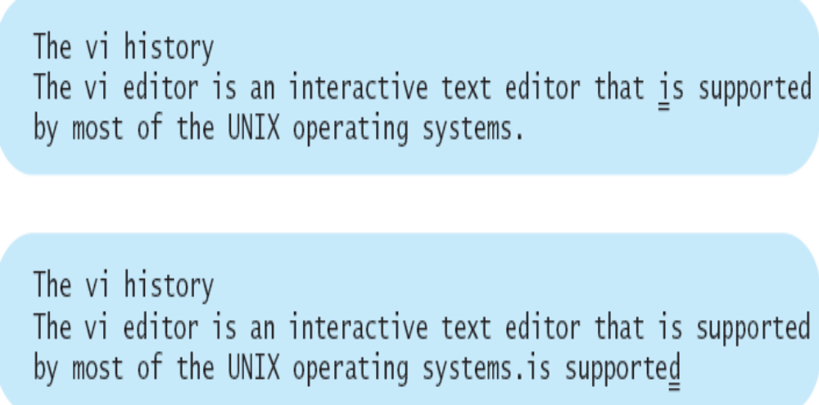
Using the Yank Operator with Scope Keys
The yank operator can use the same scope keys as the delete operator.
To copy text from the current cursor position to the end of the current line:
❏ Press y$
vi copies the text starting from the cursor position to the end of the current
line (is supported) to the temporary buffer, and the cursor remains on the letter i.
❏ Use the cursor movement keys to move the cursor to the end of the last line.
❏ Press p. vi copies the yanked text right after the cursor position.

Slide 32
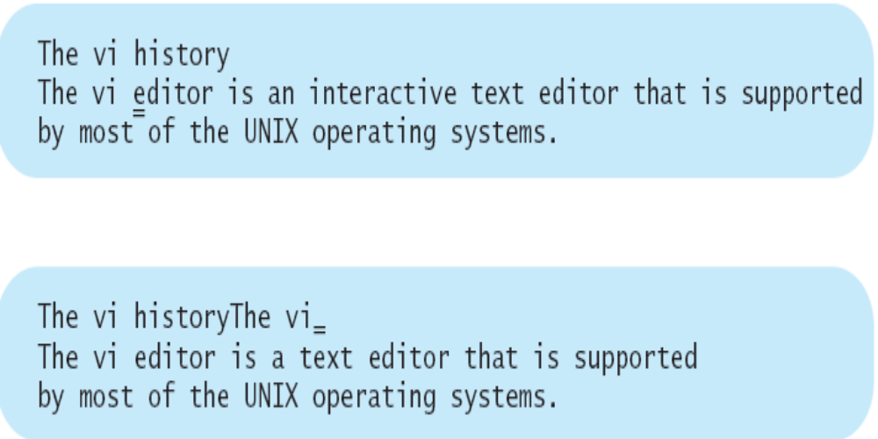
To copy text from the current cursor position to the beginning of the current line:
❏ Press y0
vi copies the text starting from the cursor position to the beginning of
the current line (The vi), and the cursor remains on the letter e.
❏ Use the cursor movement keys to place the cursor at the end of the first line.
❏ Press P
vi copies the yanked text from the temporary buffer to right before the cursor
position.

Slide 33
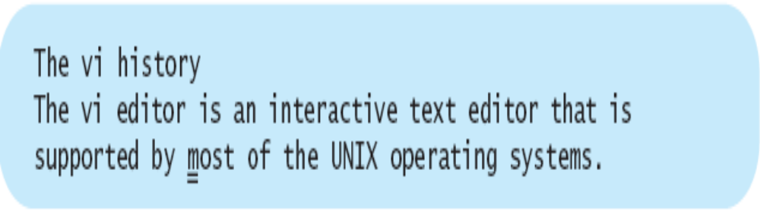
Using the Change Operator with Scope Keys
The change operator, c, can use the same scope keys as the delete and yank operators. For Example:
❏ Press cw
vi places a marker at the end of the current word, overwrites the letter t.
vi changes to text input mode.
The cursor remains on the letter m, the first character scheduled for change.
❏ Type all
This changes the word most to all.
❏ Press [Esc]. vi returns to command mode. Marker is removed.

Slide 34
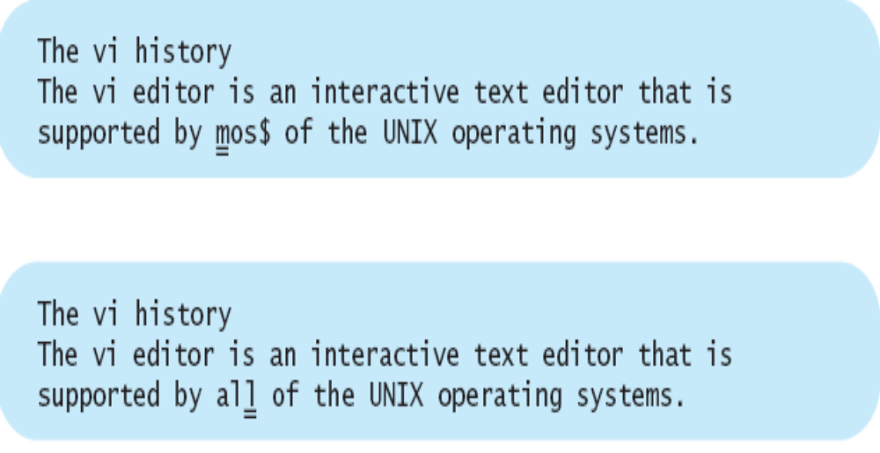

Slide 35
vi Buffers - numbered
vi has nine temporary buffers (1-9)
  make one delete/yank, goes in #1
  make another delete/yank, the new stuff goes in #1 and the old stuff goes in #2
  this is a stack system
  it’s easy to recover material from a particular buffer …
    " 9p … paste from buffer 9
See the following examples

Slide 36
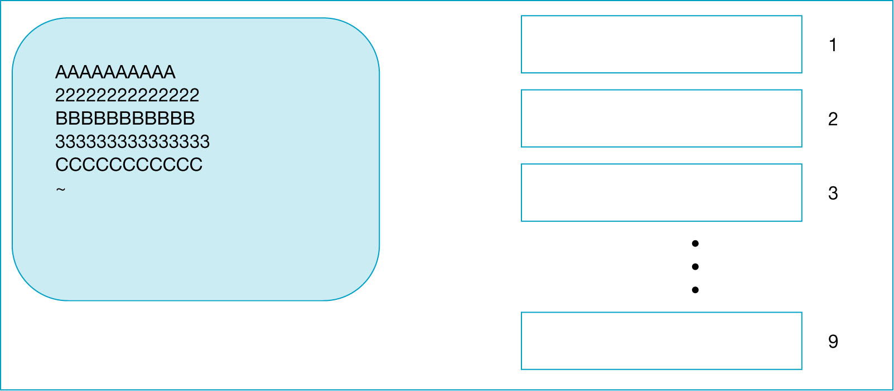
Figure 6-1 The vi Editor’s Nine Numbered Buffers
Assume that your screen looks like the screen in Figure 6.1, with five lines of text and
the numbered buffers empty, because you have not yet done any editing operation.

Slide 37
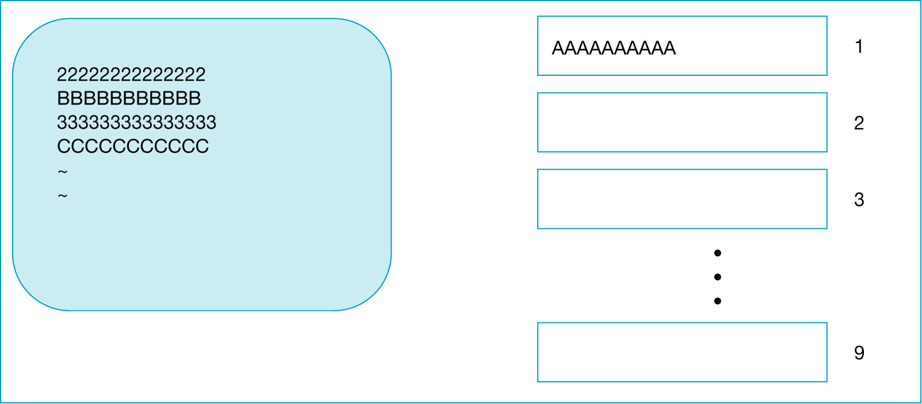
Figure 6-2 The Screen and Buffers After First Delete
❏ Position the cursor on the first line and use the delete command to delete
the current line.
The vi editor saves the deleted line in buffer 1.

Slide 38
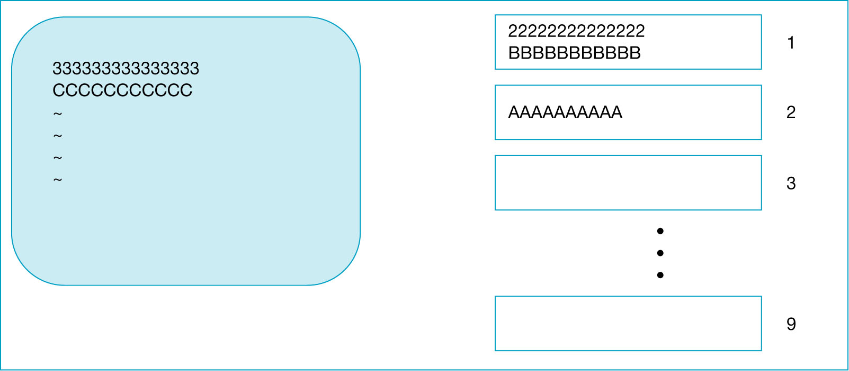
Figure 6-3 The Screen and Buffers After Second Delete
❏ Delete two lines using the delete command.
vi responds by deleting the two lines from the text and moving the contents of the temporary buffers one buffer up, to the empty buffer 2. Then it saves the deleted lines in buffer 1.
Figure 6-3 The Screen and Buffers After Second Delete

Slide 39
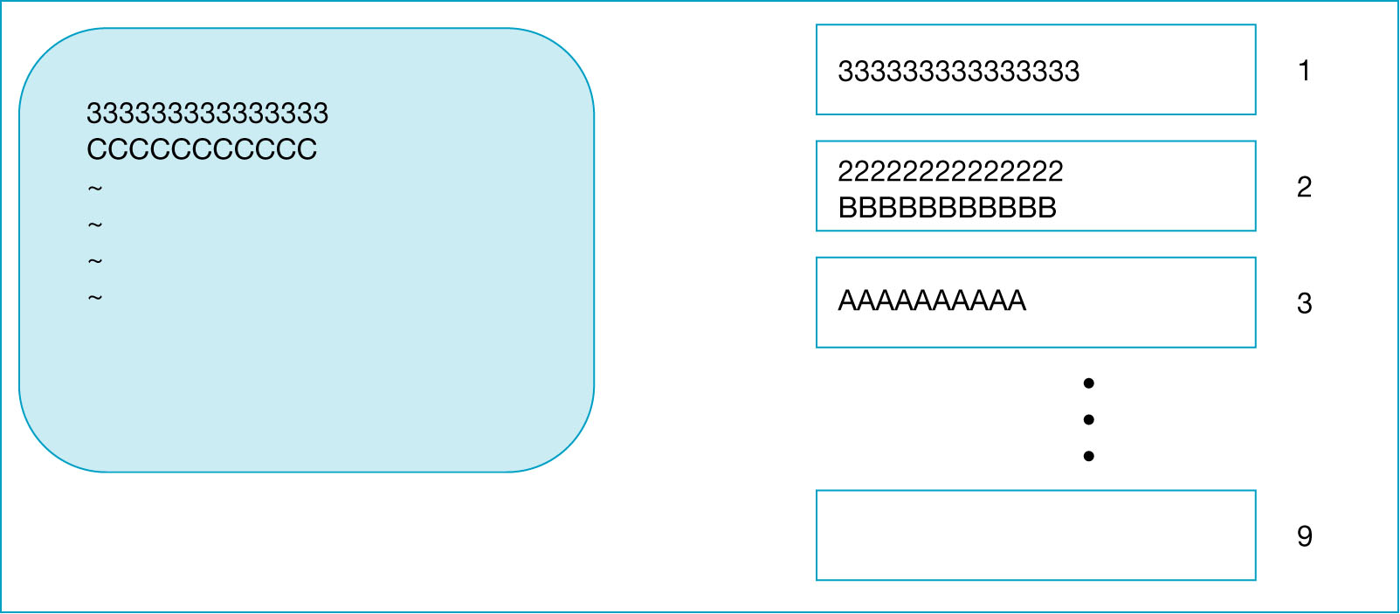
Figure 6-4 The Screen and Buffers After Yank
❏ Place the cursor on the first line and then type yy.
vi responds by copying the line you yanked into buffer 1.
Remember that vi has to move all the buffers’ contents to the next
buffers in order to empty buffer 1, and then the new material is copied into buffer 1.

Slide 40
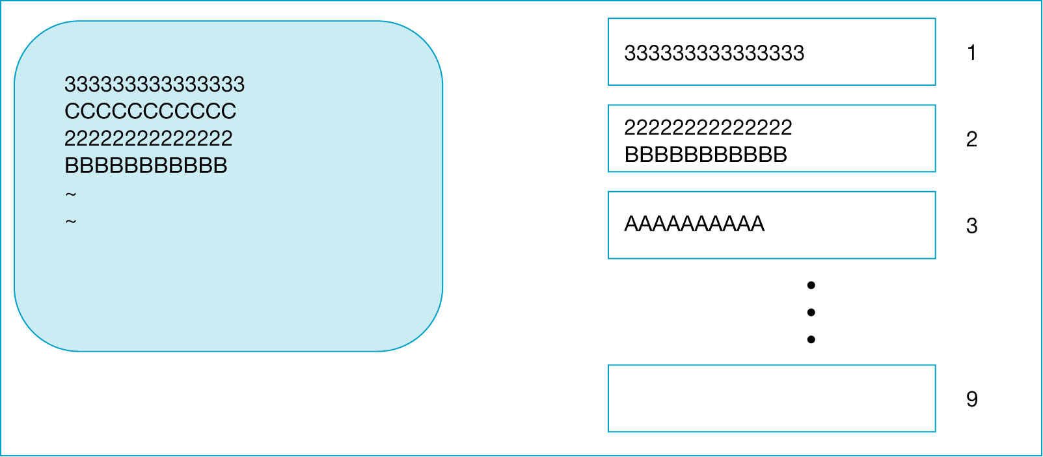
Figure 6-5 The Screen and Buffers After the Put Command
❏ You can access any one of the buffers by specifying its number as part of a command. For example, to copy the contents of buffer 2 to the end of the file:
❏ Type "2p
vi copies the contents of buffer 2 to right after the cursor position.
Accessing the buffers does not change their contents.

Slide 41
vi buffers - lettered
There are also 26 lettered buffers (a-z)
  " wdd - delete line and store in buffer w
  " wp - insert buffer w after cursor
  " z7yy - copy seven lines to buffer z
  " zP - insert buffer z before cursor

Slide 42
Cursor Positioning
[Ctrl-d] - scroll down 12 lines at a time(d-down)
[Ctrl-u] - scroll up 12 lines at a time(u-up)
[Ctrl-f] - scrolls down 24 lines at a time(f-forward)
[Ctrl-b] - scrolls up 24 lines at a time(b-backward)
Can also move to a specific line
  1000G … moves to line 1000
  1G … moves to line 1
  G … moves to the last line
  [Ctrl-g] … what line am I on?

Slide 43
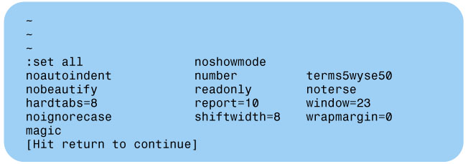
Figure 6-6 Screen Showing vi’s Options
CUSTOMIZING THE vi EDITOR
vi has many parameters (also called options or flags) that you can set, enable, or
disable to control your working environment.
In order to see the complete list of parameters on the screen and how they are
currently set in your system, enter the command mode,
❏ Type :set all, and press [Return].
Your terminal screen shows options similar to Figure 6.6.

Slide 44

The Options Formats
The set command is used to set the options, and the options fall into three categories,
each set in a different manner:
• Boolean (toggle) • Numeric • String
Assuming there is an option called X, the following examples show how to set up
the three categories of options.
The Boolean Options
Typing set X enables option X, and typing set noX disables option X.
There is no space between the word no and the option’s name.
The Numeric Options
Typing set X=12 assigns value 12 to option X.
The String Options
Typing set X=PP assigns string PP to option X.
There is no space on either side of the equal sign.

Slide 45
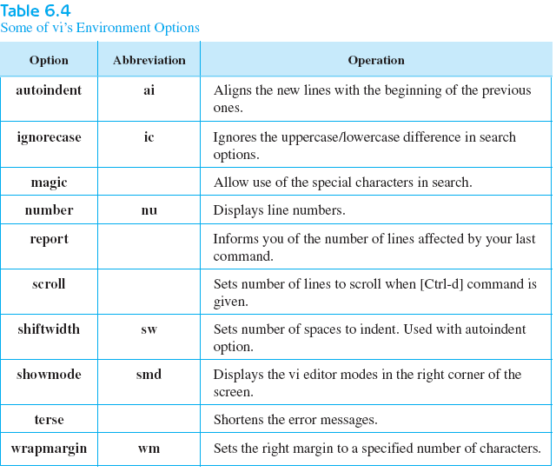
Setting the vi Environment
The behavior of the vi editor can be customized by setting the edit parameters
to new values.
The direct method of changing these values is to use the vi set command.
Using this method the changes are temporary, and they are in effect only for
your current editing session.

Slide 46
Abbreviations and Macros
Abbreviations … :ab
  :ab uno UNIX Operating System
  whenever you type this abbreviation(uno) in text mode and hit a space, the abbreviation will expand into the full text(UNIX Operating System)
  if this abbreviation is part of a word, the abbreviation will not expand, such as unofficial.
  Working in text input mode.
  this abbreviation is temporary and goes away when you exit vi

Slide 47
Abbreviations and Macros
:unab uno - Removes the abbreviation
:map - Create macros
  group of commands run on one keyword
  creates new commands in command mode
  :map q 5dd …………………now press q to delete 5 line
  but your key choices are limited
    K, q, V, [CTRL-e], [CTRL-x]
    also map to terminal function keys using #n, where n is the function key number
    :map #3 yy………………….now press F3 to yank a line
  key macros go away when you exit vi

Slide 48
Using the .vimrc file
The hidden file .vimrc is used to setup options that are used in every vi session
See the example, page 152
Edit this file to make options permanently.

Slide 49
But wait, there’s more
Running Shell Commands from vi
  :! ls … show all of the files in the directory
  :r ! ls … put the results of the ls command in the current file
  You can invoke vi from within vi
    :! vi another.file.txt
See the following example

Slide 50
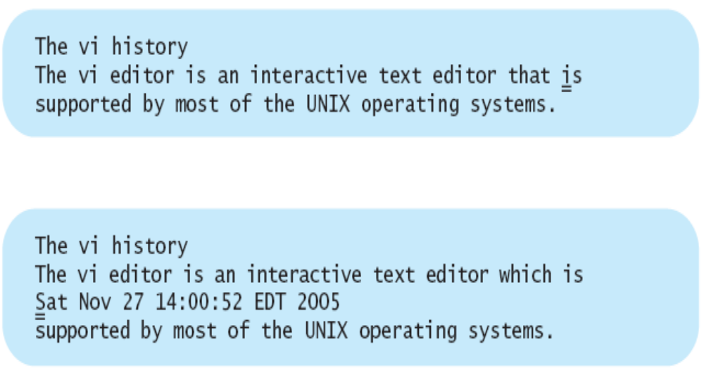
You use the :r (read) command followed by ! to incorporate the command’s result into your editing file. To read the system’s date and time:
❏ Type :r ! date and press [Return].
vi responds by putting the current date and time under the
current line. The vi editor remains in the command mode.

Slide 51
But wait, there’s more
[J] … join two lines together
  This will join the line below the current line to the current line
Search & Replace
  search forward for UNIX using :/UNIX
  cwunix … replace this word with unix
  n will search for the last search word
  . will repeat the last change
File Recovery Option
  vi –r myfirst…………….Invokes vi recovery option

Slide 52
单选题
1分
The vi command :set all
A
sets all the vi parameters
B
sets the all option
C
displays a list of the parameters currently set for vi
D
invokes the .exrc file
E
none of the above
提交

Slide 53
单选题
1分
The vi command to move the cursor to the top of the page is
A
1g
B
G
C
1G
D
top
E
go 1
提交

Slide 54
单选题
1分
The vi command to cancel the displaying of the line numbers is
A
no numbers
B
set number off
C
set nonumber
D
nu off
E
set no number
提交

Slide 55
单选题
1分
The vi commands sequence: dd G p
A
deletes the current line and saves it in the G buffer
B
deletes the current line and place it after the letter G
C
deletes two lines and place them in the G buffer
D
moves the current line to the end of the file
E
deletes the letter G
提交

Slide 56
单选题
1分
The vi command :r !ls
A
searches for the word ls in the file
B
searches for the name ls in the current directory
C
removes all occurrences of the word ls from the file
D
reads a file named ls
E
imports the list of the filenames in the current directory
提交

Slide 57
Homework
P157
  Review Exercises 1,4,6,9~11,13~14,16

