Slide 1
Fruit Inspection
Apple’s defects identifications
Anthea Silvia Sasdelli
Project Work in Computer Vision and Image processing

Slide 2



01
Introduction

Slide 3
OBJECTIVES
The goal of this project work was to develop a system aimed at locating defects and imperfections in a given dataset of apples.
In the specific, the tasks required were:
First Task
Outline the fruit by generating a binary mask
Search for the defects on each fruit
Second task
Russet detection

Slide 4
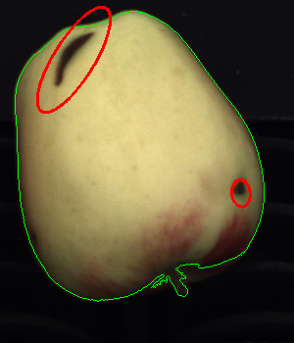
02
First Task

Slide 5
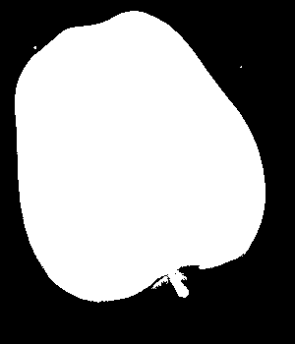

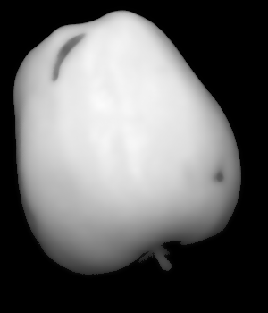
PROJECT TIMELINE
Step 1
Binarization
Step 2
Segmentation
Step 3
Smoothing

Slide 6
PROJECT TIMELINE
Step 1
Binarization
Step 2
Segmentation
Step 3
Smoothing

Slide 7

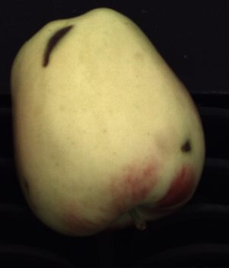
PROJECT TIMELINE
Step 1
Binarization
Foreground/background separation
Dynamic threshold →

Slide 8
PROJECT TIMELINE
Step 1
Binarization
Step 2
Segmentation
Step 3
Smoothing

Slide 9
PROJECT TIMELINE
Step 2
Segmentation

Slide 10
PROJECT TIMELINE
Step 1
Binarization
Step 2
Segmentation
Step 3
Smoothing

Slide 11
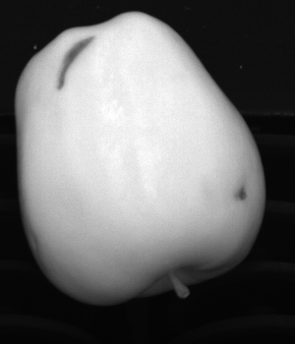
PROJECT TIMELINE
Step 3
Smoothing
Bilateral filter

Slide 12
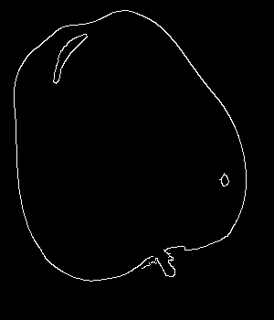
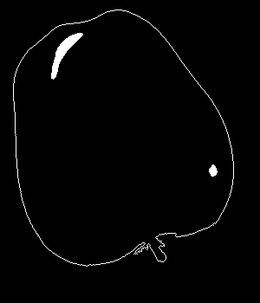
PROJECT TIMELINE
Step 4
Edge detection
Step 5
Fruit isolation
Step 6
Defects identification

Slide 13
PROJECT TIMELINE
Step 4
Edge detection
Step 5
Fruit isolation
Step 6
Defects identification

Slide 14
PROJECT TIMELINE
Step 4
Edge detection
Canny edge detector

Slide 15
PROJECT TIMELINE
Step 4
Edge detection
Step 5
Fruit isolation
Step 6
Defects identification

Slide 16
PROJECT TIMELINE
Step 5
Fruit isolation
Invert Fruit Mask
to create a background mask
Dilate Background Mask
to remove the external edge using a 5x5 kernel.
Remove External Contour
by subtracting the dilated background mask from the Canny edge image
Apply morphological closing to the result and finalize the edges creating Close Figures

Slide 17
PROJECT TIMELINE
Step 4
Edge detection
Step 5
Fruit isolation
Step 6
Defects identification

Slide 18
PROJECT TIMELINE
Step 6
Defects identification
Detect defects by labeling connected components in the processed image
Draw the fruit outline on the image using the binary mask
Iterate over detected components to identify and isolate defects, then count and highlight defects on the image.

Slide 19
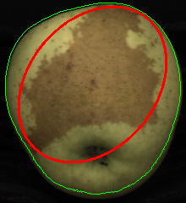
03
Second Task

Slide 20
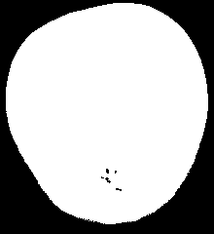

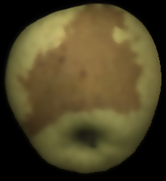
PROJECT TIMELINE
Step 1
Binarization
Step 2
Segmentation
Step 3
Smoothing

Slide 21
PROJECT TIMELINE
Step 1
Binarization
Step 2
Segmentation
Step 3
Smoothing

Slide 22
PROJECT TIMELINE
Step 1
Binarization
Step 2
Segmentation
Step 3
Smoothing

Slide 23
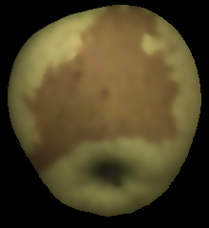

PROJECT TIMELINE
Bilateral Filter
Eroded mask
LAB Space
HSV Space

Slide 24

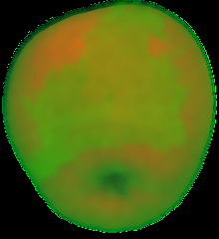
PROJECT TIMELINE
Step 3
LAB Space
Step 3
HSV Space

Slide 25
PROJECT TIMELINE
Step 4
Find defect color in
LAB Space
Step 5
Compute Mahalanobis distance in LAB Space
Step 6
Defect identification in LAB Space
Step 4
Find defect color in
HSV Space
Step 5
Compute Euclidean distance in HSV Space
Step 6
Defect identification in HSV Space

Slide 26
PROJECT TIMELINE
Step 4
Find defect color in
LAB Space
Step 5
Compute Mahalanobis distance in LAB Space
Step 6
Defect identification in LAB Space
Step 4
Find defect color in
HSV Space
Step 5
Compute Euclidean distance in HSV Space
Step 6
Defect identification in HSV Space

Slide 27




PROJECT TIMELINE
Step 4
LAB Space
Find color defect with samples
Step 4
HSV Space
Find color defect with samples

Slide 28
PROJECT TIMELINE
Step 4
Find defect color in
LAB Space
Step 5
Compute Mahalanobis distance in LAB Space
Step 6
Defect identification in LAB Space
Step 4
Find defect color in
HSV Space
Step 5
Compute Euclidean distance in HSV Space
Step 6
Defect identification in HSV Space

Slide 29


PROJECT TIMELINE
Step 5
LAB Space
Mahalanobis distance
Step 5
HSV Space
Euclidean
distance

Slide 30
PROJECT TIMELINE
Step 4
Find defect color in
LAB Space
Step 5
Compute Mahalanobis distance in LAB Space
Step 6
Defect identification in LAB Space
Step 4
Find defect color in
HSV Space
Step 5
Compute Euclidean distance in HSV Space
Step 6
Defect identification in HSV Space

Slide 31
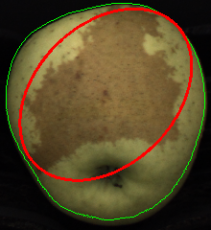
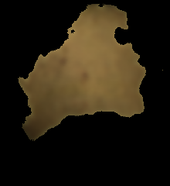
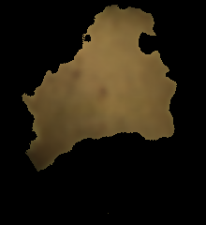
PROJECT TIMELINE
Step 6
LAB Space
Identify, isolate and mask LAB defects
Step 6
HSV Space
Identify, isolate and mask HSV defects

Slide 32
Conclusion
The first task was successfully completed.
It was indeed possible to:
delineate the edge of each apple
identify defects and highlight them in the original photo
This second task encountered more problems: the first sample in particular caused several errors in both color spaces.
In LAB Space the whole apple is identified as an error
In the HSV Space, the same error occurred but the larger areas of the russet were replaced with smaller defects
Overall, though, the color space that produced the best result was the LAB Space.

Slide 33

Thanks for your attention!

