Slide 1
IMAD5111 Practium
Christopher van Hattum ST10456305
A simple weather app allowing the input and output of data, While it can average data and show detailed data as well.

Slide 2
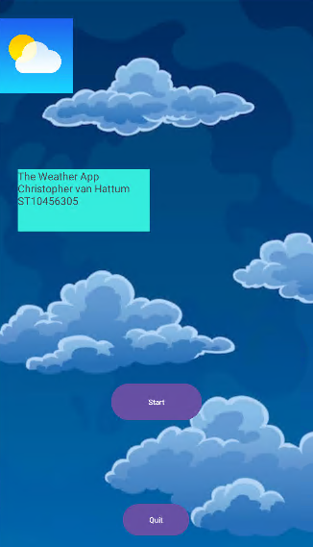
Splash Page( Simple welcome page to take you to the main app. )

Slide 3
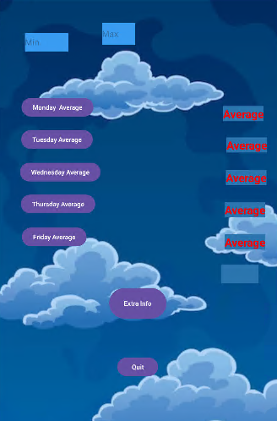
Main Page(The main page, allowing for inputting of data and outputting the average. )

Slide 4
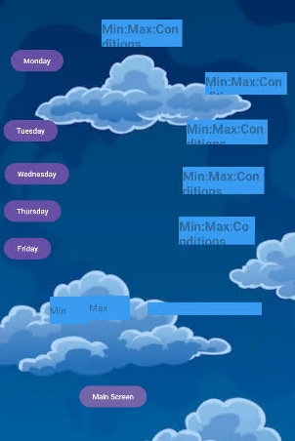
Detailed Information( A detailed overview for the weather(With data Input))

Slide 5
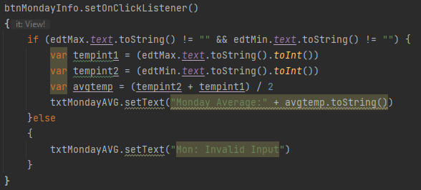
Error Handling( Modular system has plenty of Error loggers/checkers. )

