Slide 1
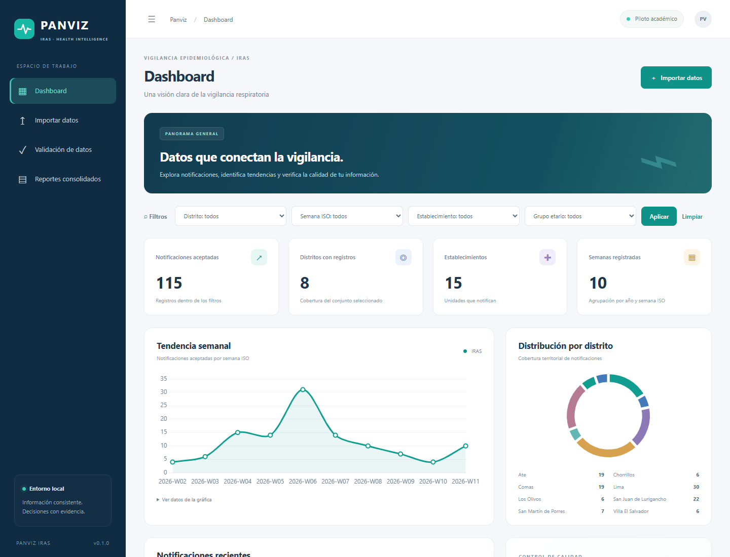
UNSA · SYSTEMS ENGINEERING
RESEARCH PROJECT
PANVIZ
IRAS
Development and verification for data quality and software traceability
Software Quality · November 10, 2026
ACADEMIC PILOT · SYNTHETIC DATA
Ajra Huacso · Hancco Mullisaca · Huacani Jara · Valdivia Segovia
Notes:
We are presenting PANVIZ IRAS, an academic pilot developed for a Software Quality course. The study is not intended to diagnose respiratory diseases. Instead, it shows how an application can ingest CSV files, identify data errors, store valid records, and produce reconciled and traceable results. All records shown in the presentation are synthetic.

Slide 2
PROBLEM
Convincing charts do not guarantee reliable data
The challenge starts with the CSV, before any dashboard.
01
02
03
Missing fields
Duplicates
Invalid dates and categories
Records missing a district or any required field must be excluded.
Repeated IDs may inflate counts without proper safeguards.
Impossible values and unsupported categories distort summaries.
No validation rules
→
unreliable totals
→
unverifiable decisions
Report · pp. 2–4
02
Notes:
CSV files are convenient for exchanging data, but their contents are not necessarily consistent. Accepting a duplicate row or an impossible date can distort every subsequent statistic. PANVIZ IRAS makes the validation criteria explicit so that each record can be accepted or rejected for a documented reason.

Slide 3
RESEARCH
What did the study seek to demonstrate?
Research question and technical objective of the pilot.
RESEARCH QUESTION
How can we reject input errors, reconcile aggregated results, and maintain traceability across requirements and changes?
01
Validation
02
Persistence
03
Verification
Testable rules and a CSV data contract
SQLite and transactional confirmation
Automated tests and traceability
Scope: local technical case study; no real patients or clinical evaluation.
Report · p. 3
03
Notes:
This applied study evaluates the development and technical verification of a system. It does not measure the prevalence of respiratory infections. Selected CMMI-DEV v1.3 practices provide a historical academic reference for organizing quality evidence; they do not imply an achieved organizational maturity level.

Slide 4
THE PRODUCT
PANVIZ IRAS: four connected modules
Local web app for managing synthetic acute respiratory infection reports.
Dashboard
01
Metrics, weekly trends, and districts
Import
02
CSV upload, preview, and confirmation
Validation
03
Rejection reason and source row
Reports
04
Grouped summaries and reconciled exports
Report · pp. 7–10
04
Notes:
The application exposes four modules in a common interface. The dashboard displays aggregates, Import provides CSV upload and preview, Validation lets users inspect rejection reasons, and Reports exports data using the selected functional filters. The interface calculates results from records actually persisted in the database.

Slide 5
TECHNICAL DESIGN
Modular architecture with clear responsibilities
Flask orchestrates; SQLite is the source of truth.
PRESENTATION
APPLICATION
DATA
Jinja2 · HTML
Flask + Blueprints
SQLite
Chart.js · charts
Validation services
Batches · accepted records
Dashboard / forms
Aggregation and export
Rejections · previews
Isolated pytest tests + temporary SQLite databases
Report · pp. 5, 7–9
05
Notes:
The architecture separates responsibilities. Jinja2 and Chart.js present data; Flask and Blueprints handle routes; internal services validate, aggregate, and export; and SQLite stores records. This modular arrangement also supports tests against temporary databases independent of the demonstration database.

Slide 6
DATA QUALITY
An explicit, testable CSV data contract
R01 and R02: six mandatory fields and validation before storage.
01
id
02
fecha_notificacion
03
establecimiento
04
distrito
05
grupo_etario
06
evento
Accepted input
Specific rules
UTF-8 · optional BOM · comma or ; · 2 MB · 10,000 rows
Real dates · age-group catalog · IRAS only
Report · p. 7
06
Notes:
A notification requires an ID, notification date, facility, district, age group, and event. The system accepts UTF-8 CSV files with an optional BOM, using a comma or semicolon delimiter. It rejects empty required fields, invalid dates, duplicates, unsupported age groups, and event values other than IRAS.

Slide 7
FUNCTIONAL FLOW
From CSV input to auditable figures
Confirmation revalidates and commits data in one transaction.
1
Input CSV
2
Preview
3
Confirmation
4
SQLite
Six fields
Row-level rules
Revalidation
Accepted and rejected
Aggregation
Reconciliation
Export
ISO week, district, facility, age group
Sum of groups = filtered total
Summary / rejection CSV
Rejection reports retain the reason and original row number.
Report · pp. 7–9
07
Notes:
After a file is selected, the system first prepares a preview. Previewing does not add any records to the accepted dataset. Only confirmation triggers server-side revalidation and a transactional write, which helps protect against duplicates introduced after preview. Rejections can be traced to their file, batch, and source row.

Slide 8
RESULT 01
The baseline dataset flagged all five expected errors
Expected outcomes defined before test execution.
Documented rejection reasons
20
Duplicate notification ID
records evaluated
Missing mandatory district
Impossible date
15 accepted
5 rejected
Age group outside the catalog
75%
25%
Event other than IRAS
5/5 errors detected · reconciliation gap = 0
Report · pp. 7, 11–12
08
Notes:
The minimal baseline dataset contained twenty rows. Fifteen were accepted and five rejected because of deliberately introduced errors: a duplicate ID, an empty district, an impossible date, an unsupported age group, and a non-IRAS event. All five expected errors were detected. The sum of grouped records equals the accepted total, so the reconciliation difference is zero.

Slide 9
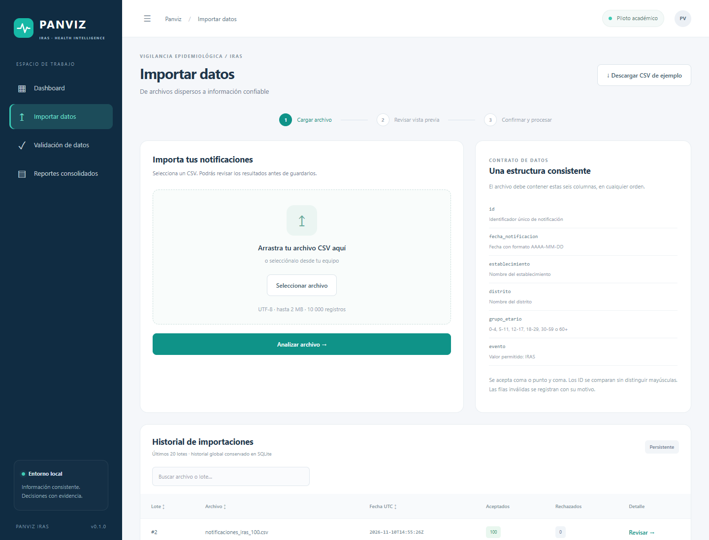
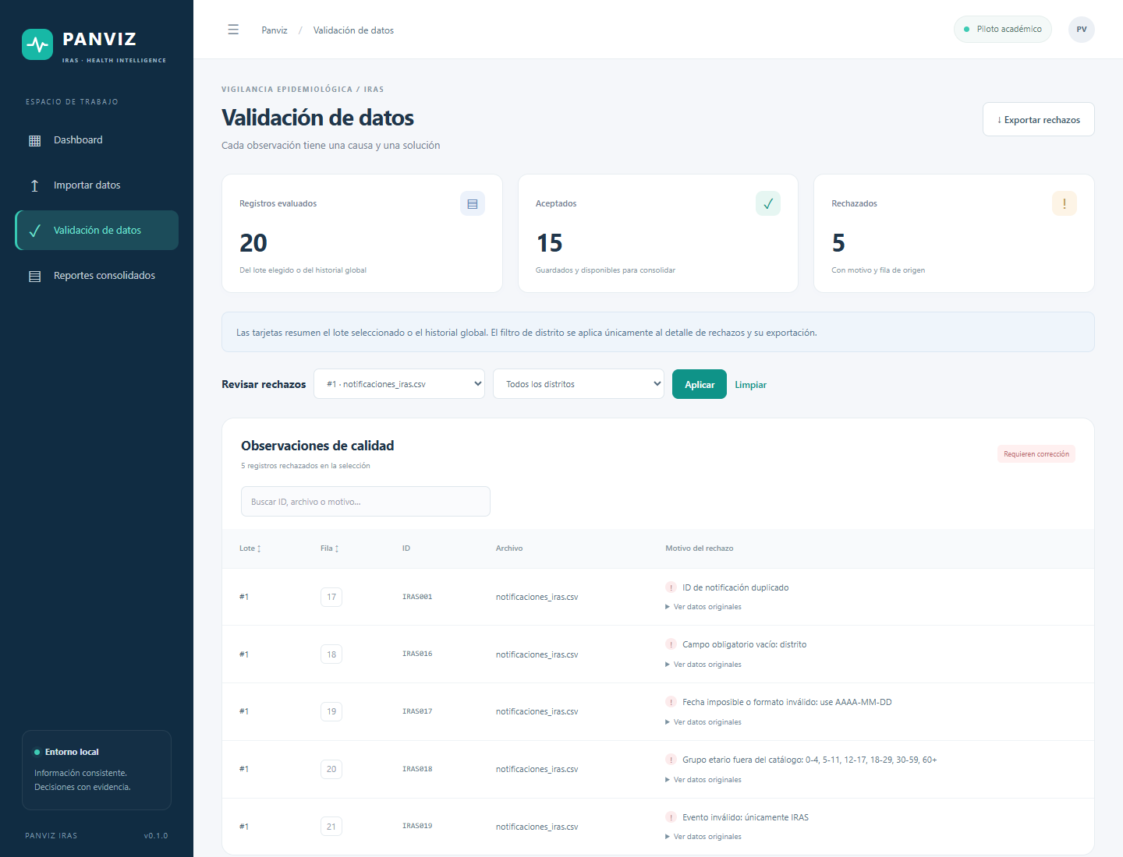
VISUAL EVIDENCE
The interface makes rules and results visible
Actual prototype screenshots from the research report.
Import: visible data contract and CSV upload
Validation: accepted, rejected, and reasons
Report · figs. 1 and 5 · pp. 8 and 12
09
Notes:
These are real screenshots from the academic prototype, not mockups. On the left, the Import module shows the six-field CSV contract and file upload controls. On the right, the Validation module shows counts and lets a user inspect errors by batch and source row. The screenshot reports 20 evaluated, 15 accepted, and 5 rejected records.

Slide 10
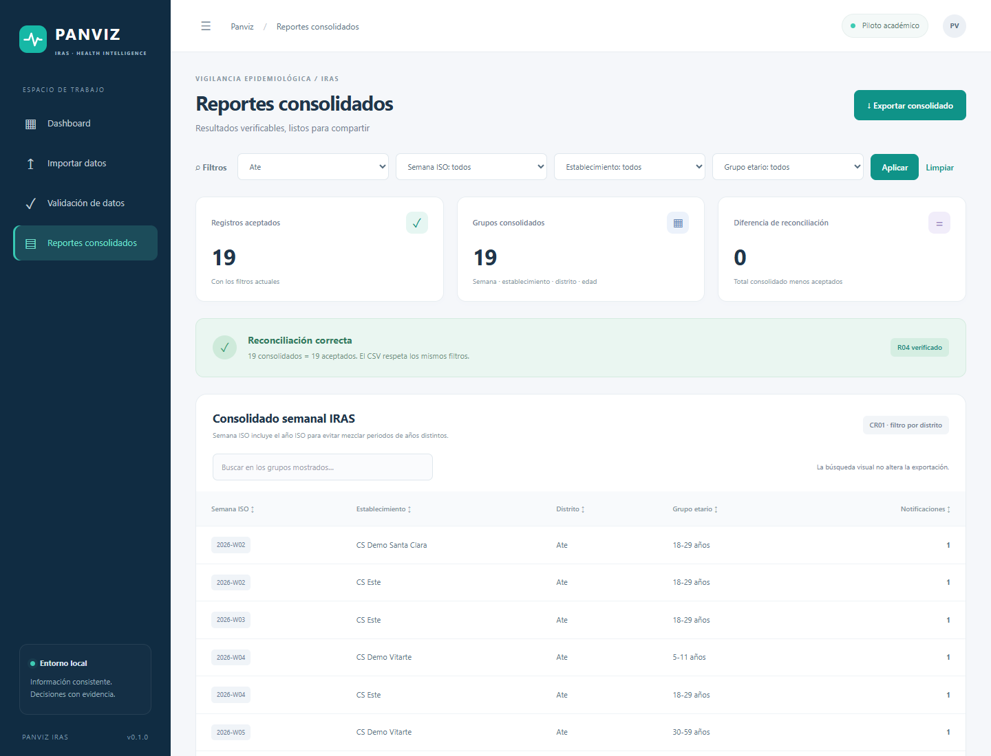
CHANGE MANAGEMENT
CR01: district filter with regression tests
The same filters apply to summaries and exports.
Ate · baseline dataset
5
accepted records
Ate · expanded dataset
19
accepted records
Reconciliation gap
0
database unchanged
Report · pp. 10–11
10
Notes:
Change request CR01 adds district-based filtering. In the isolated baseline test, selecting Ate yields five notifications, and clearing the filter restores fifteen. After an additional hundred valid synthetic rows were imported, Ate contains nineteen records. The filters used on screen and in exports remain aligned, and the report shows zero reconciliation difference. It is essential to distinguish baseline test expectations from figures in the expanded dataset.

Slide 11
AUTOMATED VERIFICATION
51 tests passed in the evaluated run
Success in tested scenarios, not a guarantee of zero defects.
Validation
Fields, duplicates, formats, and limits
1
51
Integration
Routes, templates, and confirmation
2
OF 51
Data
Temporary SQLite and transactions
3
Results
Aggregates, filters, and exports
4
0 failed
Traceability
Existing traceability-matrix references
5
Report · pp. 6, 12
11
Notes:
During the reported evaluation, 51 automated tests were run and all 51 passed. These tests cover individual rules as well as the integration of routes, templates, persistence, and export operations. Another test checks that traceability-matrix links point to existing files. This does not mean 100 percent code coverage or that every possible input has been tested.

Slide 12
SYNTHETIC DATA EXPANSION
From 15 to 115 persisted notifications
100 valid rows were added without replacing the baseline.
15
+100
115
+
=
initial accepted records
additional accepted rows
final accepted records
8 districts · 10 ISO weeks · 6 age groups · 12 demo facilities
The 20-row test oracle remains separate from the expanded demo.
Report · p. 13
12
Notes:
The original demonstration set was too evenly balanced to show variation in charts. A separate synthetic CSV was therefore created with one hundred valid new records. Once imported, the persisted accepted count increased from fifteen to one hundred and fifteen. This demonstration batch does not replace the initial set or alter its predefined test oracle.

Slide 13
VISUAL RESULTS
District distribution: synthetic data
Variation reflects synthetic data generation, not official statistics.
Lima
30
San Juan de Lurigancho
22
Ate
19
Comas
19
San Martín de Porres
7
Chorrillos
6
Los Olivos
6
Villa El Salvador
6
0
10
20
30
TOTAL = 115
Report · p. 13 · figure 6
13
Notes:
The district-level counts sum to 115. Lima has 30 records; San Juan de Lurigancho has 22; Ate and Comas have 19 each; San Martín de Porres has 7; and Chorrillos, Los Olivos, and Villa El Salvador each have 6. These values describe synthetic records created to exercise the software, not real health statistics.

Slide 14
VISUAL RESULTS
Weekly trend: the peak occurs in W06
Ten ISO weeks in 2026, totaling 115 synthetic records.
31
30
20
15
14
14
10
10
10
7
6
4
4
0
W02
W03
W04
W05
W06
W07
W08
W09
W10
W11
PEAK: 31 NOTIFICATIONS IN 2026-W06
Report · p. 14 · figure 7
14
Notes:
The ten ISO-week counts from W02 through W11 are 4, 6, 15, 14, 31, 14, 10, 7, 4, and 10, which sum to 115. W06 is the peak of the synthetic demonstration, with 31 records. It must not be described as a real outbreak.

Slide 15
TECHNICAL FINDING
Uniform charts did not indicate an algorithm defect
Inspecting SQLite data explained the apparent anomaly.
1
2
3
Observation
Diagnosis
Solution
Three districts had 5 records each; five weeks had 3 each.
The dashboard queried 15 stored rows; the 100-row CSV had not been imported.
Validate and import the expanded dataset, then reconcile again; keep the aggregation logic.
Generated file ≠ imported file ≠ dashboard data
Report · p. 14
15
Notes:
Initially, the charts looked unusually uniform. Inspection of the aggregation code found no fixed demonstration values. SQLite still contained only the balanced initial dataset; the second CSV file had been generated but not imported. After persisting that data, the dashboard displayed varying distributions without changing the aggregation algorithm.

Slide 16
QUALITY GOVERNANCE
Functional traceability and selected CMMI practices
Documented practices do not prove organizational maturity.
R01
CSV import
R02
Validation / rejections
R03
ISO-week aggregation
R04
Export / reconciliation
R05
Traceability matrix
CR01
District filter
18 reference process areas
Human evidence still pending
7 Level 2 + 11 Level 3 (CMMI-DEV v1.3)
Independent review, user validation, training, and formal sign-off.
Code and test links were checked; their adequacy still requires human review.
Report · pp. 4–5, 15–16
16
Notes:
The project maintains a traceability chain across requirements, design, source code, tests, and versions. R01 through R05 and CR01 have explicit functional scopes. The repository references seven Level 2 and eleven Level 3 process areas from CMMI-DEV v1.3. This does not justify claiming an organizational maturity level: named sign-offs, user validation, training, independent review, and evidence of sustained adoption remain outstanding.

Slide 17
CONCLUSIONS
What was demonstrated, and what remains?
Observed technical results and responsible next steps.
Observable quality
Reproducible verification
Reconciled results
15 accepted / 5 rejected in baseline
51 tests passed in the reported run
115 final acceptances and zero reconciliation gap
Next steps
User validation · independent review · performance / accessibility · security controls
Scope limit: synthetic data; no clinical effectiveness, representativeness, or CMMI certification.
Report · pp. 15–16
17
Notes:
The results support functional correctness in the tested scenarios: PANVIZ accepted and rejected the expected records, passed the reported automated test suite, and produced reconciled counts. Next steps include documented human reviews, user evaluation, and additional performance, accessibility, and security testing. Neither a real health information system nor CMMI organizational maturity was assessed.

Slide 18
PANVIZ IRAS
Thank you
Questions and discussion
SOURCES AND EVIDENCE
PANVIZ IRAS research report (2026) · Figures and app screenshots
Code and documentation: github.com/AnthoLogy63/PANVIZ_IRAS-System
Report references: WHO · SEI/CMMI v1.3 · Flask · SQLite · pytest · Python · WCAG 2.2
Software Quality · UNSA · November 10, 2026
Notes:
We welcome questions about the CSV data contract, Flask and SQLite architecture, acceptance criteria, automated testing, reconciled results, and outstanding process-quality activities.

