Slide 1



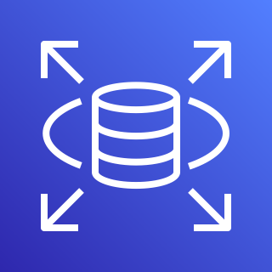




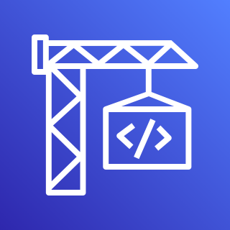
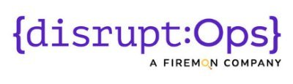








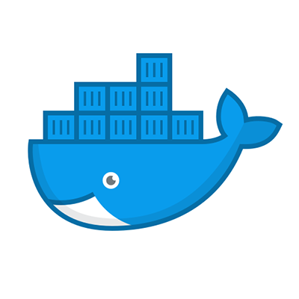

ElectricEye
REPORT
Run ElectricEye Anywhere
(with Python)!
AWS IOT Greengrass
AWS Security Hub
Amazon RDS
(PostgreSQL)
PostgreSQL DB
JSON & CSV
Amazon EC2
Endpoint/Server
DisruptOps Platform
AWS CodeBuild
EVALUATE
GCP Compute Engine
AWS Fargate/ECS
AWS Resources
Amazon Batch
ENRICH
Azure VM
Detect-Secrets by Yelp
AWS CloudShell
Shodan API
Docker container
Amazon EKS

