Slide 1













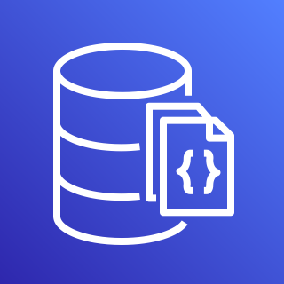

















ElectricEye
REPORT
EXTEND
Run ElectricEye Anywhere
(with Python)
AWS IOT Greengrass
AWS Security Hub
Amazon RDS
(PostgreSQL)
PostgreSQL DB
JSON & CSV
AWS Lambda
AWS Systems Manager
Amazon EventBridge
Amazon EC2
Endpoint/Server
AWS CodeBuild
EVALUATE
FireMon DisruptOps Platform
MongoDB
Amazon DocumentDB
Microsoft Teams
Slack
PagerDuty
GCP Compute Engine
AWS Fargate/ECS
AWS Resources
ENRICH
Atlassian Jira
Azure DevOps
ServiceNow
ITSM
Azure VM
Amazon Batch
ElectricEye Response
Detect-Secrets by Yelp
Shodan API
AWS CloudShell
Docker container
NMAP
(Attack Surface Monitoring)
Amazon EKS

Slide 2






















CLOUD SECURITY POSTURE MANAGEMENT (CSPM)
SAAS SECURITY POSTURE MANAGEMENT (SSPM)
ATTACK SURFACE MONITORING (ASM)
CLOUD ASSET MANAGEMENT (CAM)
COMING SOON!
COMING SOON!
Run ElectricEye
Anywhere With Python
COMING SOON!
COMING SOON!
COMING SOON!
detect-secrets
SUPPORTED OUTPUTS
COMING SOON!
MongoDB,
PostgreSQL
HTML, JSON,
CSV
Amazon DocumentDB
AWS Security Hub
Firemon Cloud Defense
Amazon SQS
Amazon DynamoDB
Microsoft Teams
Slack

