Slide 1











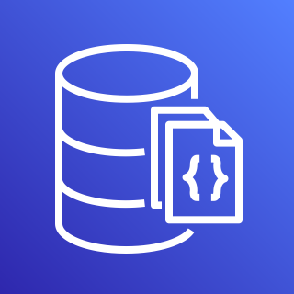

















CLOUD SECURITY POSTURE MANAGEMENT (CSPM)
SUPPORTED OUTPUTS
(OCSF, File, DB, Queue, SaaS)
JSON (x3)
CSV
HTML (x2)
COMING SOON!
EVALUATE
ENRICH
REPORT
MongoDB
PostgreSQL
Amazon SQS
SAAS SECURITY POSTURE MANAGEMENT (SSPM)
ATTACK SURFACE MONITORING (ASM)
OCSF v1.1.0
Amazon DocumentDB
AWS Security Hub
COMING SOON!
COMING SOON!
COMING SOON!
Amazon DynamoDB
Teams
Slack
COMING SOON!
Firemon Cloud Defense

