Slide 1













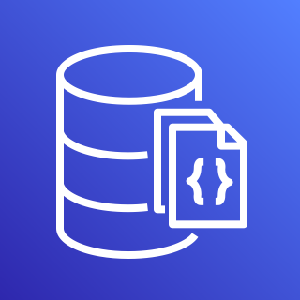

















ElectricEye
REPORT
EXTEND
Run ElectricEye Anywhere
(with Python)
AWS IOT Greengrass
AWS Security Hub
Amazon RDS
(PostgreSQL)
PostgreSQL DB
JSON & CSV
AWS Lambda
AWS Systems Manager
Amazon EventBridge
Amazon EC2
Endpoint/Server
AWS CodeBuild
EVALUATE
FireMon DisruptOps Platform
MongoDB
Amazon DocumentDB
Microsoft Teams
Slack
PagerDuty
GCP Compute Engine
AWS Fargate/ECS
AWS Resources
ENRICH
Atlassian Jira
Azure DevOps
ServiceNow
ITSM
Azure VM
Amazon Batch
ElectricEye Response
Detect-Secrets by Yelp
Shodan API
AWS CloudShell
Docker container
NMAP
(Attack Surface Monitoring)
Amazon EKS

