Slide 1

















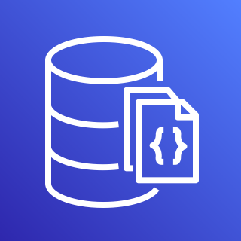










Evaluate security & performance configurations of public cloud providers & SaaS platforms
Output findings to common formats, DBs, Slack, AWS services, and/or OCSF
Run ElectricEye with Docker, or anywhere Python is installed
Enrich specialized “attack surface” checks using secrets detection, RBVM & OSINT tooling

