Slide 1

















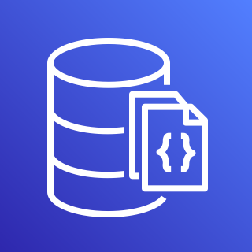

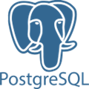







Evaluate security & performance configurations of popular Public Clouds & SaaS platforms
Output to common formats, databases & AWS cloud services
Run ElectricEye with Docker, or anywhere Python is installed
Enrich specialized “attack surface” checks courtesy of secrets management & OSINT tooling

Slide 2







CLOUD SECURITY POSTURE MANAGEMENT (CSPM)
SUPPORTED OUTPUTS
(OCSF, File, DB, Queue, SaaS)
JSON, CSV, HTML
PostgreSQL
Amazon SQS
EVALUATE
ENRICH
REPORT
COMING SOON!
MongoDB
Amazon DocumentDB
AWS Security Hub
SAAS SECURITY POSTURE MANAGEMENT (SSPM)
ATTACK SURFACE MONITORING (ASM)
OCSF v1.1.0
Firemon Cloud Defense
Slack
COMING SOON!
COMING SOON!
AWS Kinesis Firehose
COMING SOON!

