Slide 1

HERON Workshop Examples
A case-by-case training in running HERON
INL/MIS-22-65661

Slide 2
Learning by Example
HERON cases from basic to complex
Exercises, follow-alongs
Examples found in HERON/tests/workshop/htse
TODO

Slide 3
Example 1
As Simple As They Come

Slide 4




Starter Case
Components
NGCC (natural gas electricity generator)
Import (imports electricity from external)
Grid (demand to be met)
Objective
How big should the NGCC be built to minimize costs?

Slide 5
Starter Case
Guiding Physics/Economics (Drivers)
Grid
fixed demand to be met
NGCC
Capital cost for sizing
Variable cost for dispatching
Import
Variable cost (expensive!) for providing electricity

Slide 6



Translating to HERON
See HERON/tests/workshop/htse/example1_simple/heron_input.xml
Case
Global information about the problem
Time shape, discount rates, solvers, etc.
Components
Technical and economic properties of each component
Produces and Demands
Dispatch: Independent and Fixed
DataGenerators
Synthetic History Data Source

Slide 7
Component by Component
Grid
Technical Specs
Demands electricity
Fixed dispatch (no flexibility, demand must be met)
“Capacity” (demand) depends on synthetic time series
Note: time series generators trained separately
Economics
None
Regulated market example
Minimize cost to meet demand

Slide 8
Component by Component
NGCC
Technical Specs
Produces electricity
Independent dispatch (0 to Capacity each hour)
Capacity (electricity) optimized from 10 GW to 40 GW
Note: units (GW) are up to the user but should be consistent!
Economics
Capex, driven by capacity
Variable O&M, driven by activity
Cost of natural gas, etc
Talk about ValuedParams, Fixed Value
Depreciation, DiscountRate
resource conventions

Slide 9
Component by Component
Import
Technical Specs
Produces electricity
Independent dispatch (0 to Capacity each time step)
Capacity (electricity) fixed at large number
Note: consider demand to know what fixed cap is enough!
Economics
Variable O&M, driven by activity
Cost of importing electricity

Slide 10

Consider the Case
Why Import?
Why not just have NGCC?
If NGCC not enough to meet demand, solve “fails”
This doesn’t provide useful feedback to optimizer; it doesn’t know what’s wrong
Instead, provide large incentive to meet demand with NGCC
Example:
GW
Demand
Import
NGCC

Slide 11
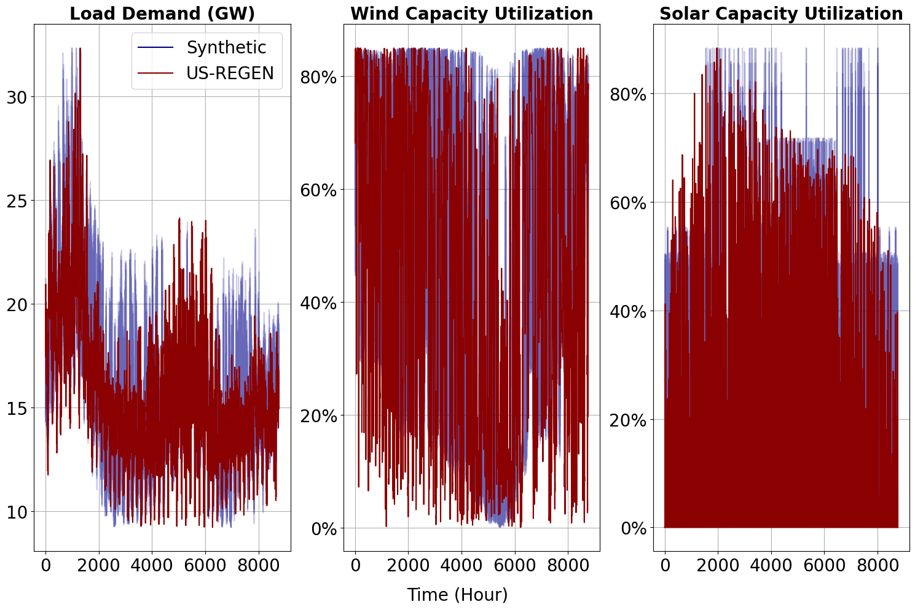
Demand
Stochastically Trained
Based on NYISO projections from EPRI
See INL/EXT-21-65473,
“A Technical and Economic Assessment of LWR Flexible Operation for Generation/Demand Balancing to Optimize Plant Revenue”, Dec 2021

Slide 12
Running the Case
Check Parallelization
Available threads: cpus * cores/cpu * threads/core
search: how many threads does my computer have [windows/mac/linux]
useful parallelization -> limited by inner, outer characteristics
/path/to/heron heron_input.xml + outer
It’s optimizing, so it will take a bit!
Things to look at (see following slides):
1_simple_o/opt_soln_0.csv (spreadsheet) optimizer progress
Screen Output

Slide 13
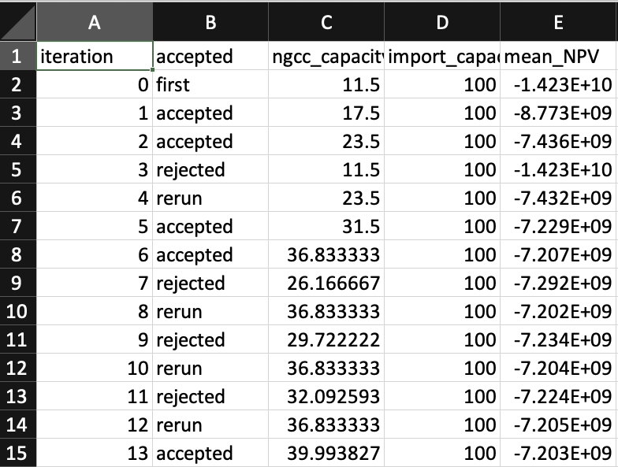
Things to Look At While Running
1_simple_o/opt_soln_0.csv – progress of the optimizer
case name
outer
optimization record
Component Sizes
(opt variables)
Mean NPV
(objective)
Optimizer Steps
(sets of samples)
Status of each step
Accepted: improvement!
Rejected: went too far
Rerun: re-check gradient
Note our losses are getting smaller!

Slide 14
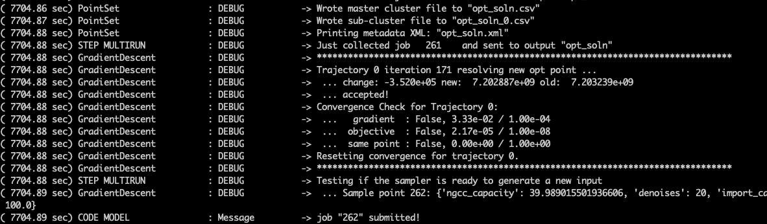
Things to Look At While Running
Screen Output: How To Read the Matrix
Accepted Sample
This means a new optimal point has been found!

Slide 15
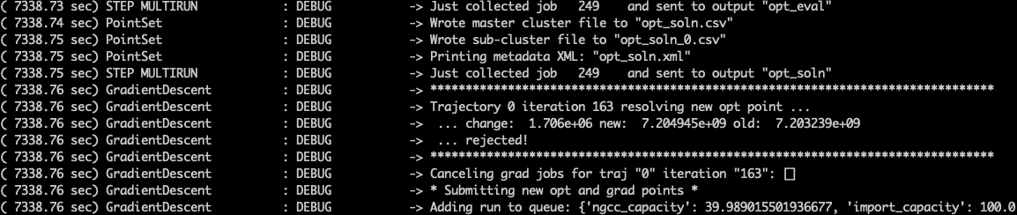
Things to Look At While Running
Screen Output: How To Read the Matrix
Rejected Sample
This means the new proposed opt point is worse than the old opt point
Reasons: inaccurate gradient, too large step, no better points nearby
Happens frequently, especially near the end

Slide 16
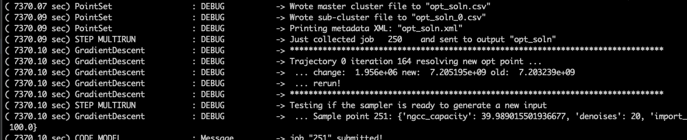
Things to Look At While Running
Screen Output: How To Read the Matrix
Rerun Sample
Return to best-so-far opt point and rerun the gradient, cut step size
Helps to resolve two reasons for rejecting proposed opt points

Slide 17
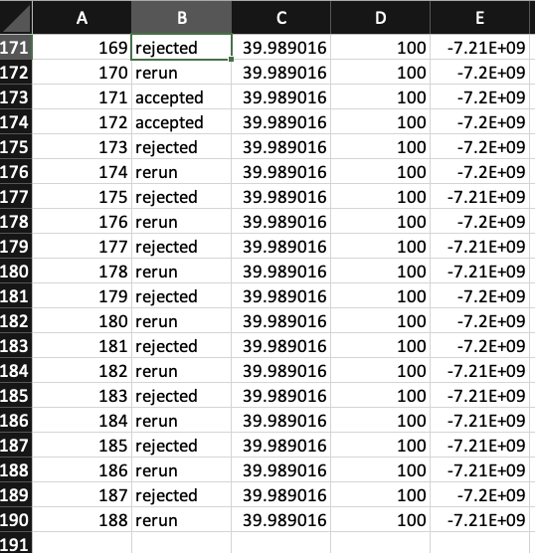
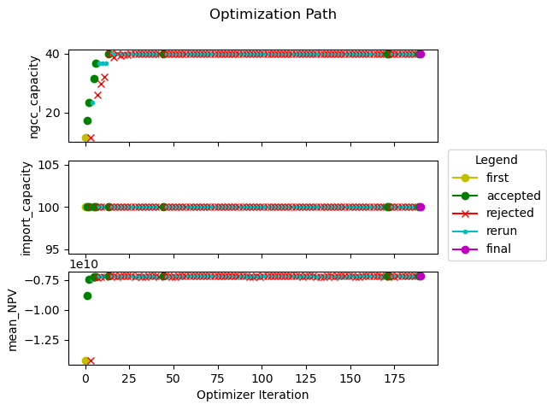
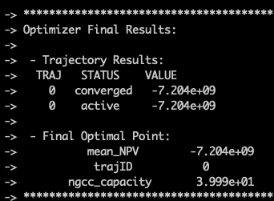
Now that it’s done …
Things to look at (see next slides)
opt_soln_0.csv
filter opt CSV by “accepted” to see acceptance path
final solution is the last “accepted” point in the CSV
opt_path.png
visualization of opt_soln_0.csv
screen output

Slide 18
Things to look at now that it’s done
Screen Output
isn’t 40 GW kind of insane?
Summary of optimizer status
Trajectory that found best point
Objective value
Opt Vars values
objective
opt var

Slide 19
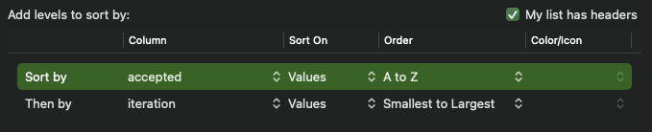
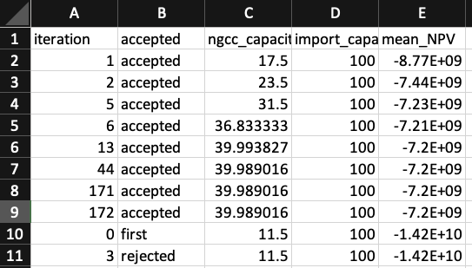
Things to look at now that it’s done
1_simple_o/opt_soln_0.csv
Last “accepted” point is solution
200 iterations is low (good!)
Sort by “accepted” then “iteration”
opt var
objective

Slide 20
Things to look at now that it’s done
1_simple_o/opt_path.png
Messy plot
Many plots are bad
but some are useful
Not intended for report quality
Indicative of process
towards the end only small changes
capacities
(opt vars)
E[NPV]
(objective)
most optimization happens in the first
few time steps

Slide 21
Wrap up Example 1
That’s it!
Takeaways:
3-unit problem, single resource
Setting up feasible problems
Running and observing HERON runs
Viewing results

Slide 22
TODO other examples
Add battery storage
multi-resource (HTSE, hydrogen market)
VREs (wind, solar)
technical complexity
transfer functions
economic complexity
Multiple markets
regulated vs deregulated
price taker, price maker
Synthetic Histories
Gathering input data
demand, vre
WACC, economic factors
technical properties of components

