Slide 1
Stock Price Prediction with LSTM
Deep Learning Project Supervisor: Anastase - Alexandre Charantonis
Authors: Antonio Antona, Barillon Yanis & Vandenbussche David

Slide 2
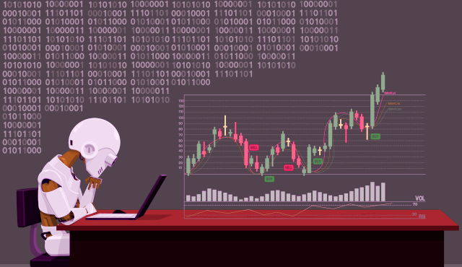
CONTENTS
Introduction
Architecture
Anticipated Issues
Evaluation of Prediction’s Performance for Stock Price Prediction
Results phase of the project
How to find hyperparameters
Relevant
Hyperparameters to tune
Conclusion
Stock price prediction & Machine Learning.

Slide 3

INTRODUCTION
The attempt is to forecast the upcoming value of one stock, activity known as Stock Market Prediction. It is an area that has driven the focus of
many individuals including not only companies, but also traders, market participants, data analysts, and
even computer engineers working in the domain of Machine Learning (ML) and Artificial Intelligence
(AI).

Slide 4
Machine learning
a subfield of artificial intelligence, which is broadly defined as the capability of a machine to imitate intelligent human behavior.

Slide 5
Traditional Machine Learning Methods
Deep Learning and Neural Networks
Methods
Graph-Based Approaches
Time Series Analysis Methods

Slide 6
COMMON PROBLEMS
Incorrect Application of Pre-processing
Selection Bias
Portfolio Construction

Slide 7
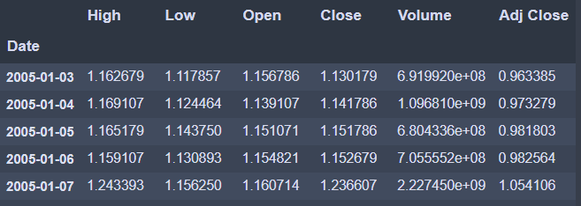
CONCLUSION
The data in this paper consist of the daily opening prices of one stock in the New York Stock Exchange from our dataset,
we choose a period from 01/01/2005 to 01/01/2015 .
To build our model we are going to use the LSTM method, our model uses 60% of data for training and the other 20% of data for testing, last 20% for data validation.
For training we use mean squared error to optimize our model.

Slide 8
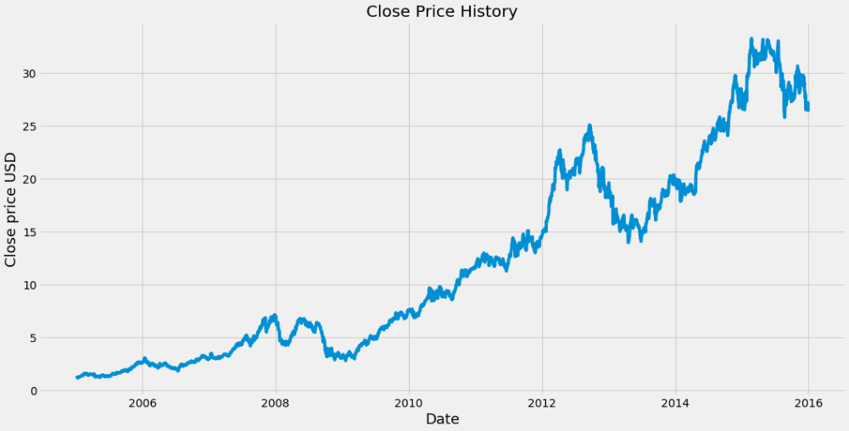
CLOSE PRICE HISTORY OF APPLE
million active developers use JavaScript over
other programming languages

Slide 9
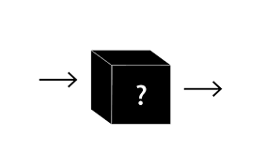
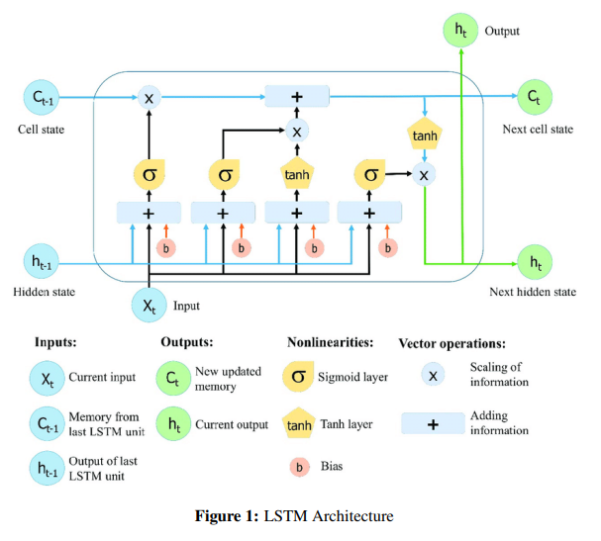
ARCHITECTURE
LSTM is a type of recurrent neural network (RNN) that is designed to model long-term dependencies in sequential data.
LSTM has a "memory" cell that can retain information for long periods of time, and three gating mechanisms (input, output, and forget gates) that can control the flow of information into and out of the cell.

Slide 10

Anticipated Issues
Data leakage: model is exposed to data that it should not have access to, leading to artificially high performance.
LSTM can be more computationally expensive than other types of RNNs.

Slide 11
HYPERPARAMETERS OPTIMIZATION
Bayesian Optimization
Optimization neurons
So we have a first LSTM layer with 35 neurons then another LSTM layer with 125 neurons, followed by a Dense layer of 31 neurons and another one of 15 neurons.
The time of search for optimal parameters exploded really fast with our huge training data (1600 arrays of 60 values).
We choose the number of trials equal to square root of the number of different combinations for the optimiser to try, which gives us 15 trials.
function from keras
in the first and second LSTM layers, and on the activation function for the dense layers.

Slide 12

CHOICE OF LOSS
MSE
MAE
First we choose the mean squared error as a loss to optimise and a metrics to evaluate our network.
Then we realise that the mean absolute error have more sense as a metrics as we have some really small number with the normalisation.
So we try using mean absolute error as the loss.
The result was catastrophic as the MAE doesn’t have the regularity properties of the MSE.

Slide 13
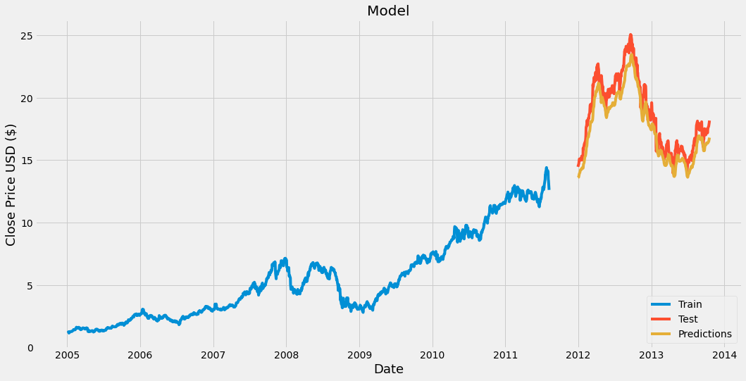
Model predictions BEFORE hyperparameters optimization
million active developers use JavaScript over
other programming languages

Slide 14
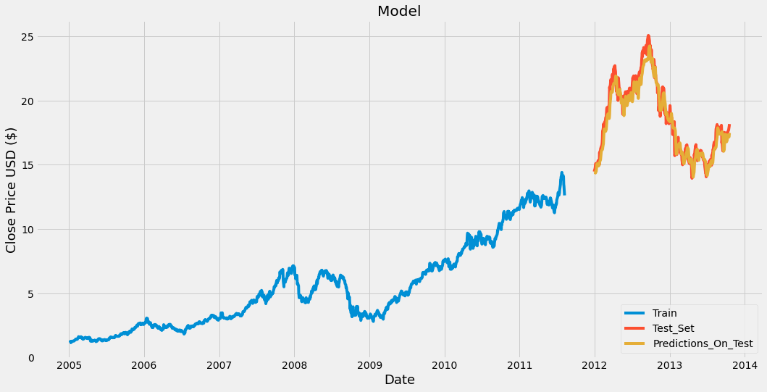
Model predictions AFTER hyperparameters optimization
million active developers use JavaScript over
other programming languages

Slide 15

THANKS!
Do you have any questions?
Antonio Antona
Barillon Yanis
&
Vandenbussche David
Course of Deep Learning - University of Paris Saclay - Department of Applied Mathematics

