Slide 1
Stock Report
Summary

Slide 2
IBM: 2018-11-06 to 2018-11-27

Slide 3
Summary
IBM closed up at 119.56 dollars per share on 2018-11-27.
High: 120.25
Low: 118.06
Close: 119.56
Notes:
Data were analyzed using these packages:
tidyquant
quantmod
tidyverse

Slide 4
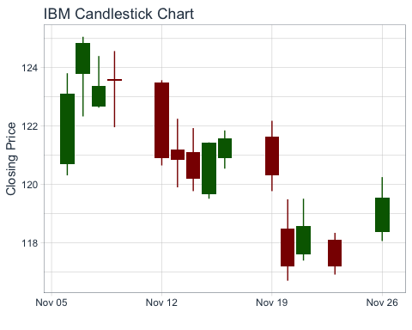
Price History
Stock prices for IBM

Slide 5
IBM last week
date | open | high | low | close
2018-11-15 | 119.66 | 121.44 | 119.51 | 121.44
2018-11-16 | 120.89 | 121.85 | 120.54 | 121.57
2018-11-19 | 121.63 | 122.18 | 119.77 | 120.31
2018-11-20 | 118.49 | 119.49 | 116.70 | 117.20
2018-11-21 | 117.61 | 119.51 | 117.39 | 118.57
2018-11-23 | 118.09 | 118.34 | 116.91 | 117.19
2018-11-26 | 118.37 | 120.25 | 118.06 | 119.56

Slide 6
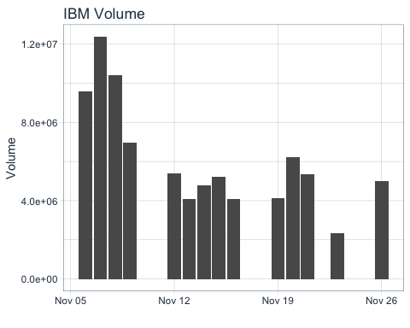
Volume
IBM trading volume was 4,983,800 shares on 2018-11-27. Average trading volume over this time period was 6,133,400 shares.
Trading volume for IBM

