Slide 1
PowerPoint
With R Markdown Nathan Stephens nathan@rstudio.com

Slide 2
What we do
Build and promote software that supports reproducible data analysis
Primary focus is the usability in our interfaces and API’s
Dedicated to R and open source software
70% of our engineering effort is towards open source

Slide 3
Who is the R Admin?
A data scientist (who knows R) and works with IT/Ops to:
Establish R as an analytic standard
Promote R tooling
Integrate R into other systems.
R Views: Analytics Administration for R

Slide 4
That is why the r admin is rad!

Slide 5
References
Github: r-admin-2018
Analytics Administration for R
Make R a Legitimate Part of Your Organization
A Data Science Lab for R
The Unix Workbench

Slide 6
Demos

Slide 7
Bitcoin ETL
Extract
dat_json <- fromJSON("https://blockchain.info/ticker") dat_df <- map_dfr(dat_json, c, .id="name")
Transform
dat <- dat_df %>% mutate(timestamp = Sys.time()) %>% select(timestamp, name:symbol)
Load
con <- dbConnect(odbc::odbc(), "Postgres (DSN)") dbWriteTable(con, "bitcoin", dat, append = TRUE)

Slide 8
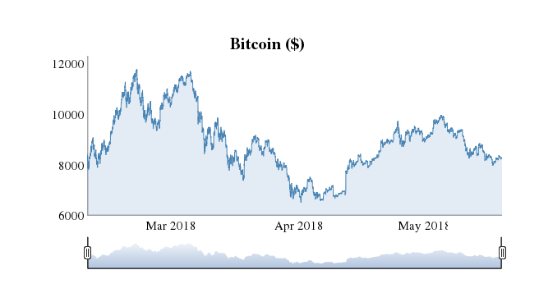
Bitcoin Report

Slide 9
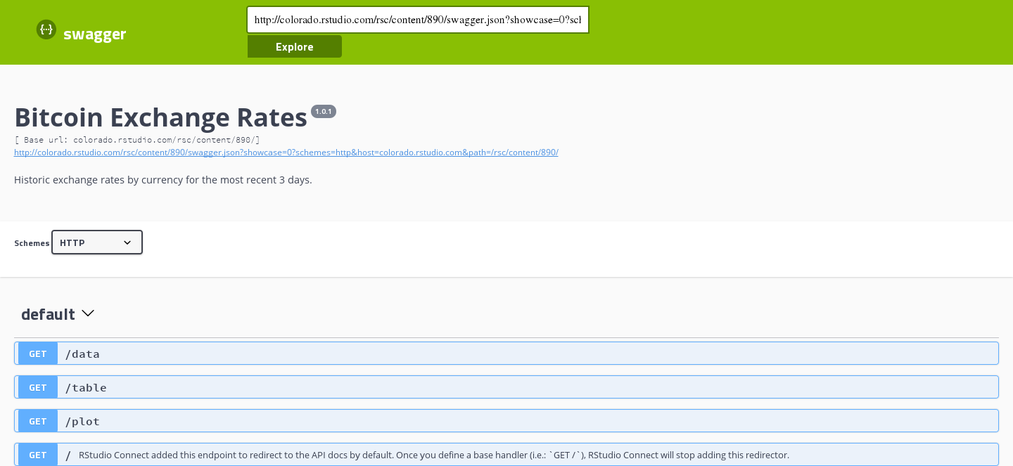
Bitcoin API

Slide 10
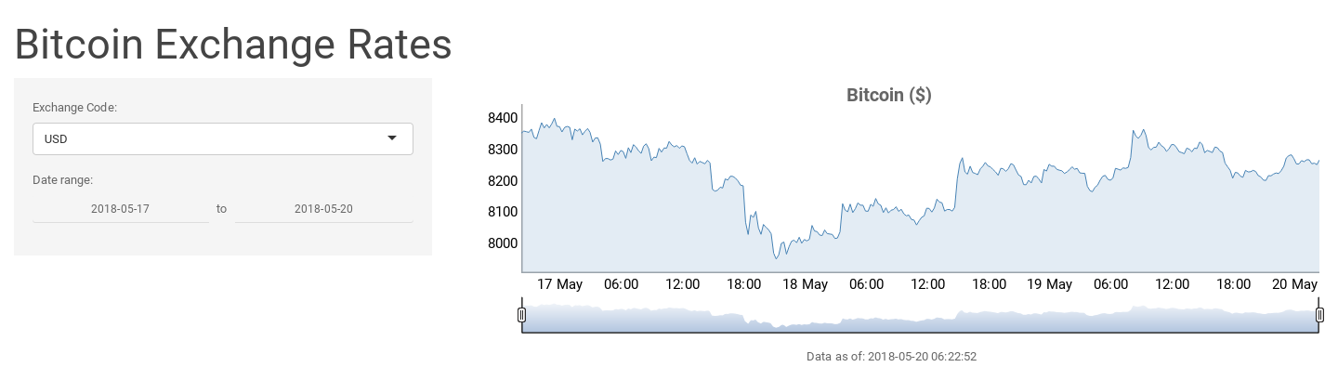
Bitcoin App

