Slide 1
R Code Chunks

Slide 2
Overview
R Code Chunks can be used as a means to render R output into documents or to simply display code for illustration.
You may choose to remove source code from your PowerPoint presentation by setting echo=FALSE in the code chunk options.

Slide 3
Syntax Highlighting
Source code will render with syntax highlighting inline with other markdown text in your document.
library(dplyr) nycflights13::flights %>% select(carrier, arr_time) %>% filter(!is.na(arr_time)) %>% group_by(carrier) %>% summarize(average = mean(arr_time)) %>% arrange(average)

Slide 4
Table Output
Table output from kable will assume the table design of whatever template you use.
knitr::kable(mtcars)

Slide 5
Table Example
Sepal.Length | Sepal.Width | Petal.Length | Petal.Width | Species
5.1 | 3.5 | 1.4 | 0.2 | setosa
4.9 | 3.0 | 1.4 | 0.2 | setosa
4.7 | 3.2 | 1.3 | 0.2 | setosa
4.6 | 3.1 | 1.5 | 0.2 | setosa
5.0 | 3.6 | 1.4 | 0.2 | setosa
5.4 | 3.9 | 1.7 | 0.4 | setosa

Slide 6
Plot Output
R code chunks can also be used to render plots.
Images will be scaled automatically to fit the slide.
You can change image size with fig.width and fig.height code chunk options.
library(ggplot2) ggplot(data = mpg, mapping = aes(x = displ, y = hwy)) + geom_point(mapping = aes(color = class)) + geom_smooth(method = "loess")

Slide 7
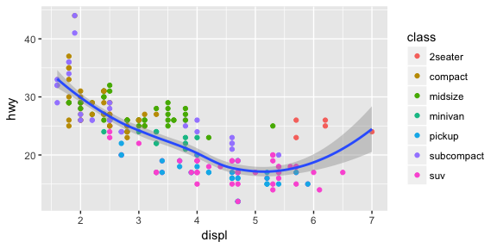
Plot Example
Highway miles per gallon vs engine displacement

Slide 8
Webshot
You can capture HTML Widgets and Shiny apps by installing the webshot package and phantomjs.
The webshot package will automatically take a screenshot of an interactive HTML Widget and insert it into your presentation.
The knitr::include_app function will use webshot to embed a screenshot of a Shiny application that links viewers to a live application hosted on RStudio Connect, Shiny Server, or Shinyapps.io.

Slide 9
Webshot Examples
# Install install.packages("webshot") webshot::install_phantomjs() # Capture an HTML Widget dygraphs::dygraph(nhtemp, main = "New Haven Temperatures") # Capture a Shiny app knitr::include_app('https://gallery.shinyapps.io/goog-trend-index/')

Slide 10
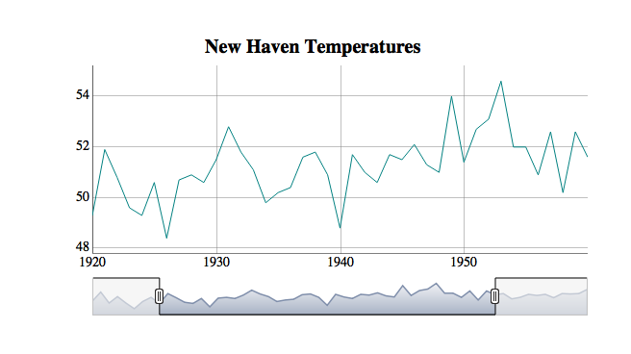
HTML Widget Webshot
Screenshot of interactive dygraph

Slide 11
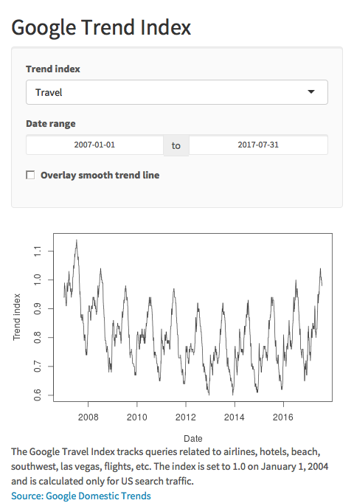
Shiny App Webshot
Click image to open

Slide 12
Useful Code Chunk Options
Remove source code
echo=TRUE
Cache your screenshots
cache=TRUE
Wait for the image to load before taking a screenshot
screenshot.opts=list(delay=5)
Specify image width or height
fig.width=15
Add an image caption
fig.cap="Click Image to Open App"

Slide 13
Code Chunk Example
In this example the code chunk will wait one second for an app to load, resize the width to 15 inches, and cache the image for later use.
{r, cache=TRUE, screenshot.opts=list(delay=1), fig.width=15}

