Slide 1
Bank Marketing Exploratory Analysis

Slide 2
Background

Slide 3
Data source
We are working with a dataset from a Portuguese bank. The data categorizes direct marketing efforts (phone calls) designed to sell term deposit products. The dataset was donated to UCI’s Machine Learning Repository. The goal is to predict which clients are most likely to subscribe to a term deposit. Data range from May 2008 to November 2010

Slide 4
Model data set
Read data and clean up column names. Remove unnecessary columns and records. Impute year and create a column for date.

Slide 5
Exploratory data analysis

Slide 6
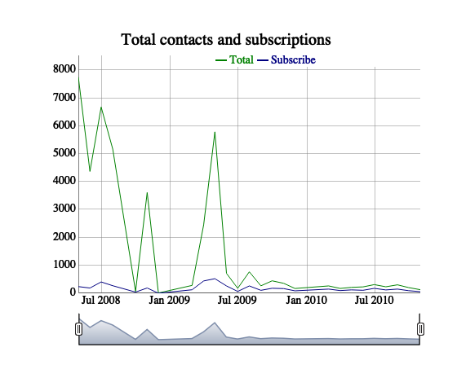
Total contacts and subscriptions
There were far more contacts in 2008 and 2009.

Slide 7
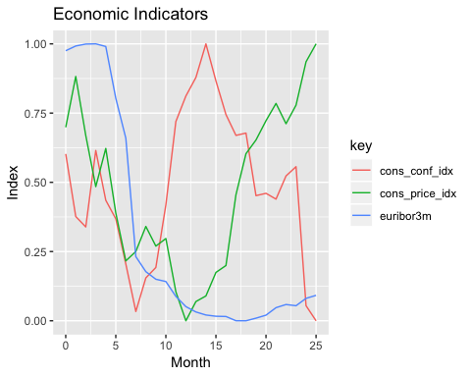
Economic indicators
Term deposits are correlated to some extent with macro economic indicators.

Slide 8
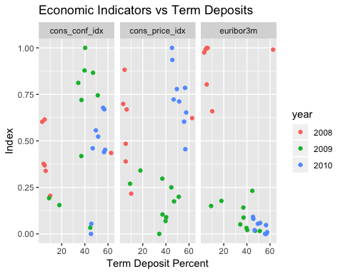
Term deposit percent
Lower rates of euribor3m were associated with associated with more term desposits.

Slide 9
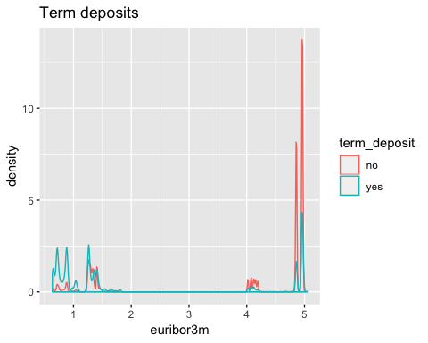
Term deposits
Clients with a successful prior outcome were much more likley to subscribe to a term deposit.

Slide 10
Prior outcome
prior_outcome | no | yes
failure | 10.0 | 13.0
nonexistent | 88.7 | 67.7
success | 1.3 | 19.3

Slide 11
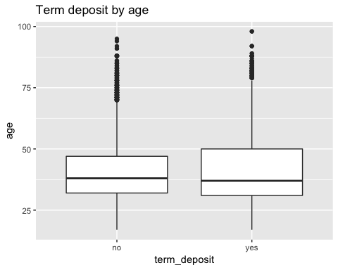
Term deposit by age
Contacts who subscribe to term deposits skew slightly older and younger.

Slide 12
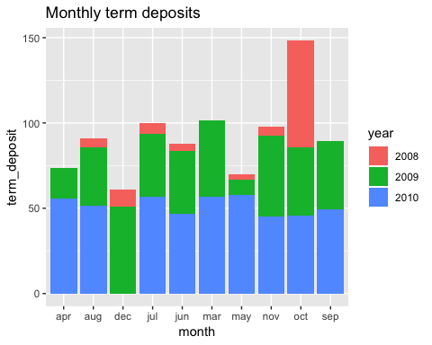
Term deposits by month
October saw an unusually high percent of term deposits in 2008.

Slide 13
Jobs by subscription
job | no | yes
admin | 24.8 | 29.1
bluecollar | 23.6 | 13.8
entrepreneur | 3.6 | 2.7
housemaid | 2.6 | 2.3
management | 7.1 | 7.1
retired | 3.5 | 9.4
selfemployed | 3.5 | 3.2
services | 10.0 | 7.0
student | 1.6 | 5.9
technician | 16.5 | 15.7
unemployed | 2.4 | 3.1
unknown | 0.8 | 0.8

Slide 14
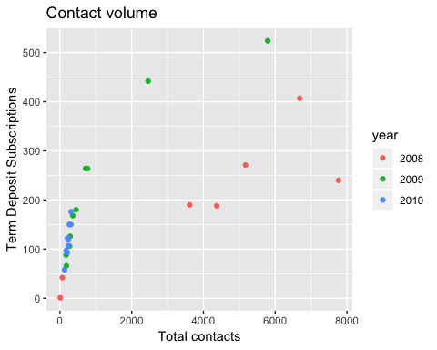
Contact volume
There were far more contacts in 2008 than in 2010

Slide 15
Summary

Slide 16
Conclusions
There is a lot of variability in total contacts and in percentage of term deposit subscriptions over time. There were far more contacts made in 2008 when the three month Euribor rate was high. As total contacts dropped, the percentage of term deposit subscriptions increased.
Subscriptions are correlated with a variety of factors, including age and job to name a few. There is also a strong correlation with prior outcomes, as one might expect.

Slide 17
Next steps
This analysis only analyzed a few select variables. The next goal should be to predict term deposit subscriptions as a function of all the variables in the data.
Use the following models to predict term deposit and compare model performance:
Logistic
Ranger
with cross validation (Caret)

