Slide 1
Stock Report
Summary

Slide 2
TSLA: 2018-11-07 to 2018-11-28

Slide 3
Summary
TSLA closed up at 343.92 dollars per share on 2018-11-28.
High: 346.96
Low: 335.5
Close: 343.92
Notes:
Data were analyzed using these packages:
tidyquant
quantmod
tidyverse

Slide 4
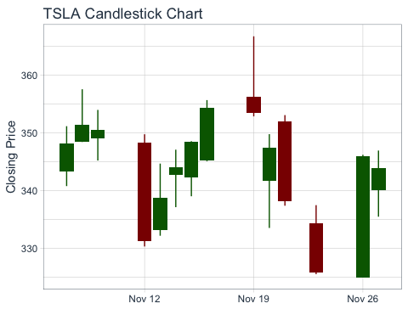
Price History
Stock prices

Slide 5
TSLA last week
date | open | high | low | close
2018-11-16 | 345.19 | 355.70 | 345.12 | 354.31
2018-11-19 | 356.34 | 366.75 | 352.88 | 353.47
2018-11-20 | 341.75 | 349.80 | 333.55 | 347.49
2018-11-21 | 352.00 | 353.10 | 337.40 | 338.19
2018-11-23 | 334.35 | 337.50 | 325.55 | 325.83
2018-11-26 | 325.00 | 346.22 | 325.00 | 346.00
2018-11-27 | 340.05 | 346.96 | 335.50 | 343.92

Slide 6
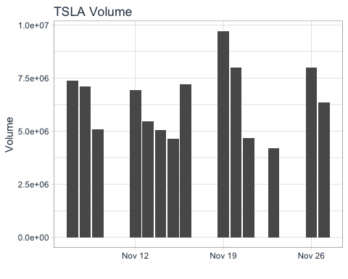
Volume
TSLA trading volume was 6,349,700 shares on 2018-11-28. Average trading volume over this time period was 6,411,307 shares.
Trading volume

