Slide 1
Rendering PowerPoint Presentations
With R Markdown RStudio Inc.

Slide 2
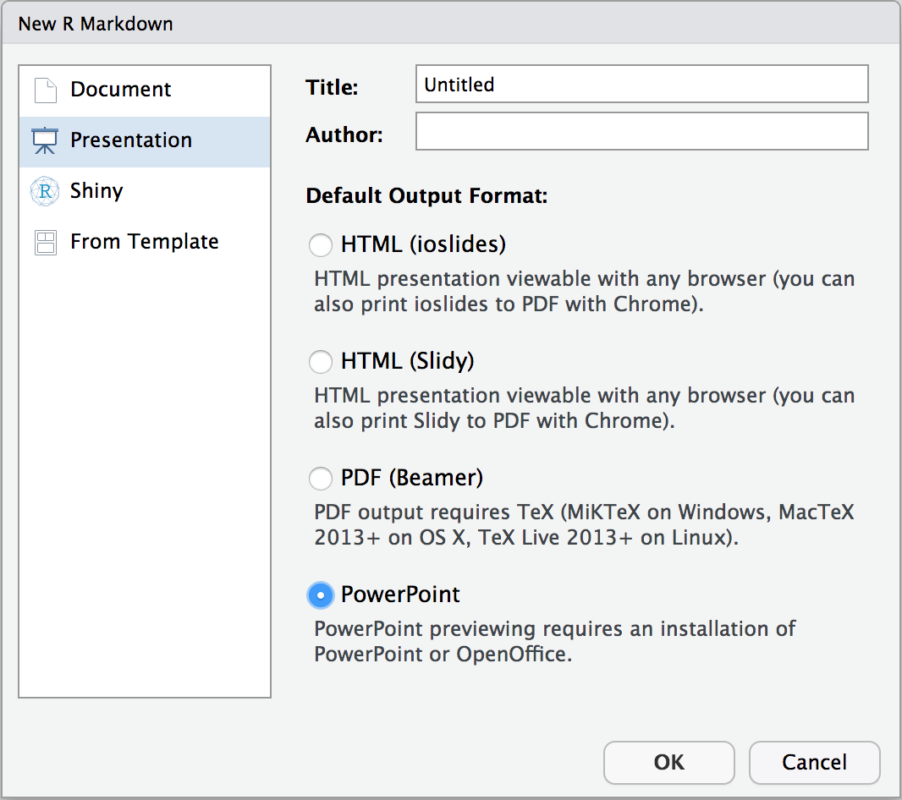
Open a new presentation

Slide 3
Example R Markdown
--- title: My presentation output: powerpoint_presentation --- # Section Header Slide ## Title and Content Slide * Bullet 1 * Bullet 2 ## Slide 2 ![](image.png)

Slide 4
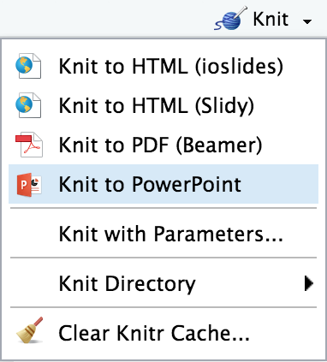
Knit to PowerPoint

Slide 5
Markdown features

Slide 6
Standard features
Inline formatting: italics, bold, strikeout, _{sub}^{super}scripts, small caps, verbatim
Lists
Numbered
Unnumbered
Images
Links
Block quotations
LaTeX math expressions and equations: $e^{iπ}+1$

Slide 7

Columns
Create slides with two columns. Insert text and images into columns.
::::::: {.columns} ::: {.column} Column 1 ::: ::: {.column} Column 2 ::: :::::::
R for Data Science

Slide 8
Templates
Change the slide size or design with a reference doc when the presentation is rendered.
--- title: My presentation output: powerpoint_presentation: reference_doc: template.pptx ---

Slide 9
PowerPoint tables with formatting
manufacturer | displ | hwy | class
audi | 1.8 | 29 | compact
chevrolet | 5.3 | 20 | suv
dodge | 2.4 | 24 | minivan

Slide 10
Code blocks
R code chunks render with syntax highlighting.
library(tidyverse) nycflights13::flights %>% filter(year == 2013 & month == 6) %>% group_by(carrier) %>% mutate(diff = (dep_delay - arr_delay)^2) %>% summarize(mean = mean(diff, na.rm = TRUE)) %>% arrange(desc(mean)) %>% top_n(5)

Slide 11
Speaker notes
Add speaker notes to title and content slides.
::: notes here are my notes :::
Notes:
here are my notes

Slide 12
R Output

Slide 13
Knitr Tables
Sepal.Length | Sepal.Width | Petal.Length | Petal.Width | Species
5.1 | 3.5 | 1.4 | 0.2 | setosa
4.9 | 3.0 | 1.4 | 0.2 | setosa
4.7 | 3.2 | 1.3 | 0.2 | setosa
4.6 | 3.1 | 1.5 | 0.2 | setosa
5.0 | 3.6 | 1.4 | 0.2 | setosa
5.4 | 3.9 | 1.7 | 0.4 | setosa
4.6 | 3.4 | 1.4 | 0.3 | setosa
5.0 | 3.4 | 1.5 | 0.2 | setosa
Notes:
{r, echo=FALSE} knitr::kable(head(iris, 4))

Slide 14
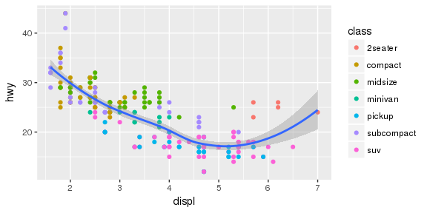
Visualizations with ggplot2
Highway miles per gallon vs engine displacement
Notes:
{r echo=FALSE, fig.height=3, fig.width=6, fig.cap=“Highway miles per gallon vs engine displacement”} ggplot(data = mpg, mapping = aes(x = displ, y = hwy)) + geom_point(mapping = aes(color = class)) + geom_smooth(method = “loess”)

Slide 15
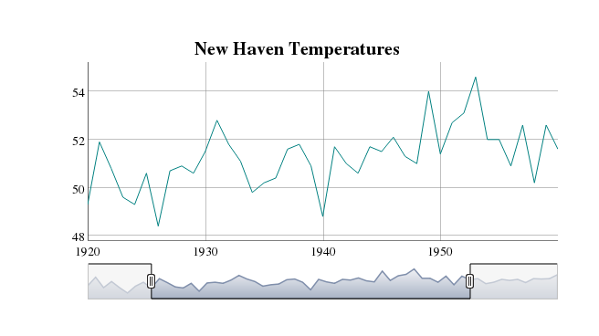
HTML Widget Webshot
Screenshot of interactive dygraph
Notes:
{r echo=FALSE, fig.height=3, fig.width=6, fig.cap=“Screenshot of interactive dygraph”} dygraph(nhtemp, main = “New Haven Temperatures”) %>% dyRangeSelector(dateWindow = c(“1920-01-01”, “1960-01-01”))

Slide 16
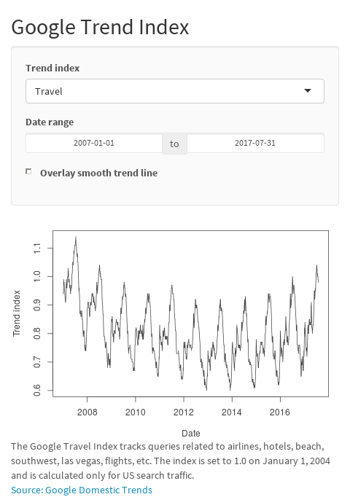
Shiny App Webshot
Click image to open
Notes:
{r cache=TRUE, screenshot.opts=list(delay=1), echo=FALSE, fig.cap=“Click image to open”} knitr::include_app(‘https://gallery.shinyapps.io/goog-trend-index/’)

Slide 17
Other Details

Slide 18
Getting started
Download RStudio Preview
Download rmarkdown from GitHub
devtools::install_github("rstudio/rmarkdown")

Slide 19
How to render the presentation
Press the knit button to render the presentation in RStudio
Or render from the command line
> pandoc habits.txt -o habits.pptx

Slide 20
How to take a Webshot
Install webshot package and install phantomjs.
install.packages("webshot") webshot::install_phantomjs()
Use inlcude_app to webshot an app.
knitr::include_app('<URL>')

Slide 21
Useful code chunk options
Caching
cache=TRUE
Save time by caching plots and other output
Screenshot delay
screenshot.opts=list(delay=1)
Allow apps to load before taking a screenshot
Captions
fig.cap="caption"
Add a caption to an image

Slide 22
Slide types
Title. Defined in the YAML header.
Section header. Break the presentation into sections. These slides have a section header but no content.
Title and content. Presentation content.
Two Content. Presentation content in two columns.
See the Pandoc Manual for specific rules on controlling the slide-level option

Slide 23
References
Getting help
R Markdown: The Definitive Guide
Authoring Basics
Authoring Pandoc Markdown
R Code Chunks
Pandoc Manual
Submitting issues
rmarkdown/issues

