Slide 1
Stock Report

Slide 2
TSLA: 2018-06-06 to 2018-06-27

Slide 3
Summary
TSLA closed up at 342 dollars per share on 2018-06-27.
High: 343.55
Low: 325.8
Close: 342
Notes:
Data were analyzed using these packages:
tidyquant
quantmod
tidyverse

Slide 4
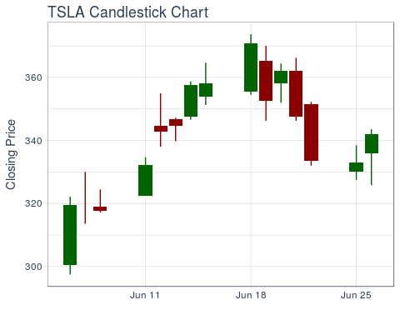
Price History

Slide 5
TSLA last week
date | open | high | low | close
2018-06-18 | 355.40 | 373.73 | 354.50 | 370.83
2018-06-19 | 365.16 | 370.00 | 346.25 | 352.55
2018-06-20 | 358.04 | 364.38 | 352.00 | 362.22
2018-06-21 | 362.00 | 366.21 | 346.27 | 347.51
2018-06-22 | 351.54 | 352.25 | 332.00 | 333.63
2018-06-25 | 330.12 | 338.47 | 327.50 | 333.01
2018-06-26 | 336.05 | 343.55 | 325.80 | 342.00

Slide 6
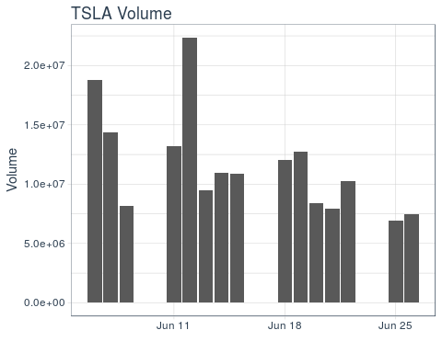
Volume
TSLA trading volume was 7,437,500 shares on 2018-06-27. Average trading volume over this time period was 11,597,907 shares.

