Slide 1
Including Images

Slide 2
Summary
Insert images from file or from the web
![](file)
![](URL)
Create links
![caption](image) plain image
[![caption](image)](link) linked image
![[caption](link)](image) linked caption
Insert images using R code (e.g. ggplot)
Insert a webshot (e.g. htmlwidgets or shiny)

Slide 3

Plain Image

Slide 4
Linked image
Click to open

Slide 5
Linked caption
R for Data Science

Slide 6

Web image

Slide 7
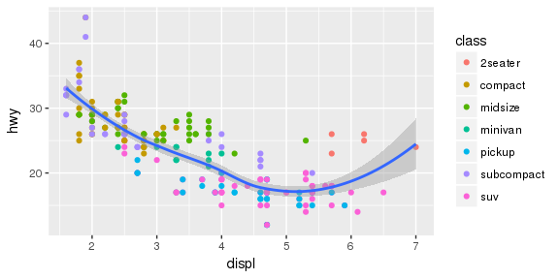
ggplot image
Highway miles per gallon vs engine displacement

Slide 8
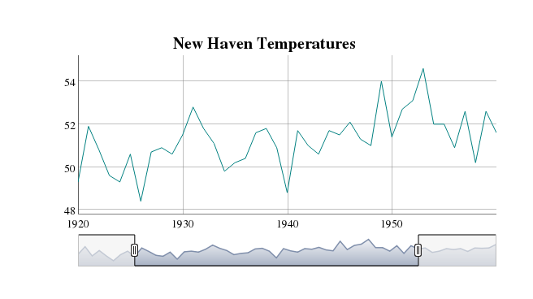
HTML Widget Webshot
Screenshot of interactive dygraph

Slide 9
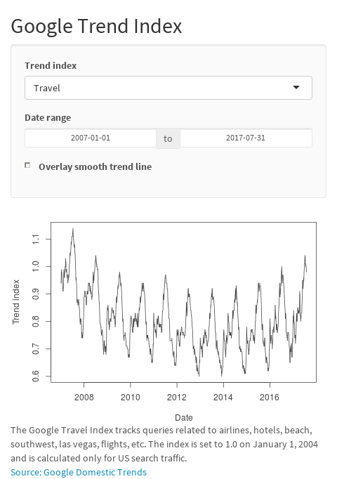
Shiny App Webshot
Click image to open

