Slide 2
## Warning: package 'quantmod' was built under R version 3.4.4

Slide 3
TSLA: 2018-07-09 to 2018-07-30

Slide 4
Summary
TSLA closed down at 297.18 dollars per share on 2018-07-30.
High: 307.69
Low: 295.34
Close: 297.18
Notes:
Data were analyzed using these packages:
tidyquant
quantmod
tidyverse

Slide 5
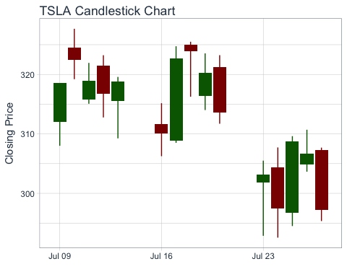
Price History

Slide 6
TSLA last week
date | open | high | low | close
2018-07-19 | 316.33 | 323.54 | 314.01 | 320.23
2018-07-20 | 321.23 | 323.24 | 311.71 | 313.58
2018-07-23 | 301.84 | 305.50 | 292.86 | 303.20
2018-07-24 | 304.42 | 307.72 | 292.55 | 297.43
2018-07-25 | 296.74 | 309.62 | 294.50 | 308.74
2018-07-26 | 304.85 | 310.70 | 303.64 | 306.65
2018-07-27 | 307.25 | 307.69 | 295.34 | 297.18

Slide 7
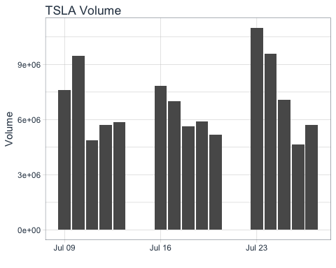
Volume
TSLA trading volume was 5,698,300 shares on 2018-07-30. Average trading volume over this time period was 6,869,860 shares.

